Slide 1
Status report of TAPP to TFTA 17th session
(26 October 2023)
Transmitted by the co-chairs
of TF for Tyre Abrasion
TFTA 17th session on 26 October 2023

Slide 2
Tyre abrasion post processing group
Scope and mandate
• Establish the test dispersion value for vehicle method
• Establish the test dispersion for the drum method
Define the criteria and conclude on the correlation between Drum method and vehicle method
To identify out of the data whether some test boundary conditions need to be reviewed
Deliverables to TFTA
Documented synthesis of the analysis with detailed description of the analysis and the conclusion, with illustrative graphs

Slide 3
Open road vehicle method
1) The newly TFTA developed test (convoy with SRTT) is well designed and allows to keeps under control the impact of external parameters
  Absolute abrasion rate of tyres strongly depend on specific tests conditions (e.g. temperature, circuits, road abrasiveness, …): the tyre abrasion index, dimensionless, on which the threshold will be applied, remains the only relevant technical metric for regulatory and information purposes
2) The test uncertainty coming from this campaign could be acceptable once it will be confronted with the range (min-max or 5-95 quantils) abrasion index of tested tyres.
  A quick & easy small improvement point (for M+S tyres only): SRTT winter could be the reference tyre for M+S tyres
  Better vehicle settings specifications
  a ratio like “Dispersion / range” gives an image of the method accuracy for regulatory purposes
  This ratio dispersion / range (discrimation power) should be reassessed with market assessment results which will give the best evaluation of the range .
  Ratio of STD/dispersion over STD/population to be consider as a different approach for the discrimation power.

Slide 4
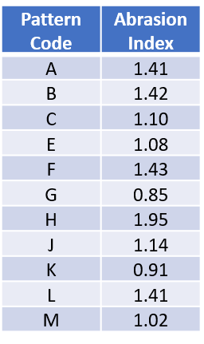
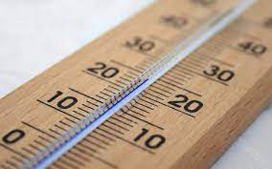



Example of ratio dispersion / range (discrimation power)
It is important to compare the test dispersion with the range of measurement :
  Range = Max abrasion – min abrasion, among a set of tires
E.g. The ratio “Dispersion / range” gives an image of the method discrimination power
  A given precision on a big range is a better performance
  than the same precision on a small range
Dispersion
Big range
σ/range = 1°C/100°C = 1%
Small range
σ/range = 1°C/5°C = 20%
Min value
      T°
Max value
Today, the range could be calculated with only 11 tires of the validation test
  Same tires for the 2 methods, but maybe not the same range on the 2 methods
The real range of abrasion method will be known after market assessment
  A bigger range is expected, as much more tires will be measured.
Range = Max-Min
= 1.95-0.85 = 1.1

Slide 5
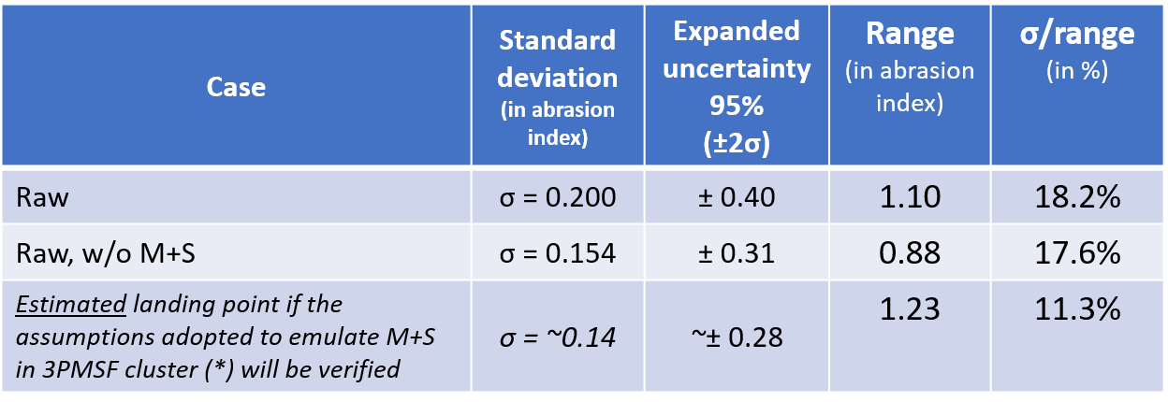
Example of ratio dispersion / range (discrimation power)
The dispersion/range will reduce the disturbation factors
Synthesis of the test dispersion coming from this vehicle campaign (2 test courses, SRTT always on the same vehicle):
(*) Assumptions: Abrasion Ref 3PMSF = f(T°) from Circuit 1 data
curve for Circuit 2, assuming same slope as Circuit 1

Slide 6
Indoor drum method
Indoor drum test method test results shows sufficient test accuracy (sufficiently low variability)
Indoor drum test method is verified based on drum test campaign results.
SRTT17 abrasion range is determined for test results.
Still under discussion
The abrasion rate of SRTT 17 normal range from 50 to 190 mg/km/ton and for SRTT 3PMSF range from 35 to 165 mg/km/ton. (allowable range in the regulation)

Slide 7
Correlation between 2 methods
Correlation studies have been performed, but the final drum data still need to be received. Data analysis on current data is ongoing;
Test methods correlation criteria under TAPP assessment.

Slide 8
Next steps
TAPP to provide preliminary conclusions by 13 November, to be confirmed by Informal Document in February 2024.
TAPP need to further assess the additional vehicle and drum data from alignment test campaign (available in November-December?)
TAPP identified some technical elements to be confirmed with specific tests done in conjunction with the Market Assessment.

Slide 9
Thank you

