Slide 1
Introduction of Japanese e-PTI
Periodical Technical inspection using diagnostic devices
PTI-33-03

Slide 2
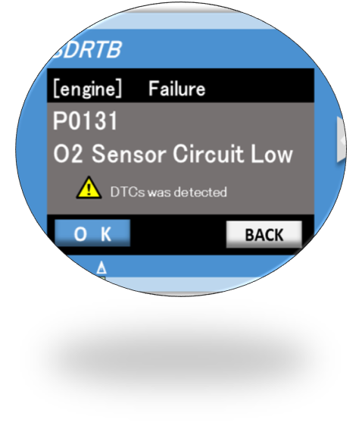

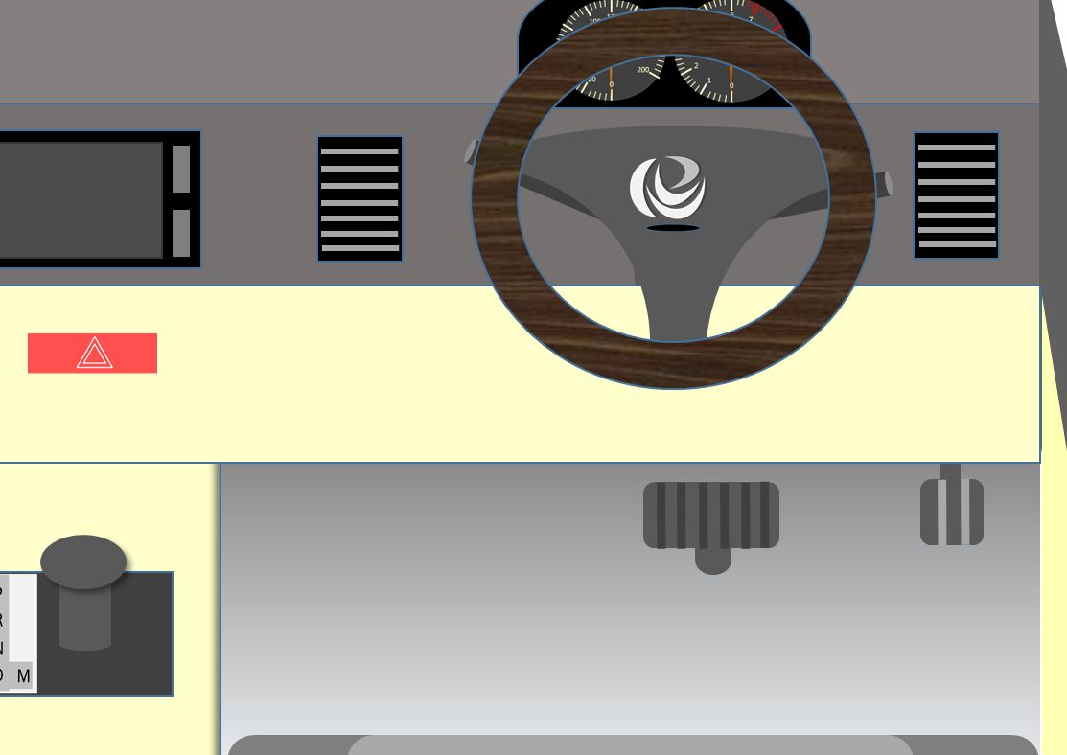
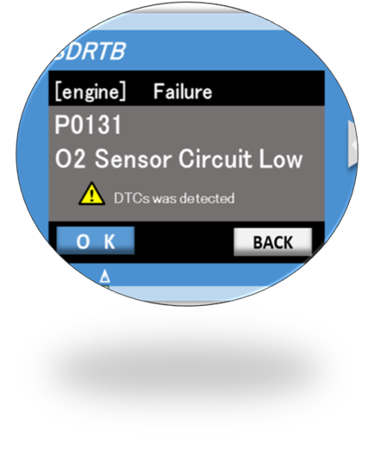
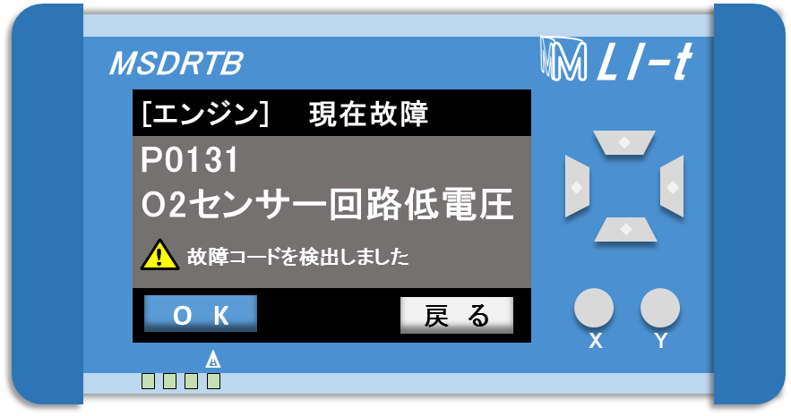



Background of Japanese e-PTI
1．It is very important to ensure continuous maintaining of function of electrical control system including ADAS system.
2．OBD* is useful to detect trouble such as disconnection or sensor malfunction not only of emission control systems but also of safety related systems.
* On-Board Diagnostics
＜Example of Display of Scan tool＞
DLC
＜DLC position（interior）＞
Communication
Connect
scan tool
Communication
DLC ※(OBD port)
Installed around the driver's seat
Port shape are standardized by ISO / SAE
※Data Link Connecter
NALTEC server

Slide 3
Outline of Japanese e-PTI (1)
Scope *
New models of passenger cars, buses and trucks (M1, M2, M3, N1, N2, N3 ) type approved after Oct. 2021**
* Vehicles not Type Approved (e.g. vehicles imported personally or through the PHP) are excluded from the scope.
** Oct. 2022 for Imported vehicles
Function to be checked at e-PTI
  Antilock Brake System (ABS)
  Electronic Stability Control (ESC)
  Brake Assist System (BAS)
  Advanced Emergency Braking (AEB)
  Acoustic Vehicle Alerting System (AVAS)
  Automatically Commanded Steering Function (ACSF)
  Automated Lane Keeping System (ALKS)
  Emission Control system
Start of e-PTI
Oct. 2024*** (e-PTI will NOT be applied to vehicles out of the scope above)
*** Oct. 2025 for Imported vehicles

Slide 4
Outline of Japanese e-PTI (2)
OEMs submit technical information of each vehicle type necessary to conduct Japanese e-PTI (a list of “Registered DTC (R-DTC)”, “Communication Protocol” etc.) to NALTEC* under direction of MLIT**.
“R-DTC list” submitted by OEMs are stored in R-DTC Database. This database is managed by NALTEC as a “pass/fail criteria” of Japanese e-PTI.
“Communication Protocol” submitted by OEMs is used for development or modification of application software to conduct Japanese e-PTI. This software is delivered to inspectors and installed in their scan tools.
At PTI, an inspector connect diagnostic device to the vehicle via DLC and read recorded DTCs by the scan tools. When R-DTC is read, the vehicle does not pass the PTI.
The R-DTC Database is securely connected online with all the inspection sites in Japan so that e-PTI can be conducted with currentness and integrity.
R-DTC :
DTC (Diagnosis Trouble Code) registered by OEM as ones related failures which make functions not conformity with TA performance requirements (UN-Regulation).
* National Agency for Automobile and Land Transport Technology ** Ministry of Land, Infrastructure, Transport and Tourism

Slide 5
Scheme of Japanese e-PTI
OEM
MLIT
NALTEC
Inspectors (NALTEC etc.)
R-DTCs
list
Manage
OBD Port
Instruct
R-DTC
Database
Send DTCs
Connect
Communication
Result
DTC Code
Definition
ECU address. etc.
Submit
Develop
Communication
Protocol
Application
Software
Submit
Deliver
Parameter
Command
Message Content
Response Code etc.

Slide 6
Schedule of Japanese e-PTI
【Legend】
：Preparation for Japanese e-PTI
：Operation for Japanese e-PTI
 |  | 2022 FY |  |  |  | 2023 FY |  |  |  | 2024 FY |  |  |  | 2025 FY
 |  | Q1 | Q2 | Q3 | Q4 | Q1 | Q2 | Q3 | Q4 | Q1 | Q2 | Q3 | Q4 | Q1 | Q2 | Q3 | Q4
Milestone
Japanese e-PTI | Domestic Vehicles
 | Imported Vehicles
Manage the technical information | Domestic Vehicles
 | Imported Vehicles
Japanese e-PTI Systems | R-DTC Database
 | Application Software
Pre-operation
of e-PTI
Oct.2023
▼
Start of e-PTI
( Domestic Vehicles )
Oct.2024
▼
Start of e-PTI
( Imported Vehicles )
Oct.2025
▼
System Release
Apr.2023
▼
Pre-Operation
Operation
Pre-Operation
Operation
Manage the technical information
Manage the technical information
Operation and
Maintenance
Operation and Maintenance
Development

Slide 7
For future global dissemination of e-PTI
Challenges for sustainable e-PTI
Japanese e-PTI can be highly affected by OEMs’ design as follows.
  DTCs can be freely designed by OEMs
  Except for the emission OBD II , the communication of OBD and scan-tools is not guaranteed
If OEMs adopt the communication standards excepting J2534 or the specification
which only allows their dedicated scan-tool connections, Japanese e-PTI would face serious obstacles.
The proposal of Japan
We should avoid such obstacles of e-PTI.
One possible solution could be establishment of the regulation to guarantee the communication of OBD and scan-tools which are harmonized to international standards (ISO .etc)
⇒ stipulate above-mentioned in UN-Regulation

Slide 8
FAQ
Question | Answer
Q1. Does Japan government require OEMs to submit R-DTC lists by law ? | A1. It is required by the notification of MLIT.
Q2. Are all R-DTC specifications standardized? | A2. No. R-DTCs are defined by each of OEMs except for emission related R-DTCs.
Q3. Does Japan government receive R-DTC lists from non-Japanese OEMs? | A3. Yes, in such a case, R-DTCs are submitted by OEM through its importer.
Q4. Does R-DTC information open to the public? | A4. No.
Q5. Is the diagnostic device specification standardized? | A5. It’s national law, and it’s need to use the dedicated e-PTI application.
Q6. What type of communication protocol does the diagnostic device use? | A6. ISO9141, ISO14229, ISO14230, ISO15765, ISO13400, ISO15031-5, SAE1979 and SAE J1939
Q7. How long does it take time e-PTI? | A7. Tens of seconds from start of the inspection to display result.

