Slide 1
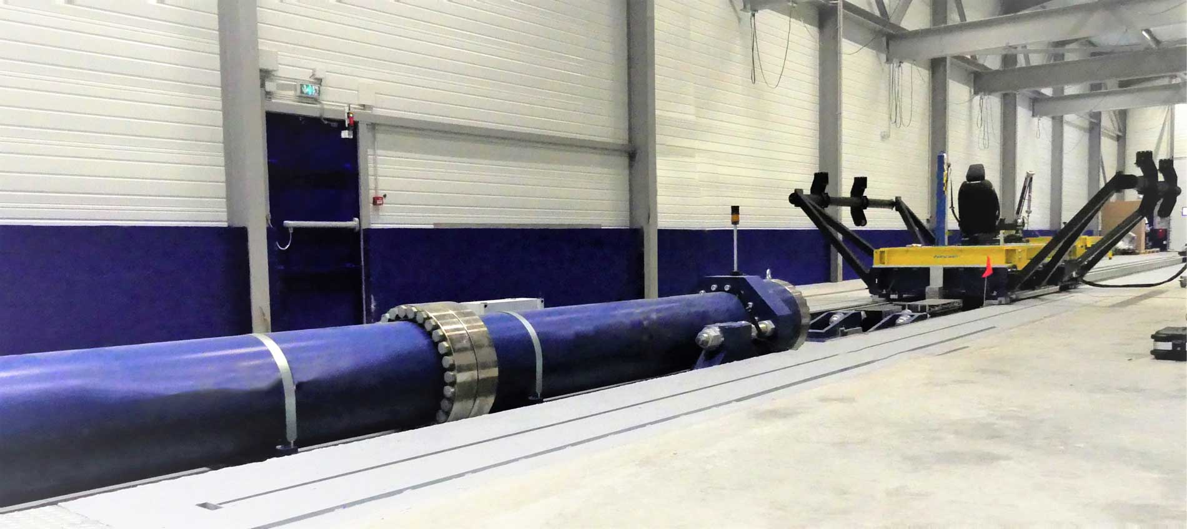

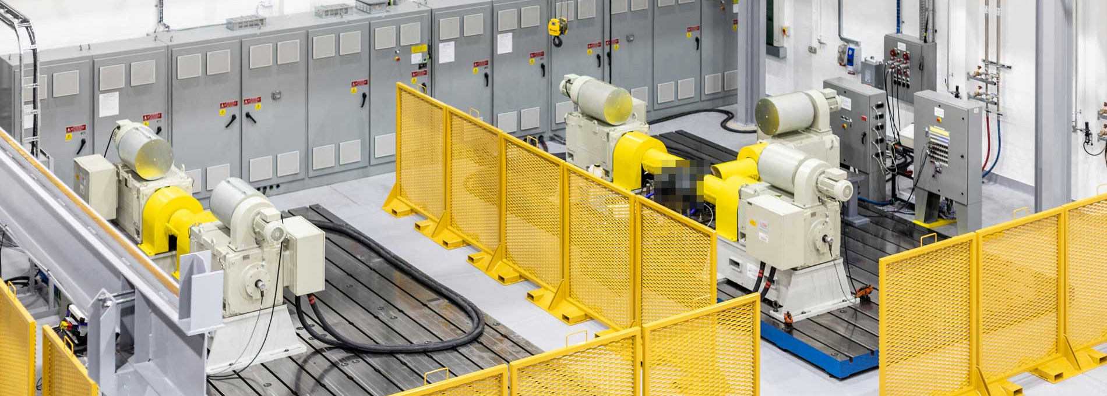
ACEA study on ASEP
07.11.2023 – RD-ASEP IWG

Slide 2
Study on ASEP and RD-ASEP Monitoring*
Study Outline
UTAC was tasked by ACEA to perform a study on ASEP and RD-ASEP.
The study consists of two work packages:
  Work Package 1
  Did the implementation of ASEP as it currently stands lead to any design changes?
  Work Package 2
  Collect data from the RD-ASEP monitoring and provide a basic analysis as input to the IWG on RD-ASEP;
Joint study of CPs and Automotive Industry
  France, Germany, Japan, The Netherlands, OICA (ACEA)
*Previous study’s presentation, questionnaires details: GRBP-78-34
RD-ASEP Monitoring Data Delivery Document: GRBP-77-15-Rev.3
Notes:
UTAC has been commissioned by ACEA to conduct a comprehensive study focusing on the ASEP and RD-ASEP initiatives. This study comprises two distinct work packages aimed at addressing specific objectives:
Work Package 1: The primary objective of this phase is to assess whether the existing implementation of ASEP has resulted in any modifications to the design process in vehicles. This involves a thorough examination of the impact of ASEP on design changes.
Work Package 2: In this phase, the focus shifts towards the RD-ASEP program. The key task is to gather pertinent data from the RD-ASEP monitoring process and subsequently carry out a preliminary analysis. The input will be supplied to the IWG on RD-ASEP.
This study is a collaborative endeavor involving the active participation of critical stakeholders, including France, Germany, Japan, The Netherlands, as well as OICA (ACEA). The concerted efforts of these entities reflect a joint commitment to advancing the field of Vehicle exterior noise.

Slide 3
Literature review : ASEP during development (2005-2009)
OICA proposal
F/D proposal
Slope-Assessment
Model-based approach
Detecting non-linearities, cycle-beating, cheating.
Engineering method based on a linear regression determined individually per vehicle.
Engine speed based.
Based on linear sound behaviour.
Establishing limit curves based on fixed slopes.
Combination of F/D and OICA proposals.
Critics/limitations:
The engine speed, as only explicative variable, limits the gear ratios to k ≤ i (for limiting the influence of the rolling noise).
No Not-to-exceed limit (No worst-case).
Slope-Assessment could allow noisier vehicles than R51.02.
Not-To-Exceed approach
Netherlands proposal
Ref. Sound Assessment
L_{urban}-Assessment
Establishing limit curves.
Method not based on a physical noise model but geometrically built from both the anchor point and a N-T-E point at the maximum engine speed.
Dealing with the worst-case, but the slope could be artificially flat, specifically for vehicles with high rated engine speed.
Preserving the benefits of R51.02.
Operating conditions close to 61 km/h and 1.9 m/s².
Defining a vehicle of concern using L_{urban} as metric.
Classifying method empirically established from dataset.
The assumptions make difficult to understand the physical noise behaviour of the vehicles.

Slide 4
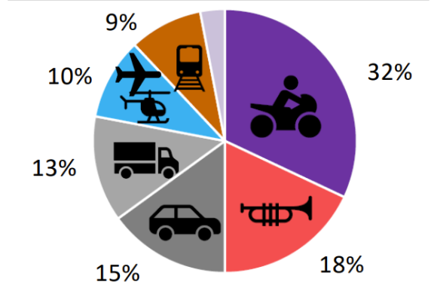
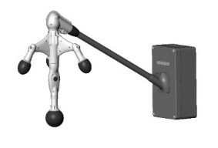
Literature review : Vehicle annoyance versus ASEP
Administration’s view: citizens’ complaints (from environment groups)
The sound emitted by M1 cars is perceived as annoyance but less important compared to other sources.
Administration’s action: noise abatement
Installation of automated noise camera to monitor sound from passing vehicles
Such monitoring can be used to gain an overview about nature, number and timing of any kind of noise events (sirens, horns, street sweepers, garbage trucks, modified vehicles, reckless driving, buses, trucks and more).
Manufacturer view: sound enthusiast customers (from press releases)
The sound’s character of cars is often perceived as pleasantness.
The ASEP provisions triggered a thorough redesign of the powertrain.
Press’ observation
The sound of newer car models seem to be less emotional.
Customers report that new cars were “disappointing compared to previous models”.

Slide 5
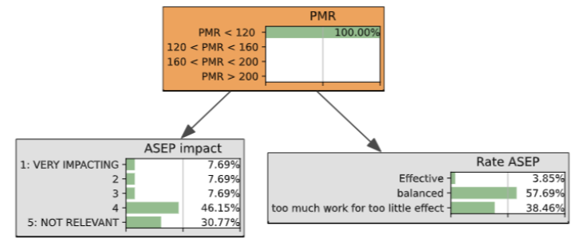
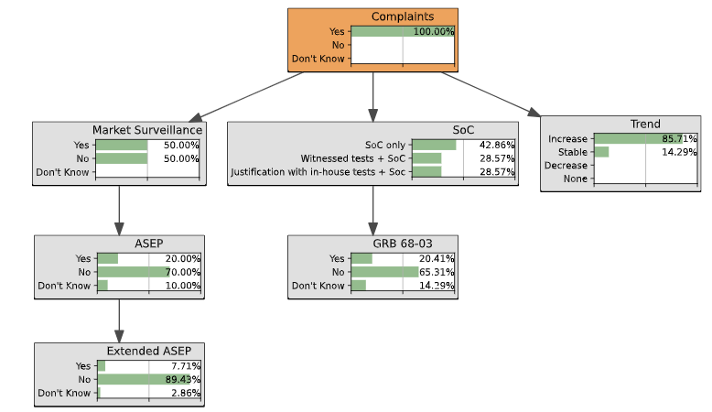
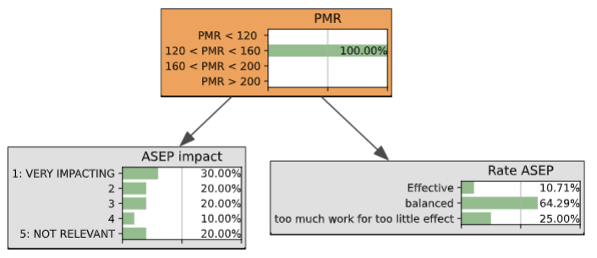
UTAC’s questionnaire OEMs and CPs
ASEP implementation and impact carried out from
  17 OEMs’ questionnaires
  15 CPs’ questionnaires
Statistical analysis approach
OEMs CPs

Slide 6
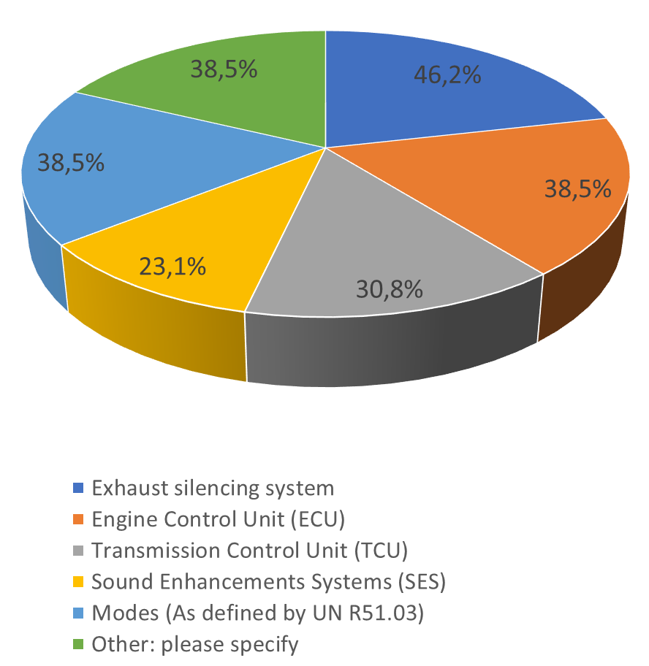
Questionnaire to OEMs’ - findings
Good representativity of the manufacturer market.
Most manufacturers apply the guidance of the GRB-68-03 voluntarily.
The higher the PMR is, the more impacting the ASEP is.
Most manufacturers of vehicles with low PMR are little impacted by ASEP.
Most manufacturers of low PMR vehicles consider ASEP too time-consuming with minimal impact.
Most manufacturers of high PMR vehicles rate ASEP as being balanced.
Conclusions:
The impact of the ASEP increases with the PMR.
ASEP has an impact, especially on exhaust system, ECU and TCU
(no trends in “other”)
Input for vehicle selection for WP1.3 on testing
Components redesigned due to ASEP

Slide 7
Questionnaire to CPs - findings
Good representativity of the CPs.
The trend of citizens’ complaints increases could be linked to more awareness of environmental noise issues (after Covid 19, with home office, …).
The Market Surveillance is not systematically applied (only half of CPs answering to the questionnaire applies MaS for noise).
ASEP is rarely tested
Low assessment or information regarding the ASEP effectiveness in reducing single vehicle noise.
Conclusions:
At least, the EU system allows enough enforcement for noise abatement
Recommendation to
  Systematically use the MaS
  Reinforce in-use controls and PTI

Slide 8
Next steps
WP1 Test program:
  Tests according to UN R51.03 and ASEP based on the test program outlined by the IWG RD-ASEP in 2017/2018.
  8 vehicles targeted of which 4 tests are in the pipe.
    If possible, twin pairs of vehicles shall be tested, one of it approved under UN R51.02 and then its successor under UN R51.03 (preferably stage 2).
    Single vehicles might be tested as well, if they are interesting.
    Vehicles selection is based on press reports and outcome of questionnaires.
  Target to complete all tests by end of 2023

Slide 9
WP2: RD-ASEP monitoring
WP2 status:
  UTAC website for data collection online (status end of October)
    Number of registered CPs: 7
    Number of data set received: 1
  Request from some OEMs to submit data on voluntary base

