Slide 1
Wet Grip of New and Worn Tyres
Experimental results on C1, C2 and C3 tyres
Dalia Broggi, Anne Serra, Fabrizio Re, Fabrizio Minarini

Slide 2
Agenda
Background
Description of JRC testing campaign
Description of EC-Idiada testing campaign
Results for C1 tyres
Results for C2 tyres
Results for C3 tyres
Summary

Slide 3
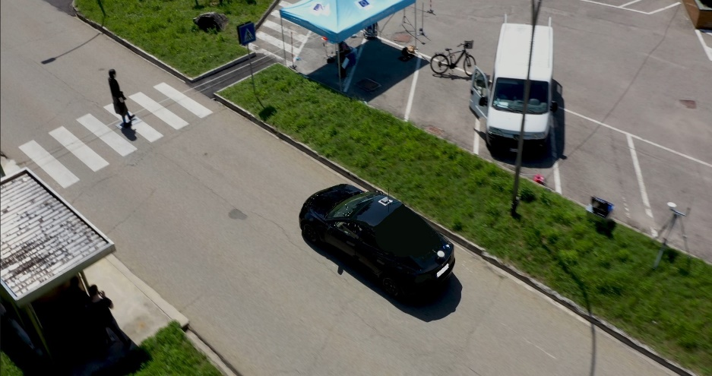
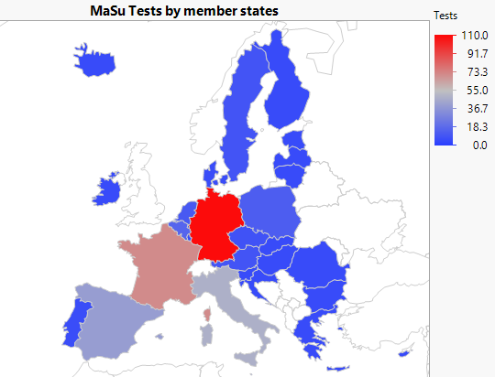

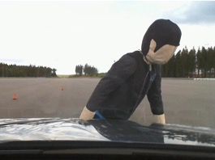
Background: Vehicle Market Surveillance in the EU
Regulation (EU) 2018/858 sets out obligation
and defines numbers and methods
for Member States and Commission
JRC Vehicle Safety Team performs Commission’s tests and checks as set out in Reg. 2018/858 art. 9
Additionally, research activity to anticipate future regulatory needs and to improve existing regulations
2019-2023:
  74 regulatory tests on 17
  vehicles and 7 components
  Tyres: UNECE 30, 54,117
  7 research campaigns

Slide 4
Background: EC-Idiada Study on wet grip of worn tyres
Aim of the study:
To provide to the European Commission a deeper knowledge of the behaviour of C2 and C3 tyres regarding wet grip performance on worn condition compared to the performance of the same tyres in new condition.
C1 tyres have been also included in the study to reconfirm the methodology to measure wet grip at worn state for C1 class tyres, approved by the GRBP and developed by the Informal Working Group Wet Grip Worn Tyres.
To support the conclusions, a testing campaign has been designed and executed including the most representative tyre sizes in the market for C1, C2 and C3 tyres.
Results of this testing campaign will be presented for all tyre classes

Slide 5
JRC’s test campaign: research on wet grip of worn tyres
Research tests on C1 tyres on the market in their new, buffed and naturally worn state:
Market evaluation → How do currently marketed tyres perform on worn wet grip test? RESULTS READY
Aging → How do tyres from an old production date behave? RESULTS READY
Buffing reproducibility → How do buffed tyres compare to naturally worn tyres? ASSESSMENT IN PROGRESS
Tyre ID | Size | Category | State of sets tested and Manufacturing Year
 |  |  | New | Buffed Worn (2 mm as per Regulation) | Naturally Worn | Buffed (Naturally worn height)
C1 JRC Tyre 1 | 175/60R15 | Normal | Set 1: 2018 Set 2: 2021 | Set 1: 2018 Set 2: 2021
C1 JRC Tyre 2 | 205/50R16 | Snow | Set 1: 2018 Set 2: 2021 | Set 1: 2018 Set 2: 2021
C1 JRC Tyre 3 | 255/50R18 | Normal | Set 1: 2018 Set 2: 2020 | Set 1: 2018 Set 2: 2020
C1 JRC Tyre 4 | 185/55R15 | Normal | Set 1: 2021 |  | Set 1: 2015 | Set 1: 2021
C1 JRC Tyre 5 | 215/45R17 | Normal | Set 1: 2023 | Set 1: 2023 | Set 1: 2019 | Set 1: 2023
C1 JRC Tyre 6 | 225/55R18 | Normal | Set 1: 2023 | Set 1: 2023 | Set 1: 2021 | Set 1: 2023
C1 JRC Tyre 7 | 235/45R18 | Normal | Set 1: 2023 | Set 1: 2023 | Set 1: 2022 | Set 1: 2023
C1 JRC Tyre 8 | 215/50 R17 | Normal | Set 1: 2023 | Set 1: 2023 | Set 1: 2020 | Set 1: 2023
Results on 1. and 2. will be presented

Slide 6
EC-Idiada test campaign: on wet grip of worn tyres
C1 Tyres tested
C2 Tyres tested
Tyre ID | Size | Category | State of sets tested and Manufacturing Year
 |  |  | New | Buffed Worn (2 mm)
C1 Idiada Tyre 1 | 195/65R15 | Winter | x | x
C1 Idiada Tyre 2 | 225/40R18 | Normal | x | x
C1 Idiada Tyre 3 | 205/55R16 | Normal | x | x
C1 Idiada Tyre 4 | 205/55R16 | Winter | x | x
C1 Idiada Tyre 5 | 225/45R17 | Winter | x | x
C1 Idiada Tyre 6 | 225/45R17 | Normal | x | x
Tyre ID | Size | Category | State of sets tested and Manufacturing Year
 |  |  | New | Buffed Worn (2 mm)
C2 Idiada Tyre 1 | 215/65R16C | Normal | x | x
C2 Idiada Tyre 2 | 215/65R16C | Winter | x | x
C2 Idiada Tyre 3 | 215/65R16C | Normal | x | x
C2 Idiada Tyre 4 | 215/65R16C | Winter | x | x
C2 Idiada Tyre 5 | 215/65R16C | Normal | x | x
C2 Idiada Tyre 6 | 235/65R16C | Winter | x | x
C2 Idiada Tyre 7 | 235/65R16C | Normal | x | x
C2 Idiada Tyre 8 | 235/65R16C | Winter | x | x
Tyre ID | Size | Category | State of sets tested and Manufacturing Year
 |  |  | New | Buffed Worn (2 mm)
C3 Idiada Tyre 1 | 295/80R22.5 | Winter | x | x
C3 Idiada Tyre 2 | 315/80R22.5 | Winter | x | x
C3 Idiada Tyre 3 | 315/80R22.5 | Winter | x | x
C3 Idiada Tyre 4 | 315/70R22.5 | Winter | x | x
C3 Idiada Tyre 5 | 315/70R22.5 | Winter | x | x
C3 Idiada Tyre 6 | 385/55R22.5 | Winter | x | x
C3 Idiada Tyre 7 | 385/65R22.5 | Winter | x | x
C3 Idiada Tyre 8 | 385/65R22.5 | Winter | x | x
Tyres were selected based on Idiada survey i.e. Percentage of Summer/Winter tyres, wet grip classes
Results on new vs buffed worn at 2 mm (as per Regulation) will be presented
C3 Tyres tested

Slide 7
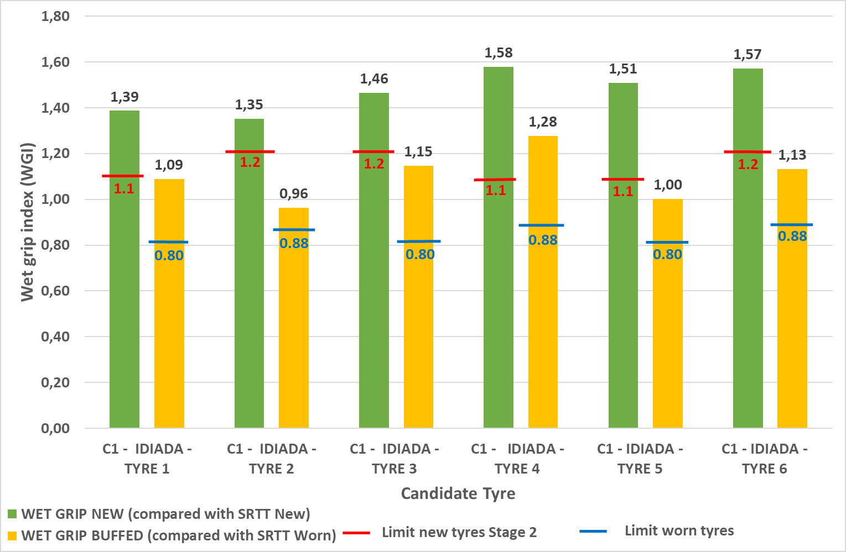
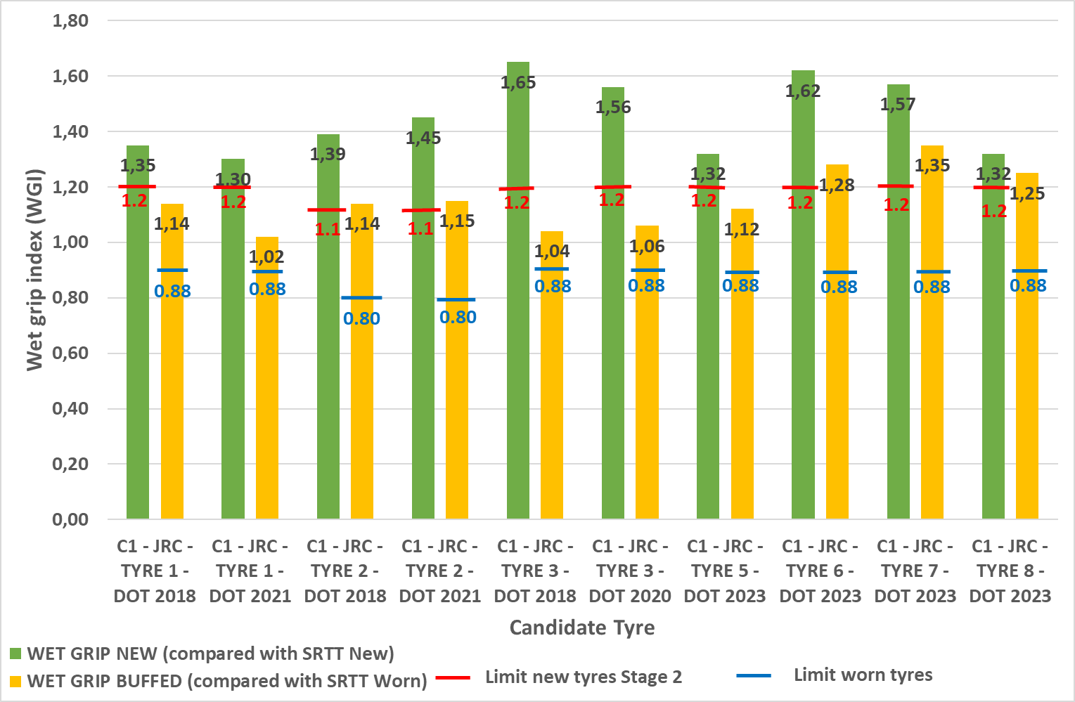
Results for C1: JRC & EC-Idiada WGI new and WGI worn
EC – Idiada Results
JRC Results
13 out of 13 tyres passed the Regulatory limit for worn tyres
Lowest WGI worn tyres is 0,96 for summer, Regulatory limit is 0,88
Lowest WGI worn tyres is 1,00 for winter, Regulatory limit is 0,8

Slide 8
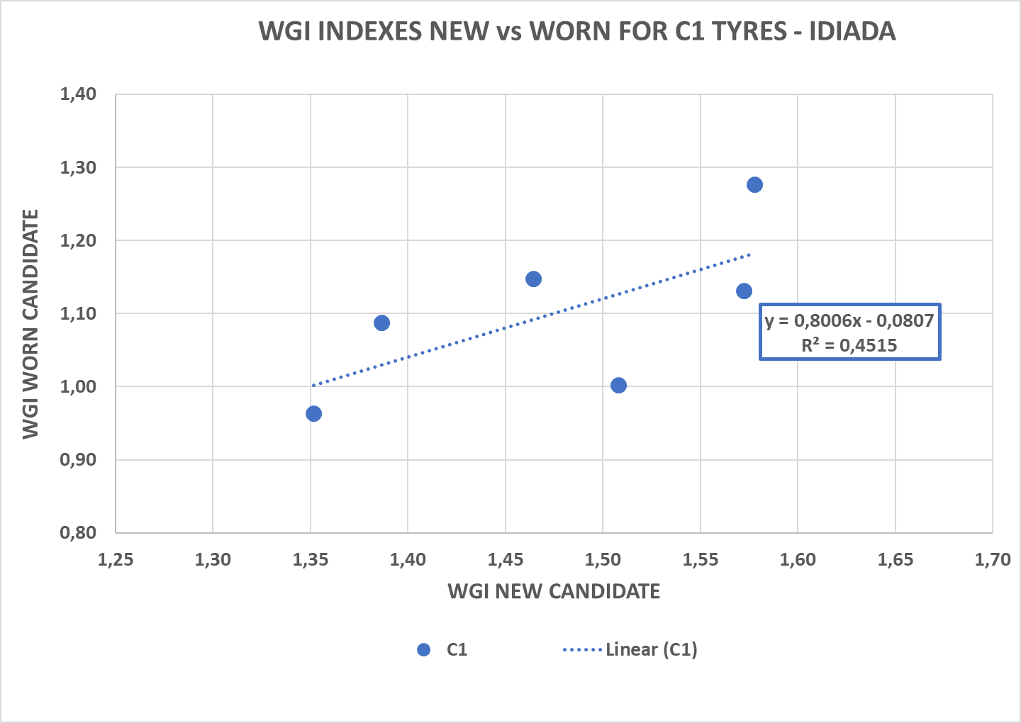
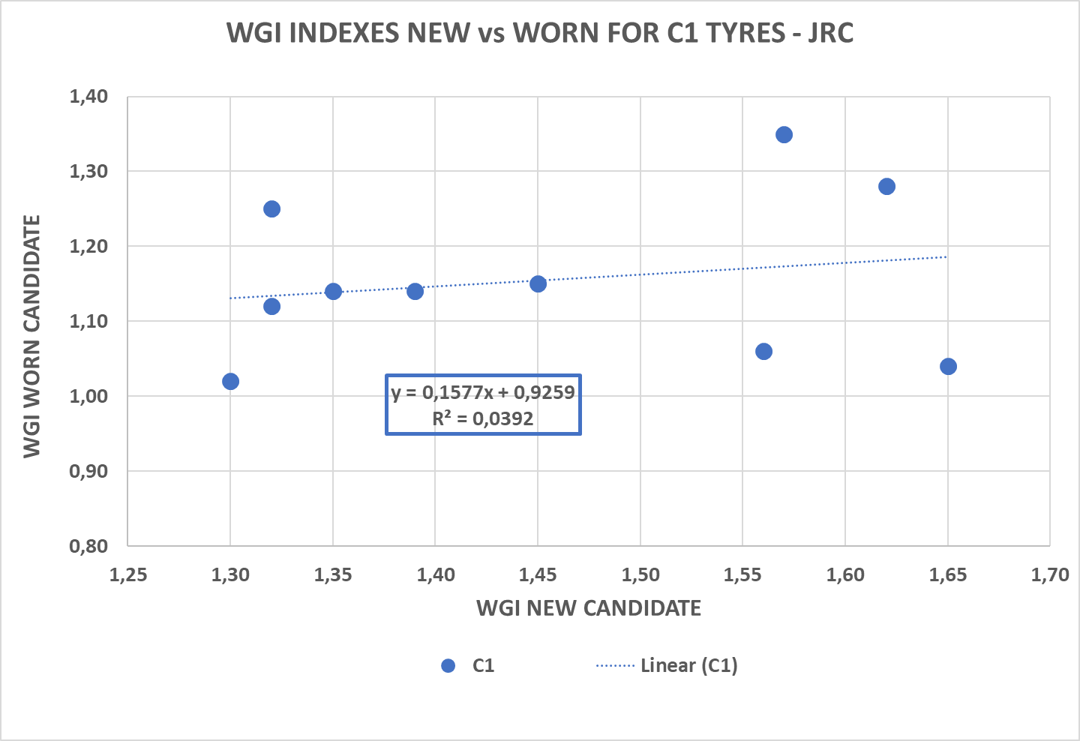
Results for C1: JRC & EC-Idiada correlation WGI new vs WGI worn
EC – Idiada Results
JRC Results
Poor correlation between new and buffed WGI both in JRC and EC-JRC results
Previous findings (GRBP-73-22) also showed R² = 0.53 → Testing need is confirmed

Slide 9
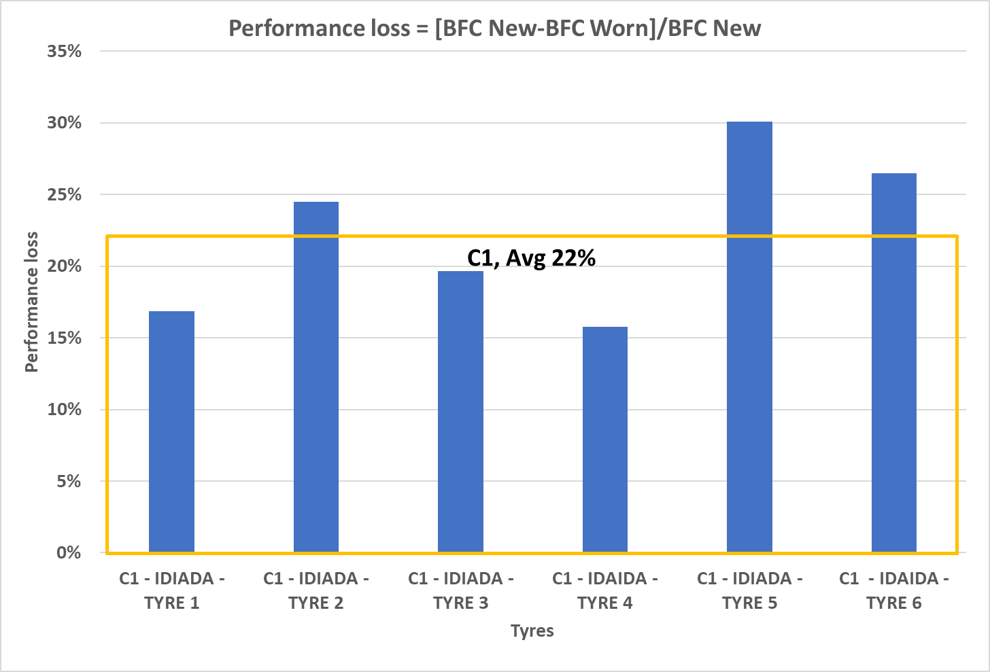
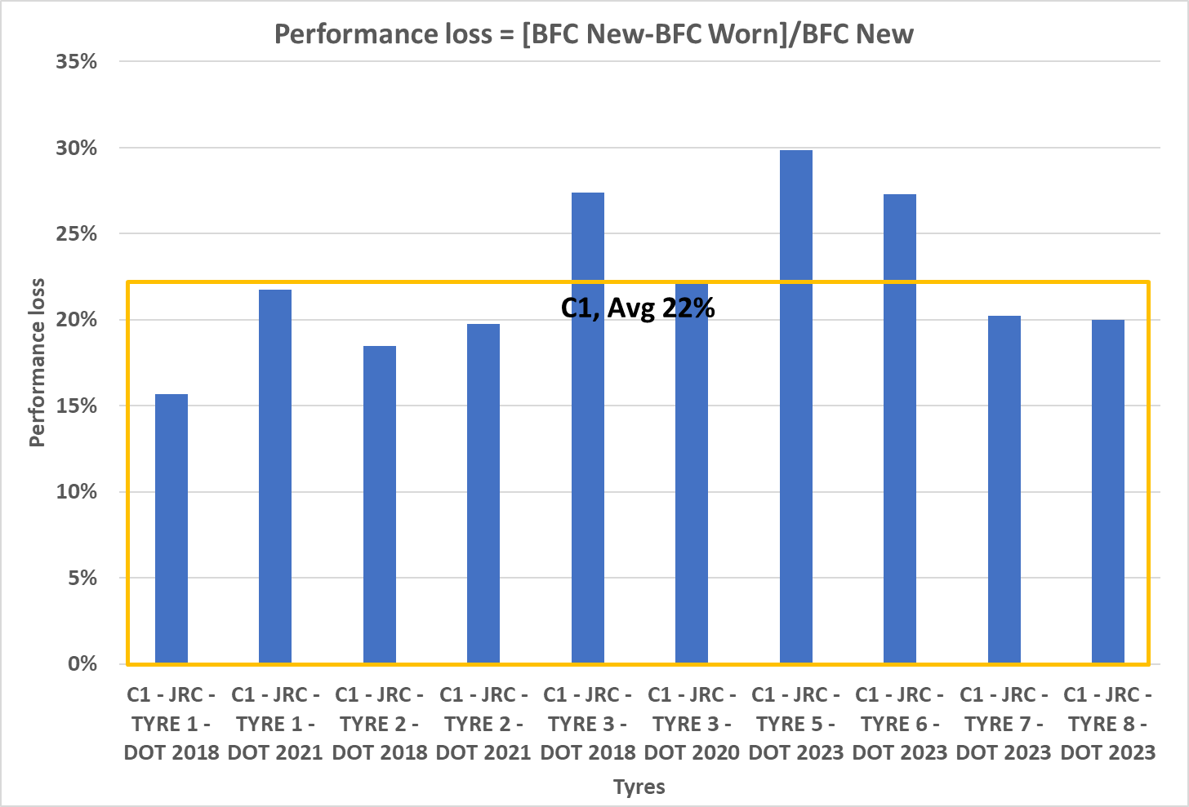
Results for C1: JRC & EC-Idiada performance drop of BFC
EC – Idiada Results
JRC Results
Average performance drop ≈ 22% for both EC-Idiada and JRC results
Performance drop is much lower than previous findings (in GRBP 73-22, 34% was presented)
Regulatory requirements have been decreased by 20% (i.e. New tyres 1,1; Worn tyres 0,88)

Slide 10
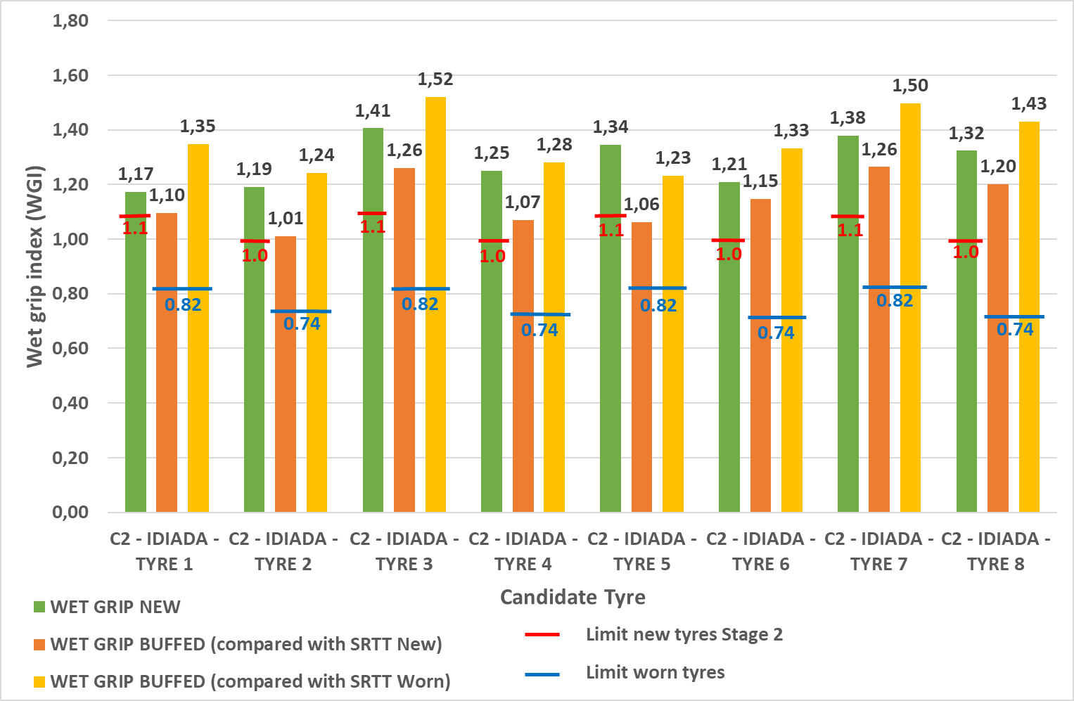
Results for C2: EC-Idiada WGI new and WGI worn
EC – Idiada Results
WGI calculated by comparing both with SRTT new and SRTT worn
8 out of 8 tyres tested passed the Regulatory limit for worn tyres with a really high margin
  lowest value for winter tyres is 1,01, proposed Regulatory limit is 0.74
  lowest value for winter tyres is 1,06, proposed Regulatory limit is 0.82

Slide 11
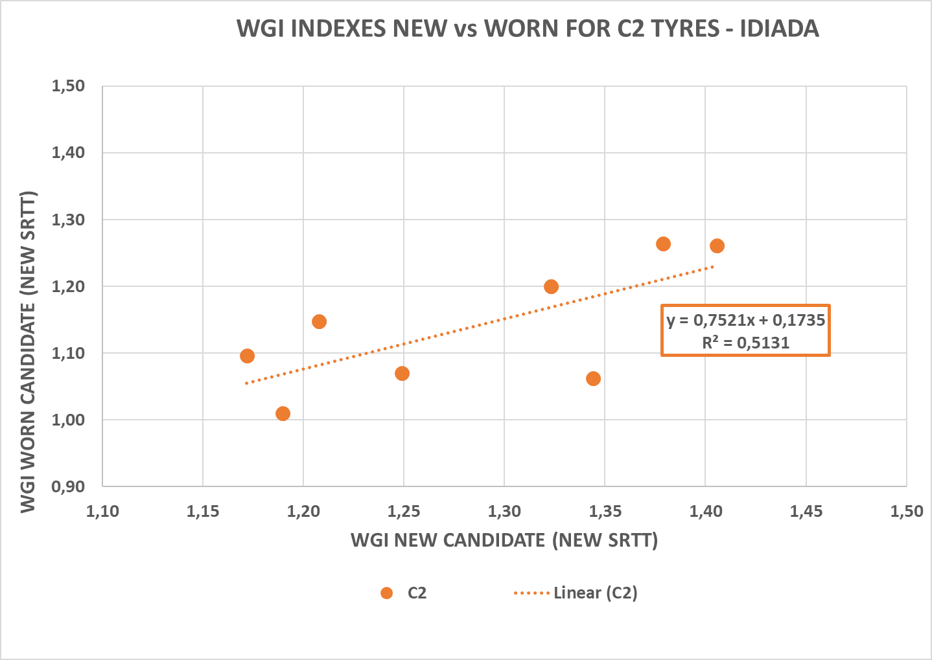
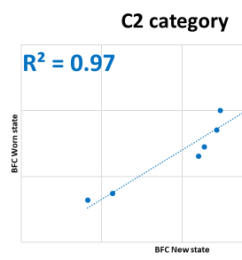


Results for C2: EC-Idiada correlation WGI new vs WGI worn
Really poor correlation between new and buffed WGI
Not possible to find worn WGI by applying a correlation formula to New WGI
EC – Idiada Results
GRBP-73-22
Adopted proposal at WP.29 186th
ECE-TRANS_WP.29_2023_8e
WGI worn calculation for C2 tyres

Slide 12
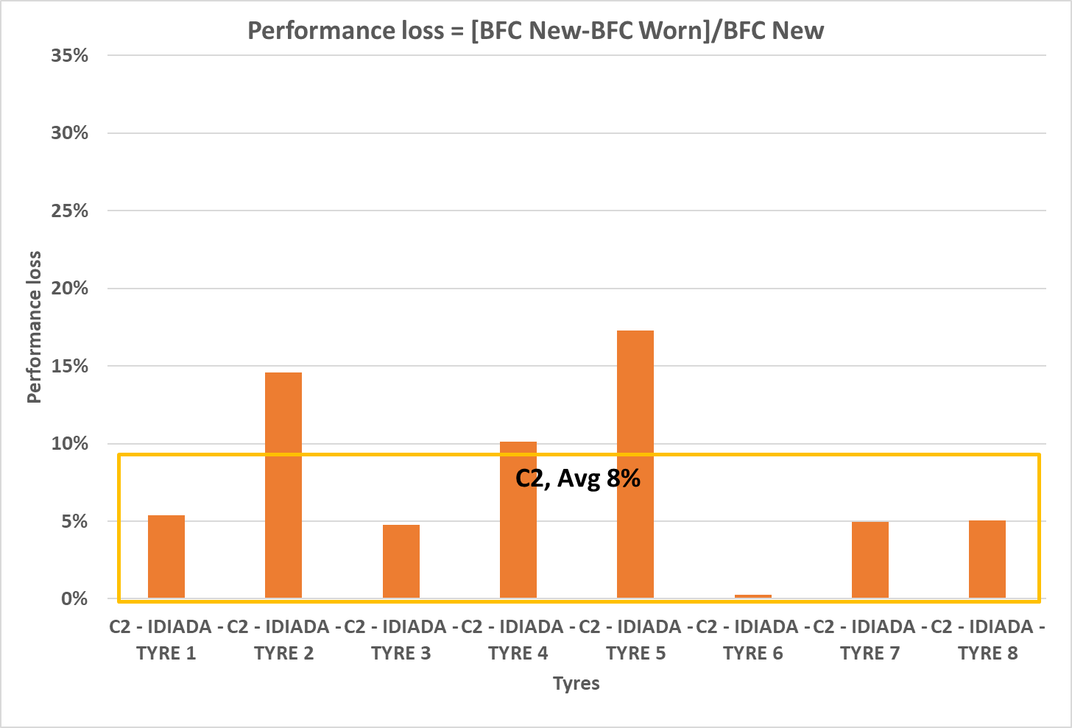
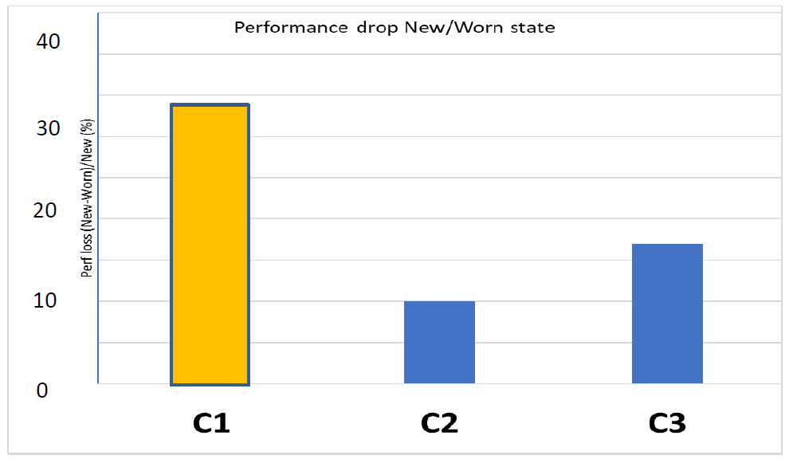
Results for C2: EC-Idiada performance drop of BFC
Average Performance Drop is 8%
Average Performance Drop found is in line with previous findings (GRBP-73-22)
However, results show an high standard deviation → the performance drop cannot be deduced from new WGI
EC – Idiada Results
Adopted proposal at WP.29 186th
ECE-TRANS_WP.29_2023_8e
WGI worn calculation for C2 tyres
GRBP-73-22

Slide 13
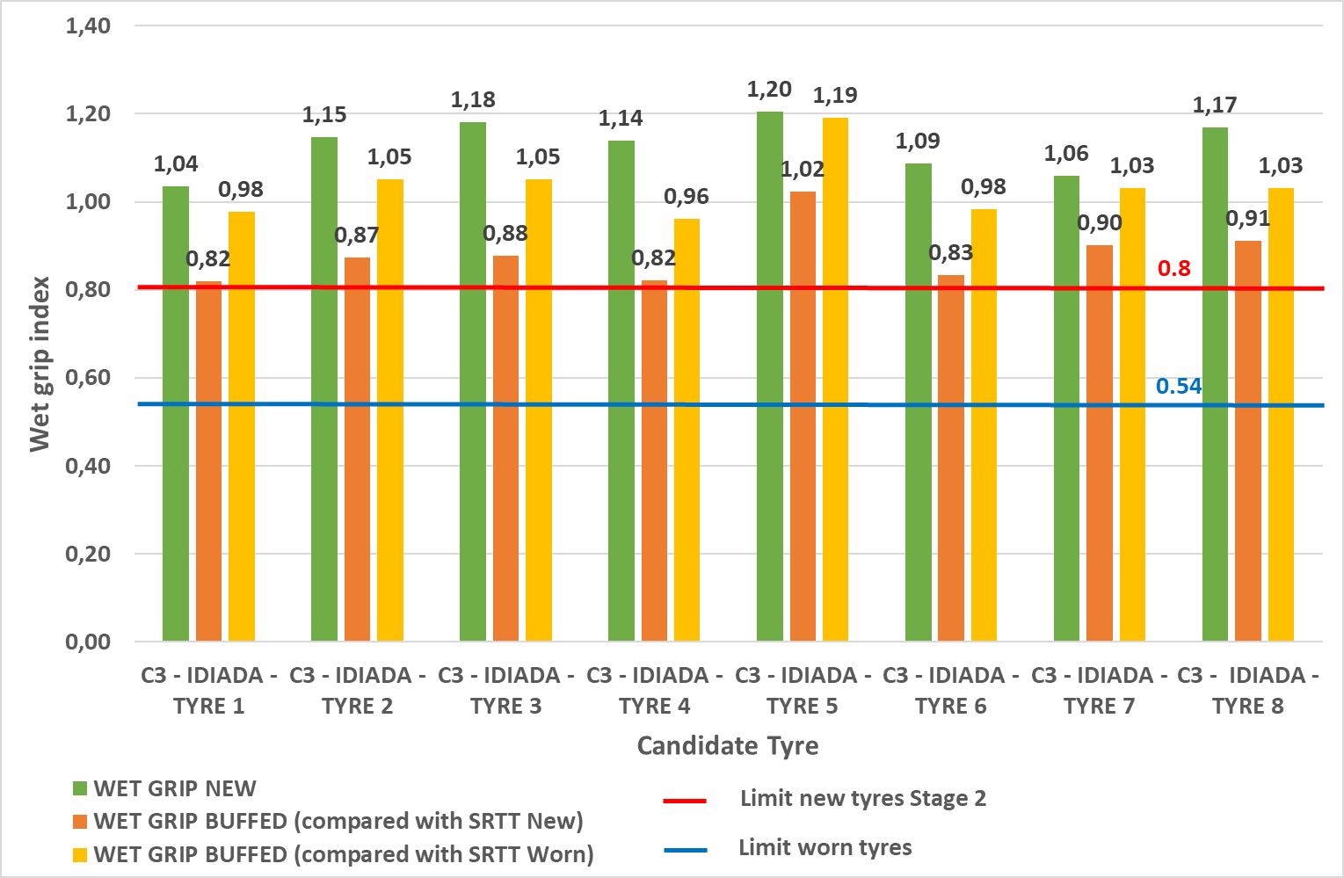
Results for C3: EC-Idiada WGI new and WGI worn
EC – Idiada Results
WGI calculated by comparing both SRTT new and SRTT worn
8 out of 8 tyres tested passed the Regulatory limit for worn tyres with a really high margin
  lowest value for traction tyres is 0.83, proposed Regulatory limit is 0.54

Slide 14
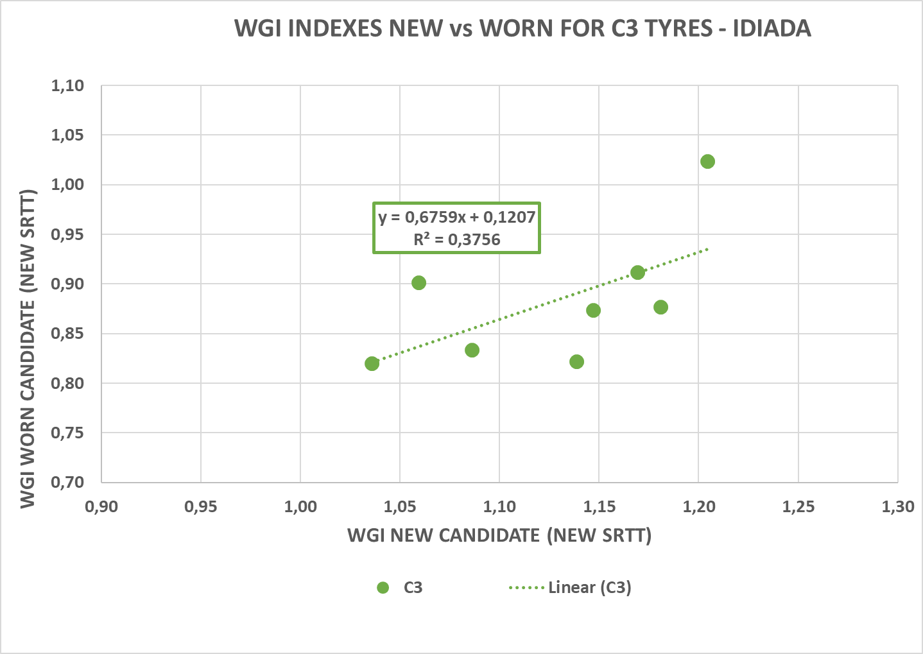
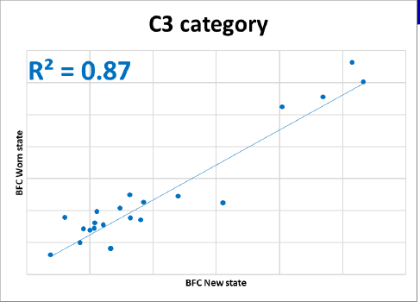


Results for C3: EC-Idiada correlation WGI new vs WGI worn
Really poor correlation between new and buffed WGI
Not possible to find worn WGI by applying a correlation formula to New WGI
EC – Idiada Results
GRBP-73-22
Adopted proposal at WP.29 186th
ECE-TRANS_WP.29_2023_8e
WGI worn calculation for C2 tyres

Slide 15
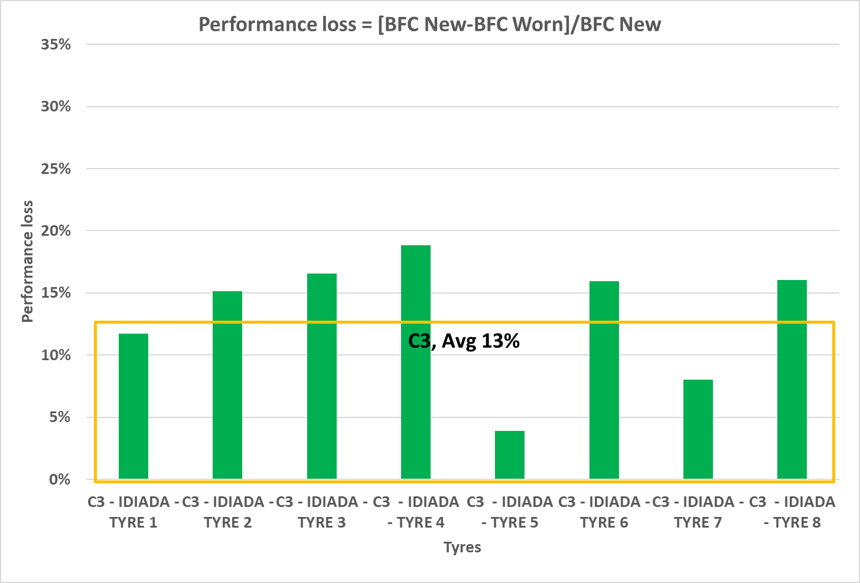
Results on C3: EC-Idiada performance drop of BFC
EC – Idiada Results
Average Performance Drop is 13%
Average Performance Drop found is in line with previous findings (GRBP-73-22)
However, results show an high standard deviation → the performance drop cannot be deduced from new WGI
Adopted proposal at WP.29 186th
ECE-TRANS_WP.29_2023_8e
WGI worn calculation for C2 tyres
GRBP-73-22

Slide 16
Summary
C1 Tyres
  All the candidate tyres tested (13/13) met the worn state regulatory limits
  The average performance drop is ≈ 22% in both EC-Idiada and JRC study. Much lower level than the results used to draft the Regulatory limits (≈ 34% in GRBP-73-22)
C2 & C3 Tyres
  All the candidate tyres tested (8/8 per tyre class) met the worn state regulatory limits with an high margin
  The average performance drop in EC-Idiada Study is ≈ 8% for C2 ≈ 14% for C3 and in line with previous findings (GRBP-73-22: ≈ 10% for C2 and ≈ 17% for C3)
  Results show an high variability in the performance drop and poor correlation between new and worn WGI, thus it was not possible to deduce worn WGI from new WGI by applying a correlation factor

Slide 17

Keep in touch
Notes:
Delete/update as appropriate

Slide 18

Thank you
© European Union 2023
Unless otherwise noted the reuse of this presentation is authorised under the CC BY 4.0 license. For any use or reproduction of elements that are not owned by the EU, permission may need to be sought directly from the respective right holders.
Notes:
Update/add/delete parts of the copy right notice where appropriate.
More information: https://myintracomm.ec.europa.eu/corp/intellectual-property/Documents/2019_Reuse-guidelines%28CC-BY%29.pdf

