Slide 1
ETRTO comments on WT-53-2
IWG WGWT 53rd session: 5 December 2023

Slide 2
ETRTO comments on EC study on C1, C2 and C3 Wet grip on worn tyre study
  ETRTO appreciate the study performed by JRC and IDIADA aiming to confirm the IWG WGWT work and to study additional parameters (like impact of tyre ageing on wet grip in worn state)
  In the following slides, ETRTO is addressing some clarification requests and some comments.

Slide 3
Slide 5:
  2018 and 2021: are those production years or testing years?
  2018 tyres: what about the storage conditions?
  Are the new tyres and buffed worn tyres from the same tyre set?
  What is the definition of “Tyres in their naturally worn state”? Under what conditions (load, position, inflation pressure, power, torque, camber, toe, market, season, driving style) is this state achieved?
  JRC tyre 2: Snow tyre: is it a 3PMSF tyre?
Slide 6:
  Tyre selection: no indication on considering the EU labelled performances as done in IWG WGWT.
  Were the tyres buffed following accordance with UNECE R117.04 Regulation specification or which regulation/specification
Slide 7:
  Any indication on the test track used by JRC. Is the testing track certified according to ISO and are the MPD, water depth, etc… in line with R117?
  IDIADA Tyre 3: 0,80 should be 0,88
  JRC tyre 4: no results: any reason?
Slide 9:
  Performance drop is much lower than previous findings (in GRBP 73-22, 34% was presented): this is not a IWG WGWT finding, but coming from the initial France study based on 15 tyres tested. The IWG WGWT always reflected on the SRTT performance drop (New versus Worn state) (-20%) to address the threshold proposal. The Idiada and JRC results confirm this setting.

Slide 4
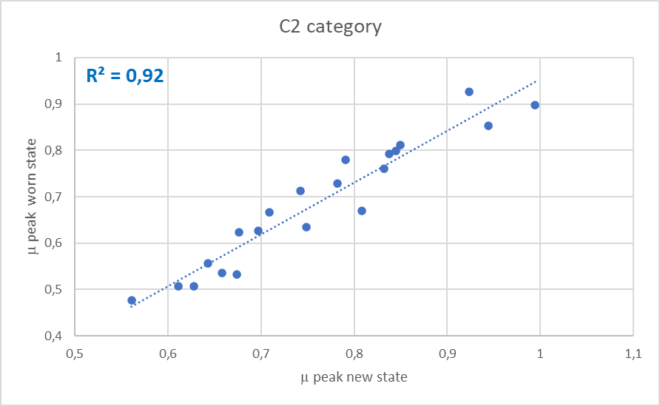
Slide 10:
  Wet Grip buffed (compared with SRTT worn): is it C1 or C2 SRTT worn? If C2 SRTT worn, what buffing profile used?
Slides 11 and 14:
  comparison between WGI (IDIADA) and BFC (IWG WGWT) is not correct as not the same parameter. (The IWG WGWT comparison should be extracted from GRBP-75-26rev1)
  the performance drop
  cannot be deduced from
  new WGI.
Slide 12:
  Tyre 6: no performance loss?
Slide 13
  0,54 WGI is only for C3 Traction and 3PMSF tyres. For Normal C3 tyre it should be 0,66.

Slide 5
Slide 16:
  Conclusion on C1 tyre: The average performance drop is ≈ 22% in both EC-Idiada and JRC study. Much lower level than the results used to draft the Regulatory limits (≈ 34% in GRBP-73-22) is misleading. The IWG WGWT always considered the measured performance drop of SRTT 16” → 20% as the basis for the regulatory limits. This is confirmed by the IDIADA and JRC study.
  Conclusions on C2 and C3: All the candidate tyres tested (8/8 per tyre class) met the worn state regulatory limits with an high margin. Difficult to draft conclusions based on a small dataset.
  Conclusions on C2 and C3: Results show an high variability in the performance drop and poor correlation between new and worn WGI, thus it was not possible to deduce worn WGI from new WGI by applying a correlation factor. The IWG WGWT test results for C2 and C3 are statistically more representative as obtained from different tracks (more than 2) and have a higher number of data points.

Slide 6
Thank you

