Slide 1
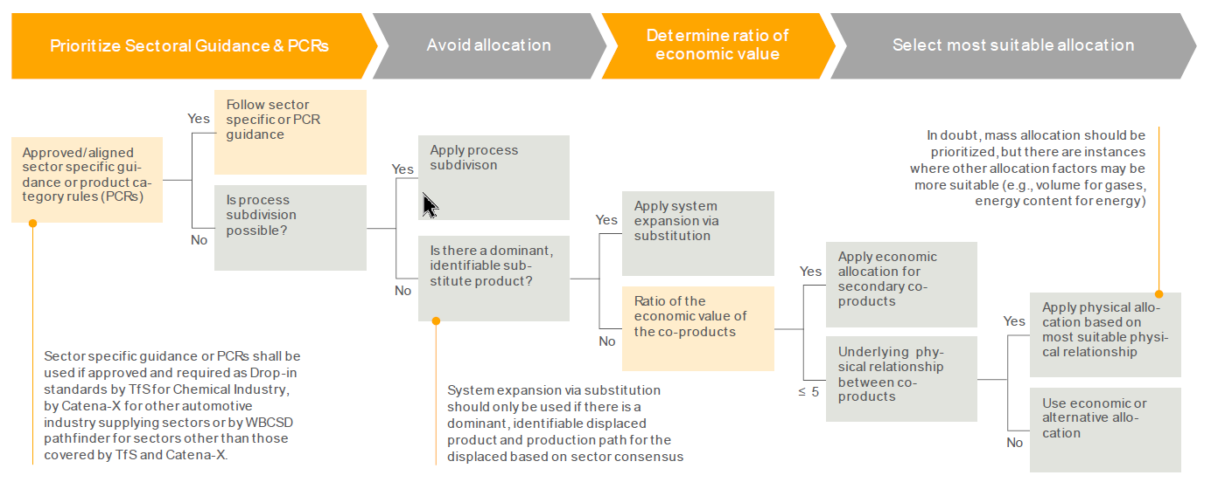
Multi-output allocation decision procedure
Definition of whitelist by UNECE IWG required
Courtesey Catena-X

