Slide 1
Overview of
EU-Automated Vehicle act
SIG-AVRS-013

Slide 2
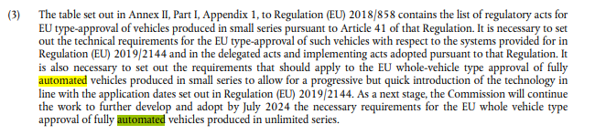
EU regulatory act for AVs
EC2022R2236 | Annex 1 | Part 1 | Appendix 1 | Table 2

Slide 3
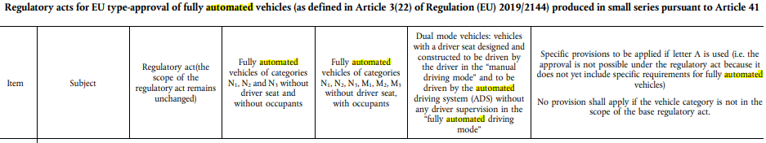
Table 2 | Relevant for GRBP AVRS

Slide 5
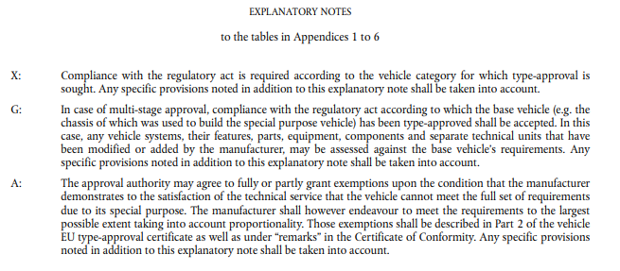
Explanation of codes A, G, X

Slide 6
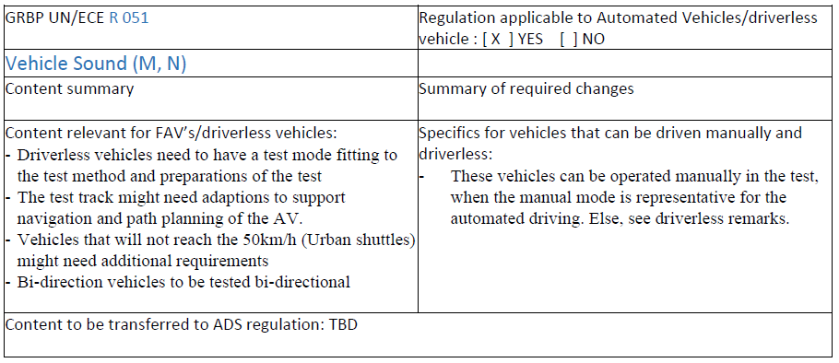
Example AVRS overview GRBP77

