Slide 1
Housekeeping information for
25th EDR-DSSAD IWG in Tokyo

Slide 2
EDR-DSSAD IG Tokyo Meeting
Date: 9-11 of April, 2024
Time: 9:30-17:00 (Recommend Lunch Time 12:00-13:30)
Venue: Bellesalle Iidabashi Ekimae
(50 and 80mins. by train from Haneda and Narita Airports)
 | AM | PM
09 (Tue.) | DSSAD | DSSAD
10 (Wed.) | EDR | EDR
11 (Thu.) | DSSAD | -
The schedule is subject to change.
Reception will be held on April 10 from 6:00 PM.
Please contact JASIC secretariat (ishida@jasic.org, tsuburai@jasic.org) by the 2nd February if you plan to attend the meeting. This information is very helpful for JASIC to decide the size of meeting room.
If you need support for VISA application or have any other queries, please contact JASIC secretariat (ishida@jasic.org, tsuburai@jasic.org).

Slide 3
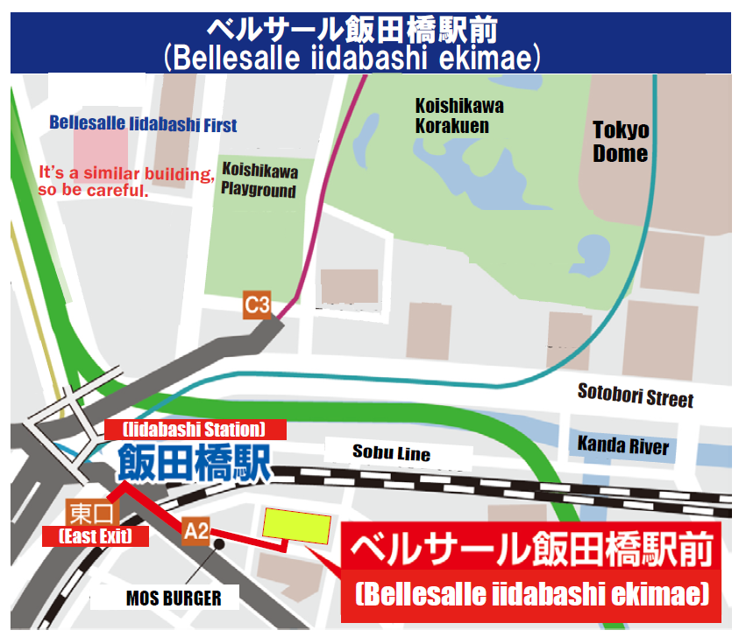
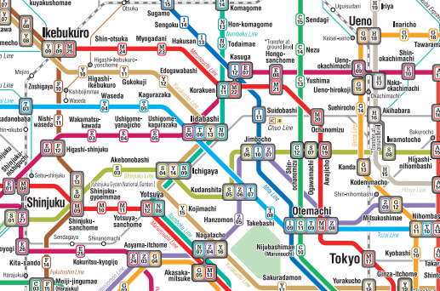

Access to the venue
Name of the venue: Bellesalle Iidabashi Ekimae
Address: Sumitomo Fudosan Iidabashi-Ekimae Bldg. 1-2F
3-8-5, Iidabashi, Chiyoda-ku, Tokyo 102-0072
(〒102-0072 東京都千代田区飯田橋3-8-5 住友不動産飯田橋駅前ビル1・2F)
TEL: 03-3263-7274
Bellesalle Iidabashi Ekimae is 2-5 minutes walk from Iidabashi stations of JR and subways.
You can use JR, Tokyo Metro Nanboku, Tokyo Metro Tozai and Tokyo Metro Yurakucho Lines to get to Iidabashi stations.
(Toward the direction of "Bellesalle Iidabashi First" )
✓
https://www.tokyometro.jp/lang_en/index.html
https://www.jreast.co.jp/multi/en/
Note: There is also "Bellesalle Iidabashi First" nearby, so please be careful not to make a mistake.

Slide 4
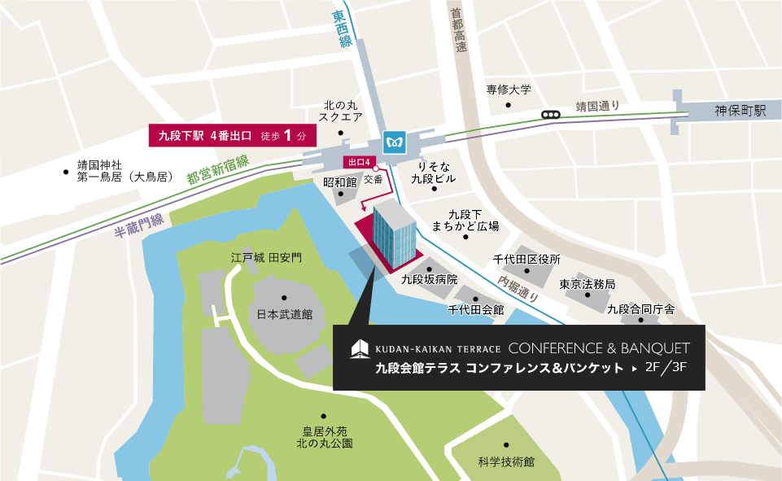
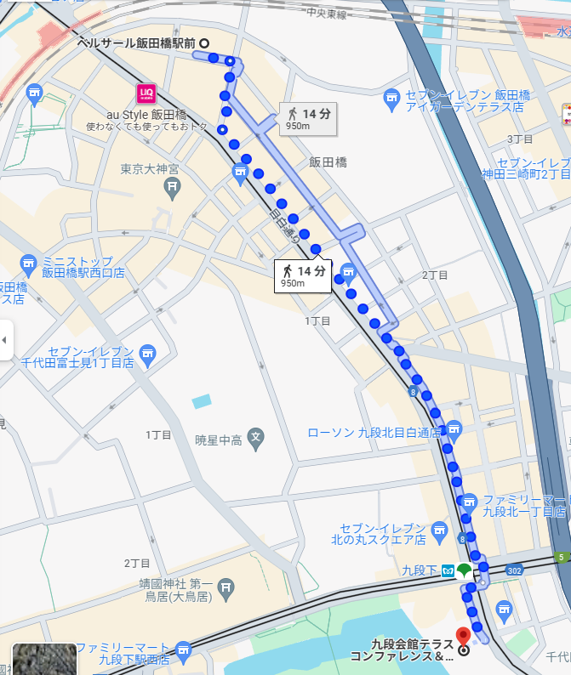
Access to the reception
Name of the venue: KUDAN-KAIKAN TERRACE CONFERENCE & BANQUET
Address: “301-ANZU” Kudan-Kaikan terrace 3F
1-6-5,Kudanminami, Chiyoda-ku, Tokyo 102-0074
(〒102-0074 東京都千代田区九段南1-6-5 九段会館テラス3階”杏”)
TEL: 03-6260-9110
KUDAN-KAIKAN TERRACE is 1 minute walk from Kudanshita stations of subways or 15 minutes walk from Bellesalle Iidabashi.
You can use JR, Tokyo Metro Tozai and Tokyo Metro Hanzomon Lines to get to Kudanshita stations.
Reception will be held on April 10 from 6:00 PM.
九段会館テラス
（ KUDAN-KAIKAN TERRACE ）
Kudanshita Station Exit 4
Bellesalle Iidabashi Ekimae
Iidabashi Station
KUDAN-KAIKAN TERRACE
✓
https://maps.app.goo.gl/9qom8792EuzqTB1S7
Kudanshita Station
KUDAN-KAIKAN TERRACE
Conference attendees can arrive at the conference in 15 minutes on foot from in front of Bellesalle Iidabashi or 8 minutes using the Tozai Line from Iidabashi Station.

Slide 5
Accommodations
Hotels that are close to the meeting location are:
Hotel Metropolitan Edmont : https://edmont-tokyo.hotel-metropolitan.com/
Tokyo Dome Hotel ： https://www.tokyodome-hotels.co.jp/e/
Tokyu Stay Suidobashi : https://www.tokyustay.co.jp/e/hotel/SUI/
Hotel Grand Hill Ichigaya : https://www.ghi.gr.jp/en/index.html
Hotel Monterey Hanzomon : https://www.hotelmonterey.co.jp/en/hanzomon/
BestWestern Fino Tokyo Akasaka : https://bwhotels.jp/tokyo-akasaka_en/english_ak
Please also search by apps. (booking.com, etc.) for your preference.

Slide 6
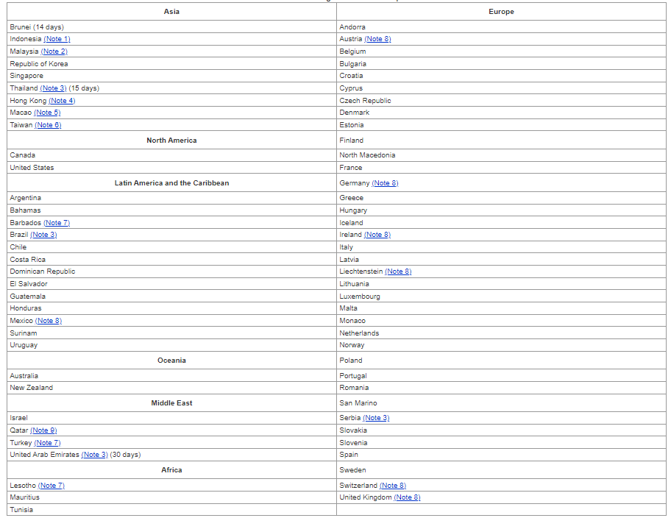
VISA Information
70 Countries and Regions for Visa Exemptions (September 30, 2023)
Link: Exemption of Visa (Short-Term Stay) | Ministry of Foreign Affairs of Japan (mofa.go.jp)

Slide 7
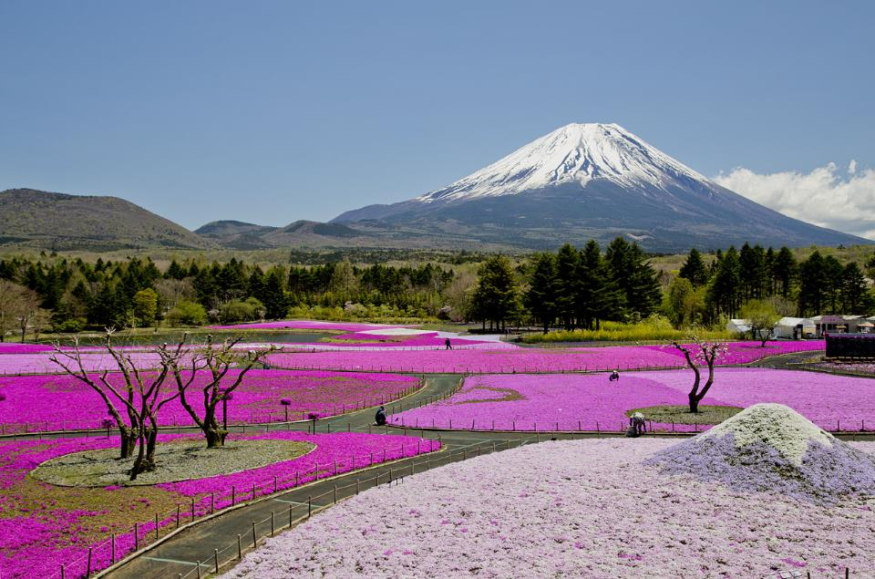
Thank you!

