Slide 1

ACPE #05
ACPE-05-XX
Industry Appendix

Slide 2
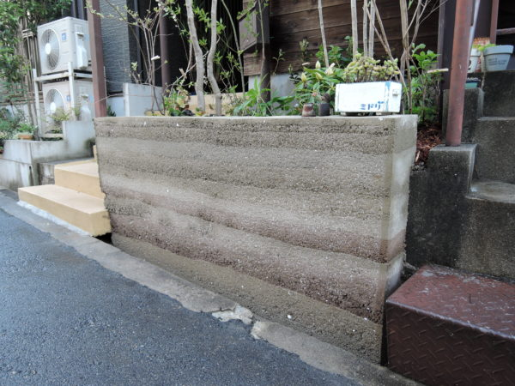
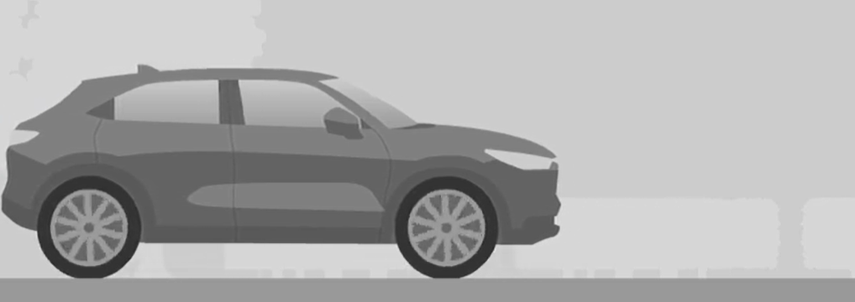
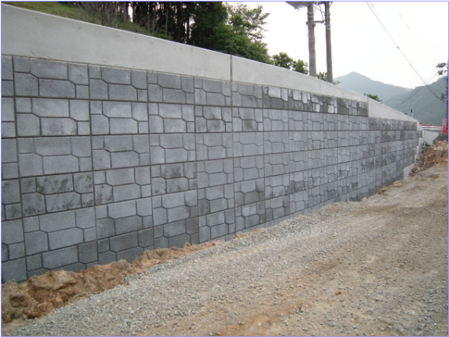
ACPE-05-XX
2. Definition、 2.8 Wall minimum size
2.8. "Obstacle" means a vehicle, wall-like structure with a width of at least 2 m and a height of at least 0.5 m , and/or pedestrian .
■ Proposal；
The height of 0.5m is low for a wall.
Considering the damage to drivers, it is appropriate to assume a higher height.
a height of at least 0.5 m → a height of at least 1.5m
Single accident
Ex. Wall
0.5m
Assuming an accident where the entire surface of the vehicle collides with the wall.
If it is 0.5m high, it will hit the bumper and stop there.
The damage to the driver is expected to be small.
Propose: At least 1,5m height
as equivalent vehicle height

Slide 3

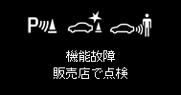
ACPE-05-XX
5.2.2 Warning signals for long term deactivation and failure
We’d like to confirm that the current specification comply with current text or not.
5.2.2.
The long-term deactivation warning signal shall be distinct from the failure warning signal specified in paragraph 5.4.3.
5.4.3. Failure warning signal
The failure warning shall be given by a constant yellow optical signal.
Actual vehicle example
 | Long term deactivation | Failure
Telltale | Always on | Always on
MID display (MID; Multi Information Display) |  | When the driver switches on a back button, the MID display will be disappeared for a little while and appeared again if the failure continues.
It corresponds to 5.4.3.
Same
Is it contrary to 5.2.2？
3

Slide 4
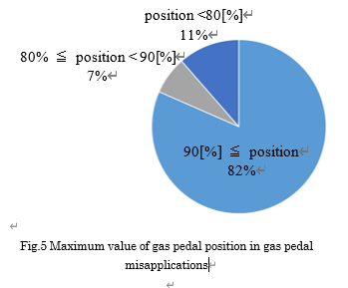
ACPE-05-XX
5.1.1 Accelerator pedal operation
(iv) The pedal application has a velocity of at least 400 %/s over a travel distance of at least 70% of the total travel distance of the accelerator control.
【Concern】
The text means to activate the ACPE when the accelerator pedal
is pressed from 0[%] to70[%] .
There are few accidents when the maximum accelerator position is 70[%].
The risk of ACPE activation during normal driving will be increased.xx
70
Accelerator position[%]
Time[s]
【Accident Data】
As a result of analyzing 100 cases of pedal misapplications,
maximum accelerator position was 90[%] or more in 82% accidents.
[Refence] Society of Automotive Engineers of Japan, Autumn conference in 2020
『Development of the acceleration suppression system
for gas pedal misapplication using big data』
【Amendment proposal】
(iv) The pedal application has a velocity of at least 400 %/s over a travel distance
of at least 70% of the total travel distance of the accelerator control.
and the maximum value of the accelerator pedal is depressed at least 90％.
4
2024/1/17

Slide 5
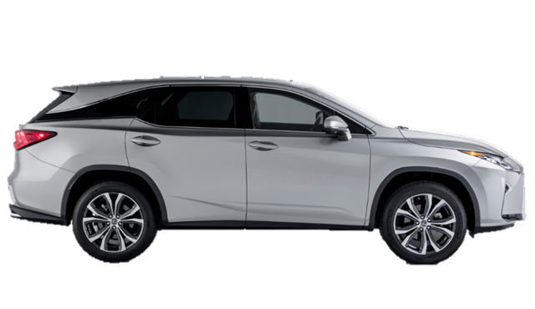

ACPE-05-XX
6.3.2 Child target concern
An example of a camera with a height of 1.5m
As it is shown at IWG#4(ACPE-04-09 (Industry) Pedestrian application plan.pptx), it is difficult to detect pedestrian reliably only by using sonar sensors for activate ACPE.
On the other hand, it is difficult to detect
the child with front camera
due to the blind spot at close range.
Adult
1.8m
1.5m
Child
New system design needed !
1.5m
1.2m
There is no proven ACPE technology.
This is not an item that should be decided in a short period of time.
→ It is appropriate to exclude child from 01 series.
Blind spot
Hardly detect within 2.0m
5
2024/1/17

Slide 6
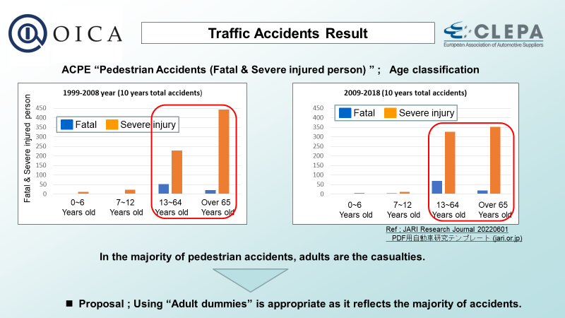
ACPE pedestrian Traffic accidents (extract ACPE-04-09)
ACPE-05-XX

