Slide 1


OICA and CLEPA joint proposal:
Update of modulations applied by UNECE R10 – 07 series of amendments

Slide 2
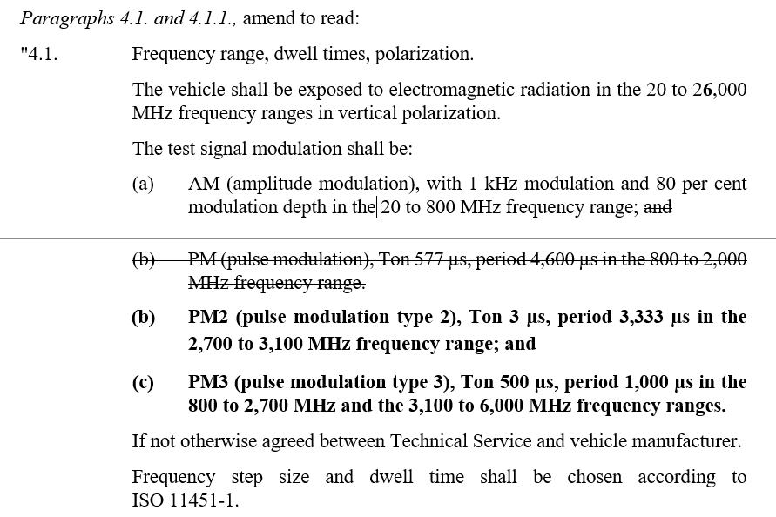
Proposal: update of modulations for consistency to ISO 11451-1 and ISO 11452-1
ECE-TRANS-WP.29-GRE-2023-27e-Rev.1
Annex 6:
AM: 20 to 400 MHz
PM2: no change
PM3:
380 to 2,700 MHz;
3,100 to 6,000 MHz
Adopt proposal for Annex 9 accordingly.

Slide 3
Justification
The decision to update the frequency range of modulations in ISO 11451-1 and ISO 11452-1 was unanimously taken during the 73rd ISO/TC22/SC32/WG3 meeting from February 19th to 23rd, 2024 in Singapore:
- Resolution 828: ISO/DIS 11452-1; next stage FDIS, publication in 03/2025
- Resolution 829: ISO/DIS 11451-1; next stage FDIS, publication in 03/ 2025
Based on a thorough investigation and summary of the practical use of AM (next slide), ISO/TC22/SC32/WG3 concluded that the applicable frequency range for AM can be limited to 400 MHz. PM3 will be applied in the frequency range starting from 380 MHz.

Slide 4
Summary: Use of AM
Communication applications:
PM3 was introduced at 380 MHz to cover TETRA, 4G, 5G, WIFI
Maritime¹⁾ applications:
1,6 – 27,5 MHz (J3E: single sideband without carrier)
Railway²⁾ applications:
Old train station control systems might still use AM
Train radio: FM or TETRA
Aviation³⁾ applications:
Frequency range for civil applications: 108 - 137 MHz (Aircraft communications radio)
Frequency range for military applications: 225 - 400 MHz (Aircraft communications radio)
Amateur Radio⁴⁾ :
Focus on frequency bands with PRIMARY status: 1,8 – 450 MHz (and 24 – 250 GHz)
No practical use in the 70 cm (420 – 450 MHz) band: highest frequency << 450 MHz
Infotainment applications⁵⁾:
Radio broadcasting: LF: 0,1485 – 0,2835 MHz / MF: 0,5265 – 1,607 MHz / HF: 3,9 – 26,1 MHz
Analog television: 47 – 838 MHz; Reference document does not provide detailed information on modulation; Analog television outdated – digital television services apply other modulations (typically OFDM, carriers with QAM);
Spectrum comparison of AM and PM3 shows similarities between both modulations
1) Information provided by Bundesamt für Seeschifffahrt und Hydrographie (The BSH is a higher federal authority within the portfolio of the Federal Ministry for Digital and Transport.)
2) Source: German component manufacturer for trains
3) Sources: Complete List Of Airband Frequencies.. | Skyscanworld.com, The basics of air band radios (buytwowayradios.com), Common Military (United States) Scanner Frequencies and Radio Frequency Reference (radioreference.com)
4) Source: International Amateur Radio Union (IARU), ITU - Amateur and Amateur-satellite Service Spectrum
5) Source: Radio Services Database CISPR/TR 31 V4 => reference document: Recommendation ITU-R BT.417-5

