Slide 1
Luminous flux
Red content
UV content
(related to discussion of 2.10.1. in R48)
SLR-66-06
P. Plathner, W. Schlager
23-Januar 2024

Slide 2
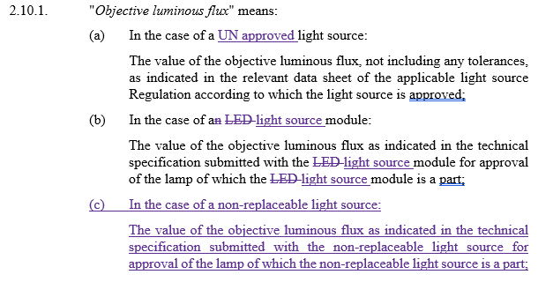
Proposal for new R48
Editorial
Impact on R149-01 for light source modules using non-LED technology !
Impact on R149-01 in case of non-replaceable light sources (new option) !

Slide 3
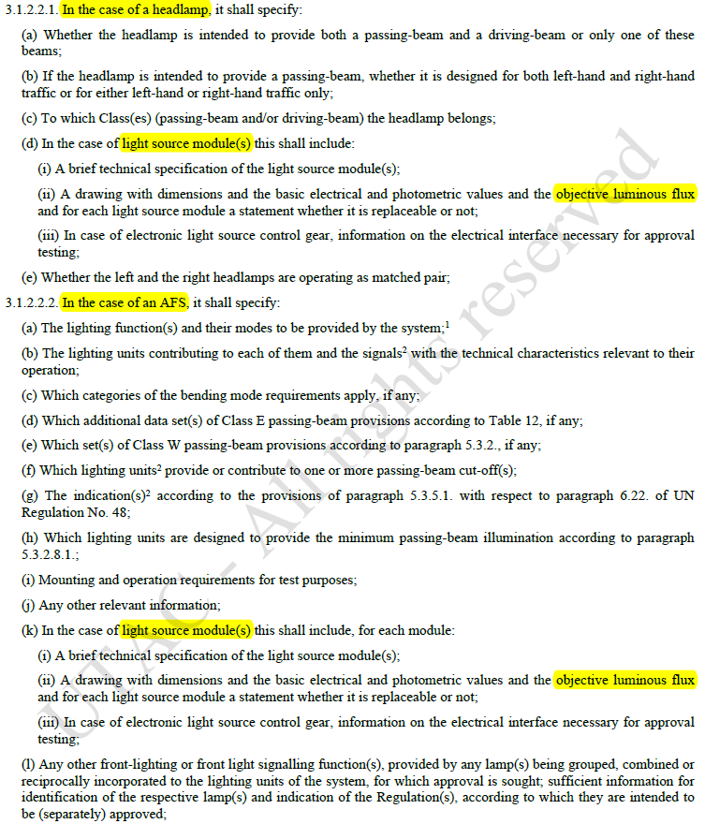
Link to R149-01
Note the existing requirement to communicate the objective luminous flux of light source modules
Proposal for R149-02:
Extend the requirements in paragraphs 3.1.2.2.1. (d) and 3.1.2.2.2. (k) to „non-replaceable light sources”

Slide 4
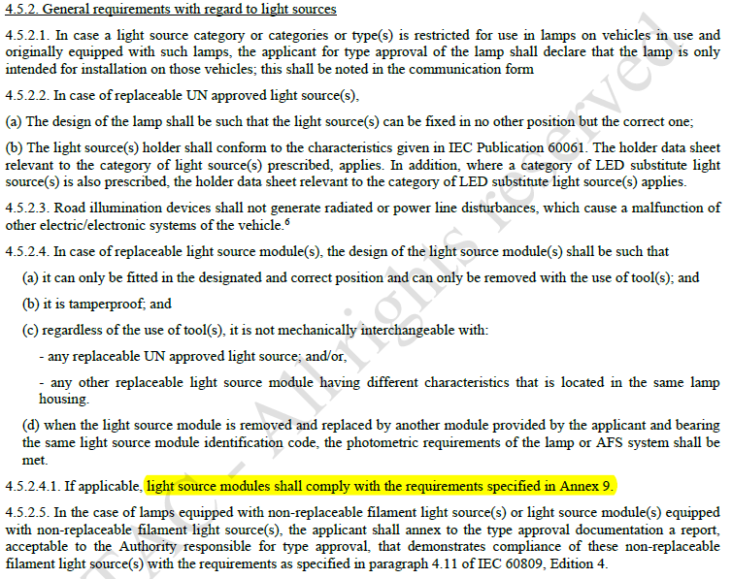
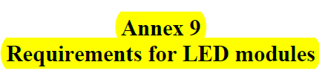
Link to R149-01
Note the existing requirement for all light source modules to comply with Annex 9, i.e. comply with …
  … minimum red content
  … maximum UV content
  … procedure to determine luminous flux
Proposal for R149-02: Correct Annex 9 to cover light source modules (of all technologies; see next slide)
Further: Discuss/find approach to cover non-replaceable light sources
  Option 1: Amend Annex 9 accordingly
  Option 2: Add separate Annex or split Annex 9 in two sections

Slide 5
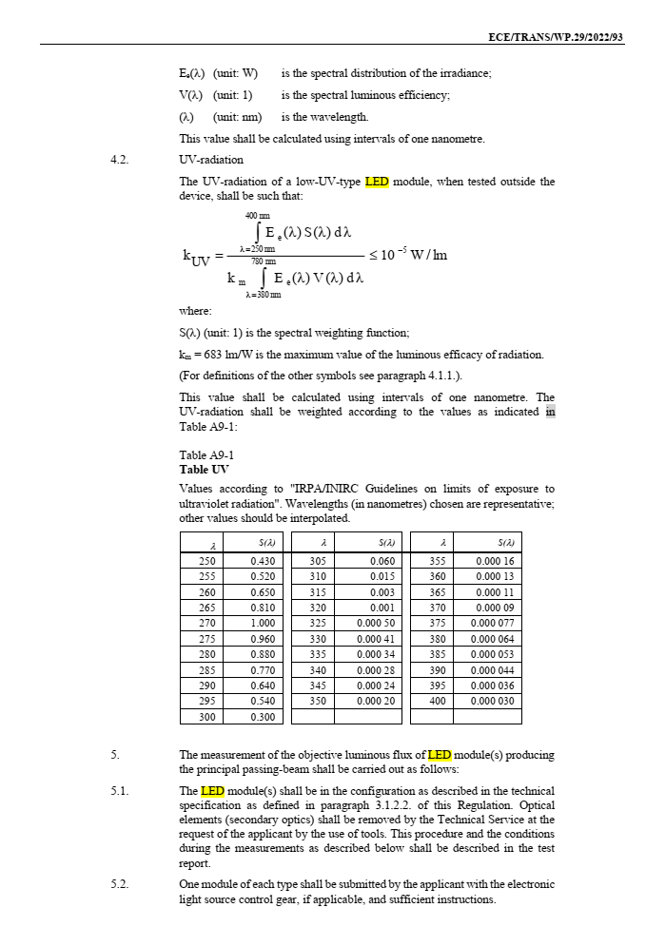
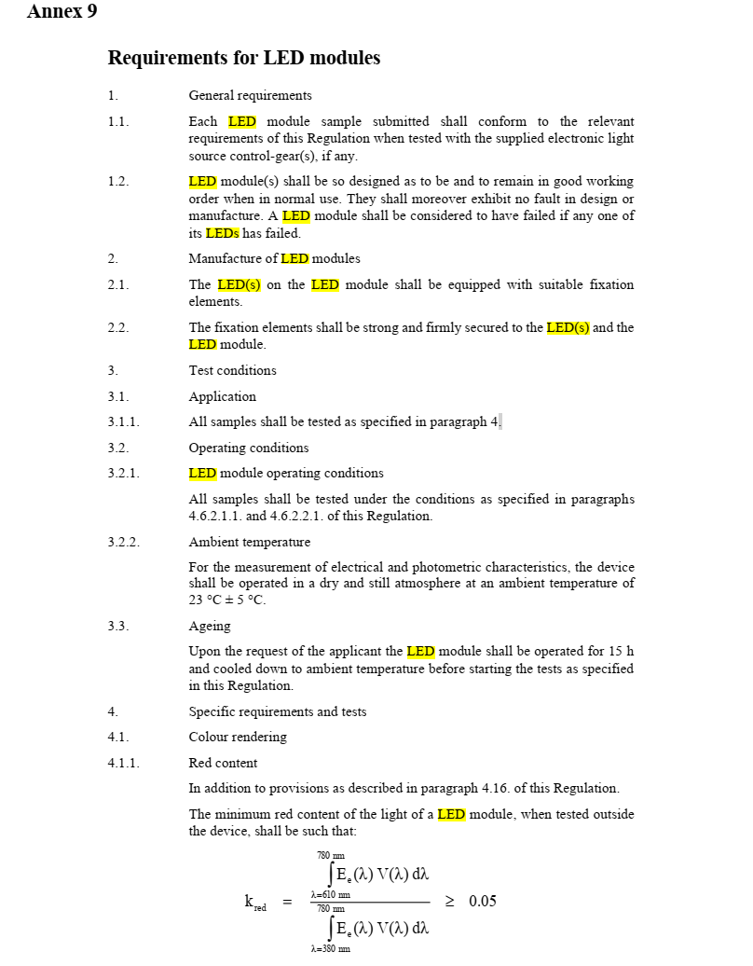
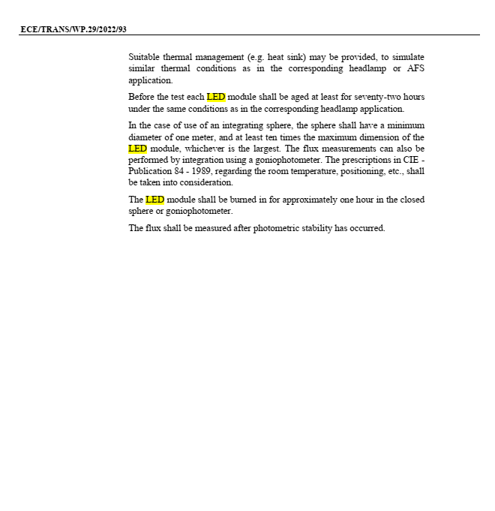
First review of Annex 9
It seems that it is mainly about replacing the term „LED module“ by the term „light source module“

