Slide 1
6th A-LCA IWG SG2 MTG
2023.Nov.23
Isao Tabushi / JASIC (Japan)

Slide 2
Overall schedule plan
 | 2023 |  |  |  |  |  | 2024 |  |  |  |  |  | 2025
 | Jun | Aug | Sep | Oct | Nov | Dec | Jan | Feb | Mar | 2Q | 3Q | 4Q | -
IWG MTG
Objective ,usage method, applicable product setting
Automotive material list/classification setting
System boundary setting - Material flow/hotspot - manufacturing SG3 - waste/recycling SG5
a level concept setting
Cutoff/Data requirement/
Setting of each material carbon intensity
Data collecting and setting
Info.exchange for verification

Slide 3
Agenda
Presentation from European aluminium
Material classification concept discussion of steel, aluminium, copper and resin
  If any participant have a different material classification proposal on steel, aluminium, copper and resin, please send the SG2 leader.
  Also please make presentation of your proposal in next SG2 meeting
Material classification concept discussion on other materials
  Currently leading team thinks next material discussion will be about battery material.

Slide 4
Material classification concept discussion of steel, aluminum, copper and resin

Slide 5
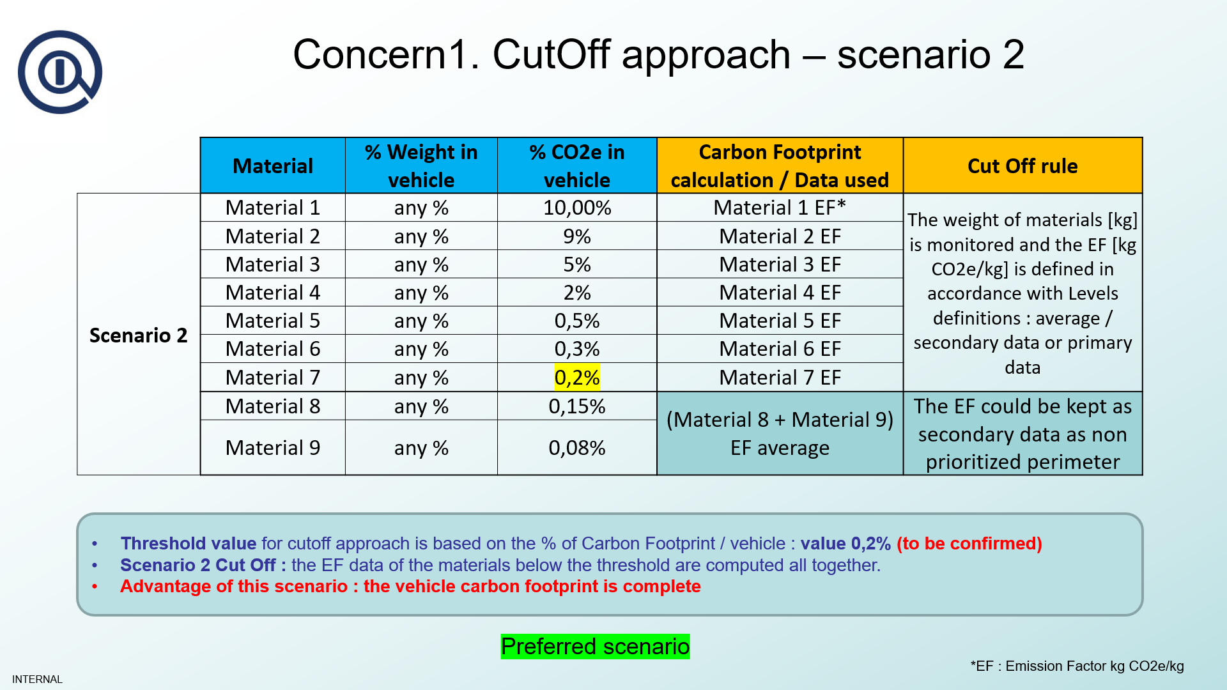
Material Classification
Base idea is higher than 1% effect material to be listed
But not only one specific vehicle considered
Need to consider ICE, HEV, BEV, Buses Trucks, and MC
Current proposal of Material Classification is considering wider range
If some colleagues want to add classification, please let me know soon as possible
If some colleagues want to delete classification, we can discuss later
Merge to some
other material
Not to be cut off
No need of cut off rules to Material acquisition
phase
Please inform your idea of classification to SG2 team

Slide 6
Battery material classification proposal

Slide 7
Concept
Prioritize higher CFP material. This means we need to focus on battery cell material.
We will not make additional material classification for Steel, Aluminium, Copper and Plastics.
Avoid to divide too much in detail (Precursor and up stream materials could have much number of classification)
Level1 | Level2 | Level3 | Level4 | Level5
Battery Cell | Cathode | Cathode active material | Precursor | Nickel sulfate Manganese sulfate Cobalt sulfate Sodium Hydroxide Ammonium Hydroxide Additives…
 |  |  | Lithium carbonate
 | Anode | Anode active material | Precursor
 | Common material for Cathode / Anode | Conductive material
 |  | Binder
 |  | Insulator
 |  | Solvent
 | Electrolyte | Lithium salt
 |  | Solvent
We propose to make Level3 material’s classification

Slide 8
Material classification proposal
Mainly we have variation on Cathode active material
Also Ni-MH battery need to be considered as HEV battery in addition to Li-ion battery.
 | Variation
Cathode active material | NMC111
 | NMC532
 | NMC622
 | NMC811
 | NCA
 | LFP
 | LMO
Anode active material | Graphite Carbon nano tube (Should have some variation)
Conductive material | Carbon black Silicon
Binder | PVDF
Insulator | Alumina
Solvent | NMP
Lithium salt | LiPF6
Solvent | Carbonate Ester … (Should have some variation)
Ni-MH battery

Slide 9
MTG Schedule plan
SG2 MTG date | 2023 |  |  |  |  |  |  | 2024
 | Jun | Jul | Aug | Sep | Oct | Nov | Dec | Jan | Feb | Mar
 | 22 | 27 | 24 | 28 | 26 | 23 | - | 25 | 22 | 28
Every Month's 4th Thursday
19:00-20:00 (JST)
Online MTG
A-LCA IWG MTG
Dec.4 @online
Jan.8-9 @Geneva

