Slide 1
32nd Unece VRU proxi group:
Potential amendment to ensure frontal direct vision requirements -Updated
Dr Steve Summerskill
VRU-Proxi-32-03

Slide 2
Contents
Highlighting a concern that has arisen which means that designs can be produced which do not meet the ‘spirit’ of the regulation which has led to a proposed amendment
New data added to the analysis to ensure that the whole sample is represented
Response to issues raised in the 126th GRSG
Ways forward

Slide 3
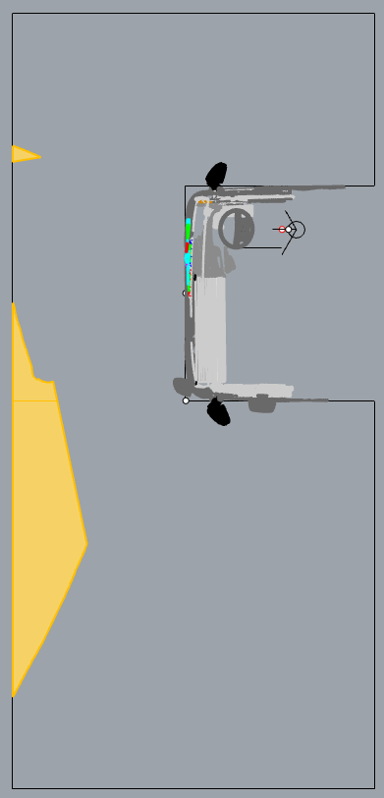
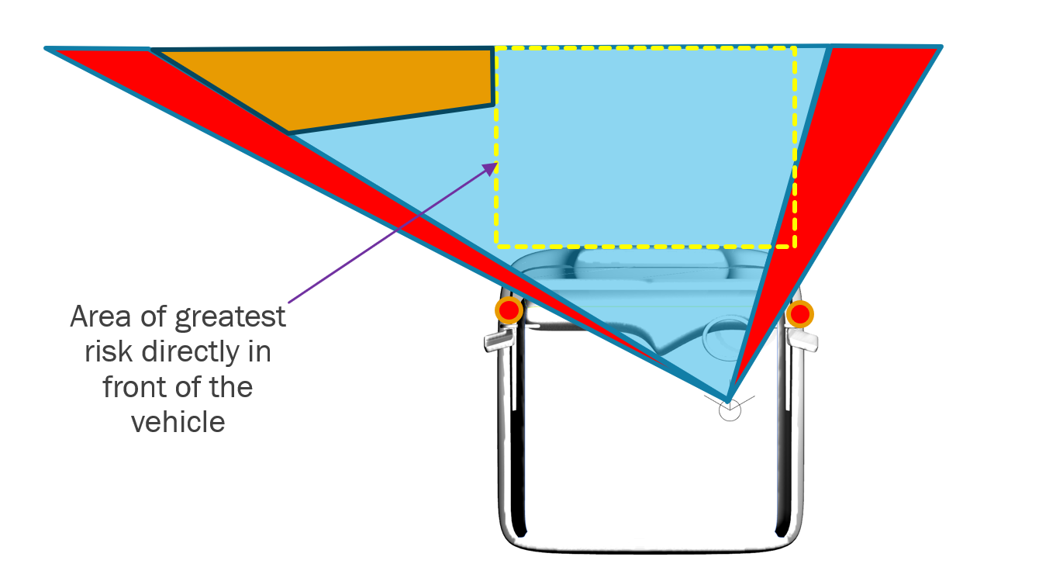
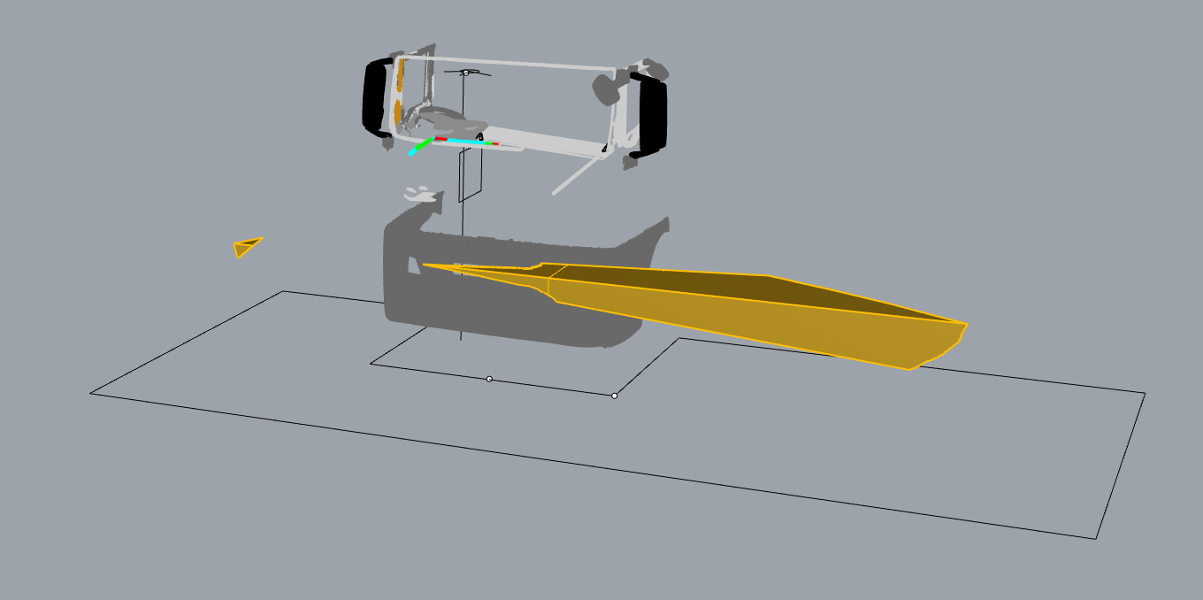
Concerns raised by manufacturer suggest design changes to meet the standard
Manufacturers (ACEA) have mentioned that lowering the Passenger side dashboard is an option for meeting the frontal requirements.
The analysis that we performed and showed below highlighted that this kind of design change would not improve direct vision directly in front of the vehicle, or the area of greatest risk for pedestrian VRUs.
Redesigned dashboard on the passenger side
Orange areas show volume gained outside of area of greatest risk for frontal collisions, potentially allowing a vehicle to pass the minimum requirements without improving direct vision directly in front of the vehicle in the area of greatest risk.

Slide 4
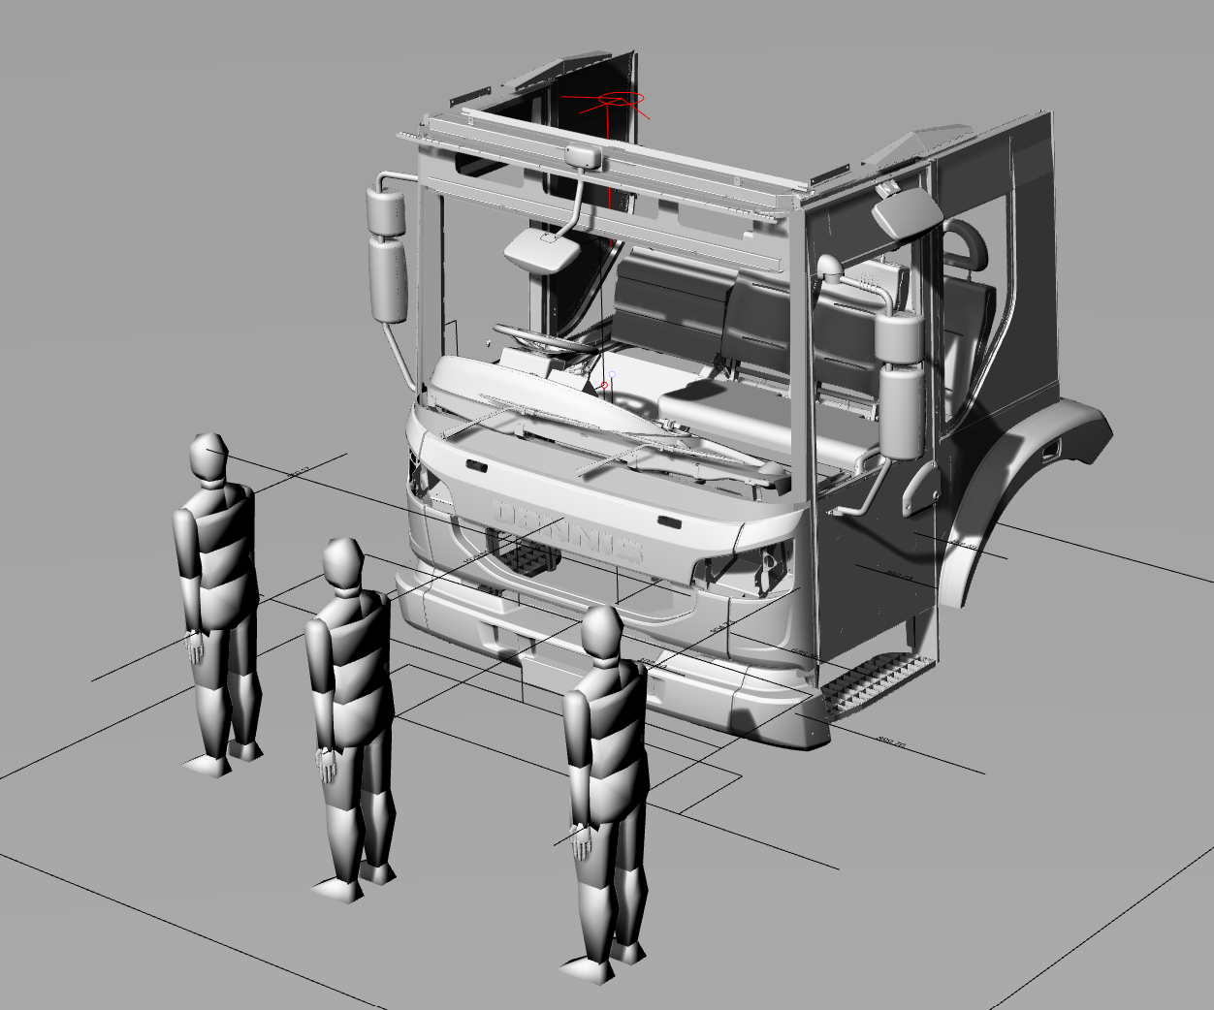
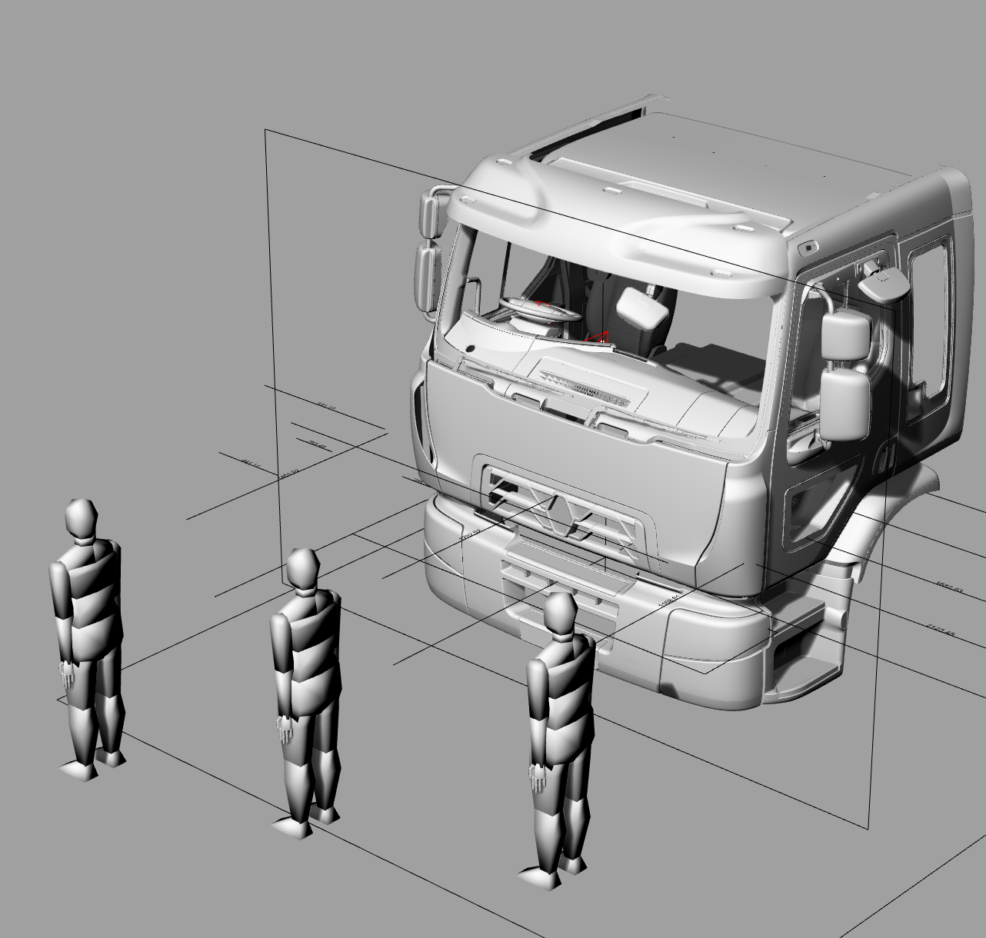
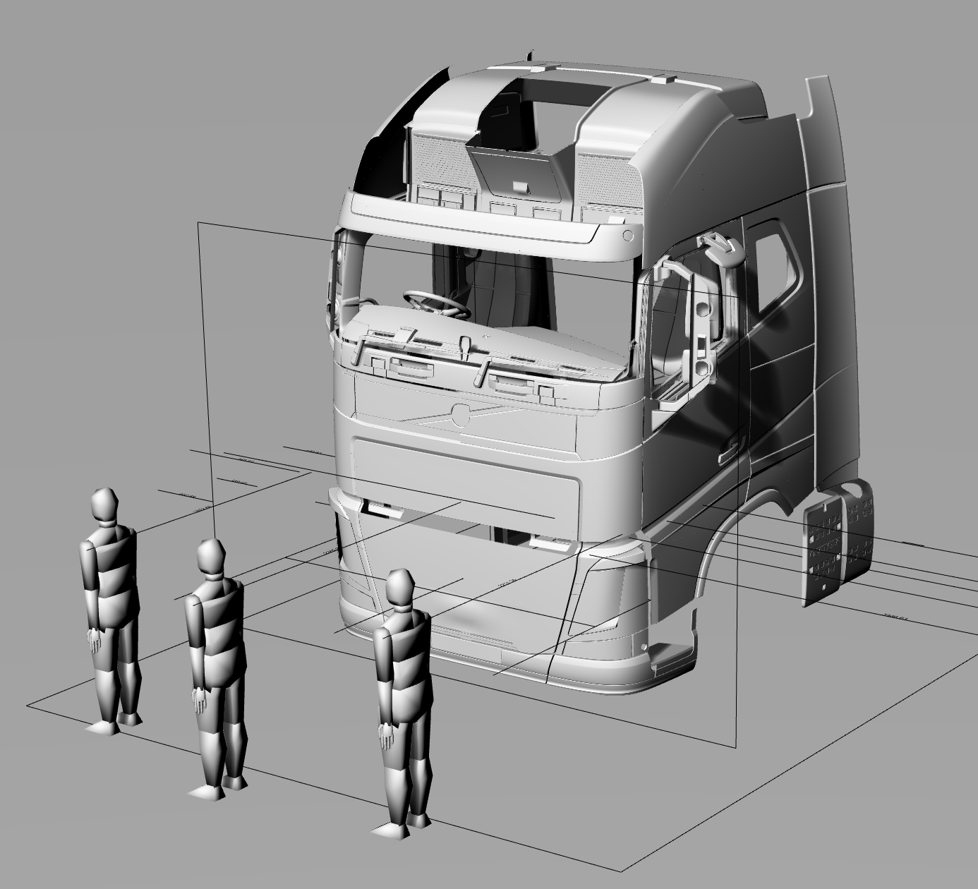
the premise that established the method used for UNECE regulation 167
Excellent
Good
As discussed in numerous VRU Proxi Group meetings, the basic premise of UNECE Regulation 167 is that the volumetric approach is given real world context using VRU simulations and the distance from the side and front of the vehicle at which the head of the VRUs can be seen.
For the front of the vehicle this involves the use of the three VRUs that placed directly in front of the vehicle to highlight the area of greatest risk established in the accident data analysis which supported the DVS design.
  The driver should be able to see the VRU approaching the vehicle, and allow the VRU to be seen when they are walking directly in front of the cab where possible.
  The Series 00 method defined average frontal average VRU distances of 1653mm for Level 1 and 1958mm for levels 2 and 3
The content above does highlight that the intent of the standard is potentially not being met in its current form as the required volume that should be visible to the front is defined by the distance at which 3 VRUs are visible (half head), but the ACEA suggested design changes to meet the volume requirements would not allow visibility of these VRUs
Pass

Slide 5
the premise that established the method used for UNECE regulation 167
Tech Neutrality
We therefore designed a new method to ensure that the intent of the standard (to allow the VRUs in front of the vehicle to be seen) as per the content in the next three sides.

Slide 6
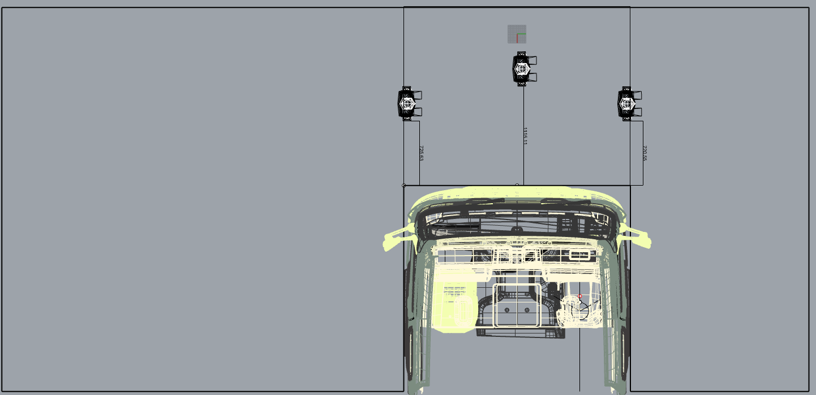
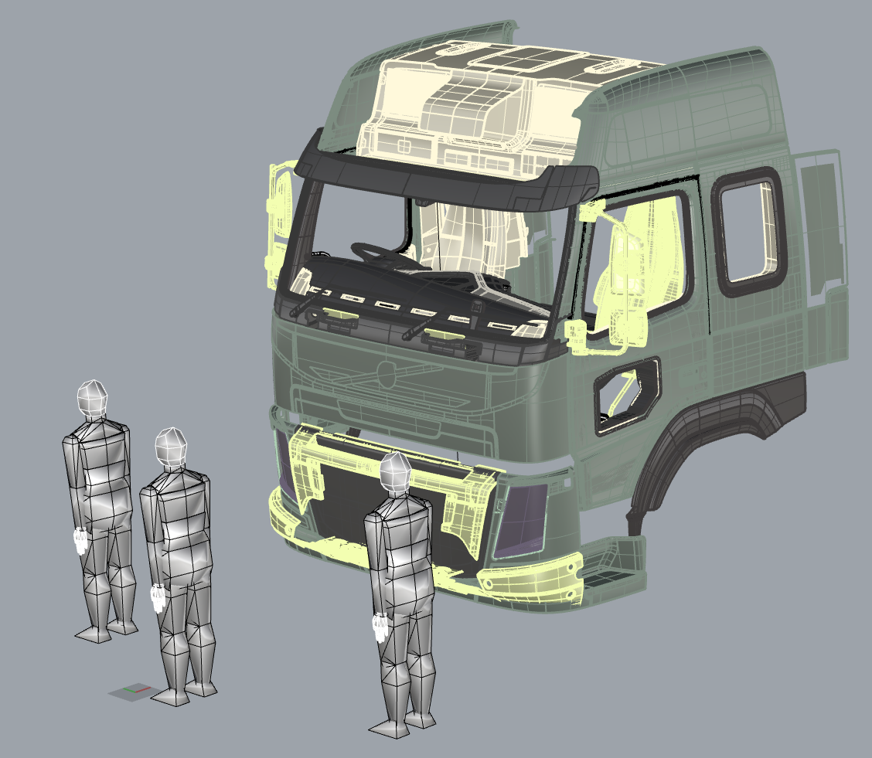
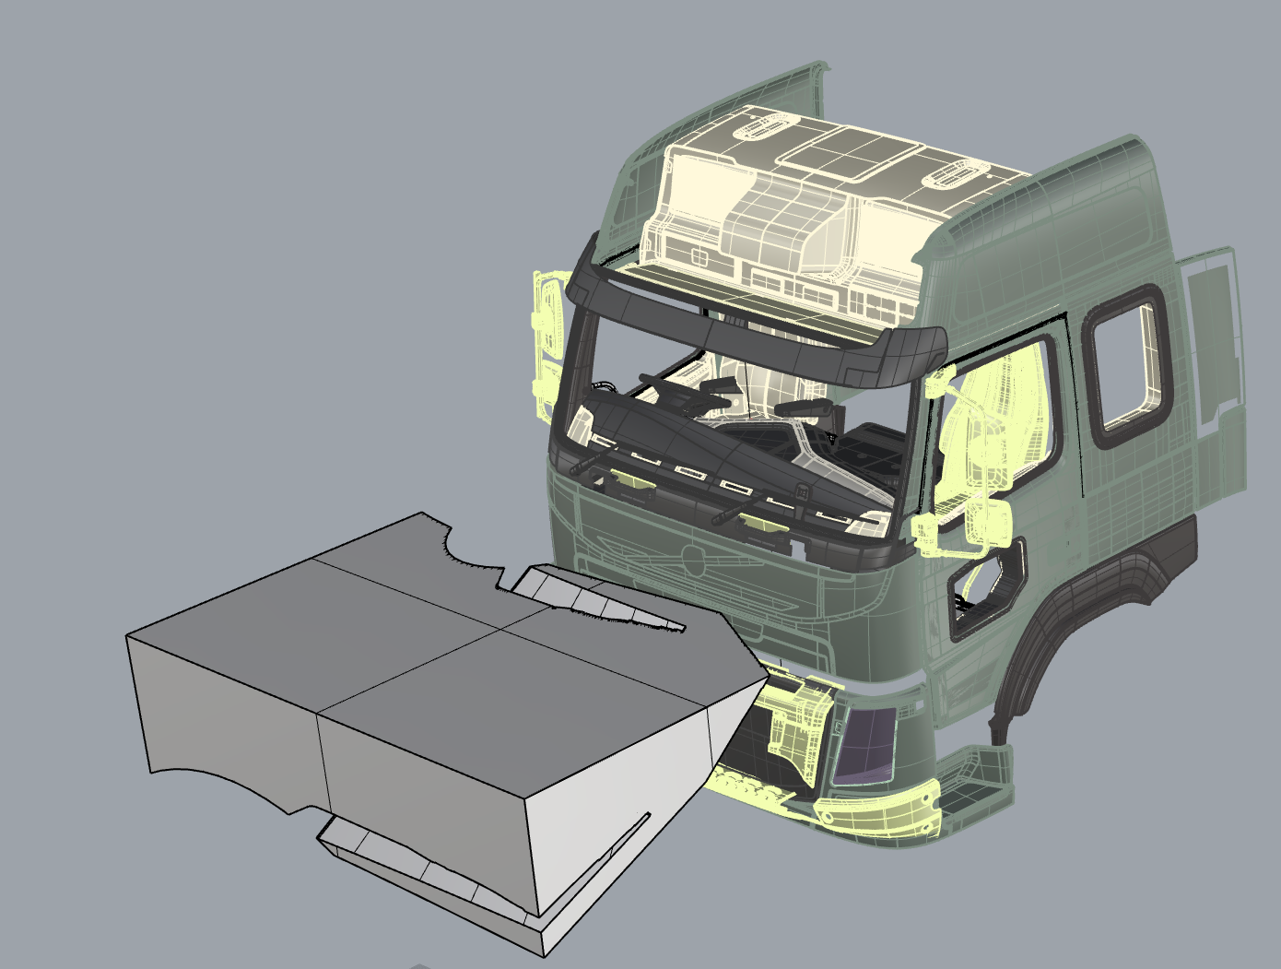
How can we ensure equivalence between the two methods?
The premise is as follows;
  What volume is equivalent to the need to see three VRUs directly in front of the vehicle?
  We needed a way to define a frontal volume
  We have taken the lateral extents of the vehicle to define the volume directly in front of the vehicle as this is the area that contains the three VRUs for the Series 00 method. We call this the Subsection Frontal Visible Volume (SFVV)
  Therefore plotting the VRU distance against the Volume gives a trend line that can be used to calculate the volume that should be seen at a certain VRU distance in the same way as the method used to define the volume requirement for the series 00 version
Three VRUs in front of the cab as defined in Series 00
Plan view of the area within which the VRUs are contained, therefore VRU distance should corelate well with volume as per the previous uses of this method
Volume that is visible between the lateral extents of the vehicle

Slide 7
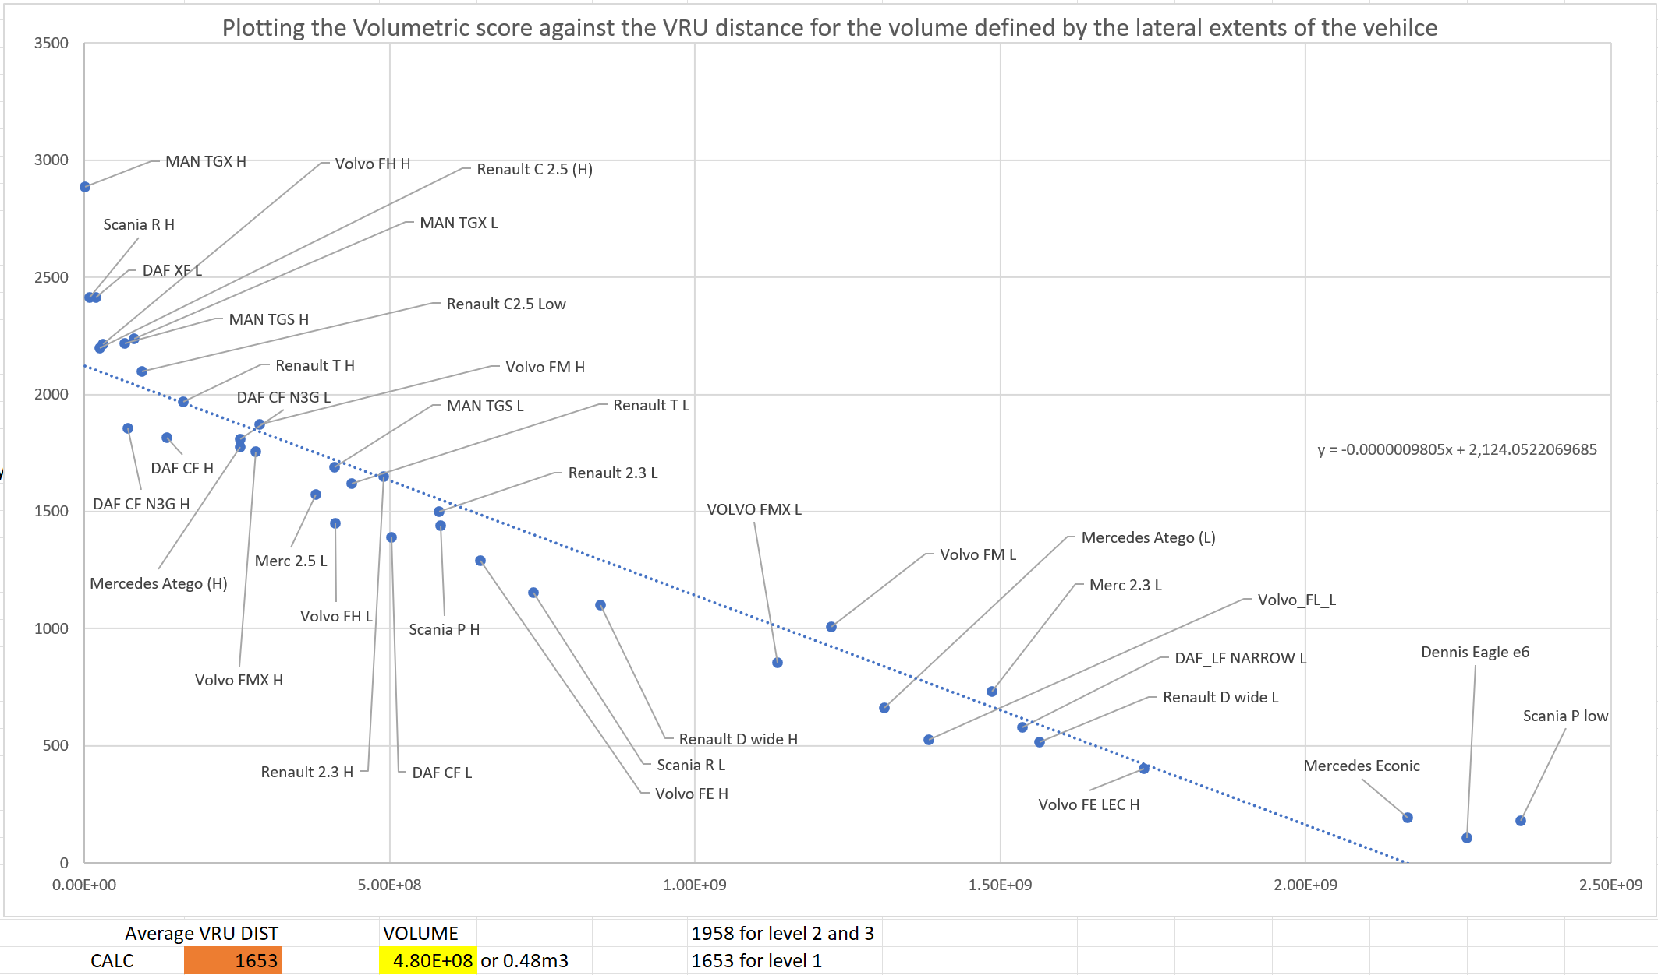
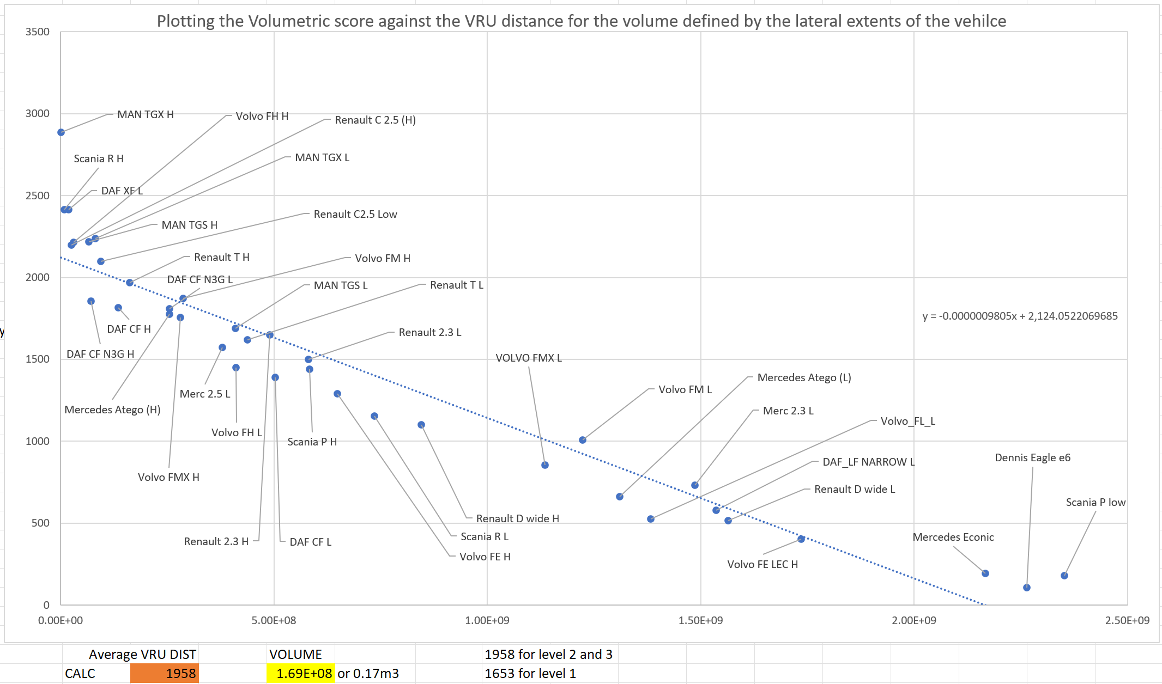
Calculating the SFVV volume requirements with a larger sample
Initially we had a sample of 15 vehicles in this analysis. We have subsequently increased this to 34 vehicles
The vehicles used are the same used to define the DVS volume requirements (no new vehicle designs since 2018)
  As an indicative value for review by manufactures based upon the VRU distances agreed in the Series 00 version table
    Level 1 vehicles (urban) would need to be able to see 0.48m³ in the FEV area (average VRU distance 1653mm)
    Level 2 (construction) and 3 (long haul) vehicles would need to be able to see 0.17m³ in the SFVV area (average VRU distance 1958mm)
  These values are a slight increase compared to the 15 vehicle sample

Slide 8

Addressing the concerns
By requiring a design to allow visibility of the Subsection Frontal Visible Volume (SFVV) area we can avoid the issue shown below.
Area of greatest risk directly in front of the vehicle
Original vehicle design
Redesign moves A-pillars rearwards
Red areas show volume gained outside of area of greatest risk for frontal collisions, potentially allowing a vehicle to pass the minimum requirements without improving direct vision directly in front of the vehicle.

Slide 9
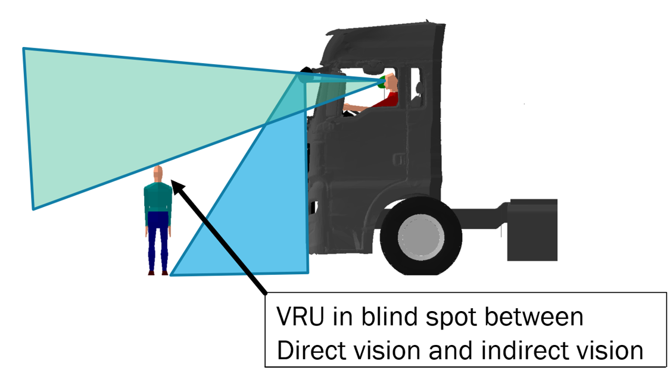
Addressing ACEA concerns raised at the 126th GRSG
One concern that was raised by ACEA at the 126th GRSG was the ability of the physical testing method to accurately measure the smaller limit for level 2 & 3 (new version 0.17m³) due to the tolerances that defined in the Reg 167 (0.1m³)
We would like to know if any work has been done with Type Approval Authorities to further develop the physical testing method? The physical testing method was a prototype which would require significant development with a considerable investment
This investment would seem unlikely as the digital method is much more cost effective
A simple solution would be to set a requirement of 0.2m³ for Level 2 and 3 vehicles, requiring at least 0.1m³ to be visible with the tolerance applied
The Digital test method is highly accurate and so we don't see a problem with this
Currently there are several cab designs which do not allow ANY SFVV volume to be seen

Slide 10
Summary
The volume required by the Series 00 version was defined by the use of VRUs directly in front of the vehicle.
It is clear that manufacturers are considering design interventions which will not allow the visibility of volume directly in front of the vehicle to be improved, e.g. ACEA have shown an option to lower the passenger side edge of the dashboard – which again improves direct vision outside of the area of greatest risk
We think that we need a solution to this issue and it would be possible with the content presented today to get an amendment into the standard quickly.
To be clear we propose that the existing frontal requirements be augmented with the requirement for a level 1 vehicle to see 0.48m³ of the SFVV
Level 2 and 3 vehicles should be able to see 0.17m³ (potentially 0.2m³ to allow for tolerance) of the SFVV area
We are happy to discuss

Slide 11
Project information
Thank you for your attention, are there any questions?
Dr Steve Summerskill (s.j.summerskill2@lboro.ac.uk)
Dr Russell Marshall
Dr Abby Paterson
Anthony Eland
Design Ergonomics Group
Loughborough Design School
Loughborough University
United Kingdom

