Slide 1

UNECE GRBP TFTA
TA-20-04
Summarized synthesis of the work done by the TAPP group
Tire Abrasion Post Processing
Full Synthesis is uploaded as per document TA-20-05

Slide 2
Agenda
Content of the test campaign
Analysis of the open road vehicle tyre abrasion test method
Analysis of the indoor drum tyre abrasion test method
Analysis of the correlation between the two methods
Next steps
2

Slide 3
Content of the test campaign
11 tires, including Summer, 3PMSF, M+S
4 tire size :
  155/65 R14, Load Index 75
  205/55 R16, Load Index 91 (SL) and 94 (XL)
  235/65 R17, Load Index 108 (XL)
  235/55 R 19, Load Index 105 (XL)
Test duplicated between vehicle and drum method
4 repetitions at each of the conditions
  On different drums (3 tbc)
  On 2 vehicle circuits, at 3 different T° (low, medium, high)
3

Slide 4
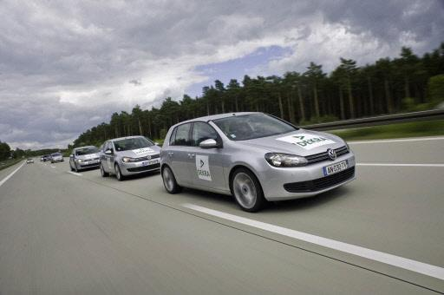
Analysis of the vehicle abrasion method
Items tested and analyzed :
T° sensitivity for summer, 3PMSF and M+S tires
Vehicle effects
Dispersion of the vehicle method
Effect of T° on abrasion index
Alignment between the two abrasion circuits
Improvements implemented
4

Slide 5
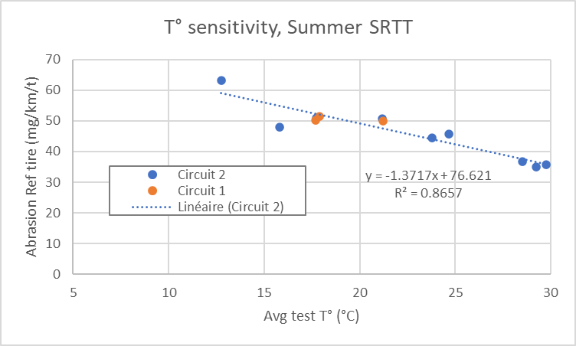
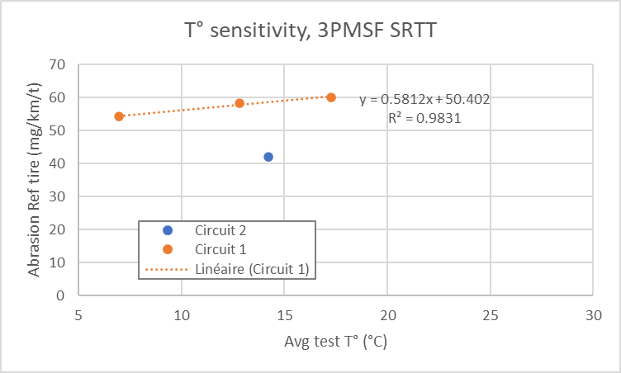
Reference tires
Comparison of circuits 1 & 2
For summer Ref tire on circuit 2: Abrasion rate decreases with temperature
  With current data, negligible circuit effect between these 2 circuits: Same abrasion level on both circuits for summer SRTT at temperature around 20 °C
For 3PMSF Ref tire, Abrasion rate increases with temperature
  Shift on the abrasion level between the 2 circuits for 3PMSF SRTT
More points are needed on Circuit 2, Circuit 1 and other circuits & vehicles to define the allowed range of circuit abrasiveness.
5

Slide 6
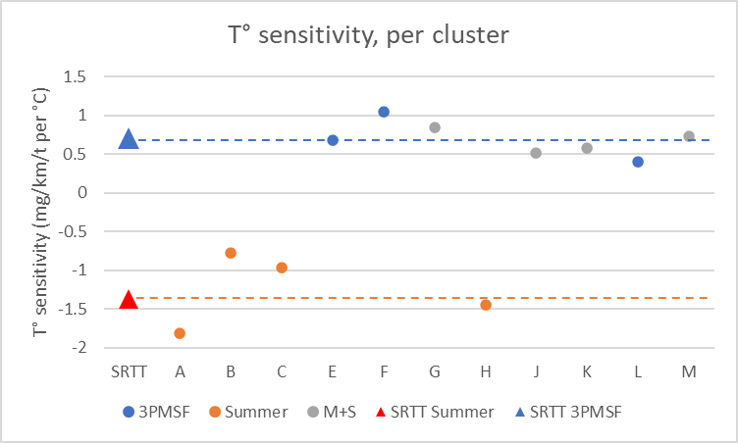
T° sensitivity per regulatory cluster
Reminder
The 3PMSF Ref tire is currently prescribed for the 3PMSF cluster
  (3 3PMSF in this test plan)
The Summer Ref tire is currently prescribed for the summer and M+S cluster clusters
  (4 M+S tires and 4 summer tires in this test plan)
We computed the T° sensitivity of each tire, and made the average per cluster
 | Average T° sensitivity (mg/km/t per °C) | Standard deviation (mg/km/t per °C)
Summer | -1.25 | 0.47
Ref summer | -1.37
 | Average T° sensitivity (mg/km/t per °C) | Standard deviation (mg/km/t per °C)
M+S | 0.67 | 0.15
3PMSF | 0.71 | 0.33
Ref 3PMSF | 0.71
M+S tires tested in this test campaign behaves like 3PMSF tires and not Summer tires
➔ a change of cluster for M+S tires is considered
6

Slide 7
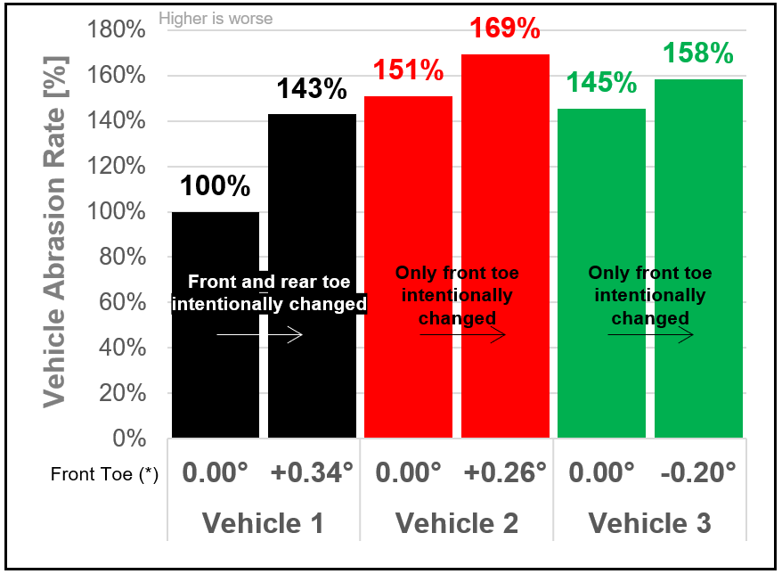
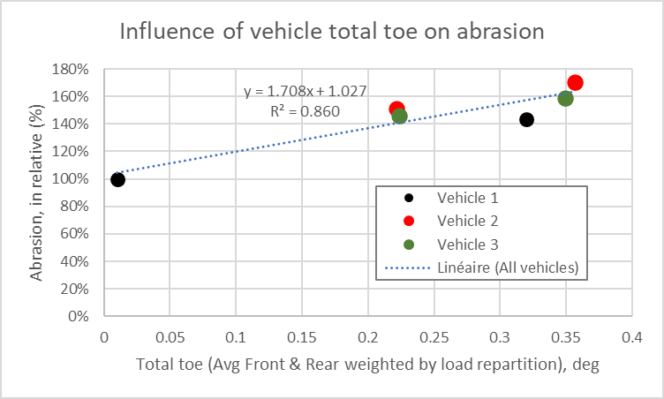
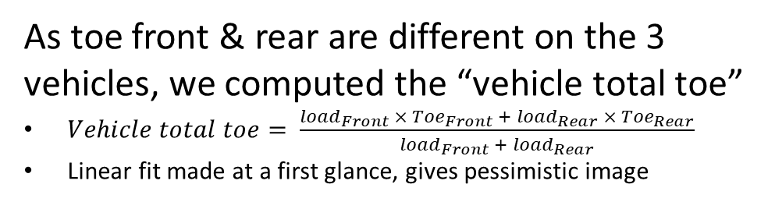
Analysis of vehicle effect
ETRTO additional results
  The tests results reveals a very significant impact of toe on abrasion.
    The effect seems to depend on the vehicle (if we look only front toe)
      As toe front & rear are different on the 3 vehicles, we computed the “vehicle total toe”
      $Vehicle total toe= \frac{{load}_{Front} × {Toe}_{Front} + {load}_{Rear} × {Toe}_{Rear}}{{load}_{Front} +{ load}_{Rear}}$
      Linear fit made at a first glance, gives pessimistic image
  New Recommended settings :
 | Front | Front | Rear | Rear
 | Toe (°) | Camber (°) | Toe (°) | Camber (°)
Loaded condition, reference vehicle | 0°± tol (*) | [-1.2° ; 0°] | [0.05°; 0.15°] | [-1.9° ; -0.6°]
Loaded condition, candidate vehicle | 0°± tol (*) | [-1.2° ; 0°] | [0.05°; 0.15°] | [-1.9° ; -0.6°]
Front | Front | Rear | Rear
Toe (°) | Camber (°) | Toe (°) | Camber (°)
0° ± tol (*) | 0° ± tol (*) | 0° ± tol (*) | 0° ± tol (*)
0° ± tol (*) | 0° ± tol (*) | 0° ± tol (*) | 0° ± tol (*)
7

Slide 8
Test dispersion of the vehicle method
Synthesis of the test dispersion on vehicle method coming from this campaign :
Case | Standard deviation (in abrasion index) | Expanded uncertainty 95% (±2σ) | Range (in abrasion index) | σ/range (in %)
Raw | σ = 0.200 | ± 0.40 | 1.10 | 18.2%
Raw, w/o M+S | σ = 0.154 | ± 0.31 | 0.88 | 17.6%
Estimated landing point if the assumptions adopted to emulate M+S in 3PMSF cluster (*) will be verified | σ = ~0.14 | ~± 0.28 | 1.23 | 11.3%
Estimated landing point, M+S emulated in 3PMSF cluster, without Peugeot 308 | σ = ~0.10 | ~± 0.20 | ~1.06 | ~9.8%
(*) Assumptions: Abrasion Ref 3PMSF = f(T°) from Circuit 1 data
The dispersion must be reassessed because significant improvements have been made in the vehicle method (M+S tire, vehicle settings), with expected good improvement of the dispersion
8

Slide 9
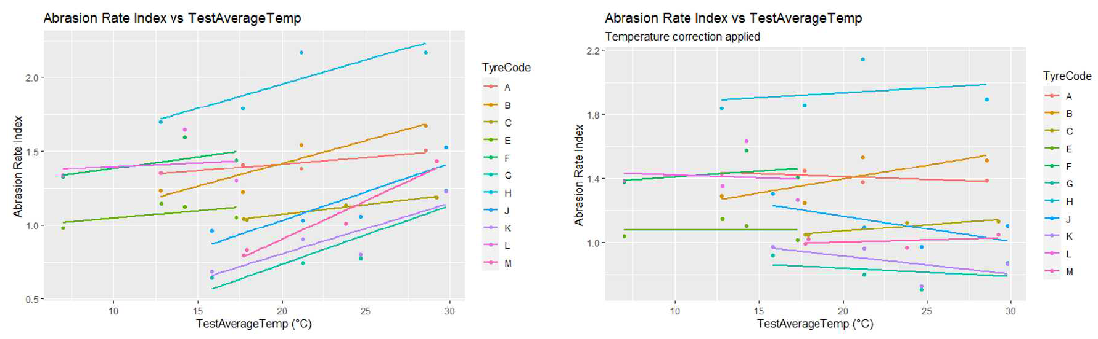
Analysis of T° effect on abrasion index
The abrasion index appears to be sensitive to T° variation, because abrasion rate evolves with T°
An improvement can be proposed, by correcting the abrasion rate before the index calculation
  Correction based on mean gradient of a group and difference to a reference T°
  Still some correlation for some tires after correction: if the tire have a different T° gradient than the one used for the correction, you still observe a T° effect
A significant improvement may be expected from this T° correction :
For vehicle method, a mean standard deviation for abrasion rate index of 0.11 instead of 0.2
  still using Sum SRTT as reference tire for M+S, and without consideration of the new vehicle settings limits
9

Slide 10
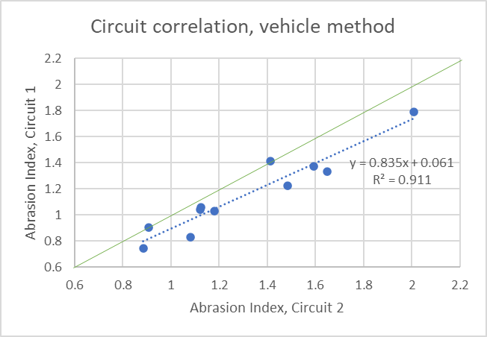
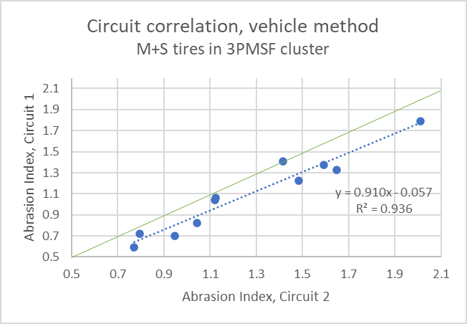
Alignment between vehicle circuits
Circuit alignment,
Emulation of M+S tires in 3PMSF cluster
Circuit alignment, all raw data
A very good alignment of the two circuits is observed
10

Slide 11
Synthesis of the vehicle method improvements
Improvement already validated :
M+S tires tested with 3PMSF ref tire
Improved vehicle settings limits
Improvements under study :
Computation of the range for the σ/range indicator
Temperature correction in the computation of the abrasion index
11

Slide 12
Agenda
Mandate of the TAPP group
Content of the test campaign
Analysis of the vehicle abrasion method
Analysis of the drum abrasion method
Analysis of the correlation between the two methods
Next steps
12

Slide 13
Analysis of the drum abrasion method
Items tested and analyzed :
Available drum data
SRTT 16’’ vs SRTT 17’’
Analysis of abrasion rate & abrasion index
Analysis of T° sensitivity & road surface
Dispersion of the drum method
Irregular wear
Improvements
13

Slide 14
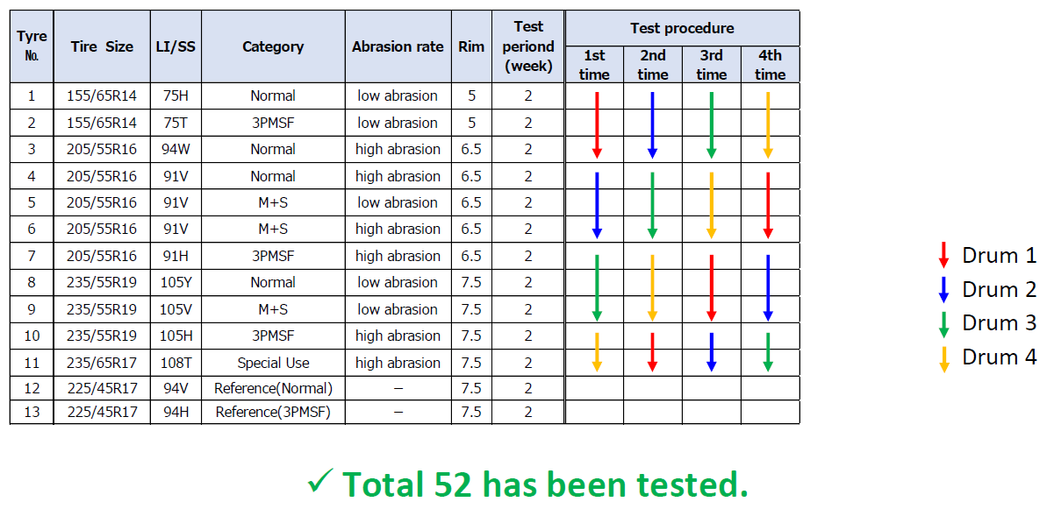
Drum available data
Test results of drum4 may not be usable due to a malfunction in the testing machine.
  The cause is still under analysis
Therefore, test data from other 3 test centers is considered for verification of indoor
1st repetition was performed with SRTT16. 2nd , 3rd , 4th repetition were performed with SRTT17.
Specific test to compare SRTT16 with SRTT17 was included during test campaign.
14

Slide 15
SRTT 16’’ vs SRTT 17’’
These data were used to convert abrasion index from the 1st repetition
Results from 3 testcenters
Results from 3 testcenters
15

Slide 16
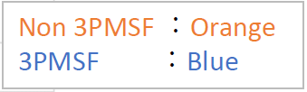
Analysis of the abrasion rate & index
Clear difference in abrasion rate per drum
The difference in abrasion rate between drums is canceled by computing the abrasion index, relative to the reference tire
16

Slide 17
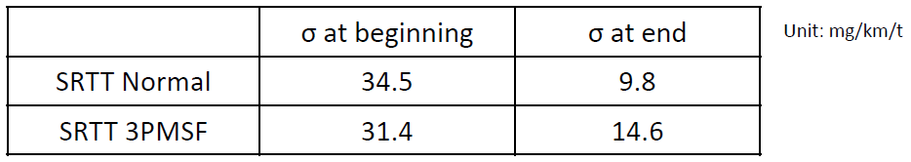
Limits of abrasion rate for Ref Tires
Within a replacement cycle of test surface, the dispersion of abrasion rate shows a decreasing trend from the beginning to end of the cycle.
We confirmed σ of abrasion rate at the beginning and the end of test surface cycle:
Considering the larger dispersion, the range is set as the abrasion rate at beginning +/-2σ .
In case of SRTT17 Normal, the abrasion rate of the reference tyre : range from 50 mg/km/t to 190 mg/km/t.
In case of SRTT17 3PMSF, the abrasion rate of the reference tyre : range from 35 mg/km/t to 165 mg/km/t.
How can we reduce the abrasion rate range of the reference tyres?
17

Slide 18
T° and drum surface effect
No significant linear effect observed between the abrasion rate index and temperature
No significant linear effect observed between the ref. abrasion rate and temperature for the 3 ref patterns
No significant effect observed between sandpaper grit 80 and a realistic surface
18

Slide 19
Dispersion of the drum method
Test Temp: all
Drum Surface: all
Drums 1 to 3
Test Data: 39
Case | Standard deviation (in abrasion index) | Expanded uncertainty 95% (±2σ) | Range (in abrasion index) | σ/range (in %)
All tyres (39 data) | σ = 0.086 | ± 0.172 | 0.612 | 14.1%
w/o M+S (26 data) | σ = 0.103 | ± 0.206 | 0.392 | 26.4%
Estimated landing point if the assumptions adopted to emulate M+S in 3PMSF cluster (*) will be verified | σ = ~0.088 | ~± 0.176 | 0.649 | 13.6%
(*) Assumptions: conversion made using the 2 conversion factors
While applying the method as described, ETRTO drums (5-7) results seems to show a higher dispersion than drums 1 to 3
Case | Standard deviation (in abrasion index) | Expanded uncertainty 95% (±2σ) | Range (in abrasion index) | σ/range (in %)
Raw | σ = 0.200 | ± 0.40 | 1.10 | 18.2%
Raw, w/o M+S | σ = 0.154 | ± 0.31 | 0.88 | 17.6%
Estimated landing point if the assumptions adopted to emulate M+S in 3PMSF cluster will be verified | σ = ~0.14 | ~± 0.28 | 1.23 | 11.3%
Vehicle method (reminder)
19
Note: ratio dispersion / range should be reassessed with market assessment results which will give the best evaluation of the range.

Slide 20
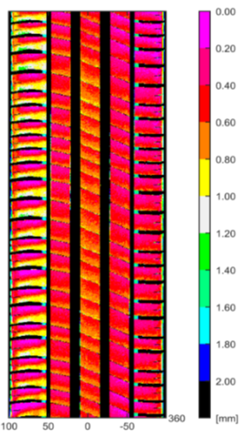

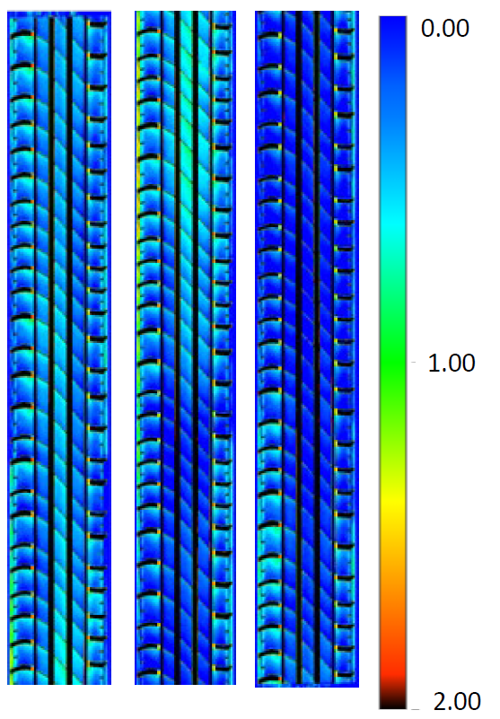
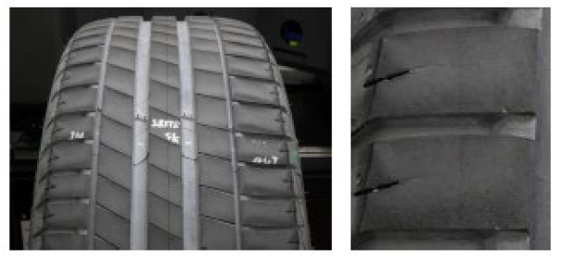
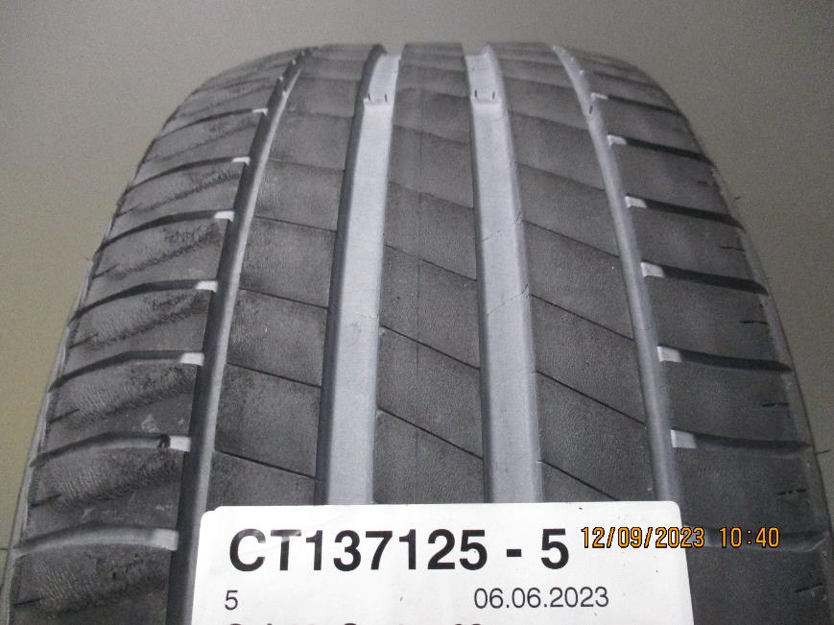
Tyre wear on drum test methods.
ETRTO
JASIC
Irregular Wear (heel & toe) was found on many tires on drum tested by ETRTO.
Example SRTT 17’’ (Drum 5)
Irregular Wear was not observed in JASIC drum.
Example 225/45R17 94V XL (Drum 1)
Heel and Toe wear was found on all the ETRTO drum results (More irregular wear on summer tires)
Further analysis is ongoing
20

Slide 21
Improvements of the drum method
4 improvements of the drum method have been implemented :
Changing the reference tires from SRTT 16’’ to SRTT 17’’
Definition of the limits of abrasion rate on Reference Tire to validate a drum test
De-gumming : limitation of the 3rd body nature (powder) to only 2 types : Talc or Silica
Split the drum surface roughness indicator into 2 indicators (macro roughness, micro roughness),
  with an allowed range for each
Some other improvements have been proposed :
Define limits of flow rate for 3rd body (de-gumming system)
Update load and pressure of the tire to improve the correlation with vehicle method
Update the forces animation (longitudinal and lateral) to improve the correlation with vehicle method
21

Slide 22
Agenda
Mandate of the TAPP group
Content of the test campaign
Analysis of the vehicle abrasion method
Analysis of the drum abrasion method
Analysis of the correlation between the two methods
Next steps
22

Slide 23
Analysis of the correlation between the two methods
Sometimes the abrasion rate indexes are very similar, sometimes more difference
Larger average standard deviation for vehicle method Could partly be explained due to temperature effect
A larger range of temperature was
tested for the vehicle method
Need to check with the market assessment generated data if this is improved with the better test method definitions
23

Slide 24
Agenda
Mandate of the TAPP group
Content of the test campaign
Analysis of the vehicle abrasion method
Analysis of the drum abrasion method
Analysis of the correlation between the two methods
Next steps
24

Slide 25
Next steps
New validation/correlation campaign in 2024 (in parallel to Market Assessment)
  Evaluate vehicle method and drum method improvement proposals
  Updated dispersion and correlation results, because the methods have been updated since 2023
Improvement of metrics :
  Dispersion of the methods is a key indicator
  σ / range is a good metric to compare methods, but range is sensitive to outliers
    Several ways to improve the indicator have been proposed
Analysis of the T° corrected criteria for the vehicle method
Analysis of the irregular wear on drums 1 to 3
Definition of the correlation criteria and threshold for the next correlation campaign
25

Slide 26
Thank you for your attention

