Slide 1

UNECE GRBP TFTA
Synthesis of the work done by the TAPP group
Tire Abrasion Post Processing

Slide 2
Agenda
Mandate of the TAPP group
Content of the test campaign
Analysis of the open road vehicle tyre abrasion test method
Analysis of the indoor drum tyre abrasion test method
Analysis of the correlation between the two methods
Next steps
2

Slide 3
Mandate of the TAPP group
Scope and mandate
  Establish the test dispersion value for the vehicle method
  Establish the test dispersion value for the drum method
  Define the criteria and conclude on the correlation between drum method and vehicle method
  To identify out of the data whether some boundary conditions need to be reviewed
Deliverables to TFTA
  Documented synthesis of the analysis with detailed description of the analysis and the conclusion, with illustrative graphs
3

Slide 4
Content of the test campaign
11 tires, including Summer, 3PMSF, M+S
4 tire size :
  155/65 R14, Load Index 75
  205/55 R16, Load Index 91 (SL) and 94 (XL)
  235/65 R17, Load Index 108 (XL)
  235/55 R 19, Load Index 105 (XL)
Test duplicated between vehicle and drum method
4 repetitions at each of the conditions
  On different drums (3 tbc)
  On 2 vehicle circuits, at 3 different T° (low, medium, high)
4

Slide 5
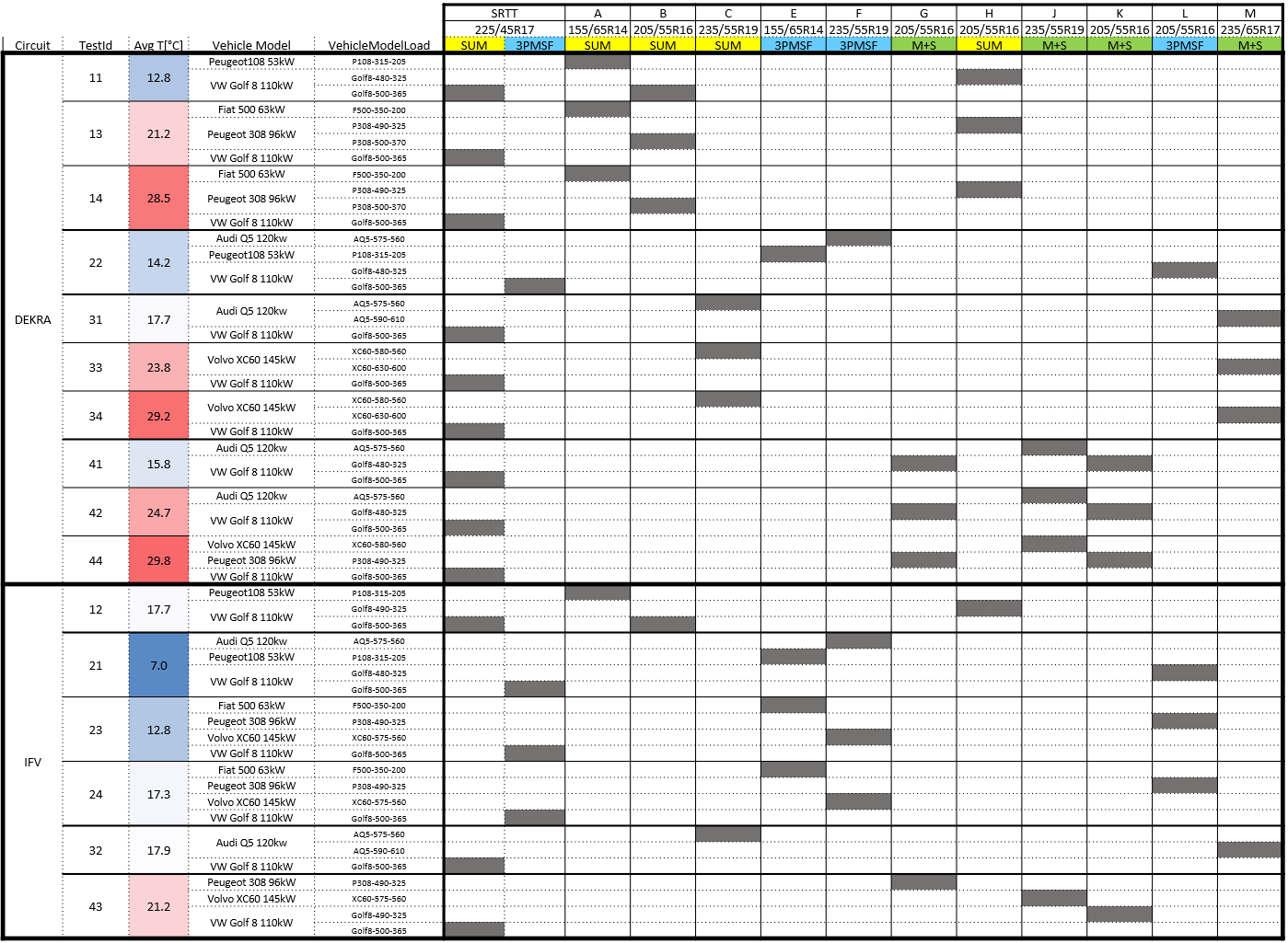
11 Candidate Tyres
Different dimensions/car segment
Different tyres application:
  4 SUM
  3 WIN (3PMSF)
  4 A/S (M+S only)
SL/XL
Low and High estimated abrasion
2 Reference Tyres:
SUM SRTT (for SUM and A/S tyres)
WIN SRTT (for WIN tyres)
4 Test Repetitions
4 different temperatures in combination with different vehicles on 2 circuits
Temp Sensitivity (*)
…
Circuit 2
Temp Sensitivity (*)
Temp Sensitivity (*)
Same tires on the 2 circuits (sometimes at different conditions)
Circuit 1
Temp Sensitivity (*)
5

Slide 6
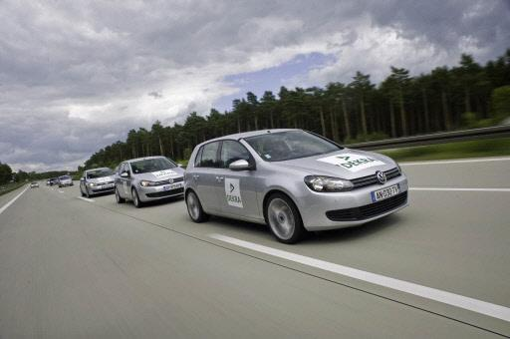
Analysis of the vehicle abrasion method
Agenda :
T° sensitivity for summer, 3PMSF and M+S tires
Vehicle effects
Dispersion of the vehicle method
Effect of T° on abrasion index
Alignment between the two abrasion circuits
Improvements implemented
6

Slide 7
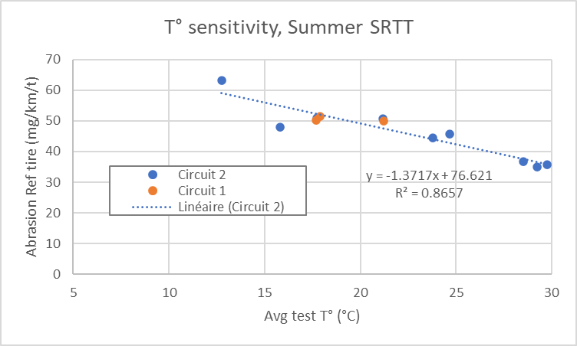
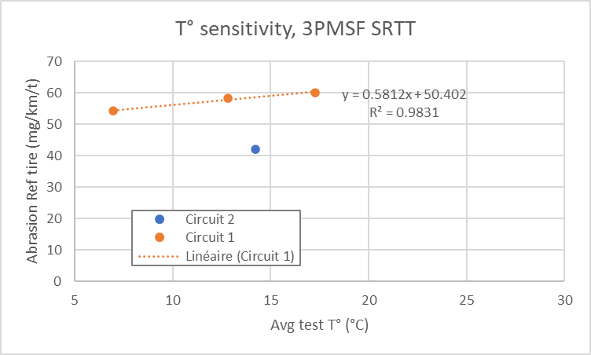
Reference tires
Comparison of circuits 1 & 2
For summer Ref tire on circuit 2: Abrasion rate decreases with temperature
  With current data, negligible circuit effect between these 2 circuits: Same abrasion level on both circuits for summer SRTT at temperature around 20 °C
For 3PMSF Ref tire, Abrasion rate increases with temperature
  Shift on the abrasion level between the 2 circuits for 3PMSF SRTT
More points are needed on Circuit 2, Circuit 1 and other circuits & vehicles to define the allowed range of circuit abrasiveness
7

Slide 8
T° sensitivity for candidate tires
The abrasion rate of the 4 summer tyres and the SumSRTT show very similar temperature gradients
• Small variations in gradient per tyre
Similar temperature gradients for 3PMSF SRTT and 3PMSF candidate tires
• Small variations in gradient per tyre
M+S tyres more similar to 3PMSF SRTT than to Summer SRTT
8

Slide 9
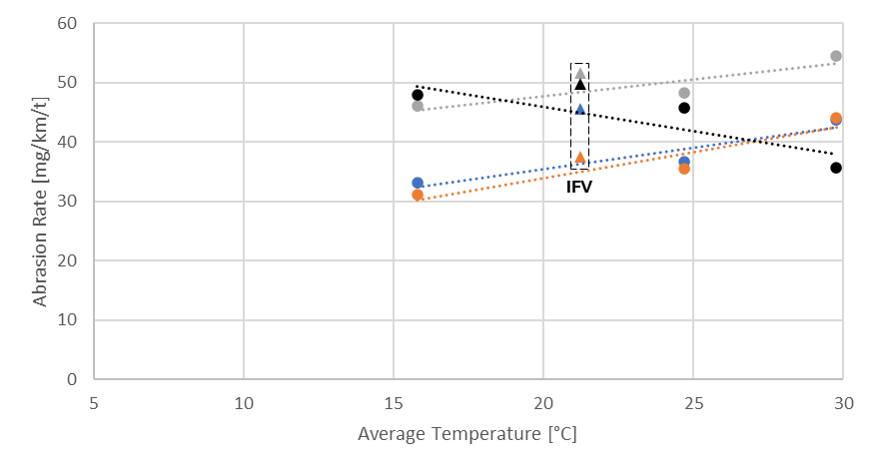
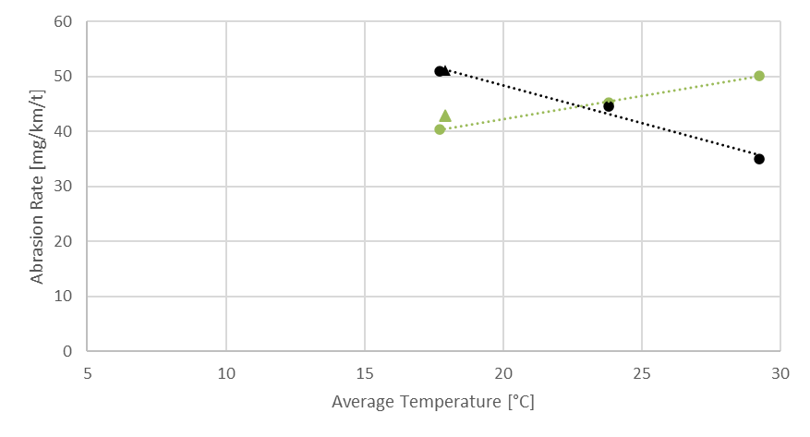
T° sensitivity for M+S tires
All tested M+S tyres showing inversion of abrasion index ranking vs summer SRTT because of the opposite sensitivity to temperature shown by M+S and summer tyres.
Ranking among tested M+S tyres roughly maintained on both circuits across the investigated temperature range, but rating in one case largely dependent on the circuit.
Circuit 1
Tire G
Tire J
Tire K
Tire M
SUM SRTT
Tire G
Tire J
Tire K
Tire M
Circuit 1
WORSE THAN SRTT
BETTER THAN SRTT
Circuit 1
Temperature sensitivity (slope) of M+S tyres tested on circuit 2 comparable, but opposite trend to Summer SRTT
No data to assess temperature sensitivity of M+S tyres on circuit 1.
3PMSF SRTT could be considered for M+S tyres
9

Slide 10
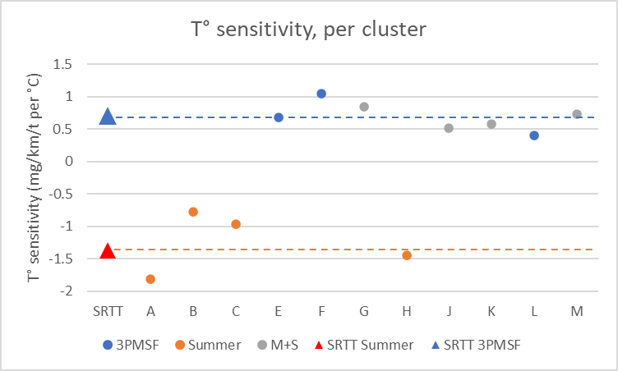
T° sensitivity per regulatory cluster
Reminder
The 3PMSF Ref tire is currently prescribed for the 3PMSF cluster
  (3 3PMSF in this test plan)
The Summer Ref tire is currently prescribed for the summer and M+S cluster clusters
  (4 M+S tires and 4 summer tires in this test plan)
We computed the T° sensitivity of each tire, and made the average per cluster
 | Average T° sensitivity (mg/km/t per °C) | Standard deviation (mg/km/t per °C)
Summer | -1.25 | 0.47
Ref summer | -1.37
 | Average T° sensitivity (mg/km/t per °C) | Standard deviation (mg/km/t per °C)
M+S | 0.67 | 0.15
3PMSF | 0.71 | 0.33
Ref 3PMSF | 0.71
M+S tires tested in this test campaign behaves like 3PMSF tires and not Summer tires
➔ a change of cluster for M+S tires is considered
10

Slide 11
Analysis of vehicle effect
Seems to be a difference in abrasion rate index for different vehicle models
Second graph is the difference with regards to the mean within one group of the sameTyre Code
11

Slide 12
Analysis of vehicle effect
        Big gap in rear toe between Golf and 308
        For the small vehicle, significant gap of Fiat 500 and Peugeot 108 vs Golf
          But Fiat 500 and Peugeot 108 are close in Rear Toe ➔ small visible vehicle effect
          With another vehicle, with smaller settings, we would have seen an effect vs F500 or P108.
 | % Weight total vs tyre capa | Total Front Toe | Camber LF | Camber RF | Total Rear Toe | Camber LR | Camber RR
Peugeot 308 | 65% | 0 | -0.60 | -0.47 | 0.69 | -1.53 | -1.42
Golf | 65% | 0 | -1.07 | -0.80 | 0.00 | -0.78 | -0.78
Fiat 500 | 71% | 0 | -1.21 | -1.62 | 0.58 | -0.84 | -1.38
Peugeot 108 | 67% | 0 | -0.75 | -1.15 | 0.45 | -0.78 | -0.63
Audi Q5 | 61% | 0 | -1.12 | -0.88 | 0.00 | -1.55 | -1.55
Volvo XC60 | 62% | 0 | -1.36 | -1.22 | 0.00 | -2.49 | -2.29
        Proposal : update the acceptable toe settings, to avoid such a situation
12

Slide 13
Analysis of vehicle effect
ETRTO additional results
  A test was made to evaluate the influence of different vehicles and different settings on abrasion
    Only FWD, same front & rear load
Test : 2 cars for each vehicle model with different alignment settings (toe mainly)
Test | (Winter Course - Average T=13.6°C)
Assessment Target | Vehicle Alignment Impact
 | Vehicle 1 | Vehicle 2 | Vehicle 3
Engine | ICE (Diesel) | ← | ←
Power | 110kW | 96kW | 85kW
Drive | FWD | ← | ←
Transmission | Automatic | ← | ←
Toe Front [°] | -0.01° → 0.32° | -0.02° → 0.24° | -0.05° → -0.2°
Toe Rear [°] | 0.01° → 0.32° | 0.52° → 0.53° | 0.48° → 0.57°
Load Front (kg) | 958 | 962 | 959
Load Rear (kg) | 650 | 649 | 649
Toe [°]
Camber [°]
Front
Rear
13

Slide 14
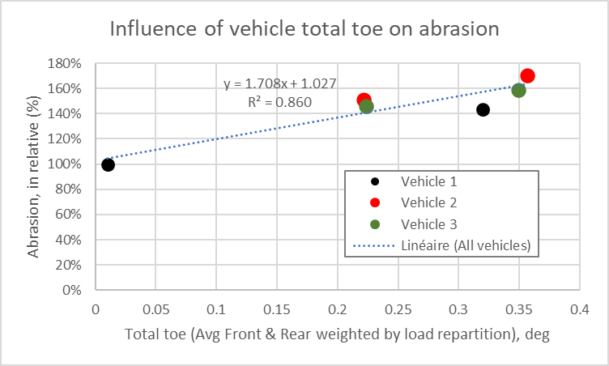
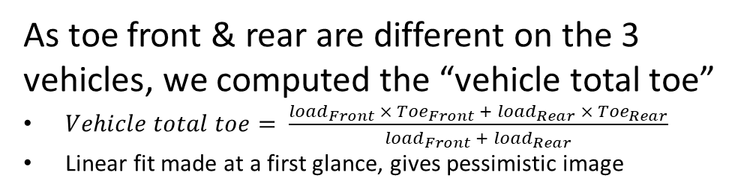
Analysis of vehicle effect
ETRTO additional results
  The tests results reveals a very significant impact of toe on abrasion.
    The effect seems to depend on the vehicle (if we look only front toe)
Higher is worse
      As toe front & rear are different on the 3 vehicles, we computed the “vehicle total toe”
      $Vehicle total toe= \frac{{load}_{Front} × {Toe}_{Front} + {load}_{Rear} × {Toe}_{Rear}}{{load}_{Front} +{ load}_{Rear}}$
      Linear fit made at a first glance, gives pessimistic image
Vehicle Abrasion Rate [%]
Front and rear toe intentionally changed
Only front toe intentionally changed
Only front toe intentionally changed
Front Toe (*)
      Vehicle total toe delivers significant coherence between all the results
      The other vehicle effects are much reduced vs raw data
14

Slide 15
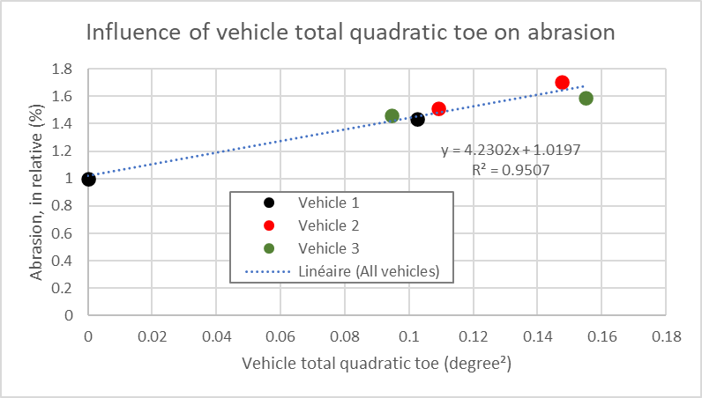

Analysis of vehicle effect
ETRTO additional results
  It is known that mass loss evolves as (tire force)²
  As force evolves linearly with toe (for small angles), abrasion is expected to be in toe²
      A more physical approach is to use toe² instead of toe
      ➔ We computed the “vehicle total quadratic toe”
      $Vehicle total quadratic toe= \frac{{load}_{Front} × {{Toe}_{Front}}^{2} + {load}_{Rear} ×{{Toe}_{Rear}}^{2}}{{load}_{Front} +{ load}_{Rear}}$
      Vehicle total quadratic toe give even better coherence between all the results
      Better regression on quadratic case than on linear case
      Physically justified approach
      Progress point : no points between 0 and 0.1 deg²
      Conclusion :
      Almost no remaining vehicle effects with quadratic toe
      ➔ There is no / few kinematic suspension effect, static toe is the main contributor to abrasion
15

Slide 16
Analysis of vehicle effect
New vehicle settings requirement
  Based on vehicle statistics :
  RWD vehicles : most of them can be tuned to 0° Toe & 0° Camber, Front & Rear
  FWD vehicle :
        All can be tuned at 0° Toe front
        Most of them cannot be tuned for Camber Front, Toe & Camber Rear
      FWD
      RWD
  New Recommended settings :
 | Front | Front | Rear | Rear
 | Toe (°) | Camber (°) | Toe (°) | Camber (°)
Loaded condition, reference vehicle | 0°± tol (*) | [-1.2° ; 0°] | [0.05°; 0.15°] | [-1.9° ; -0.6°]
Loaded condition, candidate vehicle | 0°± tol (*) | [-1.2° ; 0°] | [0.05°; 0.15°] | [-1.9° ; -0.6°]
Front | Front | Rear | Rear
Toe (°) | Camber (°) | Toe (°) | Camber (°)
0° ± tol (*) | 0° ± tol (*) | 0° ± tol (*) | 0° ± tol (*)
0° ± tol (*) | 0° ± tol (*) | 0° ± tol (*) | 0° ± tol (*)
(*) : Tolerance can differ for reference and candidate vehicle
NB : Toe & Camber are per wheel
  In case no vehicle can be found respecting these limits for a given candidate tire :
  An exception case has been described
  Wider tolerance on settings (max = 0.3° toe)
  But strict limit between settings of the candidate and reference vehicle (max delta = 0.1° for toe)
16

Slide 17
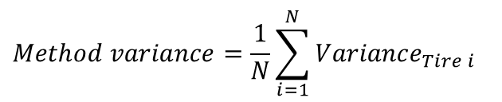
Test dispersion of the vehicle method
Test errors and test Dispersion are computed the following :
  For each tire, computation of the average of the index, for the 4 repetitions
  For each tire result (=the 4 repetitions), the error is the deviation of index vs tire averaged index
  Then we compute the variance of these errors, tire per tire
  The global variance of the method is the average of the variance per tire
Real abrasion index obtained with the test
4 errors values for tire 1
Average of tire 1 over all the available results
Variance tire 1
Variance tire 2
…
Variance tire N
Tire 1
Tire 2
…
Tire N
$$Method variance=\frac{1}{N}\sum_{i=1}^{N}{{Variance}_{Tire i}}$$
      tire abrasion index
$$Method Dispersion= \sqrt{Method variance}$$
17

Slide 18
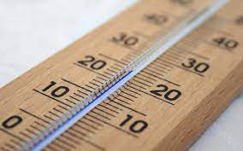



Test dispersion of the vehicle method
It is important to compare the test dispersion with the range of measurement :
  Range = Max abrasion – min abrasion, among a set of tires
E.g. The ratio “Dispersion / range” gives an image of the method precision
  A given precision on a big range is a better performance
  than the same precision on a small range
Pattern Code | Abrasion Index
A | 1.41
B | 1.42
C | 1.10
E | 1.08
F | 1.43
G | 0.85
H | 1.95
J | 1.14
K | 0.91
L | 1.41
M | 1.02
Dispersion
Big range
σ/range = 1°C/100°C = 1%
Min value
Small range
σ/range = 1°C/5°C = 20%
Max value
      T°
Today, the range could be calculated with only 11 tires of the validation test
  Same tires for the 2 methods, but maybe not the same range on the 2 methods
The real range of abrasion method will be known after market assessment
  A bigger range is expected, as much more tires will be measured.
The range calculation must be improved, because max & min are sensitive to outliers
  (e.g. taking 5-95 percentile instead of full range)
Range = Max-Min
= 1.95-0.85 = 1.1
18

Slide 19
Test dispersion of the vehicle method
Synthesis of the test dispersion on vehicle method coming from this campaign :
Case | Standard deviation (in abrasion index) | Expanded uncertainty 95% (±2σ) | Range (in abrasion index) | σ/range (in %)
Raw | σ = 0.200 | ± 0.40 | 1.10 | 18.2%
Raw, w/o M+S | σ = 0.154 | ± 0.31 | 0.88 | 17.6%
Estimated landing point if the assumptions adopted to emulate M+S in 3PMSF cluster (*) will be verified | σ = ~0.14 | ~± 0.28 | 1.23 | 11.3%
Estimated landing point, M+S emulated in 3PMSF cluster, without Peugeot 308 | σ = ~0.10 | ~± 0.20 | ~1.06 | ~9.8%
New line
(*) Assumptions: Abrasion Ref 3PMSF = f(T°) from Circuit 1 data
The dispersion must be reassessed because significant improvements have been made in the vehicle method (M+S tire, vehicle settings), with expected good improvement of the dispersion
19

Slide 20
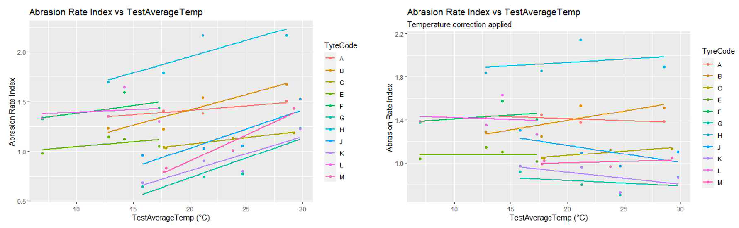
Analysis of T° effect on abrasion index
The abrasion index appears to be sensitive to T° variation, because abrasion rate evolves with T°
An improvement can be proposed, by correcting the abrasion rate before the index calculation
  Correction based on mean gradient of a group and difference to a reference T°
  Still some correlation for some tires after correction: if the tire have a different T° gradient than the one used for the correction, you still observe a T° effect
20

Slide 21
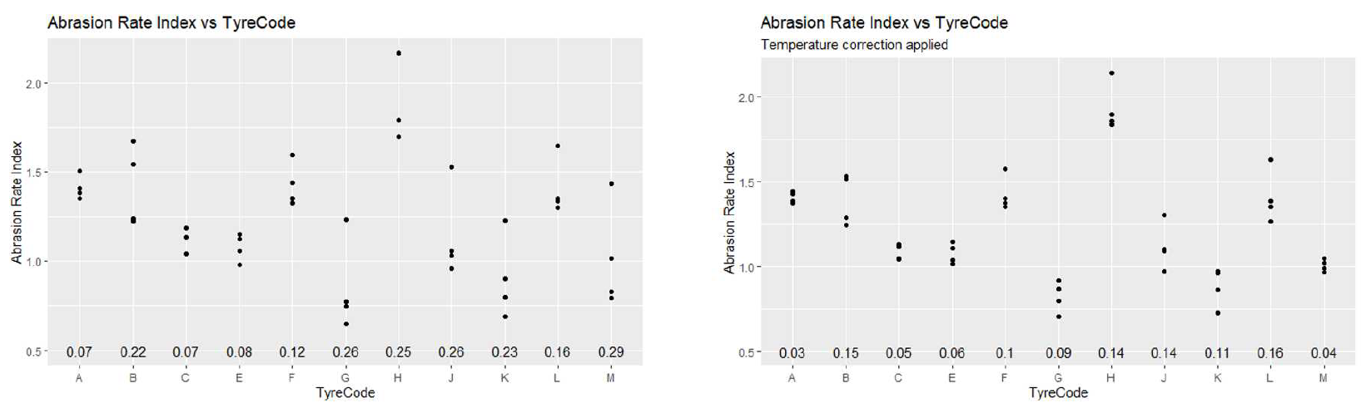
Analysis of T° effect on abrasion index
A significant improvement may be expected from this T° correction :
For vehicle method, a mean standard deviation for abrasion rate index of 0.11 instead of 0.2
  still using Sum SRTT as reference tire for M+S, and without consideration of the new vehicle settings limits
21

Slide 22
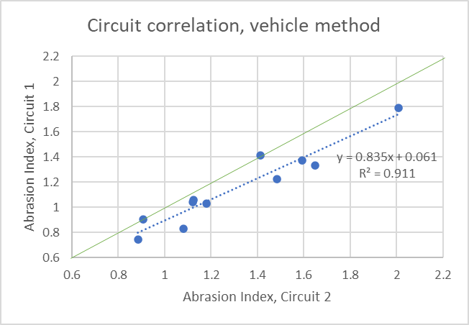
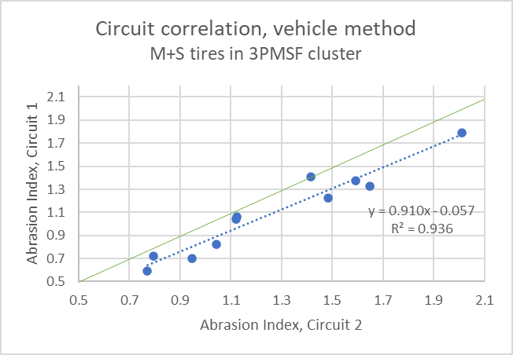
Alignment between vehicle circuits
A very good alignment of the two circuits is observed
Circuit alignment,
Emulation of M+S tires in 3PMSF cluster
Circuit alignment, all raw data
Very good correlation between the 2 circuits
22

Slide 23
Synthesis of the vehicle method improvements
Improvement already validated :
M+S tires tested with 3PMSF ref tire
Improved vehicle settings limits
Improvements under study :
Computation of the range for the σ/range indicator
Temperature correction in the computation of the abrasion index
23

Slide 24
Agenda
Mandate of the TAPP group
Content of the test campaign
Analysis of the vehicle abrasion method
Analysis of the drum abrasion method
Analysis of the correlation between the two methods
Next steps
24

Slide 25
Analysis of the drum abrasion method
Agenda :
Available drum data
SRTT 16’’ vs SRTT 17’’
Analysis of abrasion rate & abrasion index
Analysis of T° sensitivity & road surface
Dispersion of the drum method
Irregular wear
Improvements
25

Slide 26
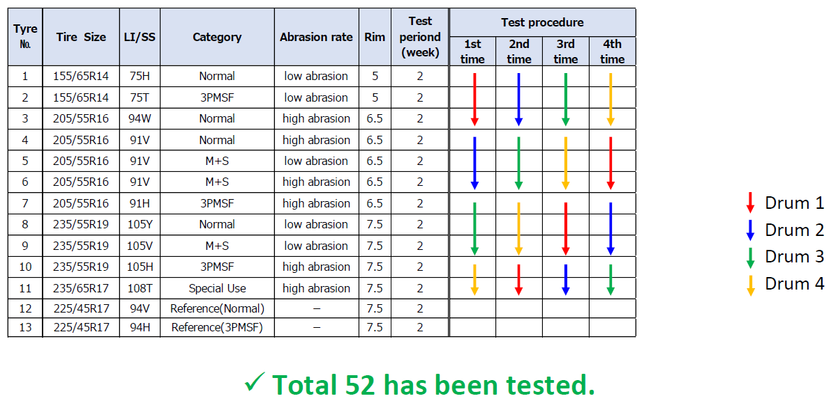
Drum available data
Test results of drum4 may not be usable due to a malfunction in the testing machine.
  The cause is still under analysis
Therefore, test data from other 3 test centers is considered for verification of indoor
1st repetition was performed with SRTT16. 2nd , 3rd , 4th repetition were performed with SRTT17.
Specific test to compare SRTT16 with SRTT17 was included during test campaign.
26

Slide 27
SRTT 16’’ vs SRTT 17’’
These data are used to convert abrasion index from the 1st repetition
Results from 3 testcenters
Results from 3 testcenters
27

Slide 28
Analysis of the abrasion rate & index
Clear difference in abrasion rate per drum
Drum testing shows a lot of variation, even vs vehicle test, and needs to be improved
28

Slide 29
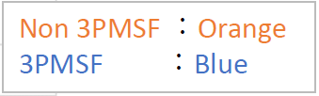
Analysis of the abrasion rate & index
The difference in abrasion rate between drums is canceled by computing the abrasion index, relative to the reference tire
29

Slide 30
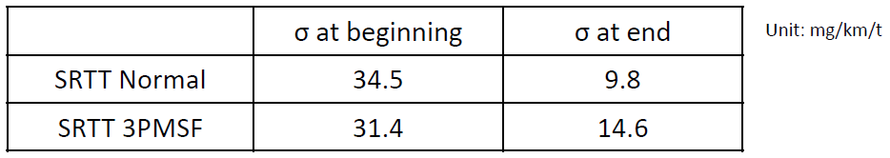
Limits of abrasion rate for Ref Tires
Within a replacement cycle of test surface, the dispersion of abrasion rate shows a decreasing trend from the beginning to end of the cycle.
We confirmed σ of abrasion rate at the beginning and the end of test surface cycle:
Considering the larger dispersion, the range is set as the abrasion rate at beginning +/-2σ .
In case of SRTT17 Normal, the abrasion rate of the reference tyre : range from 50 mg/km/t to 190 mg/km/t.
In case of SRTT17 3PMSF, the abrasion rate of the reference tyre : range from 35 mg/km/t to 165 mg/km/t.
How can we reduce the abrasion rate range of the reference tyres?
30

Slide 31
T° and drum surface effect
No significant linear effect observed between the abrasion rate index and temperature
No significant linear effect observed between the ref. abrasion rate and temperature for the 3 ref patterns
31

Slide 32
T° and drum surface effect
Most of test campaign has been performed with sandpaper #80 as drum surface.
Another drum surface* that simulated real road surface has been evaluated also.
  * an engineered road surface made of rigid hardened aggregates mixed by adhesive as simulation of asphalt pavement, with an MPD of approximately 1.4 mm
Same test results has been evaluated from different drum surfaces.
32

Slide 33
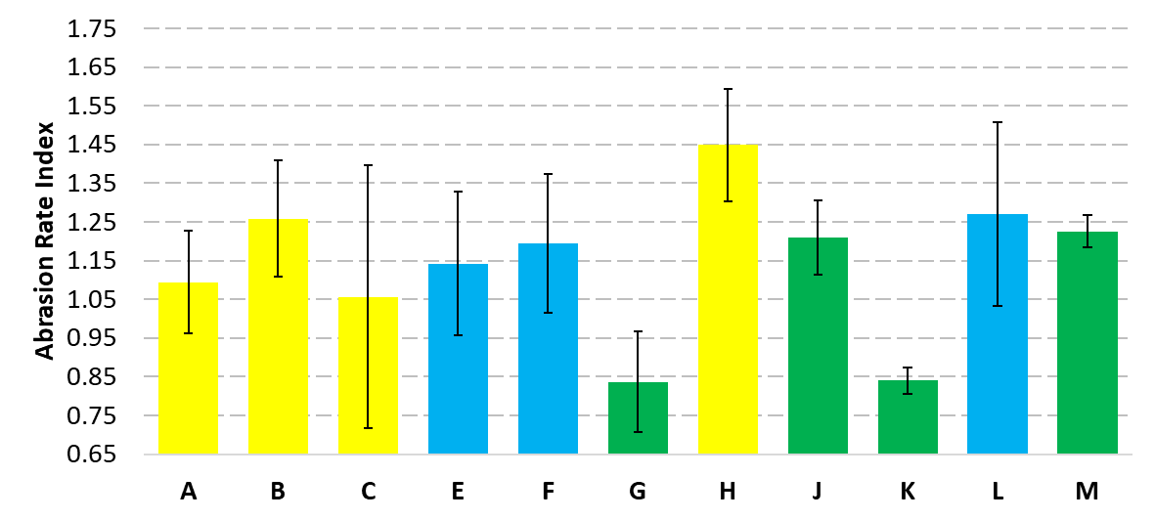
Dispersion of the drum method
Test Temp: all
Drum Surface: all
Test Data: 39
Candidate Tire | Reference Tire
SUM | SUM SRTT
A/S (M+S)
WIN (3PMSF) | WIN SRTT
Metric | ref. Abrasion Index
Method Dispersion | 0.086
Bar value calculated as average per each Tire Code
Error calculated as ±2σ per each Tire Code
Method dispersion = 0.086 ref. Abrasion Index
33

Slide 34
Dispersion of the drum method
Test Temp: all
Drum Surface: all
Drums 1 to 3
Test Data: 39
Case | Standard deviation (in abrasion index) | Expanded uncertainty 95% (±2σ) | Range (in abrasion index) | σ/range (in %)
All tyres (39 data) | σ = 0.086 | ± 0.172 | 0.612 | 14.1%
w/o M+S (26 data) | σ = 0.103 | ± 0.206 | 0.392 | 26.4%
Estimated landing point if the assumptions adopted to emulate M+S in 3PMSF cluster (*) will be verified | σ = ~0.088 | ~± 0.176 | 0.649 | 13.6%
(*) Assumptions: conversion made using the 2 conversion factors
Case | Standard deviation (in abrasion index) | Expanded uncertainty 95% (±2σ) | Range (in abrasion index) | σ/range (in %)
Raw | σ = 0.200 | ± 0.40 | 1.10 | 18.2%
Raw, w/o M+S | σ = 0.154 | ± 0.31 | 0.88 | 17.6%
Estimated landing point if the assumptions adopted to emulate M+S in 3PMSF cluster will be verified | σ = ~0.14 | ~± 0.28 | 1.23 | 11.3%
Vehicle method (reminder)
34
Note: ratio dispersion / range should be reassessed with market assessment results which will give the best evaluation of the range.

Slide 35
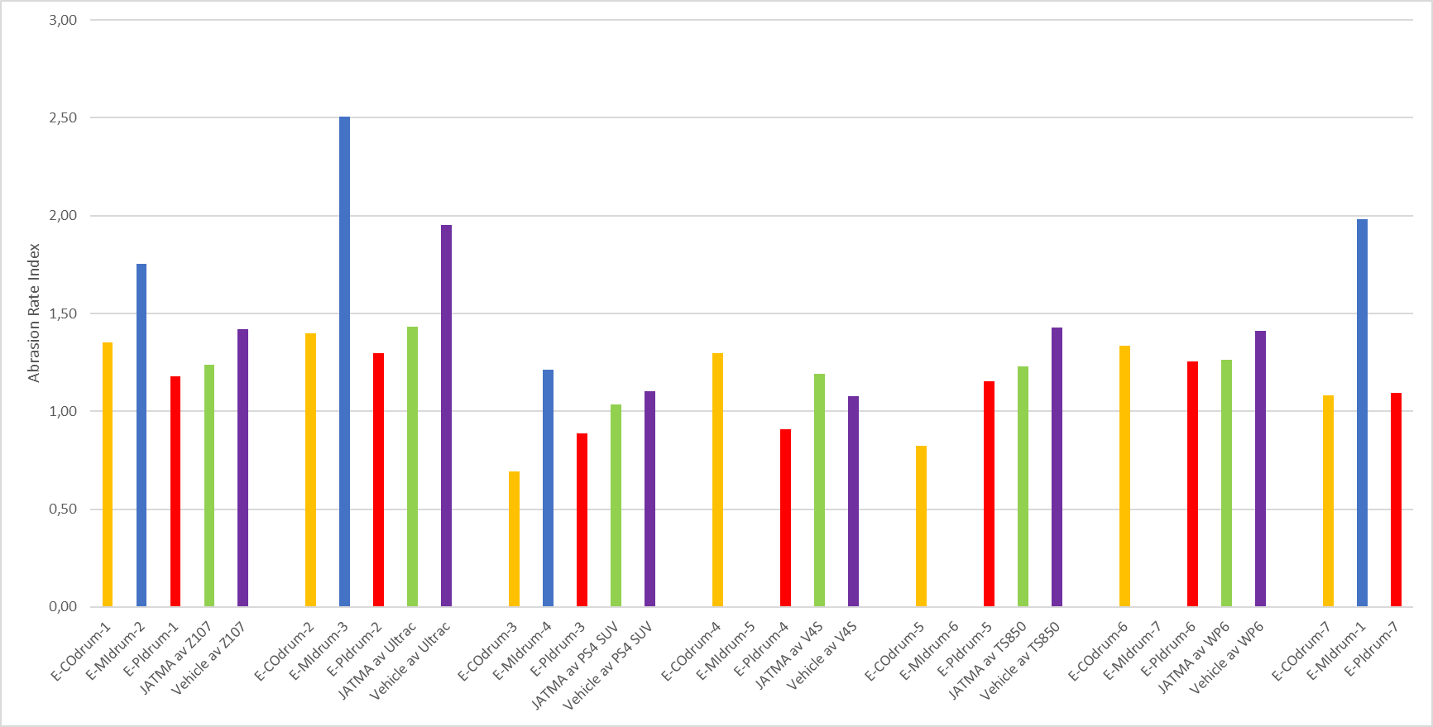
Dispersion of the drum method with ETRTO drums (drums 5 to 7)
Tire B
Tire H
Tire C
Tire E
Tire F
Tire L
Drum 5
Drum 6
Drum 7
Average Drum 1-3
Average Vehicle
While applying the method as described, ETRTO drums results seems to show a higher dispersion than drums 1 to 3
In particular, drum 6 seems to give very different results
35

Slide 36
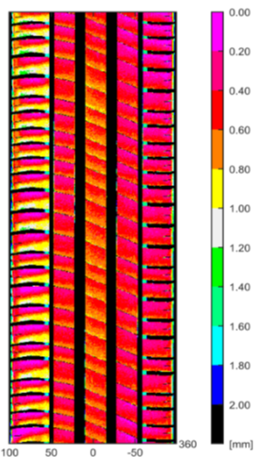

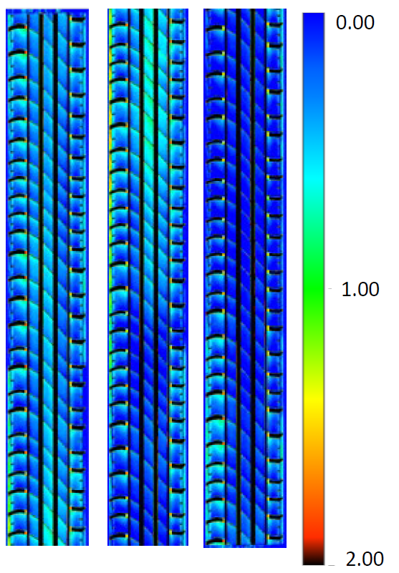
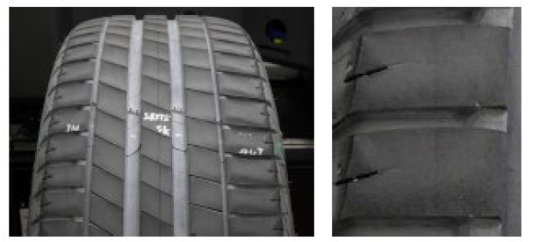
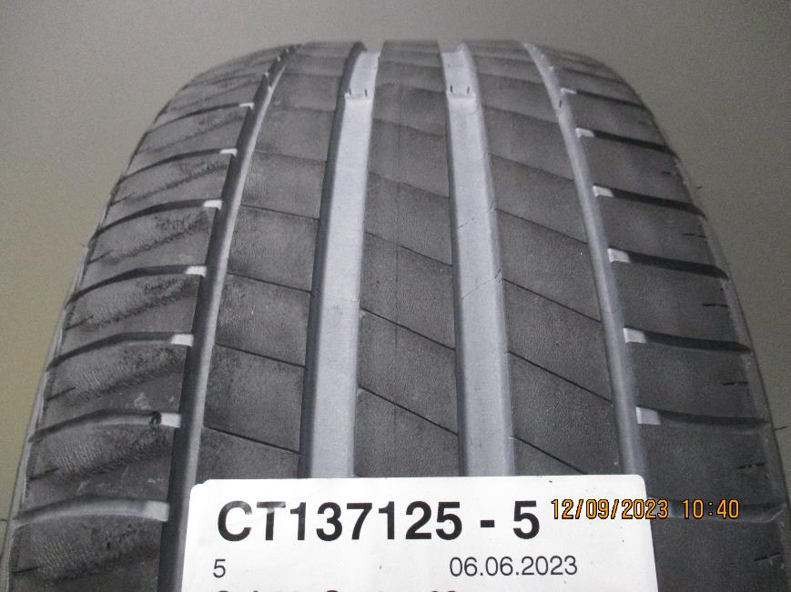
Tyre wear on drum test methods.
ETRTO
JASIC
Irregular Wear (heel & toe) was found on many tires on drum tested by ETRTO.
Example SRTT 17’’ (Drum 5)
Irregular Wear was not observed in JASIC drum.
Example 225/45R17 94V XL (Drum 1)
Heel and Toe wear was found on all the ETRTO drum results (More irregular wear on summer tires)
Further analysis is ongoing
36

Slide 37
Irregular wear on drum
Global synthesis on ETRTO drums :
Drum | Tire | Cluster | H&T | Evaluation
5 | SRTT 17'' Sum | Summer | 1 mm | high
5 | SRTT 17'' Win | 3PMSF | 0.8 mm | high
5 | ASTM 16'' SRTT | M+S | 1.2 mm | Severe
5 | B | Summer | 1.2 mm | Severe
5 | H | Summer | 1.2 mm | Severe
5 | C | Summer | 0.8 mm | high
5 | E | 3PMSF | 0.6 mm | medium
5 | L | 3PMSF | 0.6 mm | medium
5 | F | 3PMSF | 0.6 mm | medium
6 | SRTT 17'' Sum | Summer | 0.7 mm | high
6 | ASTM 16'' SRTT | M+S | > 1 mm | Severe
6 | B | Summer | 1 mm | high
6 | H | Summer | 0.8 mm | high
6 | C | Summer | 0.7 mm | high
TyreID | Max Outside | Max Inside | AVG | IW
Drum7-1- Tyre B | 0.74 | 0.45 | 0.60 | High IW
E-Drum7-1 SumSRTT | 0.6 | 0.67 | 0.64 | Medium IW
E-Drum7-2 Tyre H | 0.92 | 0.45 | 0.69 | High IW
E-Drum7-2 SumSRTT | 0.85 | 1.03 | 0.94 | High IW
E-Drum7-3- Tyre C | 1.02 | 0.94 | 0.98 | Severe IW
E-Drum7-3-SumSRTT | 1.02 | 0.94 | 0.98 | Severe IW
E-Drum7-4- Tyre E | 0.42 | 0.33 | 0.38 | Medium IW
E-Drum7-4 WinSRTT | 0.55 | 0.67 | 0.61 | Medium IW
E-Drum7-5 Tyre F | 0.51 | 0.52 | 0.52 | Medium IW
E-Drum7-5 WinSRTT | 0.61 | 0.66 | 0.64 | High IW
E-Drum7-6 Tyre L | 0.47 | 0.54 | 0.51 | Medium IW
E-Drum7-6 WinSRTT | 0.56 | 0.73 | 0.65 | Medium IW
E-Drum7-7 SRTT16 | 0.9 | 1.29 | 1.10 | High IW
E-Drum7-7 SumSRTT | 0.82 | 0.74 | 0.78 | High IW
E-Drum7-8 SRTT16 | 1.52 | 0.96 | 1.24 | Severe IW
E-Drum7-8 WinSRTT | 0.58 | 0.66 | 0.62 | Medium IW
E-Drum7-9 Tyre E | 0.47 | 0.28 | 0.38 | Medium IW
E-Drum7-9 WinSRTT | 0.58 | 0.65 | 0.62 | Medium IW
Hell and Toe wear was found on all the ETRTO drum results (More irregular wear on summer tires)
Analysis is ongoing on drums 1 to 3
37

Slide 38
Improvements of the drum method
4 improvements of the drum method have been implemented :
Changing the reference tires from SRTT 16’’ to SRTT 17’’
Definition of the limits of abrasion rate on Reference Tire to validate a drum test
De-gumming : limitation of the 3rd body nature (powder) to only 2 types : Talc or Silica
Split the drum surface roughness indicator into 2 indicators (macro roughness, micro roughness),
  with an allowed range for each
Some other improvements have been proposed :
Define limits of flow rate for 3rd body (de-gumming system)
Update load and pressure of the tire to improve the correlation with vehicle method
Update the forces animation (longitudinal and lateral) to improve the correlation with vehicle method
38

Slide 39
Agenda
Mandate of the TAPP group
Content of the test campaign
Analysis of the vehicle abrasion method
Analysis of the drum abrasion method
Analysis of the correlation between the two methods
Next steps
39

Slide 40
Analysis of the correlation between the two methods
Sometimes the abrasion rate indexes are very similar, sometimes more difference
Larger average standard deviation for vehicle method Could partly be explained due to temperature effect
A larger range of temperature was
tested for the vehicle method
40

Slide 41
Analysis of the correlation between the two methods
R-squared of 0.66 if we use regression analysis on the drum vs vehicle
MAE (mean absolute error/difference) of 0.14
Using this regression line would mean a conversion of the index between the two methods
Is a conversion desired?
Is the correlation good enough? Need to check with the market assessment generated data if this is improved with the better test method definitions
41

Slide 42
Analysis of the correlation between the two methods
Is the correlation good enough? Need to check with the market assessment generated data if this is improved with the better test method definitions
Conversion sensitive to outliers, removing tyre“H” changes the slope
R-squared decreases, because R-squared also sensitive to outliers
MAE does decrease
42

Slide 43
Analysis of the correlation between the two methods
The error bars are calculated using the standard deviation per tire, divided by the square root of number of measurements
For 3 tires, the difference between the two method is outside 2 times the standard deviation (tires A, F, H)
  Tire H was tested with the vehicle Peugeot 308 2 times over 4
43

Slide 44
Next steps
New validation/correlation campaign in 2024 (in parallel to Market Assessment)
  Evaluate vehicle method and drum method improvement proposals
  Updated dispersion and correlation results, because the methods have been updated since 2023
Improvement of metrics :
  Dispersion of the methods is a key indicator
  σ / range is a good metric to compare methods, but range is sensitive to outliers
    Several ways to improve the indicator have been proposed
Analysis of the T° corrected criteria for the vehicle method
Analysis of the irregular wear on drums 1 to 3
Definition of the correlation criteria and threshold for the next correlation campaign
44

Slide 45
Thank you for your attention

