Slide 1
Status report of TADG-ORV to TFTA 20th session
(24 Jan 2024)

Slide 2
Current status
02 Aug 2023: GRBP-78-17e_Onroad method (informal doc)
31 Aug 2023: GRBP-78-26e_TFTA status report to 78th GRBP
13 Nov 2023: TA-18-04/05 TADG-ORV (Main and Annex 10 to TFTA)
14 Nov 2023: GRBP 79: ECE-TRANS-WP29-GRBP-2024-10e (formal doc)
This document summarises the main changes to GRBP-2024-10
  TADG-ORV-74
One more meeting will take place 31/1 to finalise any comments received by GRPE and TFTA (deadline 30/1/2024)

Slide 3
Color coding
Bold / strikethrough: Changes already in formal (working) document
Yellow: text in brackets → To be decided at TFTA level
Red: Corrections agreed by TFDG-ORV
[… …] to be removed by TFTA

Slide 4
UNR 117: Main text
Improvement of Abrasion level definition
Addition of 8.6.1 that specifies the method that was used (on-road or drum)
Brackets to be discussed

Slide 5
UNR: Annex 10 (on-road method part)
Feedback from the post-processing group (TAPP)
  M+S with SRTT-17S → Already in formal document
  Vehicle alignment improvements → Already in formal document
Other changes
  Editorial minor changes
  Symbols and abbreviations additions
  Improvement of equations
  Text clarity (e.g. default mode, temperature difference for ref abrasion tests)
  Reference abrasion rate values and update over time
Not addressed (needs further evaluation)
  GPS 10 Hz to change to 1 Hz

Slide 6
Thank you for your attention!

Slide 7
General (Table of Contents)
Scope [1]
Definitions [2]
Symbols and Abbreviations [3]
Instrumentation [4]
Tyre, vehicle measurements [5]
Vehicle requirements [6]
Circuit, acceleration requir. [x]
Weather requirements [7]
Reference tyres [8]
Tyres and vehicles preparation [9, 10]
Test method and measurements [11]
Test report [12]
Appendix 1: Acceleration calculations
Appendix 2: Test report example

Slide 8
Scope
This method applies to C1 tyres in scope of this regulation except ice grip tyres and tyres having a nominal rim diameter code ≤ 13.
Exempted in UNR 117:
  Temporary tyres
  Tyres having a nominal rim diameter code ≤ 10 or ≥ 25
  Tyres designed for competitions;
  Tyres intended to be fitted to road vehicles of categories other than M, N and O
  Tyres fitted with additional devices to improve traction properties (e.g. studded tyres);
  Tyres with a speed category less than 80 km/h (speed category symbol F)
  Tyres designed only to be fitted to vehicles registered for the first time before 1 October 2000;
  Professional off-road tyres.

Slide 9
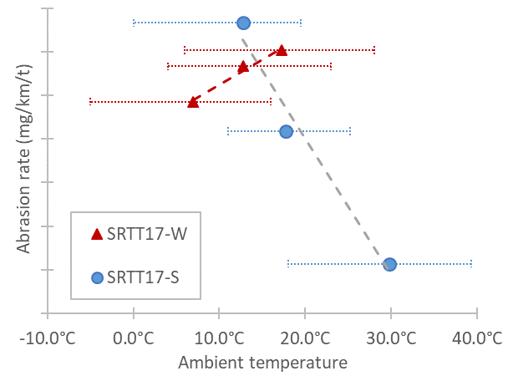
Circuit
 | Urban | Regional | Highway | Global
Share (% distance) | 30 (±5) | 30 (±5) | 40 (±5) | -
Long. acc. stdev (m/s²) | 0.42-0.80 | 0.34-0.78 | 0.18-0.53 | 0.35-0.55
Lat. acc. stdev (m/s²) | 0.54-1.27 | 0.52-1.46 | 0.32-0.78 | 0.83-1.03
Open public roads
Total distance 8000 km (-300 to +300 km) along selected circuit
Circuit of at least 300 km consisting of one or more loops
Driving style distribution (see table)
Circuit abrasion rate determination:
  Convoy of at least 1 vehicle with ref. tyres
  At three ambient temperatures: one at least
  15-25°C (SRTT17S) or 5-15°C (SRTT17W)
  Slope updated over time with new points
Abrasion level of Ref. tyres at
  20°C (SRTT17S) [25-75 mg/km/t]
  10°C (SRTT17W) [25-75 mg/km/t]
End of test
SRTT-S abrasion rate range
SRTT-W abrasion rate range

Slide 10
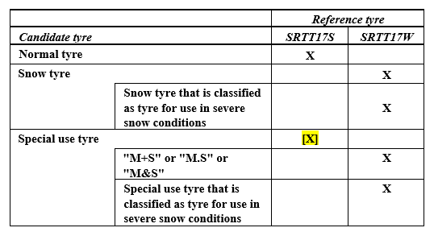
Reference tyres
Convoy
General:
Up to 4 vehicles.
One is fitted with reference tyres
Convoy composition. Homogeneous for:
  Number and position of driven wheels: FWD or RWD or AWD only in the convoy
  Same propulsion energy converters (e.g. ICE, or NOVC-HEV etc.)
  Aerodynamics F2 vehicle ref. tyres <1.2 F2 rest vehicles, if available
Vehicles and drivers rotation
  Each tyre shall be exposed to the same distance (±10%) to all drivers and positions in convoy

Slide 11
Preparation and Measurements
Tyres preparation
  Tyre mass measurement (without rim)
  Tyre fitment on rim (and vehicle)
  Tyre and wheel assembly mass measurement (optional for candidate tyres)
  Tyre inflation pressure: Ref: 290 kPa, rest 250 kPa or 290 kPa (XL, HL)
Vehicles preparation
  Vehicle balasting
    Tyre load 67% (±7%) of tyre load capacity (and not exceeding 85% vehicle max payload)
    Load distribution: FWD: 56% (±7%) to 44% (±7%); RWD/AWD: 50% (±7%) to 50% (±7%);
  Vehicle tuning (alignment)
  Vehicle mass measurement and load at each wheel

Slide 12
Measurements
During test
Long. and lat. acc. of each vehicle ≥10 Hz (cont.)
Speed of each vehicle (cont.)
Tyre pressure each day (cold condition)
Average of five temperature of at least start, mid, end, at lower and higher altitude points
Wet distance measurement, ice on road measurement
At intermediate stops
Vehicle alignment of Ref. vehicle every 2000 km
Tyre and wheel assembly mass (optional for candidate tyres)
Vehicle alignment (optional at half distance for candidate tyres vehicle)

Slide 13
Validation
 | Normal | 3PMSF
Average T (°C) | 7 to 35 | -3 to 20
Min/max for 90% of dist. (°C) | 2 / 40 | -7 / 25
Wet mileage | <20% | <20%
Ice or snow mileage | 0% | <5%
Weather and Climate
Accelerations
  see table below
  Long. and lat. acc. stdev
  within 5% of ref. vehicle values
Vehicle alignments
  End-Start: ±0.15° toe, ±0.3° camber
Visual inspection
  Sidewall marking readable
  Tyre loss <1 cm² of tread chunking area (for Ref tyre: all results invalid)
Ref. tyres abrasion rate value @20°C or @10°C within abrasion rate range
 | Global
Max speed (km/h) | 140
Long. acc. stdev (m/s²) | 0.35-0.55
Max long. acc. (m/s²) | ±5 (for ≥99.98% distance)
Lat. acc. stdev (m/s²) | 0.83-1.03
Max lat. acc. (m/s²) | ±5 (for ≥99.9% distance)

Slide 14
Calculations
ALRT = Abrasion Level of Ref. Tyres (i.e., Abrasion Rate of Ref. Tyres normalized to load) @T_{ave}
ALRT = (Σ(MRTS_{i}-MRTF_{i}) / D_{Ri} ) / Σ(Q_{R,i})
MRTS_{i} = Mass of Reference Tyre Start (wheel i)
MRTF_{i} = Mass of Reference Tyre Final (wheel i)
D_{ri} = Distance of reference tire i
Q_{R,I} = Test load of each reference tyre i
ALCT = Abrasion Level of Cand. Tyres (i.e., Abrasion Rate of Cand. Tyres normalized to load) @T_{ave}
AICT = Abrasion Index of Candidate Tyre (indep. from T_{ave})
AICT = ALCT / ALRT

Slide 15
Open points
Total length 8000 km or 6000 km
Proposal: during market assessment check at least at 6000, 8000 km
Ref. tyres abrasion rates to be confirmed (paragraph 1.6.16.)
Driving styles description (Annex 1, paragraph 2.)
Collection of data supporting decisions
Tread depth procedure (at least the measurement part)

