Slide 1
AVC-02-XX
Submitted by Japan
Information and Aspects on Vehicle Categorization for AV from Japan

Slide 2
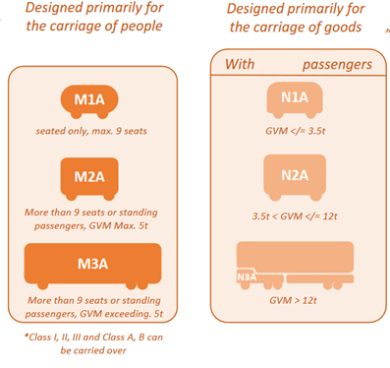
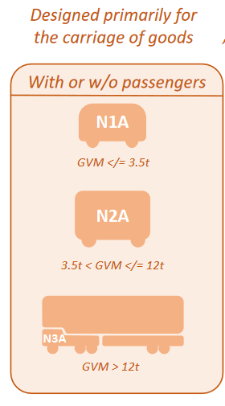
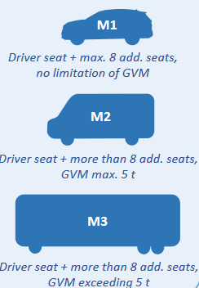
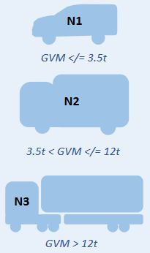
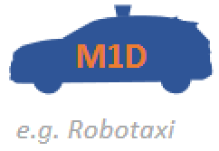
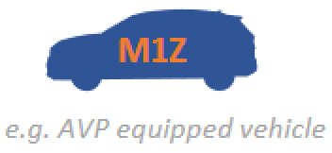





Envisaged Vehicle Categories
Designed to be manually driven
Designed to be automatically driven
Designed primarily for
the carriage of people
Designed primarily for
the carriage of goods
With passengers
Without passengers
P1
P2
[Seated or standing passengers] [>9 seats] GVM < 5t
P3
[Seated or standing passengers] [>9 seats] GVM > 5t
M1
M1
N3
Dual-mode vehicles
Dual-mode vehicle
Controller
(in-car)
Remote Driving
(out-car)
Remote Controller
(out-car)
Manual driving equipment
for emergency cases (e.g. ADS failure)

Slide 3
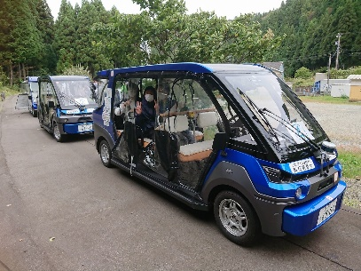
Low Speed Vehicles in Japan
Slow Mobility
Delivery Robot
Spec:
Maximum speed < 20km/h
Manually driven by a driver
(with/without ADS)
Electric motor only
Spec:
Maximum speed < 6km/h
Remotely operated
(manually/automatically)
Small dimensions
In Japan…
apply reduced sets of technical requirements
(e.g. exempting collision safety)
In Japan…
This kind of mobility is not deemed as “Vehicles” but just “Robot”
Not apply the Vehicle Safety Regulations

