Slide 1
C1 Market assessment
Principles for abrasion C1 Market assessment definition
Pres to TAPP 30/11/2023

Slide 2
CRITERIA & QUESTIONS FOR C1 MARKET ASSESSMENT
Scope and number of tyre models to be tested (total & per category)
Tyre dimensions to be tested
Tyre performance compromise representativity : Wet x RR grid criteria
Proposal of brands repartition & Final list of choice to full fill
Still to be decided

Slide 3
Scope & number of tyre models to be tested (total & per category)
Scope : C1 tyres, considering the 1958 agreement market
Number of tyres to be tested for market assessment :
Total = 200 tyre models
Normal ≈ 130 tyre models + 3PMSF ≈ 70 tyre models
Reasons of choice :
  precision of threshold and variety of models on each category
  (more details in annex 1)
Note
ICE excluded as agreed
M+S ref and % to be decided (ref = 3PMSF seems better)

Slide 4
Tyre dimensions
Proposal for tyre sizes in market assessment = 9 sizes:
These 9 sizes cover ≈ 30% of Europool sell volumes and 10% of EPREL nb of SKUs.
Inputs for choices :
Worn WGI plan sizes, Sizes with big sell volumes, broad load and rim size ranges + tyre sizes for UHP / SUV.

Slide 5
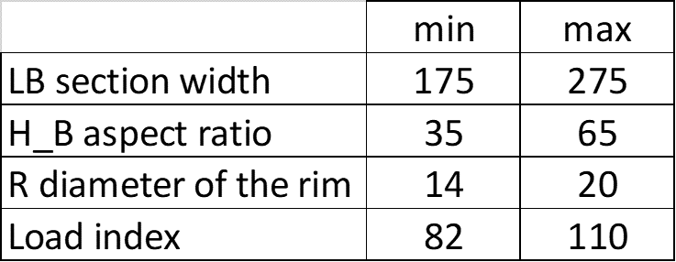
Tyre dimensions
Repartition of tyres
nb on each dimensions
for abrasion market assessment
based on nb of sku in EPREL base* :
Coverage :
LI = 82 (475kg) -110 (1060kg) ⬄ cover 85% of vehicles
Load Capacity [kg] range C1 tyres
* we apply here rules to keep only SKUS
compliant with R117.4
2 examples of impact :
1) No more E class 3PMSF (except ICE)
2) D wet class reduced : -71% on SKUs
(see annex 2 for more details)
300
400
500
600
700
800
900
1000
1100
1200

Slide 6
Wet x RR grid criteria
Proposed method to be representative of performance compromise in the market
Use Eprel matrix WET x RR compromise
for ex here for size 205/55R16 « NORMAL »
with rules « R117.4 compliant » :
for ex if we want to select 28 SKUs of 205/55R16 well disttributed in RR X WGI :
28 x
=

Slide 7
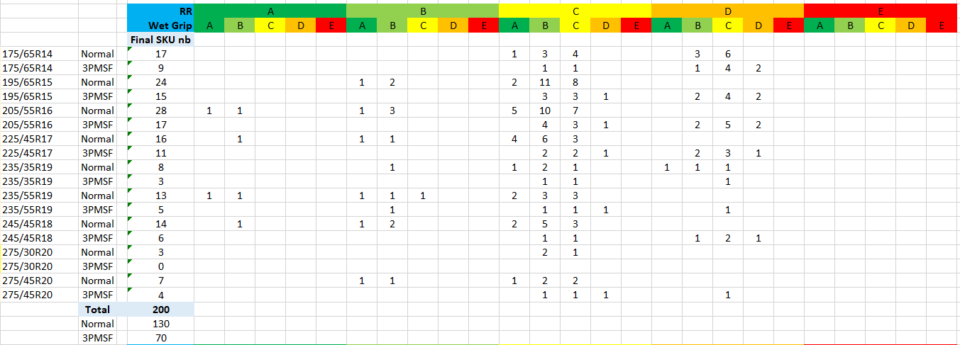
Wet x RR grid criteria
Grid of SKUs choice calculated :
R117.4 impact is taken into account in changing the EPREL repartition (annex 2).
Some adjustements will be made … for example question to solve on « outliers » (population at high labelling values with only « 1 tyre »)

Slide 8
Brands repartition & final list of choice to full fill
Proposed tyre selection principle :
Define a % for each brand participating
Randomization of attribution of the list of tyres to choose :
(in coherence with % defined)
Randomization gives equity
(fair from regulation authorities)
Final choice by tyre Companies
gives possibility to quickly define models :
with real availability
and coherent with R117.4
CIE = tyre company

Slide 9
Brands repartition & final list of choice to full fill
Proposed % per tyre company :

Slide 10
Still to be decided & done :
Points still to validate clearly :
Validate ref and nb of SKUs for M+S category
Finalize % for brands for final choices and start chocice of tyre models.

Slide 12
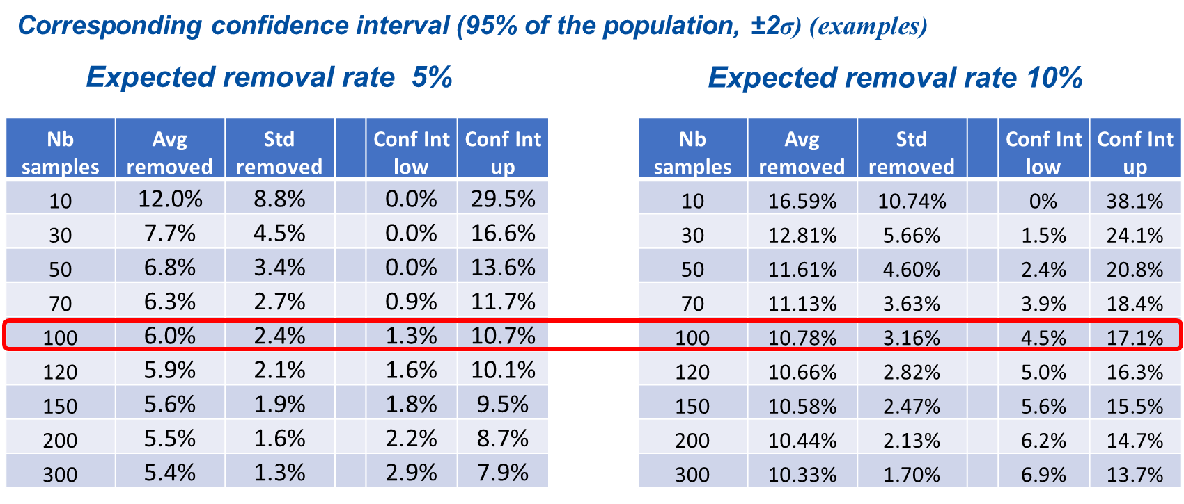
Annex 1 : Nb of tyres to be tested, reasons why
In May 2023, ETRTO WG TATF provided the UNECE TF TA an analysis to indicate the number of tyres to be tested per cluster for a relevant market assessment (see TA-13-04), with the recommendation to test 100 tyres per cluster.
On this basis, WG TATF discussed and worked out a detailed plan on how this market assessment should look like.

Slide 13
Annex2: Eprel R117.4 impact
The impact is taken into account
with a % of change => decrease of nb of SKUs
of conCerned classes.
↓?
RR
Li ≤ 87 Normal maxi 10.5 → 10 kg/T
still some labD RR possible [9.1;10 Kg/T]
Class size 1.4 → 0.9 gives -35% on SKUs
Li ≤ 87 3PMSF maxi 11.5 → 11 kg/T
still some labE RR possible [10.5;11 Kg/T]
Class size 0.9 → 0.4 gives -55% on SKUs
Li > 87 Normal maxi 10.5 → 9 kg/T => no labD RR possible
Li > 87 exceptions UHP* : 10.5 → 10kg/T
still some labD RR possible [9.1;10 Kg/T]
Class size 1.4 → 0.9 gives -35% on SKUs
Li > 87 3PMSF & Ice
maxi 11.5 → 10 kg/T => no labE RR possible
WET
Normal almost no labD wet possible
→ possible for WGI [1.2 ; 1.24]
Class size 0.14 → 0.04 gives -71% on SKUs
3PMSF no labE Wet possible
exception for ICE
↓?

Slide 14
Annex2: Eprel R117.4 impact
Example of impact on 205/55 R16 « normal » :
RR : Li > 87 Normal maxi 10.5 → 9 kg/T => no labD/E RR possible
WET : almost no labD wet possible
→ possible for WGI [1.2 ; 1.24]
Class size 0.14 → 0.04 gives -71% on SKUs

