Slide 1
TASK FORCE ON AUTOMATED VEHICLE CATEGORISATION (AVC)
Second Meeting:
18th & 19th March 2024
Categorisation discussion summary

Slide 2
Meeting Schedule / Deliverables
3rd Meeting
18th & 19th March
4th Meeting
30th April
5th Meeting
15th May
6th Meeting
11th & 12th June
Mar 24
Apr 24
May 24
Jun 24
TF AVC Status Statement to GRSG 15th – 19th April
TF AVC Status Statement to GRVA
20th – 24th May
TF AVC Report
to WP.29
25th – 28th June

Slide 3
Deliverables until June 24
Meeting dates | Goals / Deliverables
Meeting 3: 18th &19th March Hybrid – Paris | Review proposed definitions with the experts Agreement on the pattern of new subcategories Discuss proposal for low speed ADS vehicles Discuss proposal to enable standees for M1/…. category How to proceed with category L vehicles
Meeting 4: 30th April Online only | Discuss first amendment proposal of RE 3
Meeting 5: 15th May Online only | Discuss first draft of the report to WP.29 Review amendment proposal of RE 3 Discuss impact on S.R. 1
Meeting 6: 11th & 12th June Hybrid – London | Finalise report to WP.29 Submit report as an informal document In depth discussion / workshop on standees, low speed, L-category
Notes:
March 24 – goals
April – draft report to WP.29
May – approve draft
June – goals? Finalise report to WP.29 – In depth discussion/workshop on standees?
July + - low-speed etc…

Slide 4
3rd Meeting Goals
Agreement to start with M and N categories and amend the related parts in the RE3 and S.R.1
Agreement on high level categorisation
Discuss proposal for treatment of dual mode
Discuss proposal for low speed ADS vehicles
Discuss proposal to enable standees for M1/…. Category
Discuss proposal for remote control
Review proposed definitions with the experts
Pattern of new subcategories / introduce the modular approach

Slide 5
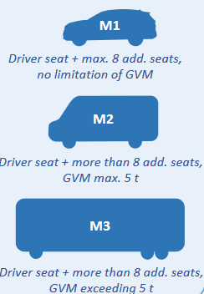
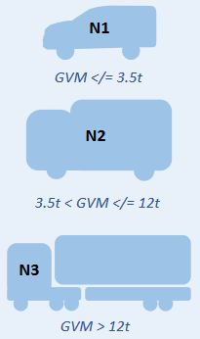
High level categorisation
Terminology to be agreed
Terminology to be agreed
Designed primarily for
the carriage of people
Designed primarily for
the carriage of goods
Dual- mode (applicable to all existing variations of M and N)
Designed primarily for
the carriage of people
Designed primarily for
the carriage of
Goods (with passengers)
Designed primarily for
the carriage of
Goods (without passengers)
M1/D
M1/A
N1/A
N1/A?
e.g. Robotaxi
GVM </= 3.5t
seated only, max. 9 seats
GVM </= 3.5t
M2/A
N2/A
N2/A?
M1/D, M2/D, M3/D
N1/D, N2/D, N3/D
More than 9 seats or standing
passengers, GVM Max. 5t
3.5t < GVM </= 12t
3.5t < GVM </= 12t
N3/D
M3/A
N3/A
N3/A?
e.g. Hub-2-Hub truck
GVM > 12t
GVM > 12t
More than 9 seats or standing
passengers, GVM exceeding. 5t

Slide 6
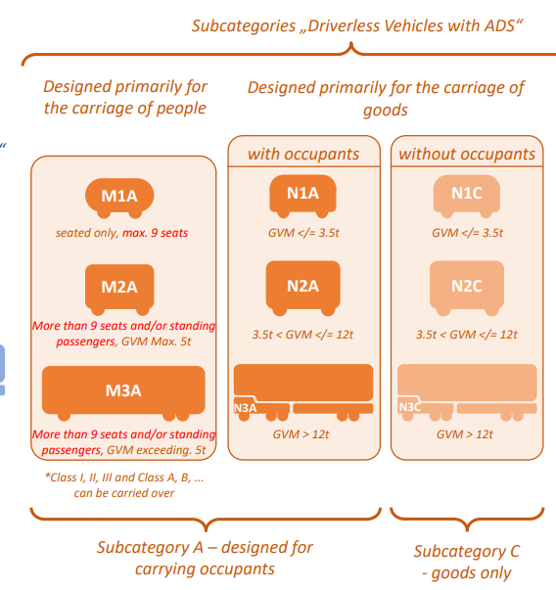
High level categorisation
Do we agree with this approach?

Slide 7
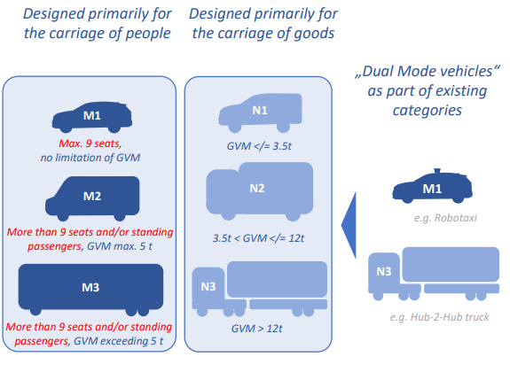
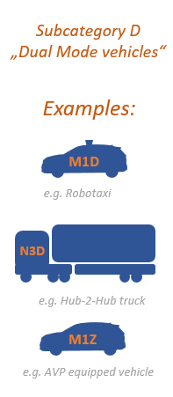
Dual Mode
Vs.
We cautiously agree that there is no technical need to sub-categorise 'dual-mode' vehicles, is the administrative need great enough to warrant a new sub-category?
Could 'dual-mode' be defined in the future ADS regulation as it is a mode of automated driving?

Slide 8


Standees
Treatment of standees in vehicles with < 9 seats
Do we want to prohibit standees in vehicles <9 seats full stop? - this would align with the spirit of S.R.1 but have implications for different CPs?
Do we want to amend existing M/N definitions… 'and/or' ?- this would have implications on the 'spirit' of what M2 and M3 is and would still not prevent standees in vehicles <9 seats.
Do we want to create a new 'sub-category/class/type' under the M1 definition or M2 definition?
Do we want to base the approval of such a vehicle based on it's ODD? By speed?

Slide 9
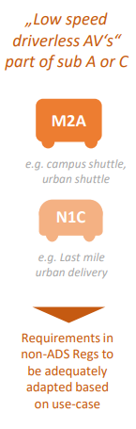
Low speed vehicles
Do we want to define in some way?
  If we do then there is clear guidance for the GRs on what is meant by 'low-speed'
  If we do not then it is up to each GR to decide what, if any, amendments there are in individual UNRs/GTRs based on vehicle speed. This could be more work for each GR? Lack of harmonisation across GRs?
Do we feel that sub-categories are needed? Are the vehicle characteristics sufficiently different to warrant sub-categories based on speed?
Should speed be considered alongside other features, such as whether standees are permitted? The vehicle ODD?

Slide 10
Remote Control
Should remote control be considered in an own category?

Slide 11
Combine definitions of new subcategories
Vehicle concepts may require a combination of subcategory definitions
Subcategories can be combined e.g. M1/ACR, N1/CD
In case of a combined subcategories an alphabetical order shall be applied to avoid proliferation
A = Automated Driving System
C = Cargo
D = Dual Mode
R = Remote Driving

Slide 12
Definitions
“Automated driving system” means the (vehicle) hardware and software that are collectively capable of performing the entire Dynamic Driving Task (DDT) on a sustained basis - FRAV/VMAD GRVA-18-50
“ADS vehicle” means a vehicle equipped with an Automated Driving System (ADS) – FRAV/VMAD GRVA-18-50
Potential new definitions:
“Dual-mode (ADS?) Vehicle” means an ADS vehicle which…
  can be driven manually under nominal conditions (OICA)
  is designed to be driven by a human being (France)
  is designed to be driven by a human being (in the vehicle), with manual control elements (Germany)
  is designed to be manually driven (Japan)
  TF-FADS has defined such vehicles as: “Vehicles equipped with manual steering controls intended for use during normal operation.”
“Driverless (ADS?) Vehicle” means an ADS vehicle which…
  does not require a driver/fallback-ready user (OICA)
  is not designed to be driven by a human being (France)
  is not designed to be driven by a human being, without manual control elements (Germany)
  Is designed to be automatically driven (Japan)
is equipped with manual steering controls and is designed to be manually driven by a human driver in the vehicle, during normal operation?
is not equipped with manual steering controls and is designed to not be manually driven by a human driver in the vehicle, during normal operation?
Should we add speed references? e.g. 6 km/h
-

Slide 13
“Remote driving ” means an ADS or manual driven vehicle which…
  Far range driving/manoeuvring?
  By a human driver, beyond line of sight
  Can it be combined with D and A subcategories?
  Existing definitions under WP1?
“Remote supervisor ” means an ADS vehicle which…
  Not able to fulfil the complete DDT in every traffic situation
  Is able to evaluate the occurring traffic situation and detect the ODD boundaries
  Propose a driving manoeuvre in case of a traffic situation which is outside of the ODD of the ADS system to the remote supervisor
  The remote supervisor agree or decline the proposed driving manoeuvre
  The DDT will be continued after contacting the remote supervisor
  Can it be combined with D and A subcategories?
  Existing definitions under WP1?
“Cargo ” means an ADS vehicle which…
  Are considered to be power-driven automated vehicles of category N1/A, N2/A or N3/A
  Are designed not to be driven by a human being in the vehicle
  Are not equipped with manual controls
  No human being is on-board the vehicle at any time while in operation.

Slide 14
Low-speed ADS Vehicle
Option 2: Sub-categories of Category A (and therefore M and N): e.g: M₁X etc.
Example speed boundaries: < 25 km/h and/or 25 km/h < 50 km/h.
Existing options…
M1/A
N1/A
N1/A?
Option 1: New categories for low-speed vehicles: e.g. LSAV-M1 etc.
seated only, max. 9 seats
GVM </= 3.5t
GVM </= 3.5t
M2/A
N2/A
N2/A?
More than 9 seats or standing
passengers, GVM Max. 5t
3.5t < GVM </= 12t
3.5t < GVM </= 12t
Speed boundaries?
M3/A
N3/A
N3/A?
Limit to driverless ADS vehicles?
More than 9 seats or standing
passengers, GVM exceeding. 5t
GVM > 12t
GVM > 12t
Implications for domestic frameworks, e.g. 2018/858?
M_{1/}AX/Y
M_{2/}AX/Y
M_{3/}AX/Y
N_{1/}AX/Y
N_{2/}AX/Y
N_{3/}AX/Y
N_{1/}A? X/Y
N_{2/}A? X/Y
N_{3/}A? X/Y

Slide 15
Standees
What about smaller automated ADS vehicles?
Existing options…
Option 1: Current text, prohibits standees in M₁ vehicles. Standees only in M₂ or M₃, i.e. larger, heavier vehicles.
Option 2: New vehicle categories: Could be limited by ODD OR speed, i.e. permit standees in ‘lower risk’ situations only, e.g. LSAV-M₁ CAL reduced or < 25 km/h limit?
Do we want to create new vehicle categories?
M1/A
Option 3: New provision for ADS vehicles comprising no more than nine seats and designed to carry standing passengers, e.g. M1/A, Class A?
What about similar, non- ADS vehicles?
seated only, max. 9 seats
M2/A
Option 4: OICA proposal: Definition change, for M2, M3, to permit designs intended to carry standing passengers.
More than 9 seats or standing
passengers, GVM Max. 5t
Are M₂ requirements sufficient for smaller, light weight vehicles?
M3/A
More than 9 seats or standing
passengers, GVM exceeding. 5t

Slide 16
L-category
Option 2: Carve out sub-categories of M and N for 3? and 4 wheelers, based on expected use cases.
Existing options…
M1/A
N1/A
N1/A?
seated only, max. 9 seats
GVM </= 3.5t
GVM </= 3.5t
M2/A
N2/A
N2/A?
Option 1: Sub-category of existing L-categories.
More than 9 seats or standing
passengers, GVM Max. 5t
3.5t < GVM </= 12t
3.5t < GVM </= 12t
Proliferated existing L-categories
Does not carry across to S.R.1
N3/A
M3/A
N3/A?
More than 9 seats or standing
passengers, GVM exceeding. 5t
GVM > 12t
GVM > 12t
Undue expectation for driverless ADS 2 wheel vehicles
N_{1/}AL
N_{2/}AL
N_{3/}AL
N_{1/}A? L
N_{2/}A? L
N_{3/}A? L

