Slide 1
FADS-14-XX
Submitted by Japan
Initial Aspects on Fitness Work for Driverless Vehicles

Slide 2
Vehicle categorization under R.E.3
New sub categories for Driverless vehicle
Designed primarily for
the carriage of people
Designed primarily for
the carriage of goods
Designed primarily for the carriage of people
Designed primarily for the carriage of goods
With occupants
w/o occupants
M1
N1
M1A
N1A
N1C
Max. 9 occupants,
no limitation of GVM
GVM </= 3.5t
max. 9 occupants
GVM </= 3.5t
GVM </= 3.5t
M2
M2A
N2C
N2
N2A
More than 9 occupants,
GVM max. 5 t
More than 9 occupants
GVM Max. 5t
3.5t < GVM </= 12t
3.5t < GVM </= 12t
M3A
3.5t < GVM </= 12t
M3
N3A
N3C
N3
More than 9 occupants
GVM exceeding. 5t
More than 9 occupants,
GVM exceeding 5 t
GVM > 12t
GVM > 12t
GVM > 12t
If LSV
If LSAV
M?X
N?X
M?AX
M?AY
N?AX
N?AY
N?CX
N?CY
< [20] km/h
< [20] km/h
< [20] km/h
[20] km/h </= v </= [60]
< [20] km/h
[20] km/h </= v </= [60]
< [20] km/h
[20] km/h </= v </= [60]
Vehicles designed to be driven by only an on-board driver with conventional operating devices
Vehicles designed to be driven without an on-board driver and/or conventional operating devices
Note: These vehicles might be controlled via fully automated driving system, remote control device or other solutions.

Slide 3
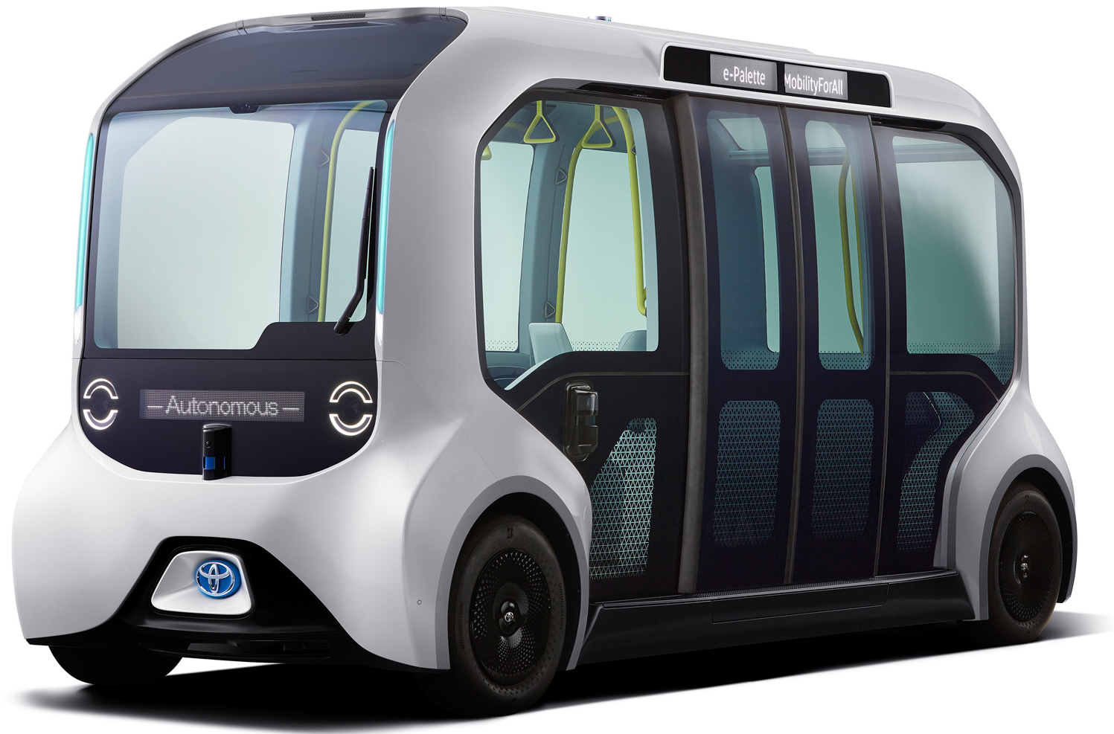
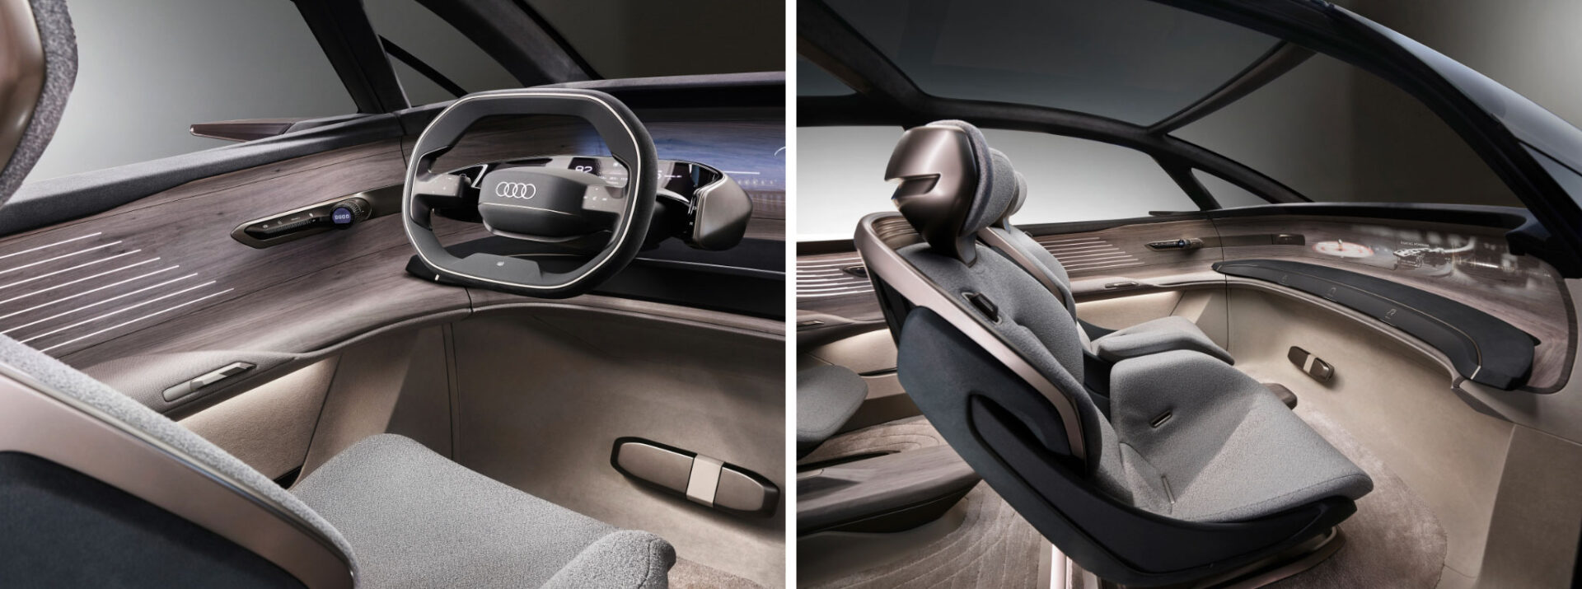
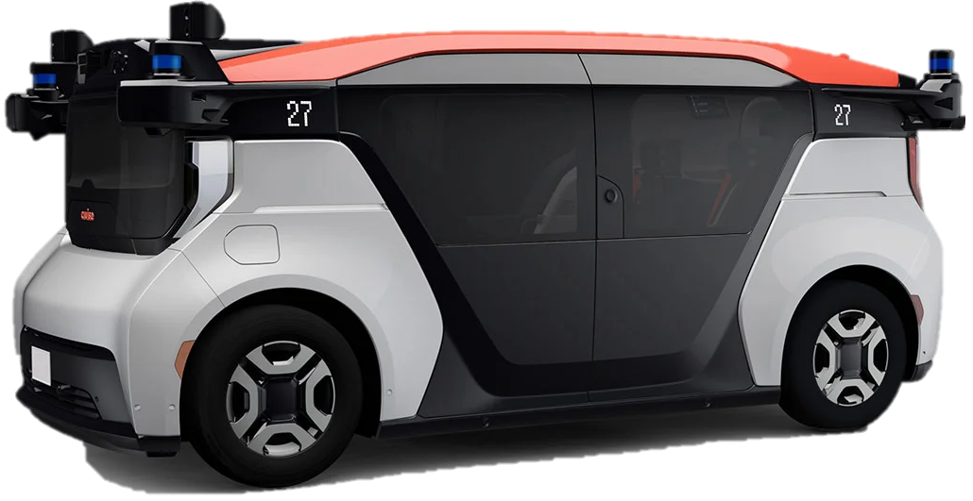
Category for Driverless Vehicles
General Description
ADS which does not issue fallback response allows operation without driver. Therefore, new vehicle designs are being expected as follows:
  Without manual control devices (steering wheel, pedals etc.)
  Without driver’s seat (passengers’ seat only)
  Temporarily conceal or nullify control devices
Vehicles of this category require some waivers or modification of Regulations due to significant changes in vehicle structure.
Designed primarily for the carriage of people
Designed primarily for the carriage of goods
With occupants
Seating, Standees, both
Or No seating
M1A
N1A
max. 9 occupants
GVM </= 3.5t
M2A
N2A
Draft Definition
3.5t < GVM </= 12t
Subcategory A – Vehicles designed exclusively for driverless operation
M3A
N3A
More than 9 occupants
GVM exceeding. 5t
Note:
This vehicle might be controlled via fully automated driving system, remote control device, or other solutions.
GVM > 12t
Typical Example
Driverless shuttle/taxi

Slide 4
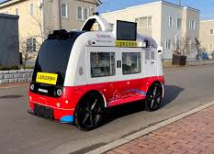
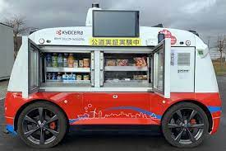
Category for Goods Delivery Occupant-less Vehicles
General Description
ADS which does not issue fallback response also allows operation with no human beings on board the vehicle at all time. These vehicles are designed to be driven on public roads, not pedestrian roads.
Vehicles of this category require some waivers or modification of Regulations, but should be separated from other driverless vehicles due to significant changes in vehicle structure.
Designed primarily for the carriage of goods
w/o occupants
N1C
GVM </= 3.5t
Draft Definition
N2C
Subcategory C – Vehicles designed exclusively for driverless operation and having a capacity no occupants
3.5t < GVM </= 12t
Note:
This vehicle might be controlled via fully automated driving system, remote control device, or other solutions.
N3C
GVM > 12t
Typical Example
Occupant-less delivery system

Slide 5
Possible impacts for regulations
Topics
To Be Considered
Driver
Driver’s seat
Without driver’s seat
Amending requirements relating to the driver's seat
Subcat. A
Visibility
Without driver under nominal conditions
To consider if requirements of visibility for passengers or not
To consider if requirements of visibility for operators to temporarily control driverless vehicles or not
Subcat. A, C
Control, HMI
Without driver under nominal conditions
Where notify information on telltales, indicators, alerts, etc. (e.g. seatbelt reminder)
Review of requirements on the premise of operation by the driver (e.g. engine switch)
Subcat. A, C
Control
Control devices
Without manual control devices (e.g. steering, pedals)
To consider if requirements regarding interaction between conventional control devices and signal from ADS or not
To consider if requirements for concealing devices or not.
Subcat. A, C
Temporary controller
Temporary controller for maintenance and emergency use
To consider if requirements on the performance of the controller or not
Subcat. A, C
User roles
User roles in the operation
Necessity of emergency stop switch
Subcat. C

Slide 6
Possible impacts for regulations
Topics
To Be Considered
Design
Seat arrangement
Free seating arrangement (e.g. facing seats)
Occupants protection in the case of facing seats.
Subcat. A
Bi-directional design
Bi-directional designs
Application of different requirements for front and rear.
(e.g. lighting devices)
Subcat. A, C
No occupants
No human beings on board the vehicle
No need to require safety of the vehicle occupants.
(e.g. seats, occupants protection, visibility)
Subcat. C
Testing method for driverless vehicles
Amending testing method/requirements on the premise of the absence of the driver
Amending test requirements considering the ODD
Other
Testing methods
Subcat. A, C
Overlap of requirements
Overlaps with ADS capabilities
Some regulations seem to overlap with ADS capabilities
Borderline of responsibilities between ADS and other devices
All category
Need to share a common understanding what degree and what direction to amend or newly develop requirements
Need of requirements at non-nominal use (e.g.Remote control in case of emergency or maintenance etc.)
Consideration by CPs domestically?

Slide 7
Prioritization of Topics
High Priority (by Jan. 2025)
Determine how to amend requirements to realize driverless vehicles
  Exempt requirements preventing the realization
  Modify existing requirements
  Add new requirements for driverless vehicles, if needed
Clarify the borderline between ADS and other device
High Priority (but it would need long time to consider)
Consider safety requirements for possible new designs
  Occupants protection in the case of facing seats.
  Requirements for bi-directional design.
Establishing testing provisions for driverless vehicles
  Test method considering the ODD
Low Priority (To be considered later)
Consider if requirements on the performance of the controller or not, if needed.
Amend regulations to realize the subcategory C (no human beings on board the vehicle), if needed.
By following the uniformed direction, overall Regulations could be harmonized

Slide 8

Outstanding topics
1. Determine how to amend requirements to realize driverless vehicles
Exempt requirements preventing the realization
Modify existing requirements
  State of ADAS(e.g. AEBS, ESC) whilst the ADS is active
  Requirements for drivability (e.g. visibility, information)
  Definitions and requirements mentioning driver/driver’s seat
  Controllability for the ADS (incl. communication)
  Test methods on the premise of the absence of the driver
Add new requirements for driverless vehicles, if needed
2. Clarify the borderline between ADS and other devices
 | For ADS | For Devices
Control | ADS shall output control signal to the vehicle devices via transmission links | Control the device following the signal from ADS received via transmission links
Performance | Comply with the performance requirements of the UNR/GTR on ADS by signaling to the other vehicle devices | Comply with the applicable performance requirements of the regulation on the device.
Failure | ADS shall detect failure that compromise its capability to perform the entire DDT within the ODD of its feature | Detected failure as specified in the regulation on the device shall be transmitted to the ADS.
ADS
Light
Devices
Steer
Brake
Accel

