Slide 1
ETRTO proposal for IWG WGWT workplan 2024-2025
IWG WGWT meeting 56th session on 13 March 2024

Slide 2
Outlines
Reminder: IWG WGWT work progress
Objectives of the next test campaign
Definition of the test plan
JASIC proposal
Concept proposal for tyre selection
Conclusions

Slide 3
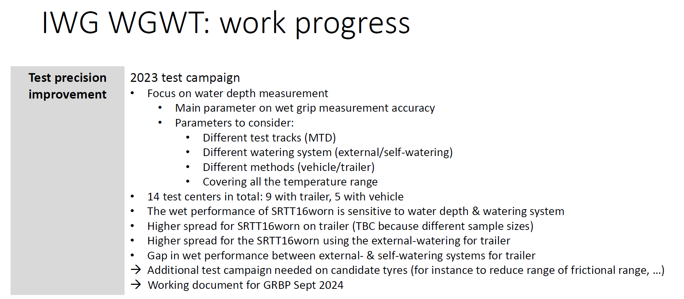
1. Reminder: IWG WGWT work progress

Slide 4
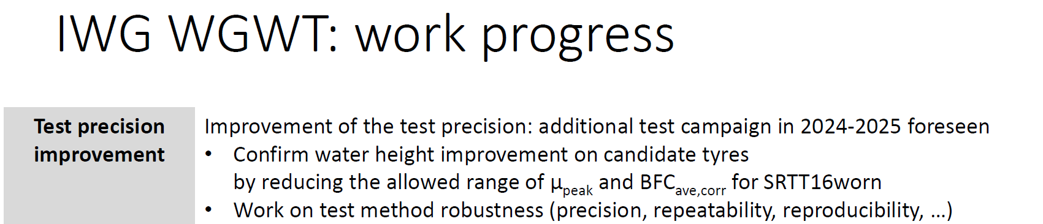
1. Reminder: IWG WGWT work progress

Slide 5
2. Objectives of the test campaign 2024/2025
ETRTO propose to adjust the test plan to the chosen objectives.
Option 1: to confirm the effectiveness of the proposed change in wetted frictional properties, and its impact on candidate tires Analytical plan
Option 2: to evaluate the need to review the coefficients of the correction equations
Tyres’ trends confirmation

Slide 6
3. Definition of the test plan (analytical).
Objective: to confirm the effectiveness of the proposed change in wetted frictional properties
Analytical plan for candidate tires:
Candidate 1-4: Summer
Candidate 5-7: 3PMSF
Candidate 8: Ice
Test sequence:
Molded SRTT- Candidate 1 – Candidate 2 – Candidate 3 – Molded SRTT
Method
Trailer and vehicle
Participants:
All the test centers (14?)
Track friction range:
New tightened friction range
Repeat:
5 measurements per tire per method = 5 x 8 tires* x 2 = 80 → 6 to 8 tires to be measured by participants (assuming 10 to 14 participants) → 2 to 3 tests sequences by participant
* Pending on the number of participating test centers

Slide 7
3. Definition of the test plan (tyres’ trends confirmation).
Objective: to review the coefficient of the equation based on complementary data to initial market assessment
Candidate tires:
Minimum 20 Summer, 4 M&S, 12 Winter = half size of previous RRT
Test sequence:
Molded SRTT- Candidate 1 – Candidate 2 – Candidate 3 – Molded SRTT
Methods
Trailer and vehicle
Participants:
All the test centers will test some tires
Track friction range:
New tightened friction range
Repeat:
3 measurements per tyre per method = 3 x 36 tires* x 2 = 216 measurements → 16 to 22 tires to be measured by participants (assuming 10 to 14 participants) → 6 to 8 test sequences by participant
* Pending on the number of participating test centers

Slide 8
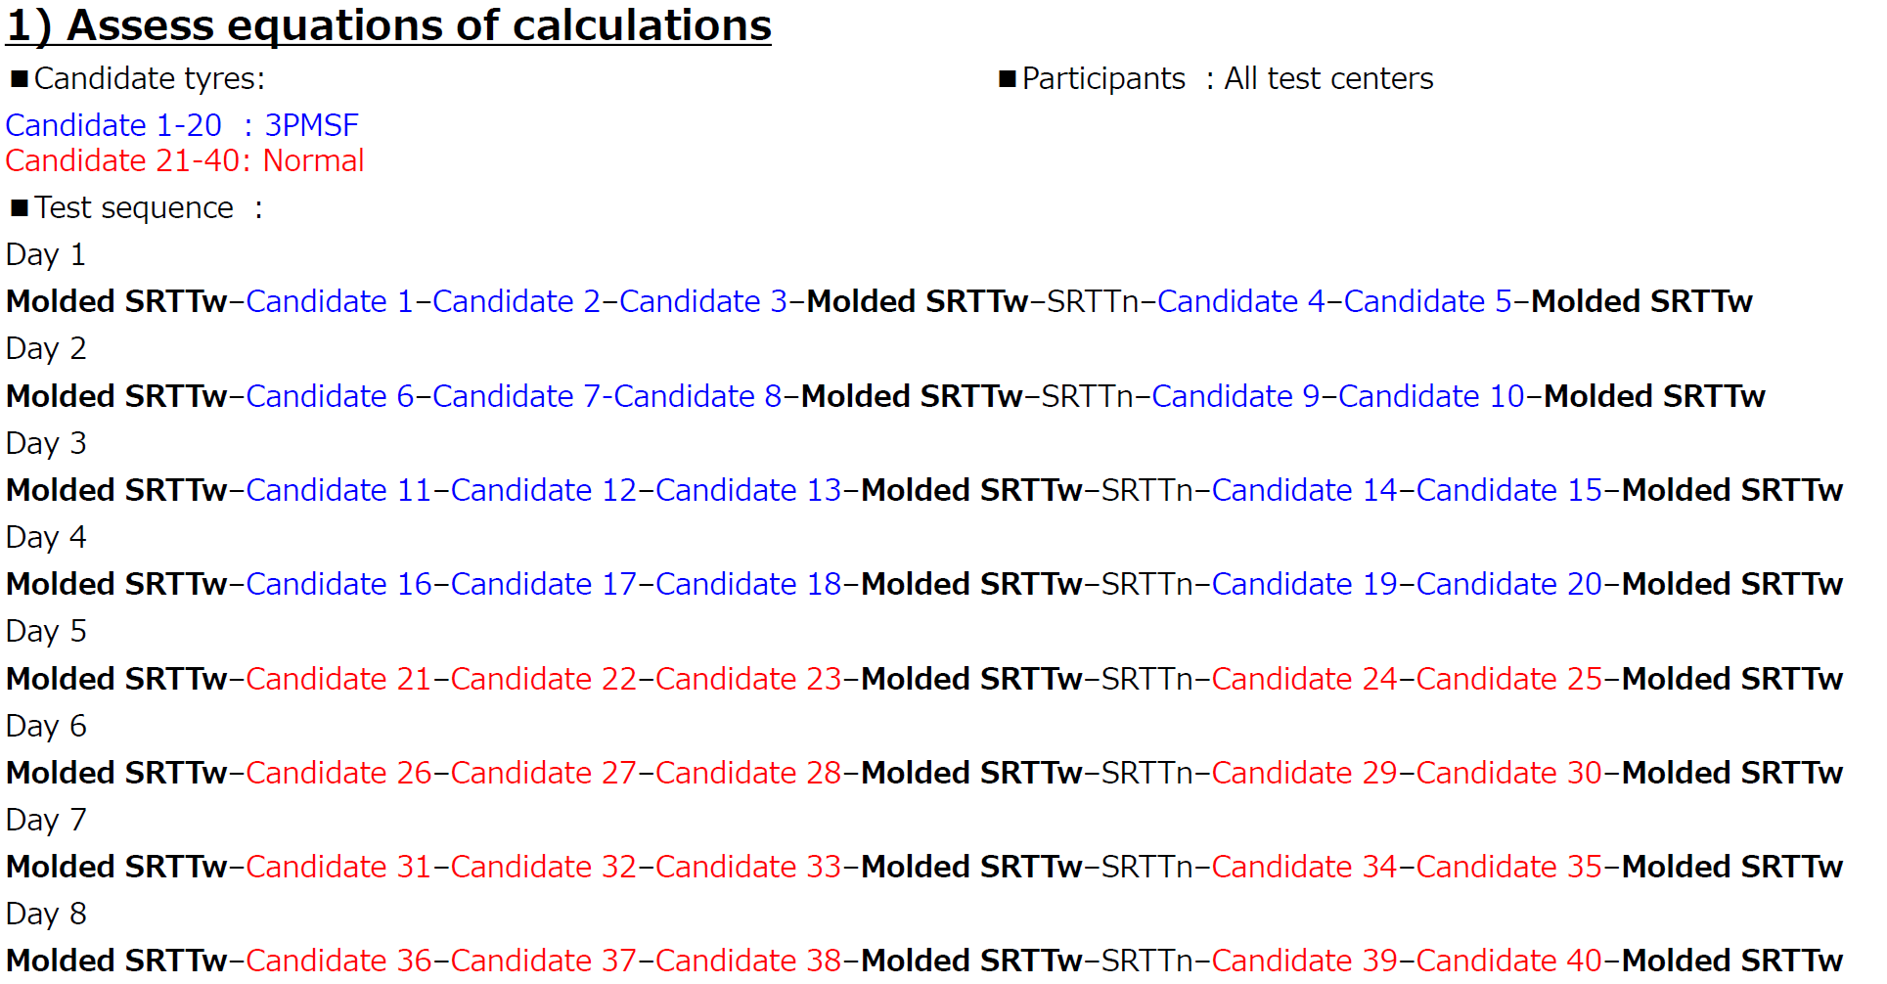
4. JASIC proposal (WT-53-7)

Slide 9

5. Concept proposal for tyre selection
For wet adhesion of tyres in worn state, UNECE R117.04 categorizes C1 tyres as follows:
NORMAL
Tyres commonly referred to as ‘Summer Tyres’
Tyres commonly referred to as ‘Ultra High Performance Tyres’
SNOW
Tyres commonly referred to as ‘All Season Tyres’
Tyres commonly referred to as ‘Winter Tyres’
Tyres referred to as ‘Scandinavian Winter Tyres’ or ‘Nordic Winter Tyres’
SPECIAL
USE
Tyres commonly referred to as ‘All Terrain Tyres’

Slide 10
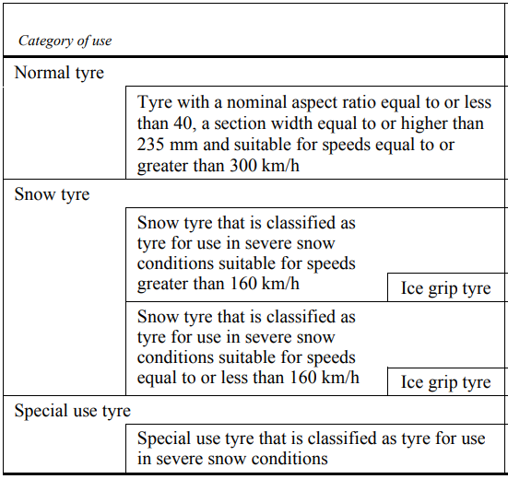
UNECE R117.04 Tyre Categorization (wet adhesion in worn state)
The table shows C1 Categorization as specified in UNECE R117.04 – section 6.4.1.
We propose to select candidate tires which reflect ‘worst case’ and ‘best case’ from each of the defined categories (and sub-categories).
A definition for ‘worst case’ performance of wet grip in worn state may be available by Tyre Type Approval Authorities (e.g. RDW).

Slide 11
Concept proposal
example
Evaluate all categories of tires as defined in section 6.4.1. of UNECE R117.04.
Evaluate all categories from a ‘worst case’ and ‘best case’ perspective.
Evaluate tires which are labeled to perform both well and poorly (in new state) in both case scenarios.
Tyres to be representative of the market
To be considered by IWG WGWT

Slide 12

Timeline for workplan2024-2025
13 March 2024
Workplan 2024-2025 definition
Testing period
Tyre preparation
Tyre selection
Logistics and test center preparation
Testing
Post processing
Q1 2024 Q2 2024 Q3 2024 Q4 2024 Q1 2025 Q2 2025 Q3 2025 Q4 2025 Q1 2026
Drafting group
Regulatory
process
GRBP Informal document
GRBP Working document

Slide 13
6. Conclusions
The workplan 2024-2025 proposal to perform the 2 options (analytical plan and tyres’ trend confirmation) will permit to achieve the objectives defined:
- to confirm the effectiveness of the reduced friction range in reducing test dispersion
- to evaluate the need to update the correction coefficients
This will require roughly 10 tests (8 to 11) sequences per test center
[SRTT- Candidate 1- candidate 2- candidate 3 – SRTT]
The proposed tyre selection concept will allow to get a representative sample of UN market in term of WGI @ worn performance and tyres’ trends

Slide 14
Thank you

