Slide 1
Note for SG6 meeting

Slide 2
Remaining issues
Species relevant to the use of fuel and electricity
Future projection for A-LCA CO2E value in vehicle life

Slide 3
1. Species relevant to the use of fuel and electricity
Reminder:
Determination of species emitted from the use of fuel & electricity is still open.
Species on IPCC AR6 table plus H2 are candidates.
Assessment of dataset is necessary.

Slide 4
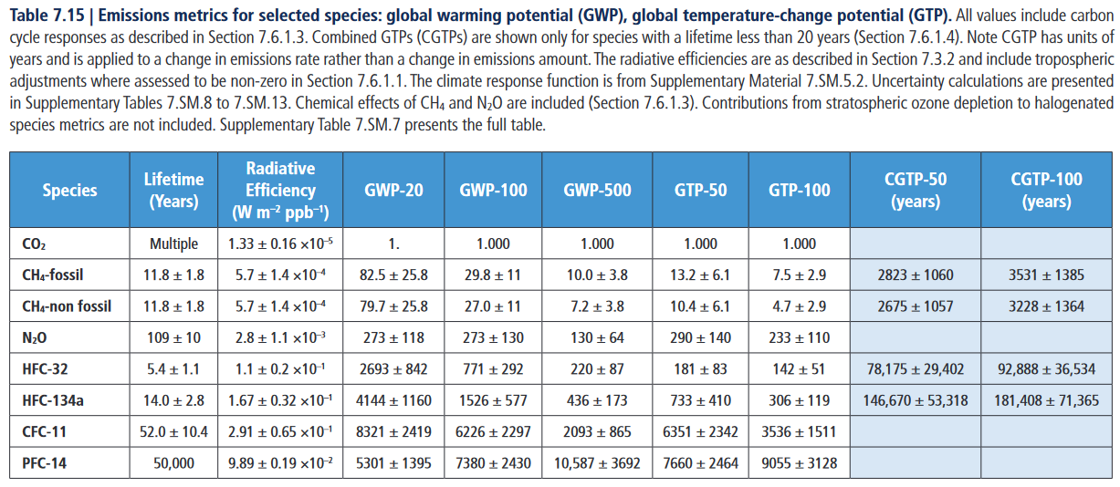
A-LCA IWG tends to agree to use "GWP100" of "IPCC AR6 Table 7.15" (Plus H2 if applicable) to calculate "CO2E".

Slide 5
Calculation example...
E: Total equivalent CO2 emissions from the production and combustion of fuel g CO2E /MJ
E = E_CO2 (g/MJ) + E_N2O (g CO2E/MJ) + E_CH4 (g CO2E/MJ) + E_H2 .....
Emission factors
GWP
E_CO2 (g/MJ) = CO2 emissions g/MJ
E_N2O (g CO2E/MJ) = N2O emissions g/MJ × N2O_GWP(AR6)
E_CH4 (g CO2E/MJ) = CH4 emissions g/MJ × CH4 fossil_GWP(AR6)
E_H2 (g CO2E/MJ) = H2 emissions g/MJ × H2_GWP(?, tbc)
etc…
Agreement required:
How the values (g/MJ) can be determined?
Agreement required:
As the methodology of A-LCA IWG, AR6 (most recent one) table should be the recommended reference(?)

Slide 6
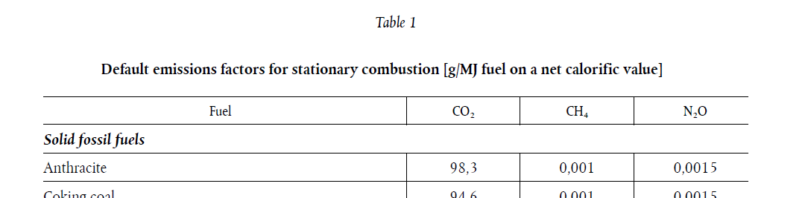
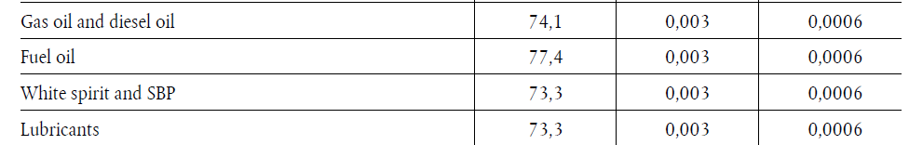
Example from a document
…
…
Commission delegated regulation (EU) 2023/1185
of 10 February 2023
https://eur-lex.europa.eu/legal-content/EN/TXT/PDF/?uri=CELEX:32023R1185

Slide 7
Possible sources for emission factors
To use international database
IEA (mix) + IPCC (emission intensity of Pathway)
To use regional database
GREET (emission intensity of Pathway), IDEA,
Ecoinvent (emission intensity of Pathway),
JEC report
To use primary data
Another idea;
Scope of emissions in emission factors need to be aligned with scope of emissions agreed on in IWG. This might mean that multiple datasets need to be combined.

Slide 8
Dataset assessment
IDEA (under assessment) ...
1. How many emission factors (g/MJ) are there?
more than 3 gases;
CO2, CH4, N2O ...
2. Regional or Global?
Regional?

Slide 9
2. Point of declaration of A-LCA CO2E value in vehicle life
Reminder:
In the last session of SG6, it was discussed that the end of production(before use) can be the "point of declaration" for the deliverable until 2025.

Slide 10
Formatting SG6's product(Draft) "until 2025"
"Point of declaration"
Material Production | Parts & Vehicle Production | Use | End of Life
Major task of SG6: to draft "requirements for Secondary Data Set of Fuel & Energy" |  | Major task of SG6: to draft "requirements for Scenario-based Data Set of Fuel & Energy"
Detailed issues loss/leakage Infrastructure ILUC etc. |  | Detailed issues ? Reminder: Vehicle life time will not be determined by SG6.
Note: This is a tentative idea of format of SG6 product toward 2025. leveling concept as SG6 is still open. This format will help us to know where we are on the format when we discuss details on our current agenda items.

Slide 11
Future scenario (as the deliverable until 2025)
As it was discussed, it is difficult to determine what will be happened in the future.
To be simplified...
Future scenario on fuel and electricity will be the same condition of those of the point of "end of production".
*Once we find the way how to project the future scenario and agreed withe the way, we will update our Methodology

Slide 12
AoB
L to MJ conversion factor
SG Report on 14th IWG in Korea

Slide 13
Asking for guidance from A-LCA IWG
Which option should be selected for the deliverable until 2025?

Slide 14
appendix

Slide 15
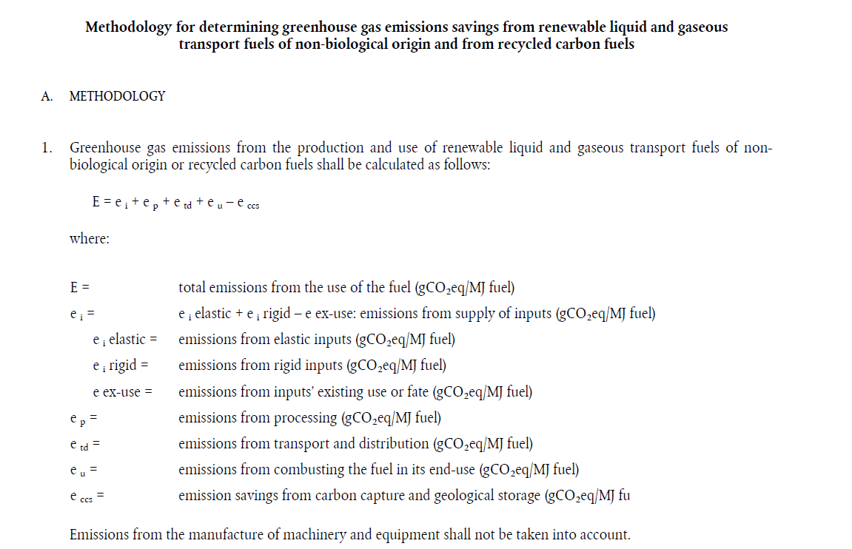
Methodology and Example
w/o Infrastructure
COMMISSION DELEGATED REGULATION (EU) 2023/1185
of 10 February 2023

Slide 16
(Draft) Level concept in SG6:
Level 1: Global average CO2-eq kg/MJ
Level 2: Regional CO2-eq kg/MJ
Level 3: Primary data for 3 spices(CO2, N2O and CH4 fossils)
+ H2(If applicable) CO2-eq kg/MJ
Level 4: Primally data for production and transportation of Fuel & Electricity CO2-eq kg/MJ

Slide 17
Emission Process | Life phases of Vehicle |  |  |  | Fuel & Energy
 | SG2 Production (Material) | SG3 Production (Parts & Vehicle) | SG4 Use | SG5 End of Life | SG6 (Petrol Diesel Electricity production)
Gas production | HFC-32, HFC-134a(refrigerant) PFC-14(semiconductor production) ,(H2?) | NA | NA (H2 as fuel) | NA | CO2, N2O, CH4 fossil
Combustion | NA | NA | CO2,N2O,(H2 as fuel) | NA | CO2, N2O, CH4 fossil
Transport (incl. Leakage) | HFC-32, HFC-134a(refrigerant) PFC-14(semiconductor production) ,(H2?) | HFC-32, HFC-134a(refrigerant) PFC-14(semiconductor production) | NA (H2 as fuel) | HFC-32, HFC-134a(refrigerant) , CFC-11 | CH4 fossil
Other processes (Emissions from soil) | ? | ? | ? | ? | ?
+H2
(if any)
Scope of SG6

