Slide 1
Default Road Load issue
WLTP-08-26e
  Initial Dutch proposal for a
  <hybrid road load approach>
  Update 10-11-14
  Progress report Annex 4 Open Issues: WLTP-07-07e
  5. Default road load parameters (OIL #17)
  In the Munich meeting the request of OICA members to reconsider default road load table values was discussed extensively. Task force members welcomed a hybrid approach combining default road load table values and road load measurements. [It was agreed that the hybrid approach requires no validation tests.]
  NL (RDW) offered to draft a proposal shortly after WLTP-IWG #7, to be discussed before the summer break in the Task Force. The initial proposal is still scheduled for WLTP- IWG #8.9.
  This proposal was presented in the Annex 4 TF on the 16th October 2014 in Delft (NL)

Slide 2
The Default Road Load method
The aim for the Default Road Load method:
  It is an alternative method for the coast down or torque meter method and usable for all vehicle categories of WLTP (M1 and N1/N2).
  This alternative is a calculation method based on vehicle parameters without any testing.
  The alternative calculation method is attractive due to low cost and low effort (no testing).
  From regulatory point of view the Road Load Determination by testing is preferable, so the calculation method should be unattractive due to the road load results.
  The GRPE agreed to set therefore the default RL value at such a level that less than 4% of the tested road load values are higher than the calculated road load values.
  On gathered data from road load values from US, S-Korea and Europe the equation was set at a level of 40% above the mean and adopted in the GRPE. Only additional data could amend the equation in future.

Slide 3
Default Road Load method
The Default Road Load method :
  The assessment of road load determination of multi stage vehicles is very extensive caused by the variety of possible bodyworks.
  Even with the introduction of a RL family it will still be difficult to obtain the cycle energy demand for all possible bodyworks which could be used by the second stage manufacturers
  The most suitable solution for multi stage vehicles is the use of the default road load method.
  The aim that the default values should be unattractive due to the road load results is for these multi stage vehicles not appropriate.
  The introduction of a Hybrid Road Load method for these multi stage vehicles may be an solution.
  What is a Hybrid Road Load method?

Slide 4
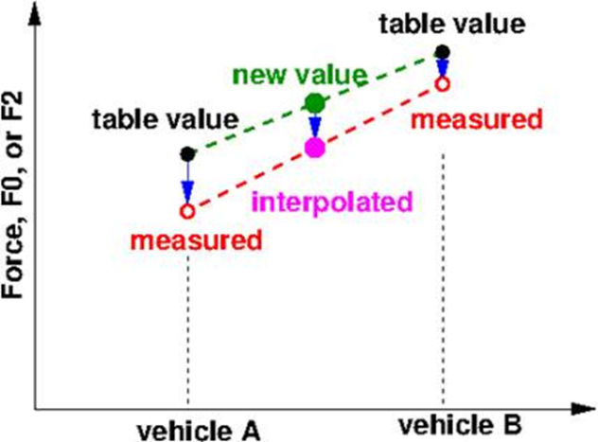
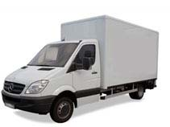
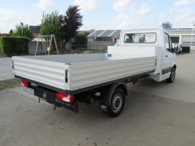
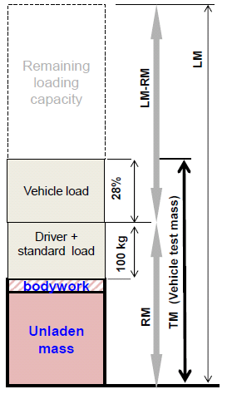
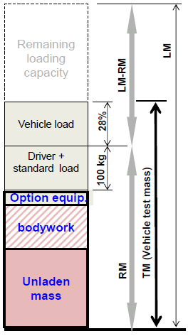

Hybrid Road Load method
Minimum size
Maximum size
Minimum TM
Maximum TM
Vehicle A
measured
Vehicle B
measured
Interpolated vehicle force of specific vehicle

Slide 5

Hybrid Road Load method
The basic of a Hybrid Road Load method :
  The ‘table’ values are based on physical properties of the vehicles: sizes and weight.
  If for special “multi stage N class vehicles” the minimum and maximum version in size and weight the Road Loads are measured, then it is possible to combine the measured and table (formula) values for RL values ; “hybrid RL method”.
  If for these two vehicles in A and B version (within a “multi stage family”) the measured values are lower than the table values, then it is possible to interpolate values of other vehicles versions in this family on the basis of the table value of the specific vehicle version. This can be performed on the total force, or for each of the two parameters (rolling resistance on the basis of weight, and air-drag on the basis of size, separately).
Force

Slide 6
Hybrid Road Load method
The Hybrid Road Load method :
Definitions and restrictions:
  With kind of vehicle categories may use this Hybrid solution?
  Only vehicles with are build in multi stage “Vehicle submitted to multi-stage type-approval (only in the case of completed vehicles of category N1 within the scope of Regulation (EC) No 715/2007”
  “Multi stage family”:
    Restrictions of in size and mass of vehicle range;
    less than [20] % deviation from the highest value
Comments from Annex 4 TF
Proposal received positively
Do not restrict to N1 vehicles and multi stage but also for M1 cars which are just too big to be measured in normal wind tunnels.
Defines a minimum frontal area of M1 vehicles for which the hybrid approach is allowed (Annex 4 paragraph 3.2.4. concerning solid blockage)

Slide 7

Hybrid Road Load method
The Hybrid Road Load method :
Definitions and restrictions:
Reference vehicles:
    square shape [less than 20% deviation of width at 90% of the height]
    no gaps or holes in the frontal area
    Road load measurements establishing a range (< 20%)
F_{interpolated} [v] = F[v]_{low} + (F[v]_{high}-F[v]_{low})/(F[v]^{table}_{high} – F[v]^{table}_{low}) (F[v]^{table}_{interpolate} -F[v]^{table}_{low})
offset
ratio of measured and table slopes
distance in table value

