Slide 1
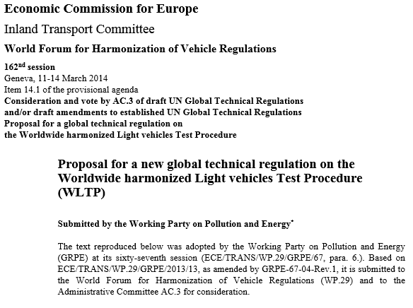
WLTP GTR 15
WLTP-08-40e
Report by
Drafting Coordinator,
Serge Dubuc

Slide 2
History
The GTR (ECE/TRANS/WP.29/2014/27) was:
  approved at the extraordinary session of the GRPE in November 2013
  adopted by WP.29 on March 3, 2014
  published as ECE/TRANS/180/Add.15 along with technical report ECE/TRANS/180/Add.15/Appendix 1 on May 12, 2014

Slide 3
Comments on tracking changes
Minor editorial changes can be found by searching for “GTR CORRECTION” or by using the “next element” option tracking feature in Word
Items which have not yet received feedback from experts can be found by searching for “OPEN POINTS”
Items having received expert feedback can be found searching for “EXPERT APPROVAL”
Items having been approved by the Informal Working Group can be found searching for “CONFIRMATION”

Slide 4
Major Developments since WLTP IWG Meeting #7
A number of points were discussed during IWG Meeting #7 (June, 2014, Geneva) which required expert input. The deadline was 31.08.2014.
  Upon request of the Leading Team, these were converted to CONFIRMED after that deadline.
Leading Team on 09.09.2014 also requested that all GTR CORRECTIONS, OPEN POINTS and EXPERT PROPOSALS introduced into the GTR since WLTP-07-04 be supplemented with a deadline for expert comments. These points can be found in the GTR by searching for "31.10.2014". This GTR was uploaded to UN ECE and EU servers.

Slide 5
Some Minor Developments since WLTP IWG Meeting #7
Temperatures, including those with tolerances, are in both K and °C
Paragraph 4.1.1.1. in Annex 8 (Pure and hybrid electric vehicles) deleted as requested in IWG Meeting #7
Text on rolling resistance of an individual vehicle having front and rear tyres with different rolling resistances incorporated
A general equation for the calculation of total hydrocarbon density for each reference fuel with an average composition of C_{X}H_{Y}O_{Z} is incorporated
All others can be found by searching for GTR CORRECTIONS, OPEN POINTS and EXPERT PROPOSALS

Slide 6
Future work
Processing those items with an October 31, 2014 deadline
Incorporating decisions made by the VPSD group once they have been approved by the appropriate experts
Incorporating text approved during WLTP IWG meetings

