Slide 1

WLTP-08-47e
BMW, 04.11.2014
Christoph Lueginger
WLTP normalization rotational Mass
Comments on road load normalization proposal by TNO

Slide 2
WLTP normalization rotational masses
examples for rotational masses of BMW
Examples are taken from current BMW vehicles.
Tires are typical ones (high customer take rate), apart from "basic-tire".
10 kg is the weighting tolerance in the GTR.
WLTP normalization rotational masses, BMW, 04.11.2014

Slide 3
WLTP normalization rotational masses
examples for rotational masses of BMW
Examples are taken from current BMW vehicles.
Tires are typical ones (high customer take rate), apart from "basic-tire".
10 kg is the weighting tolerance in the GTR.
WLTP normalization rotational masses, BMW, 04.11.2014

Slide 4
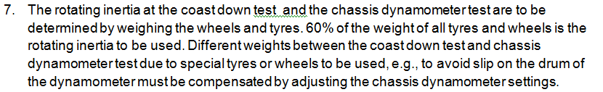
WLTP normalization rotational masses
Analysis on 60% rule proposed by TNO
TNO proposal for rotational masses: 60% of wheel-weight.
property of correction | fulfilled?
tolerance > measurement tolerance | ✗
significant influence | ✗
measureable | ✓
physical meaning of correction func. | ✓
improves result | ✗
Fact box check for correction function.
Measurement tolerance of weight in Annex 4 is +/- 10 kg, in general the error is smaller than that. Additionally the error is divided in half on a 1-axle dyno.
3%-rule is more on the worst case side.
Average error:
3%-rule: -0.8..+3.4 kg (depending on vehicle weight)
60%-rule: -2.3 kg
Maximum error is bigger for the 60%-rule (-11.1 kg) than for the 3%-rule (+9 kg).
60%-rule increases effort on dyno in an unnecessary way without improving the result.
WLTP normalization rotational masses, BMW, 04.11.2014

Slide 5
WLTP normalization rotational masses
Proposal
Proposal:
Do not include the 60%-rule.
Add as an option of the manufacturer the possibility to use 3% of test mass instead of 3% of (Miro+25kg), which adds another 6 kg but simplifies dyno operation.
Justification:
60%-rule increases effort without improving the result.
Using 3% of TM is even more on the worst case side and reduces potential errors in dyno handling.
WLTP normalization rotational masses, BMW, 04.11.2014

Slide 6
WLTP normalization
Backup
Backup
WLTP normalization rotational masses, BMW, 04.11.2014

Slide 7
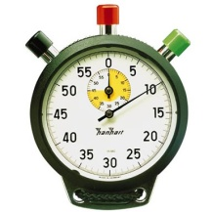
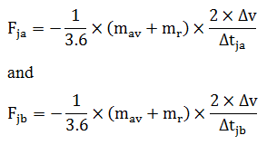
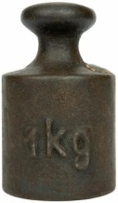
WLTP GTR Rotating Masses
Clarification for road load
← on road on dyno →
Coast down
times measured
Calculation
times to forces
Road load
F0F1F2
Calculation
forces to times
Chassis dyno setting
Road load
m + m_{r} (3%)
Vehicle speed
m + m_{r} (3%)
to be consistent
same weight to be used
If "3%" is mentioned in this presentation, it includes also individually determined values.
The 3% are used to consider rotating masses.
Only wheels are relevant, drivetrain influence is very small compared to the wheels.
To get the same times measured at the coast down the same mass has to be used in both calculations and is therefore independent of 2WD/4WD or 1-axle/2-axle dyno mode…
WLTP normalization rotational masses, BMW, 10.10.2014

Slide 8
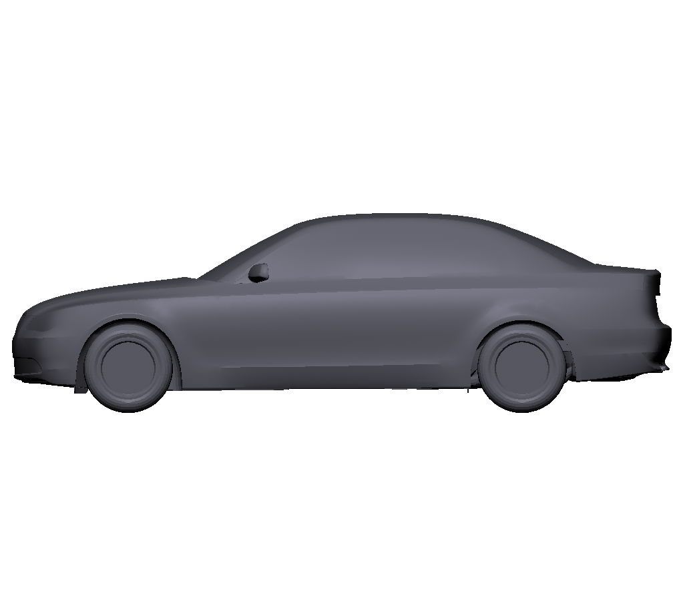
WLTP GTR Rotating Masses
Clarification for dyno setting
2-axle dyno
1-axle dyno
+ 1.5 % of Miro
for not driven axle
inertia setting:
TM
inertia setting:
TM + 1.5% * Miro
The 3 % / 1.5 % regarding inertia are the same values as used for calculating the road load, but for a complete different reason. Therefore these two issues should not be mixed up.
WLTP normalization rotational masses, BMW, 10.10.2014

