Slide 1
WLTP
Vehicle range and energy consumption
EVE 12
28 October 2014

Slide 2
Test cycle, test procedure and test conditions are in principle the same for conventional vehicles and electrified vehicles
Areas where there is differences is described in annex 8 of the GTR
  Charge depleting test (OVC-HEV and PEV)
  Preconditioning (OVC-HEV)
  REESS conditioning

Slide 3
GTR No 15
  Phase 1 includes test cycle and test procedure for type 1 test, normal ambient conditions
  Proposal for phase 2 includes test procedure for low ambient temperature, high altitude, durability and in-service conformity
    Consider for EV, durability for battery and electric motor

Slide 4
Electric vehicles considered in the GTR
  NOVC-HEV
  OVC-HEV
  PEV
  FCV

Slide 5
For electrified vehicles test procedure consist of two tests
  Charge sustaining
  Charge depleteting
Test cycle WLTC and WLTC_{city}

Slide 6
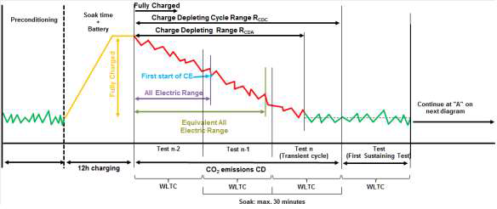
Charge depleting CD

Slide 7
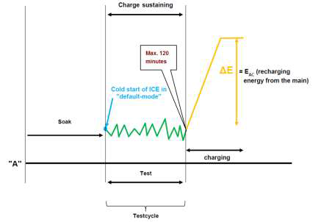
Charge sustaining CS

Slide 8
Charge depleting PEV

Slide 9
OVC-HEV
  CD and CS test
PEV
  CD test
NOVC-HEV
  CS test
FCV
  Procedure under development in phase 1b

Slide 10
Test conditions same as for conventional vehicles
  Ambient temperature
  Soak
  Test equipment

Slide 11
Values derived from the tests
  Emission compound (OVC-HEV and NOVC-HEV)
  CO2 and fuel consumption (OVC-HEV and NOVC-HEV)
  Electric energy consumption (OVC-HEV and PEV)
  Electric range (OVC-HEV and PEV)
    All Electric Range
    Charge Depleting Range

Slide 12
Amendments for EV in phase 1b
  Phase specific calculation for CO₂ and fuel consumption
  Shortened test procedure for PEV
  Combined approach for EV
  Test procedure for FCV

