Slide 1
Topic 3:
Battery performance and durability
Presented by: USA, Canada, Recharge
Day 1, Agenda Item 5
EVE-12 meeting
October 28-29, 2014

Slide 2
Outline
Defining battery durability
Factors influencing battery durability
Battery durability work:
  Private and standard associations
  Regulatory agencies
Next steps

Slide 3
Defining battery durability
Full useful life standards
  How will an electrified vehicle perform over its useful life?
  How will the criteria pollutants and/or CO2 emissions change?
  CP’s could define end of life performance criteria.
Customer satisfaction
  Example: As a customer, the expectation is that the battery will last the full useful life of the vehicle or at least be comparable to the non-electric equivalent in its class
  If regulations are technology forcing, do we understand the performance of electrified vehicles under all conditions.
Other possible definitions:
  Time taken to deplete the battery of one charge at certain operating conditions
  Number of charge cycles until the end of useful life
  Mean time between failure

Slide 4
Defining battery durability
Recharge:
  The definition of the battery performance and durability requires the understanding of the battery expected Service Life and End of Life criteria.
    RECHARGE has been selected by the European Commission for a Pilot Study of the Batteries Product Environment Footprint : these definitions have been discussed recently.
  The expected service of the battery is the total energy delivered over the battery life (in Wh).
    It can be measured during a life cycle test of a battery
  Recharge believes that a single “representative” testing of the various battery usage in EV application is impossible.
  The battery robustness and durability can be assessed in a “simple” testing
  These cycling tests need eventually to be consolidated with other adequate data from the battery manufacturer to assess the performance in different conditions.
  The « battery life model » is needed for the BMS, and provide the information for all usage conditions.

Slide 5
Factors influencing battery durability
DOC (top range of SOC used – bottom range of SOC used)
Cell temperatures ( = f(ambient temp, BMS, Thermal management system)
Conditions of use and protection from elements (vibration, moisture, etc.)
Discharge rate/pattern (i.e. duty cycle)
Charge rate (i.e. SAE Level 1, 2 or 3, AC or DC)

Slide 6
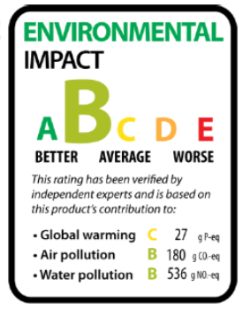
Battery End of life criteria and CO2 emission
The battery minimum electrical performance (End of live criteria) depends on the Battery management system requirements.
The battery smart management can change according Battery State of Health;
  favorize the vehicle efficiency (i.e. while using more power from the battery),
  enhance the battery life (i.e. while limiting the power).
The CO2 emissions of an HEV is under the BMS (*) control, it cannot be directly linked to the battery performance or duration.
(*) dual power management between the ICE and the Battery.

Slide 7
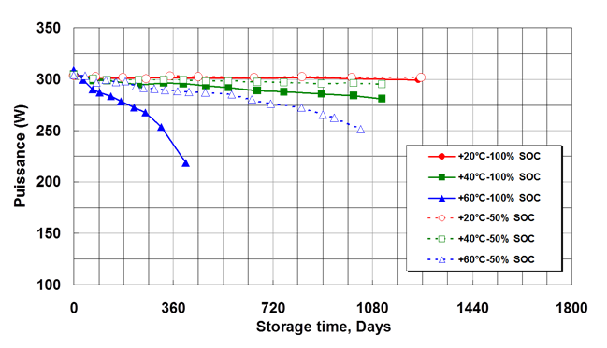
Factors influencing battery durability
Example, Recharge: Battery performance sensitivity to SOC and temperature
Typical Li-Cobalt battery behavior: impact of the storage temperature and different state of charge (SOC).
Compared to the result at 20°C, the life duration at 60°C is divided by 3.

Slide 8
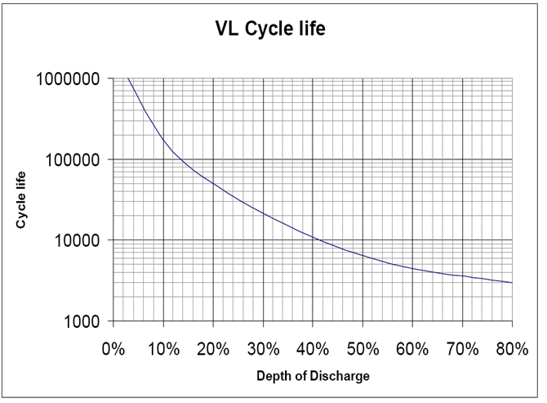
Factors influencing battery durability
Example, Recharge: Battery performance sensitivity to DOD
The depth of discharge (DOD) has a large effect on the number of cycle
total energy released at 3% DOD is 12 times larger than at 80% DOD

Slide 9
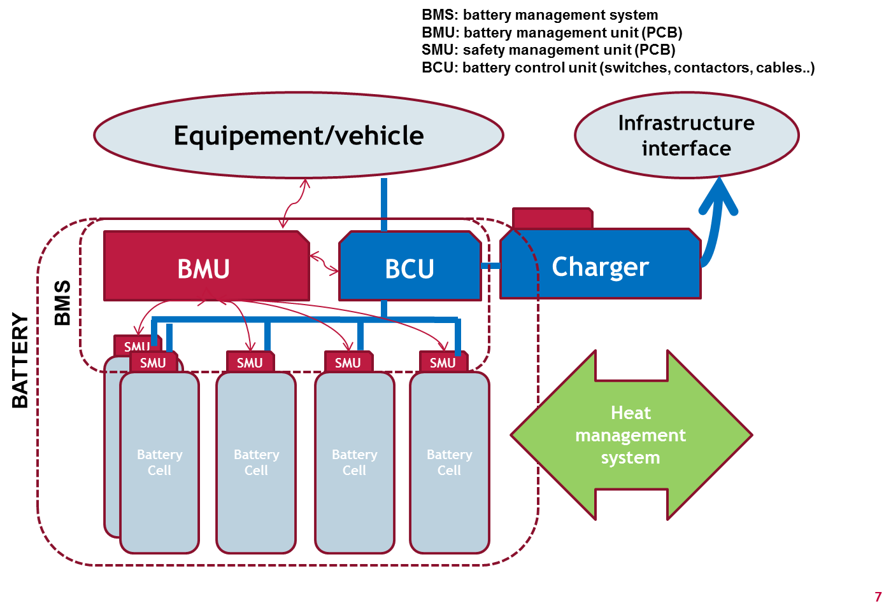
Factors influencing battery durability
Example, Recharge: Battery performance and EV battery design

Slide 10
Factors influencing battery durability
Example, Recharge: Battery performance and EV battery usage
Examples:
  The weight of the battery in a « Renault twizzy » is much smaller (100 kg) than in a « Tesla » (350kg) and is not used with the same conditions
  HEV, PHEV and EV batteries are used in a very different way (particularly about DOD range)
  Thermal management systems: can be more expensive, but more efficient to protect the battery and enhance the battery life duration

Slide 11
Battery durability work:
Private and standard associations
Examples:
  J1798 – Performance rating of battery modules
  J2289 – Functional guidelines-EV Battery Pack
  ISO 12405 – Abuse and Performance
  IEC 62660 – Abuse and Performance
  INL/EEL – Life, characterization, durability

Slide 12
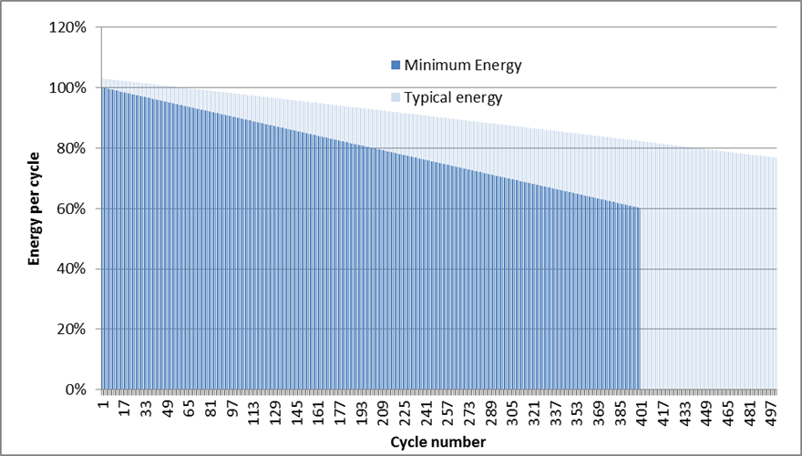
Battery durability work:
Private and standard associations
Example, Recharge: Energy per cycle using IEC 61960 cycle life testing standard as a reference

Slide 13
Battery durability work:
Private and standard associations
Example, Recharge: Standards Cycling tests for EV
More complex charge/discharge profile
But still not a representation of the large variety of real life uses, thermal conditions in use, etc…
Only provides the battery duration information in specific conditions.
IEC 62660 microcycle discharge rich profile for Battery EVE

Slide 14
Battery durability work:
Regulatory agencies
Environment Canada:
eTV and ERMS are anticipating a collaborative project starting this fiscal year
2) Range Degradation due to Mileage Accumulation
Typical 5-door BEV available in North America
Mileage Accumulation: Up to 100000km (testing every 15000km)
Mix of DC Level 2 and Level 3 charging during accumulation
Observation of real SOC% during testing
Logging select CANbus signals during all accumulation
In-Lab testing:
  Ambient temperature: 35C, 25C & -18C (w/ and w/o cabin heat)
  Duty Cycles: SAE J1634, SAE J1634 US06 MCT, NYCC, SC03
Measurements: 1) Select CANbus signals, 2) Vehicle Energy draws
Instrumentation:
  CANbus Logger
  High Precision Power Analyser and clamp-on probes
  Chassis Dynamometer system
  Thermocouples and Datalogger

Slide 15
Next steps
Confirm that EVE should continue the investigation of battery durability.
Establish a definition of battery durability
  What criteria should be established for full useful life requirements?
Identify all factors that effect battery durability
Design an appropriate test program or methodology for evaluating battery durability (Design of Experiments?)
  Where test cycles and procedures are considered, the WLTP will be the basis
Perform testing and report results at future EVE and WLTP meetings.
  Reference Part A of the new EVE mandate

