Slide 1
Topic 1:
Vehicle Range and Energy Consumption
Presented by: Japan, WLTP
Day 1, Agenda Item 4
EVE-12 meeting
October 28-29, 2014

Slide 2
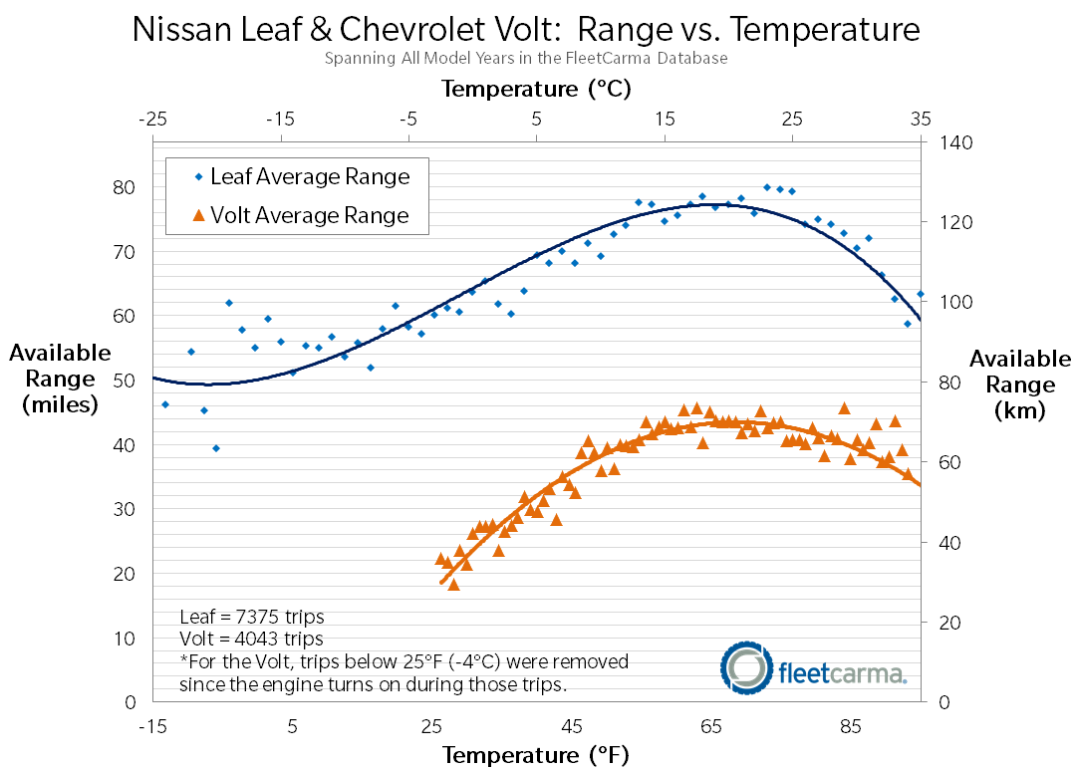
Vehicle Range and Energy Consumption
It is recognized that electrified vehicle range and energy consumption is greatly effected by environmental conditions and vehicle interior climate control and occupant comfort.
Recommendation 5.1 is “to quantify the impact of climate and auxiliary system operation on range and energy efficiency”
http://news.fleetcarma.com/wp-content/uploads/2013/12/LeafandVolt_Range_Cold_Weather_FleetCarma.png

Slide 3
Topic 4:
Battery Recycling
Presented by: OICA
Day 1, Agenda Item 6
EVE-12 meeting
October 28-29, 2014

Slide 4
Battery Recyclability
The reference guide recommends “Having well thought and standardized requirements in this area is likely to make actual recycling requirements easier to specify and more effective in the long term.”
Within the scope of WP.29?

