Slide 1

Proposal to EPPR-08-08e
EPPR-08-34e
Test type III requirements: emissions of crankcase gases
National Motorcycle Quality Supervisory & Testing Center (Tianjin)
Tianjin Motorcycle Technical Center(TMTC)
2014.10

Slide 2
Proposal 1 :
Clause no. | Content | Proposal | Justification
EPPR-08-08e 4.1.7 | 4.1.7 The pressures measured in the crankcase and the ambient pressure shall be measured to within ± 0.1 kPa and shall be sampled with a frequency ≥ 1 Hz within a time period of ≥ 60 s when the conditions in point 4.1.2.are continuously operated and stabilised. | Delete the sampled frequency description in point 4.1.7 of Section B.2. | In point 4.1.4.2, “inclined-tube manometer” can be used for measured the pressure of crankcase. But in point 4.1.7, test frequency are required “≥ 1 Hz”, Devices like “inclined-tube manometer” is unable to meet the requirements of frequency.

Slide 3
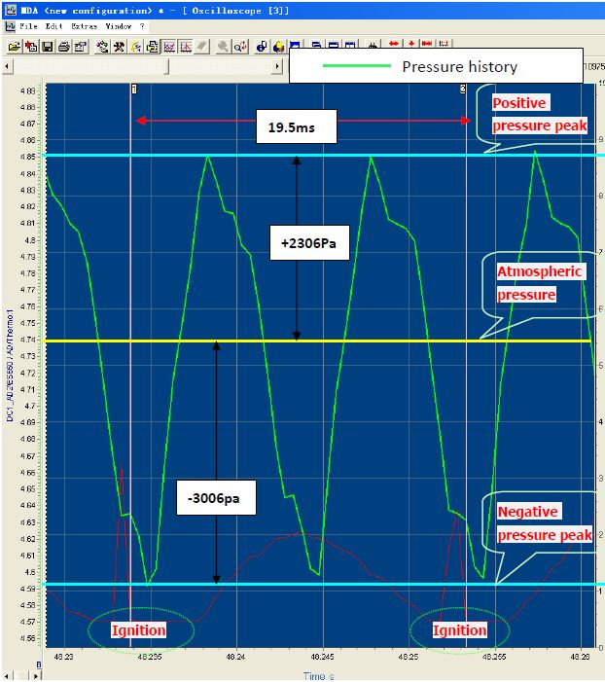
Proposal 1 :
Justification
Verification test :
The test completed with absolute pressure sensor, the sampling frequency is 2000Hz(0.5ms).
When the piston moves up and down, sine distribution of positive and negative pressure in the rapid transformation produced in the crankcase.

Slide 4
Proposal 2 :
Clause no. | Content | Proposal | Justification
EPPR-08-08e 4.2.3 | 4.2.3 Alternative additional type III test method (No 2) 4.2.3.1 The manufacturer shall prove [to the approval authority] that the crankcase ventilation system of the engine is… | Delete point 4.2.3 in Section B.2. | This method can only prove that the crankcase sealing, it is often used to PLT (production-line testing ) ,and irrelevant to the “emissions of crankcase gases”,.

Slide 5
Thank you for your attention!
http://www.ticeri.com/
http://www.cnmtctj.com/

