Slide 1
Introduction of
Electrical Transmission Braking Systems
Workshop hosted by the Special Interest Group on electrical braking systems
TEAMs Meeting
May 2nd , 01:00 PM CEST – 04:00 PM CEST

Slide 2
Table of Contents
EBSIG´s Terms of Reference (TOR´s) Mr. B. Frost (Chair SIG EMB)
EBSIG´s Drafting principles Mr. B. Frost (Chair SIG EMB)
Specimen architectures Mr. P. Teyssier ( OICA) / Mr. N. Syed (CLEPA)
Brake circuit isolation Mr. S. Schilling (CLEPA)
Periodical Technical Inspection (PTI) Mr. P. Teyssier (OICA)
Terminology Mr. N. Syed (CLEPA)
Principles to manage energy Mr. H. Hunold / Mr. S. Schilling (CLEPA)
EMS Mr. S. Schilling (CLEPA)
Annex 7 (R 13) , Annex 4 ( 13-H) Mr. V. Heim / Mr. P. Teyssier (OICA)
Indicators Mr. P. Teyssier (OICA)/ Mr. C. ADAM (CLEPA)
Auxiliaries Mr. V. Kenneweg (OICA)

Slide 3
1. EBSIG´s Terms of Reference (GRVA-18-54)
A. Energy supply and brake transmission architectures.
1. Identify design principles for the energy supply.
2. Identify the brake transmission arrangements that may be recognised by UN Regulations Nos. 13 and 13-H.
3. Develop recommendations for the methodology of measuring/monitoring the value of energy available in a reserve of energy suitable for use in identifying critical energy thresholds.
4. Identify the safety critical elements of electromechanical braking systems that will require monitoring for fault/failure and the generation of warning signals.
Based upon understanding from the above, and building upon the content of the
GRVA Informal Document GRVA-15-17:
1. Develop proposals to amend UN Regulation No. 13,
2. Develop proposals to amend UN Regulation No. 13-H, and
3. Make recommendations regarding the application of the electrical system safety principles with respect
to other UN Regulations, esp. UN Regulation No. 79.

Slide 4
2. EBSIG´s drafting principles (GRVA-16-07)
The essential principles of the regulations are that a braking system employing stored energy:
May have a vacuum, hydraulic, pneumatic, electric, or mixed medium transmission.
The transmission must comprise at least two independent braking circuits each acting on a minimum of two wheels.
Each of those circuits must have its own independent energy reserve.
The value of each reserve must be monitored, and a warning system must be provided to alert the driver if the value falls below a prescribed level.
At all times that the vehicle is able to be driven (or be in motion), and there are no faults present in the system, the total value of the energy reserves has to be sufficient to satisfy the performance requirements of regulations.
When isolated from its supply, the total energy reserve must allow a defined number of full brake applications and still be sufficient to ensure secondary braking at the end.
The energy reserve of each circuit must be maintained at a level that can ensure secondary brake performance should a fault/failure occur in the other circuit.

Slide 5
3. Specimen architectures
ETBS versus EBS
This new definition is specific to R13 and covers existing typical layouts on HCVs (since the mid-90’s): the so called “Electronic Braking System (EBS)”.
The aim is to avoid any confusion between EBS and ETBS.
EBS is addressed with special additional requirements of section 5.2.1.27., while ETBS is addressed in new section 5.2.1.35.
2.52. “Electronically controlled Braking System’” (EBS) means a service braking system where the control is generating an electrical signal in the control transmission and electrical output signals to devices which generate actuating forces produced from stored or generated pneumatic energy.
EBS
ETBS
2.53. “Electrical Transmission Braking System” (ETBS) means a braking system of a power-driven vehicle where the service braking force, and transmission, depend exclusively on the use, controlled by the driver, of energy provided from electrical storage devices.
Control transmission
Electrical *
Electrical
Energy transmission
Pneumatic
Electrical
* Existing systems all have a pneumatic backup

Slide 6
3. Specimen architectures
Caution (about the layouts)
The following layouts are only indicative diagrams, not actual implementations.
They do not aim to show an exhaustive view of all possibilities.
The principles of the different layouts could be mixed and give new layouts.

Slide 7

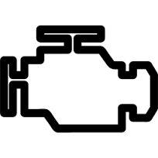
3. Specimen architectures
Electronically Controlled Braking System - Typical HCV EBS layout (R13)
Energy Source
ICE
Air Compressor
Air tank circuit 1
air
Circuit 1
Brake Valve
1
Brake Valve
2
Mechanical drive
Air Tank circuit 2
Circuit 2
Alternator
Electrical signal
Brake Controller
3
1
2
air
Control transmission
Energy transmission
Battery
24V
Energy supply

Slide 8
3. Specimen architectures
ETBS - Layout 1 - Specific battery for braking
Energy Source
ESD 1
Specific battery for braking
ICE
KL 30.1
Alternator
Circuit 1
Brake Controller
1
Brake Controller
2
Mechanical drive
Battery
24 V
ESD 2
Auxiliary equipment
Circuit 2
1
2
Control transmission
Highlights:
The energy in the Electrical Storage Devices (ESD) can only be used by the braking system.
This layout has an energy source (the alternator).
The energy source is part of the electrical supply.
Energy transmission
Energy supply

Slide 9

3. Specimen architectures
ETBS - Layout 2 - Multipurpose battery for braking and auxiliaries
No energy Source
ESD 1
battery for braking
and auxiliaries
Traction Battery (HV)
KL 30.1
DC /DC
Circuit 1
Brake Controller
1
Brake Controller
2
ESD 2
Auxiliary equipment
Circuit 2
1
2
Control transmission
Highlights:
The energy in the Electrical Storage Devices (ESD) can be used by the braking system and by auxiliary equipment.
This layout has no energy source (a traction battery is not a source).
Energy transmission
Energy supply

Slide 10

3. Specimen architectures
ETBS - Layout 3 - Traction battery used as an electrical storage device
No energy Source
ESD 1
battery for braking
and auxiliaries
Traction Battery (HV)
DC /DC
Circuit 1
Circuit 1
Brake Controller
1
Brake Controller
2
DC/DC
Circuit 2
Circuit 2
ESD 2
Auxiliary equipment
Steering System
Other equipment
1
2
Control transmission
Highlights:
The traction battery is both the electrical supply of circuit 1 and the electrical storage device of circuit 2 (which has no supply).
Another energy medium than electricity may be used to power the brakes, e.g. an electro-hydraulic converter could be used to power hydraulic brakes. Such a layout remains an ETBS since the reserves remains electrical storage devices. This possibility is also valid for the other layouts.
Energy transmission
Energy supply

Slide 11
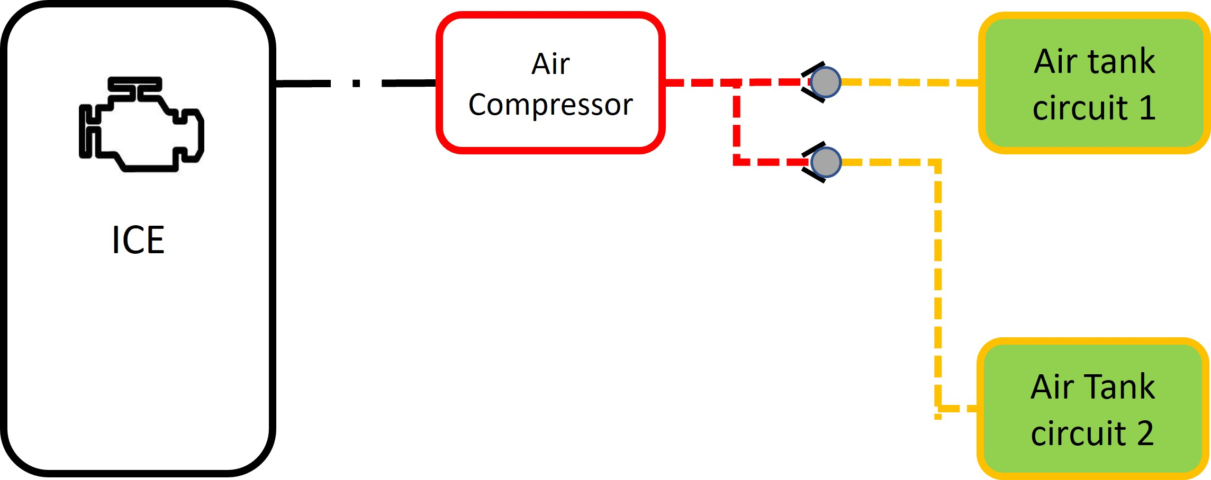
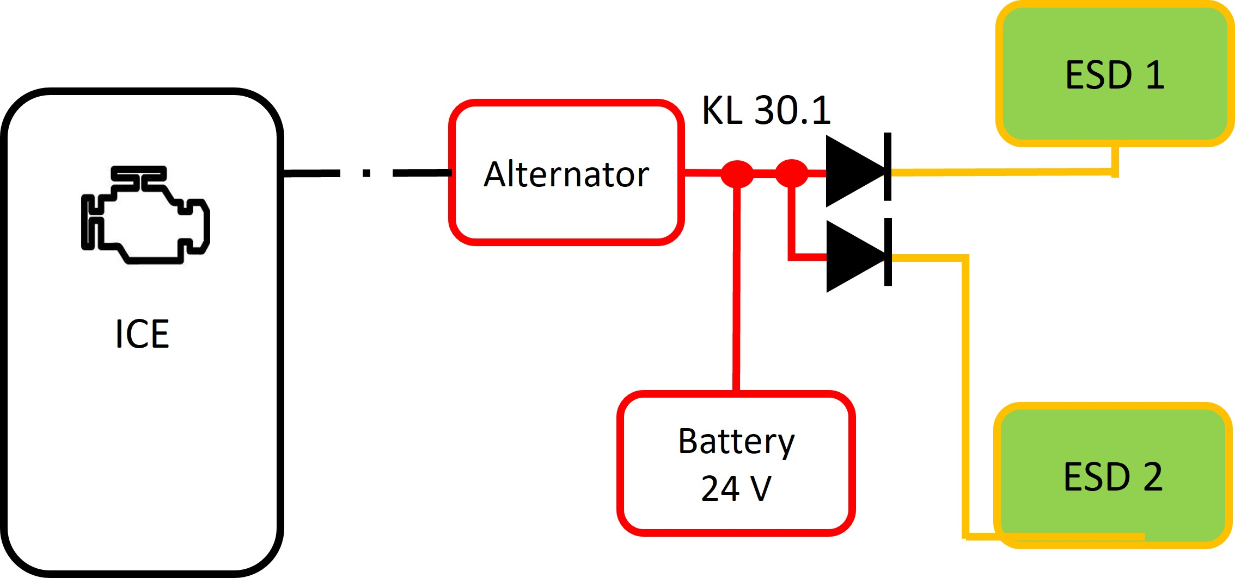
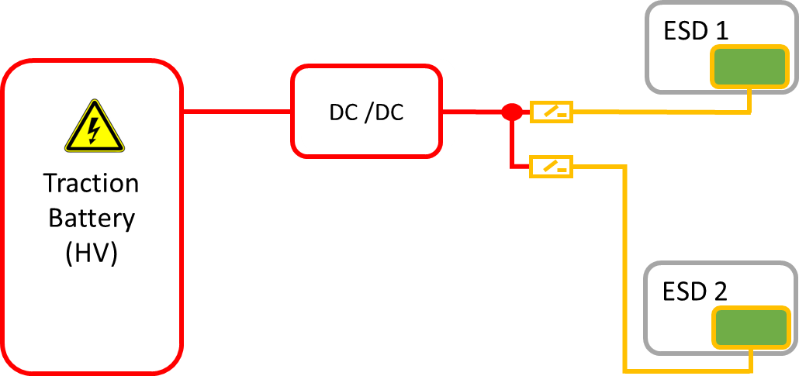
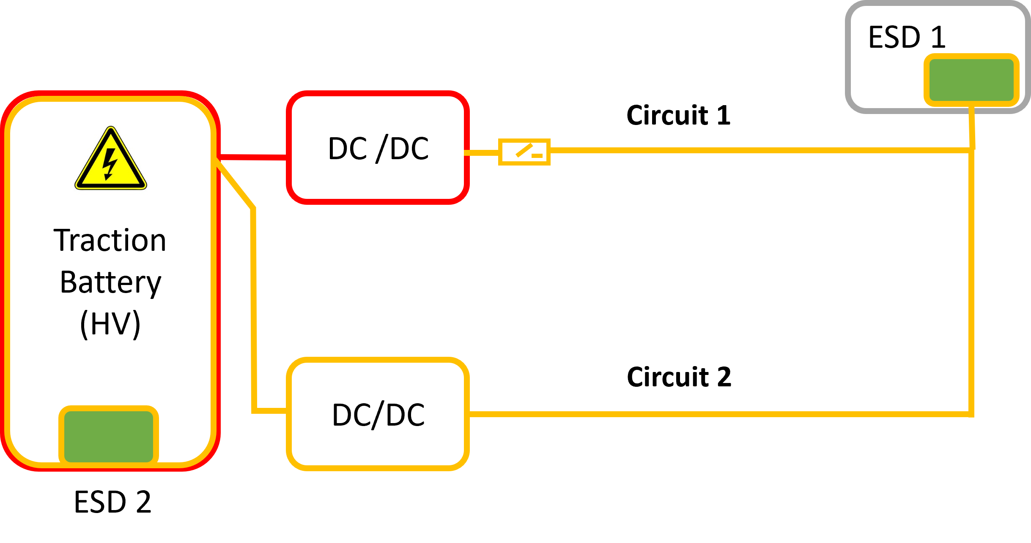
4. Brake circuit isolation
Different technical solutions in dependance of the architecture
Architecture | Architecture | Protection Element
Electronically Controlled Braking System - Typical HCV EBS layout (R13) |  | Circuit Protection Valve
ETBS - Layout 1 - Specific battery for braking |  | Diode
ETBS - Layout 2 - Multipurpose battery for braking and auxiliaries |  | Active Separating and Connecting Element (ATV)
ETBS - Layout 3 - Traction battery used as an electrical storage device |  | Active Separating and Connecting Element (ATV)

Slide 12
4. Brake circuit isolation
Active Separating and Connecting Element (ATV)
Technological solutions for ATVs exist
ATVs are used in production vehicles today
They may be standalone components, or integrated into other ECUs (e.g. Zone Controllers)
ATVs are an important part of safe vehicle power supply system
They can be used to ensure independency in systems other than braking systems

Slide 13
5. Periodical Technical Inspection (PTI)
Procedure to check that the means of detection to trigger the warning signals are operational.
Reference braking force:
  Reference brake values extended from pneumatic systems, therefore applicable to more vehicle categories.
  First time that reference braking forces are introduced in R13H (alignment on R13).
  Must be possible to evaluate the relationship between the brake demand and the measured braking force on a roller brake tester.
  The manufacturer must describe the method by which this can be realized.
Challenge:
  Application of reference braking values for ETBS systems is not standardized (e.g. brake demand value could be as a percent value, a voltage, brake pedal force or stroke, pressure).
  ETBS is a technology in its infancy; being too prescriptive at this stage could limit the possibilities for development.
  PTI requirements could be reviewed in the medium term, based upon market experience.

Slide 14
Coffee Break

Slide 15
6. Terminology
6.1. Electrical Storage Device
"Electrical storage device" means a device, or combination of individual devices, each capable of storing an electrical charge and of providing electrical power to the braking system transmission. Electrical storage devices which are connected in series and/or parallel for the purpose of supplying a single braking circuit, shall be considered as one electrical storage device within this Regulation.
-
+
-
+
-
+
-
+
-
+
-
+
A combination of devices in series
= one electrical storage device.
-
+
-
+
A combination of devices in series and parallel
= one electrical storage device.
-
+
A combination of devices in parallel
= one electrical storage device.
-
+

Slide 16
6. Terminology
6.2. Electrical Storage Device
The “state of an electrical storage device” means its ability to provide power (W) and quantity of energy (Wh) at the time.
transmission
transmission
This is the useful extractable power and energy (which is available to the transmission) based on the condition at the time.
This may vary with battery temperature.
This will vary during discharge and re-charge.
-
+
-
+
The “performance of an electrical storage device” means its ability to provide power (W) and quantity of energy (Wh) when fully charged.
transmission
transmission
This is the useful extractable power and energy (which is available to the transmission) when fully charged. This may reduce over time through use.
-
+
-
+
The “effect of ageing” is quantifying the irreversible degradation of the performance of an electrical storage device, due to e.g., the effects of time, use, and environmental exposure.

Slide 17


Terminology
6.3. Energy Source and Electrical Supply
-
+
DC
Batt
-
+
-
+
-
+
DC
Alternator
(similar to compressor)
Battery / Capacitor
(similar to an air tank)
DC/DC
(similar to a pressure regulator)
"Energy source" means a device that both generates and provides energy required for the braking system.
Is a source because it generates electrical energy
Is not generating, but only releasing stored energy
Is not generating, but only processing (high voltage) electrical energy to (low voltage) electrical
"Electrical supply" means a device (e.g. battery, REESS, generator, fuel-cell or a combination of these components) that supplies electrical power to the braking system's electrical storage device(s).
As part of the supply
In most layouts it is a storage device.
However, it can be part of a supply (e.g. Traction battery that supplies the braking system’s electrical storage device).
Is part of the supply

Slide 18
7. Principles to manage energy
The energy medium is the fundamental difference between an Electric Transmission Braking Systems (ETBS) and current technology (electrical energy versus compressed air).
In case of ETBS, the energy, that can be provided to the braking system must be predicted whereas in a pneumatic braking system the available energy is measurable.
Unlike pneumatic pressure, the electric energy cannot be directly measured but only be assessed based on monitoring of several physical parameters.
The most relevant parameter is not the energy which is stored in an electrical storage device at any time, but rather the energy and the power which is capable of being provided to the electrical load (i.e., the brake).

Slide 19
8. Energy Management System (EMS)
General tasks how measure and manage electrical energy
Measure and/or monitor in real time the energy available in the reserve in all operating conditions and over the lifetime (high/low temperatures, ageing, …).
Determine the value of the power and the energy that can be provided to the brake transmission (e.g., the effect of resistance on the flow of energy).
Compare that value with the known threshold value required to meet the specific performances required by the regulations.
To generate a warning to the driver in real time in accordance with the known threshold value.

Slide 20
8. Energy Management System (EMS)
Pneumatic Braking System vs. “Electrical Transmission Braking System”
Pneumatic Braking Systems (PBS)
  the reserve of energy can be measured and monitored at any time directly (by direct means at TA and PTI )
Electrical Transmission Braking System (ETBS) according to para. 2.5.3. (UN R13) and para. 2.34. (UN R13H)
  the reserve of energy cannot be measured and monitored at any time directly.
  multiple signals (voltage, current, temperature) are necessary to be observed to measure, monitor, and deduce the output power of the Electrical Storage Device (reference: para 2.48 (UN R13), para. 2.30 (UN R13H))
“Electrical Transmission Braking System” (ETBS) means a braking system of a power-driven vehicle where the service braking force, and transmission, depend exclusively on the use, controlled by the driver, of energy provided from electrical storage devices.
➔ Definition of Energy Management System (EMS) according to para. 2.51. (UN R13) and para. 2.33. (UN R13-H)
“Energy Management System” means, an electrical device(s), being part of, or used by, an electrical transmission braking system, that monitors critical variables that impact on the performance and state of the electrical storage devices (e.g., voltage, temperature, internal resistance, effect of ageing, state of charge, power consumption, charging cycles, etc.) and deduces the actual capability of the devices to fulfil the performance requirements of this Regulation.

Slide 21
8. Energy Management System (EMS)
(Example: Lead acid battery state detection| basic principle)
Voltage
A
Estimator of battery states & parameters
Examples of Predictors
V
Current
Model of the battery
Indicator
5.2.1.13.2. (UN R13)
5.2.14.4. (UN R13-H)
Temperature
State of the electrical storage device
-
+
T
Adaption of parameters
Determine effect of ageing
Warning light
5.2.1.35.6 (UN R13)
5.2.24.6 (UN R13-H)
Signals to be measured and given as an input for the “model of the battery”
( voltage ,current, temperature)
State variables and model parameters as an input for the Predictors
Warnings and Indicators are continuously triggered
Load profiles
(number of brake applications)
Influences like low temperature, high temperature ,the exchange of electrical storage device, ageing; long-time parking shall be considered and covered.
Technological solutions for EMS are available from various suppliers, their reliability is field-proven.
EMS shall demonstrate compliance according to
  5.2.1.35.8.2. / 5.2.1.35.8.3. (UN R13) respectively 5.2.24.8.2. / 5.2.24.8.3. (UN R13-H)
  UN-R13-Annex18 and UN-R13H-Annex 8

Slide 22
9. Annex 7 / Annex 4 UN R13 / Annex 7 Part A, compressed-air braking systems
Start of Annex7 test at pressure p2 declared by the manufactuer
Energy for
Start of assessment of Annex7 test (8+1)
Red Warning Signal according to 5.2.1.13.1. (a)
Service Braking
Secondary Braking
9+n
9+3
9+2
9+1
9
8
7
6
5
4
3
2
1
0
Full stroke actuation

Slide 23
9. Annex 7 / Annex 4 Part D, §1.2.ff. (ETBS)
Example 1
Energy for
Yellow Warning Signal according to 5.2.1.35.7.
Start of Annex7 test (8+1)
Red Warning Signal according to 5.2.1.13.1. (b)
Service Braking
Secondary Braking
9+n
9+3
9+2
9+1
9
8
7
6
5
4
3
2
1
0
Actuation as defined in Annex 7-part D – 1.2.2.3

Slide 24
9. Annex 7 / Annex 4 Part D, §1.2.ff. (ETBS)
Example 2
Energy for
Start of Annex7 test (8+1)
Yellow Warning Signal according to 5.2.1.35.7.
Red Warning Signal according to 5.2.1.13.1. (b)
Service Braking
Secondary Braking
9+n
9+3
9+2
9+1
9
8
7
6
5
4
3
2
1
0
Actuation as defined in Annex 7-part D – 1.2.2.3

Slide 25




9. Annex 7 / Annex 4 Part D, clarification of §1.2.3.3.
Annex 7, para. 1.2.3.3.: “Each actuation shall cause a demand (a_{ref}) on the brake actuators necessary to deliver the maximum possible deceleration designed to be delivered by the system in the Type-0 condition (e.g. cold brakes, Type-0 speed, laden, fully charged electrical storage devices), limited to 8.0m/s².
The demand value to the brake actuators may be reduced to a lower value a_{reduced}, while not being lower than the prescribed service braking deceleration. In this case, the duration-T of each full stroke actuation shall be increased as per according to the following formula below: ….. “
Case 1
Deceleration (maximum) a_{ref}=7m/s²
Control Transm.
Energy Transm.
Brake Control
Unit
a_{executed} =7m/s²
T=8s
a_{ref}=a_{executed} =7m/s²
Case 2
Deceleration (limited) a_{ref}=8m/s²
Control Transm.
Energy Transm.
Brake Control
Unit
a_{executed} =8m/s²
T=8s
a_{ref}=a_{executed} =8m/s²
Case 3
Deceleration (reduced) a_{reduced}=6.43m/s²
a_{reduced_min}=6.43m/s²
a_{reduced_min}=5m/s²
Control Transm.
Energy Transm.
Brake Control
Unit
a_{ref}≠a_{reduced} a_{reduced}=a_{executed} =6.43m/s²
T=8/6.43*8s T=9.95s
a_{executed} =6.43m/s²

Slide 26
9. Annex 7 /Annex 4 Part D, Section 2 ( test of the capacity of the electrical supply)
Type-I test (Annex 4) – Dynamic test
State of the ESDs
Yellow warning
5.2.1.35.x
Red warning
(5.2.1.13.1.b)
Brake application
Start
1
2
3
4
5
6
7
8
9
10
19
20
21
max. 1min
Energy provided by the electrical supply to the electrical transmission during Type-I dynamic test (followed by the hot performance test)
=
Energy provided to the electrical transmission
during the Annex 7 static test
80%v_{max} → 0km/h
Capacity of the electrical supply
(Annex 7, Part D, section 2) - Static test
State of the ESDs
Yellow warning
5.2.1.35.x
Red warning
(5.2.1.13.1.b)
Brake application
Start
1
2
3
4
5
6
7
8
9
10
19
20
21
PASS Condition: the state of the ESDs is above the level of the red warning, and the Pw warning is not activated

Slide 27
10. Indicator
Performance
The indicator shall provide at least [4] different levels of ageing above the level at which a maintenance of the electrical storage device(s) is recommended. This 5th level shall be given before the warning signal required by 5.2.1.35.6. is activated. The different levels above this indication shall be evenly distributed with respect to the performance of the ESD.
even performance drop between levels (effect of ageing)
>= 8+1
Number of cycles
Change recommended
5.2.1.35.6 (UN R13)
5.2.24.6. (UN R13-H)

Slide 28
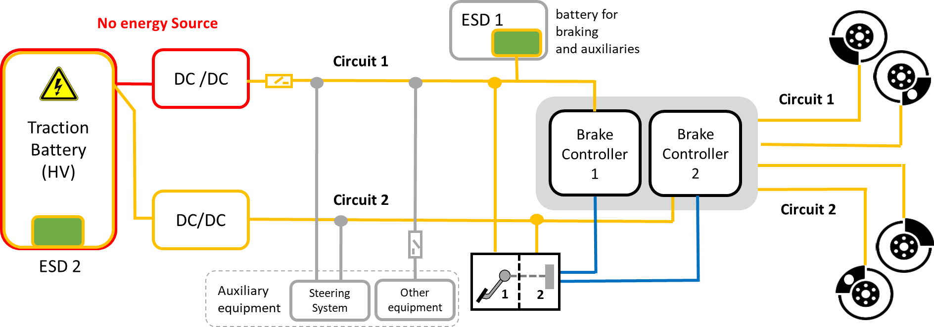

11. Auxiliary Equipment
- Circuit with electrical supply -
2.55./2.35. “Auxiliary equipment” means, for the purposes of this Regulation, the collective of systems, functions, or components, including those that are essential to the operation of the vehicle, that are supplied with energy from the same energy reserves as the braking system.
Indicative layout
Relevant situation according to 5.2.1.35.10. (5.2.24.10.):
① Auxiliary Equipment is supplied from the same ESD as the braking system
② Failure of the electrical supply that is providing energy to this ESD
①
①
②
Requirement
Failure of the
electrical supply
ESD starts depleting
t
Possible strategies between occurrence of failure and red warning
Red Warning
acc. to 5.2.1.13.1. (b) in R13
resp. 5.2.14.1. (b) in R13-H *)
Switching off auxiliary equipment
Automatically bringing the vehicle to standstill
A combination of both (first switching off parts of aux. eq., later the standstill)
IMPORTANT: The operation of auxiliary equipment required to satisfy the performance requirements of another safety related UN regulation shall not be affected.
*) Service brake performance cannot be achieved, or
4+1 actuations are still possible,
whichever occures first

Slide 29
11. Auxiliary Equipment
- Circuit w/o electrical supply -
2.55./2.35. “Auxiliary equipment” means, for the purposes of this Regulation, the collective of systems, functions, or components, including those that are essential to the operation of the vehicle, that are supplied with energy from the same energy reserves as the braking system.
Indicative layout
Relevant situation according to 5.2.1.35.10. (5.2.24.10.):
① Auxiliary Equipment is supplied from the same ESD as the braking system
② a) No electrical supply (e.g. Traction Battery is one ESD) -> non-fault
b) Failure that prevents Traction Battery from providing braking system
①
②
Requirement
Normal operation or
failure occurs
2a) normal operation / 2b) no provision of braking system
t
Possible strategies before red warning
Red Warning
acc. to 5.2.1.13.1. (b) in R13
resp. 5.2.14.1. (b) in R13-H *)
Switching off auxiliary equipment
Automatically bringing the vehicle to standstill
A combination of both (first switching off parts of aux. eq., later the standstill)
IMPORTANT: The operation of auxiliary equipment required to satisfy the performance requirements of another safety related UN regulation shall not be affected.
*) Service brake performance cannot be achieved, or
4+1 actuations are still possible,
whichever occures first

