Slide 1
C2 tyre abrasion rate index vehicle method description
TFTA 23rd session 25 April 2024

Slide 2
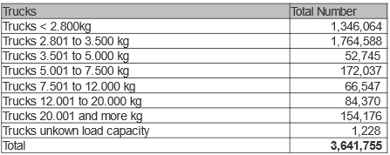
C2 tyres and truck market data
Sources:
  Tyres: Europool 2022
  Vehicles: KBA (German Federal motor transport authority) (➔ Germany only)
Major market for “C2” trucks : GVW <= 3500 kg
Major market for C2 tyres: 235/65R16C

Slide 3
C2 tyres: abrasion rate index vehicle test method concept
Concept similar to C1 tyres vehicle test method, mg/km/T of candidate to reference index
Convoy of up to 4 vehicles with reference tyres
Vehicles:
  4 single tyres, up to 3.5T GVW, FWD, allowing to test each and every C2 tyres up to LI 121.
  loaded [60%;74%] of tyre nominal load
  Alignment constraints to be defined
Controlled driving condition representative of European market driving/service conditions*
  Acceleration standard deviation : X: 0.45 m/s2, Y 0.93 m/s2
  Same road distribution constraints as for C1 tyres
  ➔ the current C1 circuits have been successfully tested with vehicles loaded at 3.5T and are compliant
Reference tyres:
  The relevance of temperature influence must be confirmed.
  Depending on the results, a strategy for reference tyre and its usage has to be confirmed
*number of reference data for C2-featuring vehicles tbd

Slide 4
Ongoing test
Targets:
  Test distance
  Temp. impact
3PMSF running
Normal running

Slide 5
Summary and next steps
Concept defined and under preliminary tests
Next steps:
  Confirm temperature sensitivity,
  Define reference tyre strategy,
  Extend test method to other sizes (e.g. LT sizes),
  Study vehicle impact and axle geometry tuning,
  Define validation plan based on C1 learnings
  Define market assessment based on C1 learning
  Run market assessment

Slide 6
Thanks for your attention

