Slide 1
ADS-IWG Credibility
Phase 1 summary
Submitted by the OPI on Virtual Testing Credibility Assessment provisions
Document ADS-04-12/Rev.1
4th ADS IWG session
8-11 October 2024
ADS 4th session
09/10/2024
Biagio Ciuffo, Riccardo Donà

Slide 2
Summary on Credibility section
5 meetings held between the 3rd (Brussels) and 4th (London) IWG-ADS:
Transposition of VMAD-SG2 guideline document into regulatory text:
  Extract part of the guideline text containing explicit and implicit requirements
  Rephrasing to match the “who shall do what” format
Restructuring of the document to match regulation’s structure:
  4. General Requirements: general obligation for the manufacturer to demonstrate suitability of the simulation toolchain through credibility assessment
  5. Requirements/Specification: lists requirements for credibility (management, analysis, V&V) which address the manufacturer
  6. Assessment: role of the auditor
  Annex: TBD

Slide 3
Summary on Credibility section
General agreements on most requirements transposed from the guideline
Open items:
  Possibility of using more than a simulation toolchain and whether the current text (using wording “toolchain(s)”) is clear in this regard:
  Possibility of re-using only a tool part of a simulation toolchain for a different use-case
  Add additional clarification details to overcome vagueness on specific requirements.
Future work (Phase 2/3) :
  Role of the assessor: limited supporting text from guideline, new text to be developed
  Need to find the right balance in providing clarity without overengineering requirements
  Link with SMS (e.g., competency of the personnel, interaction with suppliers)

Slide 4
Open item 1
Dealing with multiple toolchains
Rationale: manufacturers might wish to use different simulation toolchains to cover different aspects of the ADS assessment (e.g., HIL for failure scenarios and MIL to complement some physical tests/parameters exploration…).
Options:
  (current) Use notation “simulation toolchain(s)” throughout the requirements’ list
  add specific requirement in the specification section that clarifies the point, ex:
  5.X.Y. [tentative] The manufacturer may use multiple simulation toolchains provided that each simulation toolchain is suitable for the specific use case

Slide 5
Open item 2
Dealing with tool(s) from another toolchain(s)
Rationale: manufacturers might wish to use an already developed tool from a toolchain for a different use-case with potentially different criticality
Option: suggested definition for simulation toolchain that might fit better:
  [OLD] “Simulation toolchain” means a combination of simulation tools that are used to support the validation of an ADS
  [NEW] “Simulation toolchain” means a simulation tool or a combination of simulation tools that are used to support the confirmation of the ADS safety case's claims
The new definition has the following clarifications:
  it makes clear that a simulation toolchain might be made up of a single tool;
  it ties the scope of a toolchain to the safety case (requirements + AoUR).

Slide 6
Open item 3
Level of detail in requirements
Rationale: original guideline document listed approaches to document the credibility and its sub-pillars (e.g., criticality based on ISO 26262). The guideline nature affords to be more exhaustive but in the regulatory text a suitable trade-off between level of detail and flexibility for the manufacturer is needed.
Options:
  (current) relatively open text derived from guideline where provisions which could potentially force explicit approaches towards credibility assessment have been removed
  Develop new content/add examples in the body of the text
  Move discussion to interpretation document

Slide 7
Thank you
Notes:
Update/add/delete parts of the copy right notice where appropriate.
More information: https://myintracomm.ec.europa.eu/corp/intellectual-property/Documents/2019_Reuse-guidelines%28CC-BY%29.pdf

Slide 8
Back-up slides

Slide 9
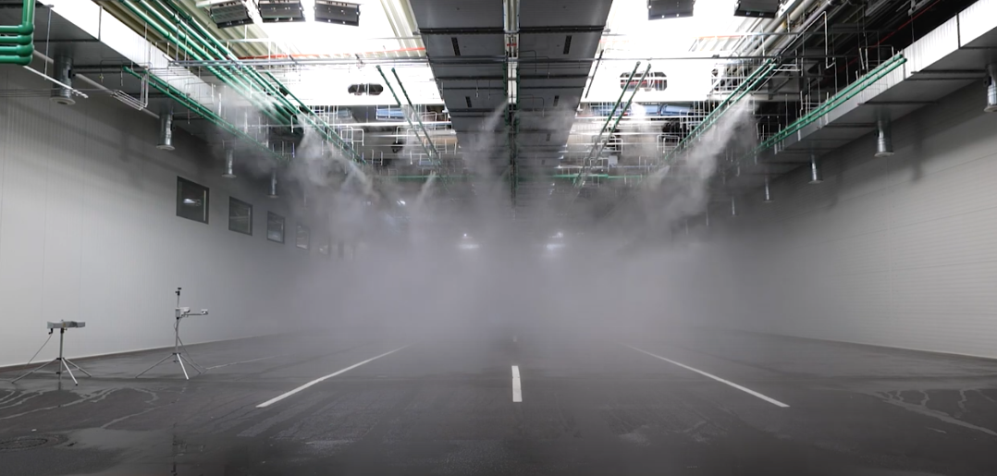
Updates – definitions
3.33 “Simulation” means the imitation of the operation of a real-world process or system over time utilizing a software implementation for some (or all) of the models, tools or test environment.
Rationale: previous definition of “simulation” (no text in green) did not rule out test environment like this:

Slide 10
Criticality
Option 1: Criticality-centred approach:
5.X.2. [JRC Proposal] The manufacturer shall demonstrate that the simulation toolchain(s) is suitable to use for virtual testing by:
  performing a criticality analysis that evaluates the potential risk and consequences of using the simulation toolchain(s) for the assessment of the ADS safety case and functional/user requirements;
  demonstrating that the simulation toolchain(s) fulfils the credibility requirements corresponding to the identified criticality as per the requirements listed in this section.
Option 2: Capability-centred approach:
5.X.2 [RH/UK Alternative] The manufacturer shall demonstrate that the simulation toolchain(s) is suitable to use for virtual testing by demonstrating compliance with the requirement listed in this section.
  The manufacturer shall document the capability of the simulation toolchain and explain their claim that it is suitable to undertake the virtual testing.
  The manufacturer shall document the activities and processes that support the claim that the simulation toolchain is suitable to use for virtual testing.
  The manufacturer shall provide evidence that supports their claim that the simulation toolchain is suitable to use for virtual testing.

Slide 11
Roles
Manufacturers (Section 5):
  Define the minimum level of credibility to deem results credible based on the criticality of the application
  Perform the credibility assessment on the simulation toolchain to verify suitability
Authorities (Section 6):
  Review/audit credibility assessment
  Demand the execution of virtual tests on the (credible) simulation toolchain

Slide 12
Flow – to be updated

