Slide 1
Transmitted by the Netherlands
Informal Document GRPE-91-XX
91st GRPE, 14th – 16th of October, 2024,
agenda item 17
Report to 91th Session of GRPE
(October 2024)
Task Force Automated Vehicles Regulation Screening
(TF-AVRS)

Slide 2


TF Automated Vehicles Regulation Screening
9
13
Number of Meetings
Participants
(Contracting Parties & NGOs)
Web-meetings
9 TF-AVRS in 2023
10th TF-AVRS: 29th January 2024
11th TF-AVRS: 22nd February 2024
12th TF-AVRS: 27th March 2024
13th TF-AVRS: 23rd April 2024
14th TF-AVRS: 27th May 2024
15th TF-AVRS: 18th June 2024
16th TF-AVRS: 2nd September 2024
17th TF-AVRS: 10th October 2024
CPs:
Germany, France, United Kingdom, South Africa, [United States], The Netherlands
NGO‘s:
OICA, EUROMOT
Report TF-AVRS – GRPE-91

Slide 3
TF Automated Vehicles Regulation Screening
Targets
WP29 requests a screening of regulation for application of Automated Vehicles.
GRVA proposed a template for the screening
TF-FADS (GRVA) provides further guidance
Roles
Chair: [The Netherlands] => Vacant
Secretariat: […] => Vacant
TF-AVRS wikipage
https://wiki.unece.org/pages/viewpage.action?pageId=198672917&src=contextnavpagetreemode
Report TF-AVRS – GRPE-91

Slide 4
Screening process: Considered items
1. Terminology
    Relevant terms based on GRVA guidance (accelerator, handle-bar type steering)
2. Use cases AVs
    Driverless AVs
      With passenger
      Without passengers (cargo)
    AVs with driver
    Bi-directional AV’s => on hold for the moment due to GRVA decision
3. Other considered items
    Telltales & warning signals
    Test modes
Report TF-AVRS – GRPE-91

Slide 5
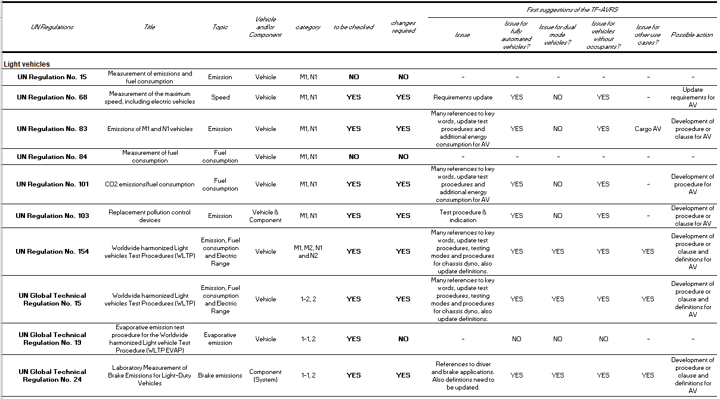
Report TF-AVRS – GRPE-91

Slide 6
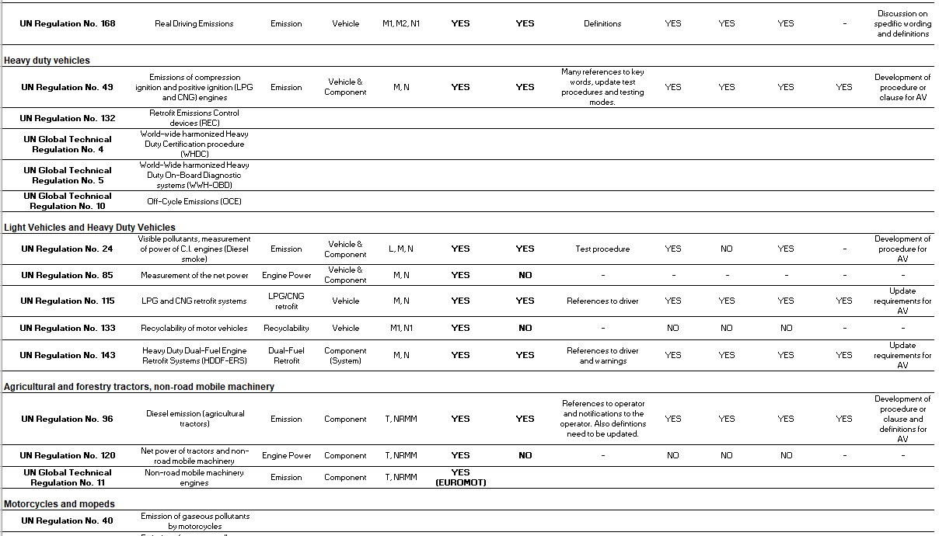
Report TF-AVRS – GRPE-91

Slide 7
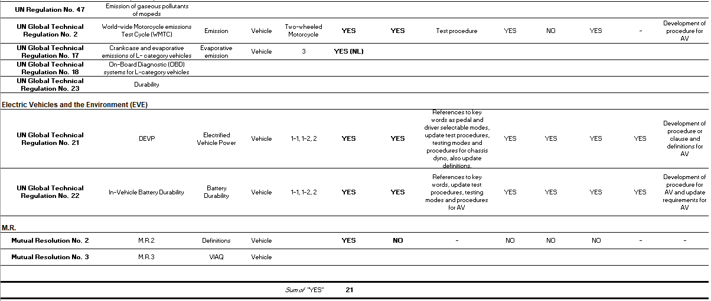
Report TF-AVRS – GRPE-91

Slide 8
TF-AVRS Results
No vehicle categories will be excluded from screening
2 Regulations are excluded from screening (old)
21 regulations are screened => 9 during last GRPE
2 regulations are planned to be screened
9 regulations still need to be addressed
  4 HDV UN GTR/UN R
  4 L-category UN GTR/UN R
  1 M.R.
Report TF-AVRS – GRPE-91

Slide 9
Next steps
Continue with meetings once per month. A face-to-face meeting to discuss next steps of TF-AVRS will be planned.
Participants from CP’s and NGO’s are really needed to accelerate the screening and to continue the necessary work after the screening => The actual updating of UN GTR’s and UN R’s.
GRPE is really behind on other GR’s
Changes to GRPE Regulations should be in place before the ADS Regulation is ready in 2026
Who is willing to join TF-AVRS?
Report TF-AVRS – GRPE-91

Slide 10
Thank you for your attention
Report TF-AVRS – GRPE-91

