Slide 1

ACPE IWG #09
ACPE-09-03
Vehicle Category

Slide 2
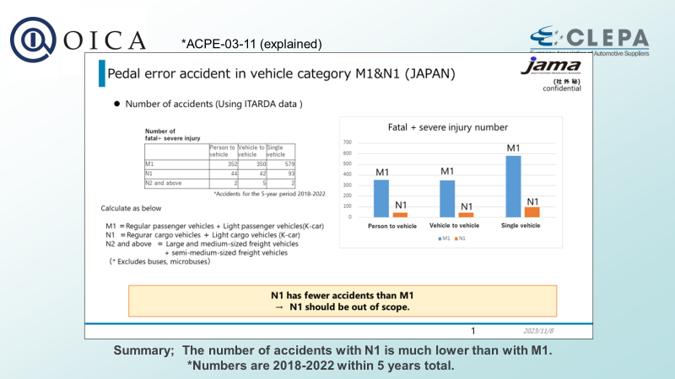
Traffic accidents result
(ACPE-04-11, repost)
ACPE-09-03

Slide 3
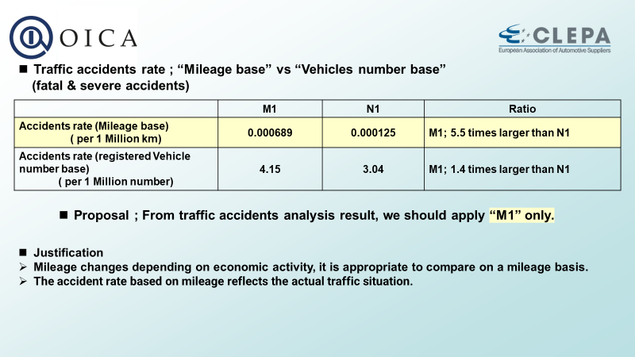
Traffic accidents result
(ACPE-04-11, repost)
ACPE-09-03
Propose: Exclude N1
Justification
From Traffic accident analysis, N1 Accidents number and accidents rate is small

Slide 4
ACPE-09-03
Thank you

