Slide 1

ACPE IWG #09
ACPE-09-05
Test Procedure proposal

Slide 2
ACPE-09-05
Background : Traffic Accidents Analysis
ACPE traffic accidents rate (Percentage of ACPE accidents in the "number of accidents" by location)
Rate is higher at parking lot
Ref ; info124_e.pdf (itarda.or.jp)

Slide 3
ACPE-09-05
Background : Traffic Accidents Analysis
Actions to take in the event of ACPE accident (Parking lots)
Starting up, Moving straight are higher
Reversing and turning are lower
Ref ; info124_e.pdf (itarda.or.jp)

Slide 4
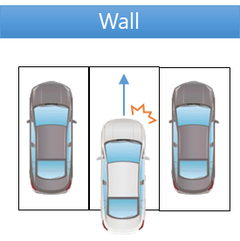
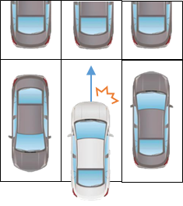
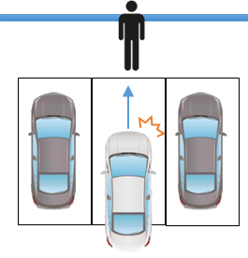
ACPE-09-05
Assuming accidents scenario
Assuming pedal error in a parking lot
Parking lot
Pedal error may occur when entering and exiting a parking lot
(repeated forward and backward movement)

Slide 5


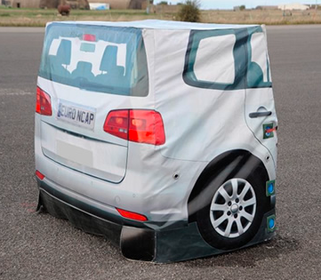

ACPE-09-05
Test procedure proposal
Simulate situations such as entering and exiting a parking lot
Simulates pedal error during short distance travel
Forward
Release
brake
Sudden
acceleration
Backward
Release
brake
Sudden
acceleration
[1.5]m
[1.5]m
[2.5]m
[2.5]m
Release the brake pedal, drive (Creep) a short distance then applying the accelerator pedal input.
(distance is [ ] (square bracket)
JAMA plan to conduct real vehicle test on end of July. (try to several distance)
Testability viewpoint
Specifying distance makes it easier to adjust the target position. (considering test repeatability and reproducibility )
If we specify running time or subject vehicle speed, we have to adjust the target position every time.
(There is a large variation in the initial movement of the vehicle.)

Slide 6
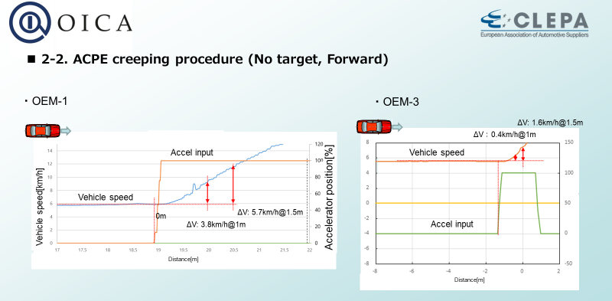
ACPE-09-05
Performance requirement
Acceleration when the accelerator is pressed while driving tends to be gradual
based on the results of actual vehicle tests (ref : ACPE-06-09 document)
If the distance to the obstacle is short, the initial vehicle speed increase is also small.
→ Would it be possible to measure the distance from the accelerator input to the obstacle in [1.5] m
and use the same requirements as for the 00 series?
Test distance, performance, etc. are scheduled for actual testing at the end of July
→ We would like to propose these parameter at the IWG in September

Slide 7
ACPE-09-05
Creeping (Long) Run test procedure concern
Example
Distance or time
Pedal error
Brake release
Creep long run (without gas pedal input)
[1.5]m
Pedal error
Creep long run (without gas pedal input)
[1.5]m
It is unlikely that such a scenario is ACPE typical accident scenario.
(creeping long run (ex. 5sec or more, or 10m running)
Although we believe that such accidents are not zero, they are unlikely to be typical.
Vehicle speed up by creeping long run → It may occur AEBS intervention before ACPE.
Ex. AEBS intervention → Accelerator input → AEBS override → Vehicle accelerate
Creeping speed exceeds AEBS operating speed

Slide 8
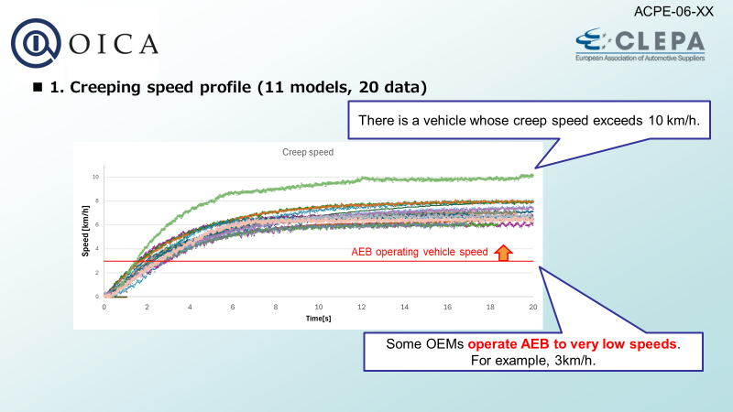
ACPE-09-05
Creeping speed profile (ACPE-06-09 document)
(repost)

Slide 9
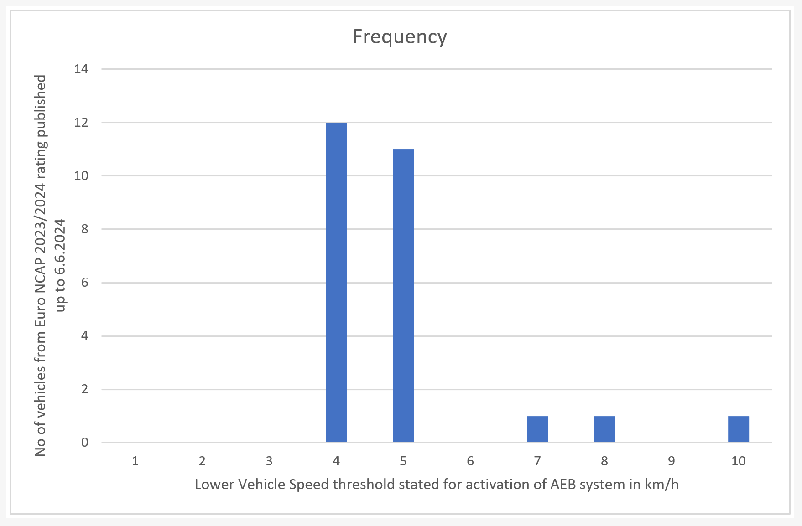
ACPE-09-05
AEBS activation lower speed
Extract “Euro NCAP” AEBS test result
Many AEBS can activate at lower speed
(from 4~5km/h)
*Excerpts from the test results sheets for each vehicle
Ref; Euro NCAP | The European New Car Assessment Programme

Slide 10
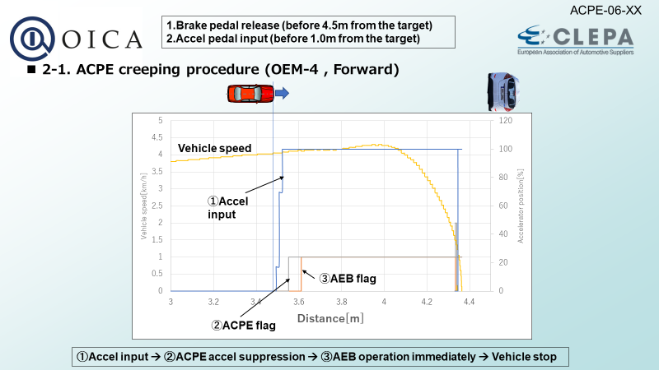
ACPE-09-05
Test results example : ACPE-06-09 document
(Creeping run test)
Distance: 1.0m
from accel input to obstacle
Result: AEB operates immediately
after accelerator input
In this vehicle, AEBS was not deactivated by "accelerator operation"
It is possible by design not to activate AEB when it is determined that the driver has the intention.
Also, for vehicles with higher creep speeds, AEB may activate before the accelerator is input
There are many different operating concepts, and it is difficult to define them uniformly.
This test procedure seemed to be inappropriate as an evaluation method for ACPE.

Slide 11
ACPE-09-05
Test procedure proposal
Test procedure | Target | 00 series TP From standstill to accelerate （1.0/1.5m） |  | 01 series TP Moving OFF
 | Vehicle (3D or 2D) | X |  | X
 | Pedestrian | N/A |  | X
 | Performance requirement | Warning function Speed reduction ・ΔV＜8km/h、 ・Reduction rate more than 30% （w/wo ACPE） |  | （Tentative） Warning function Speed reduction ・ΔV＜8km/h、 ・Reduction rate more than 30% （w/wo ACPE）
After the 01 series is applied, only the 01 series test will be applied.

Slide 12
ACPE-09-05
Summary
Test procedure recommendation ; “Moving Off” scenario based on Traffic accidents analysis.
(The vehicle starts moving and the driver immediately operates pedal error.)
Creeping run test
If the creep travel time is increased, it will overlap with the AEBS operating speed range.
As the result, a variety of actions may occur.
・AEBS operates prior to accel input
・AEBS activation will be cancelled by driver’s accel input. etc
It seemed to be inappropriate to evaluate ACPE function
Proposal
Test Procedure : Moving Off test (short distance run → then accel input)
Test parameter : Would like to propose at September #10 IWG
Based on real vehicle tests (test distance, requirements, etc)

Slide 13
ACPE-09-05
Thank you

Slide 14
ACPE-09-05
Appendix ； EURO NCAP Test result sheet
The AEBS activation lower speed is shown
Assessment details (euroncap.com)

