Slide 1
WTPP outcome on IWG WGWT workplan 2024-2025
WTPP 23 May 2024

Slide 2
Outcome of last IWG WGWT meeting on 17 April 2024
Workplan 2024-2025 will consider a smaller number of representative sku’s to be tested (compared to 2019-2021) with a higher number of repetitions to study:
Temperature effect (by considering wider temperature range in the R117 temperature range)
2 levels of water height
Compare self-watering with external watering (pending on test center capability) to verify if two watering methods (self- and external-watering) give the same worn tyre wet performance index with the candidate tyres

Slide 3
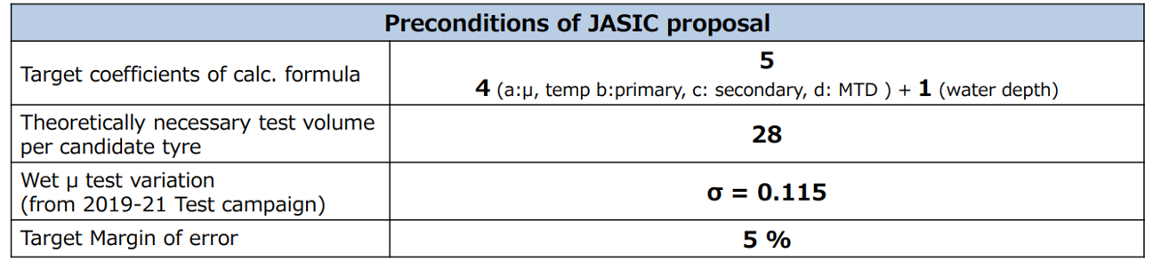
JASIC and ETRTO target: test method precision improvement
ETRTO objective is to make use of workplan 2024-2025 to confirm that all proposed changes are improving the test method precision.
JASIC objective is to conduct test campaign to review and improve calculation formula by statistical point of view. Target condition as
Clear divergent point of view on the objective.

Slide 4
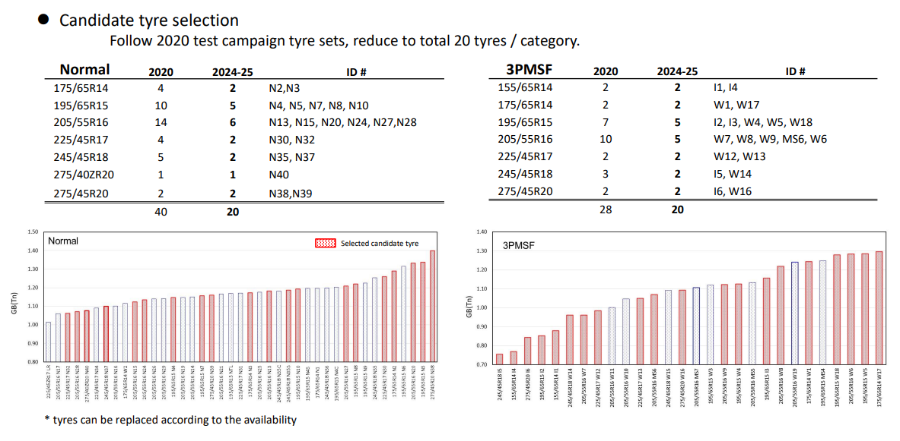
ETRTO and JASIC initial proposals
ETRTO: 8 SKU’s, 3 repetitions, all test centers → 24 test/test center
JASIC: 40 SKU’s, 3 repetitions, all test centers → 120 test/test center

Slide 5
Comments on ETRTO and JASIC initial proposals
JASIC refused ETRTO proposal as for them 8 SKU’s is largely not sufficient
ETRTO proposed to review the proposal, but explained that the JASIC proposal is not reaching the objective and with the risk to spend huge efforts for non-guaranteed results.

Slide 6
ETRTO alternate proposal
ETRTO reflected on an alternate proposal with the following considerations:
  To increase 8→24 SKU’s to be closer to JASIC proposal
  To fulfil the testplan objectives
  To keep 3 repetitions (analytical approach) to study the test method dispersion/variability and control the measurement uncertainty
  To not jeopardize the agreed timing

Slide 7
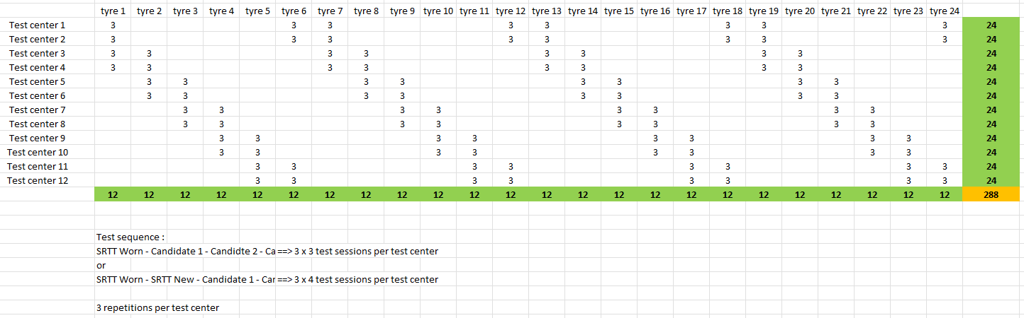
ETRTO alternate proposal
24 SKU’s, 12 test centers, each test center testing 8 SKU’s, 3 repetitions, each SKU tested in 4 test centers
Still considering the agreed test sequence “SRTT16 worn – Candidates – SRTT16 worn”, two levels low/high of wet surface temperatures and two levels of water height (e.g. 0.7 / 1.3 mm) for capable test centers

Slide 8
ETRTO alternate proposal conclusions
ETRTO alternate proposal has to be seen as a compromise approach responding to JASIC request to increase the number of SKU’s
ETRTO is strongly convinced that this proposal is responding to the IWG WGWT objectives, and will allow the IWG WGWT to assess the parameters that are in the correction formula (track frictional properties, T°, MTD, …) and verify the improvement of the test precision

Slide 9
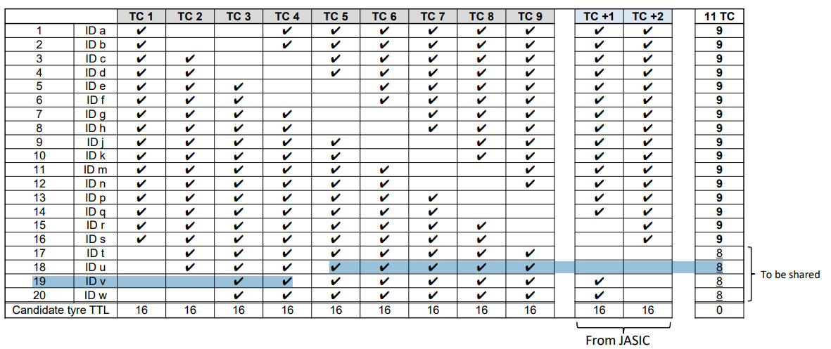
JASIC alternate proposal
Marging of error should be maximum 5%: ETRTO alternate proposal (sample size = 4) is 11.3% → need for sample of 20 tyres /category.
For test volume rationalisation:
JASIC proposed to add 2 test centers → sample could be reduced from 20 → 16

Slide 10
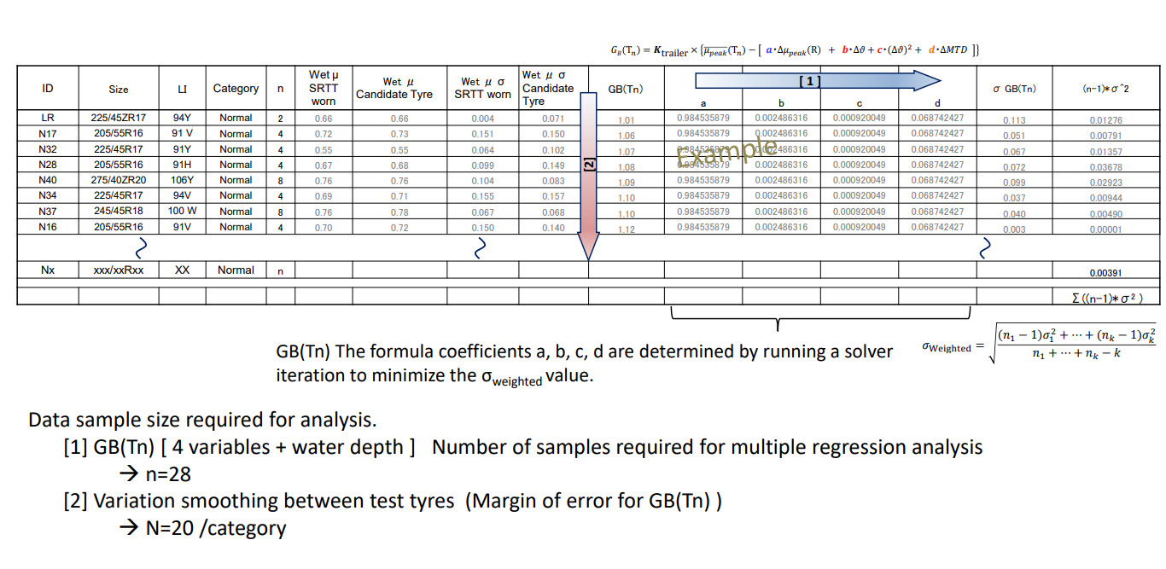

Slide 11
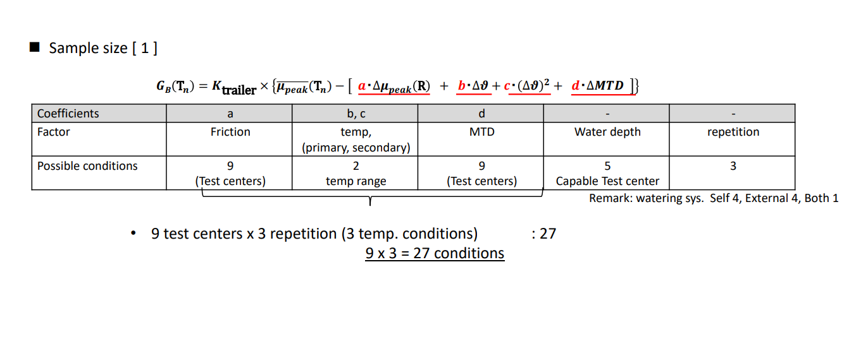

Slide 12
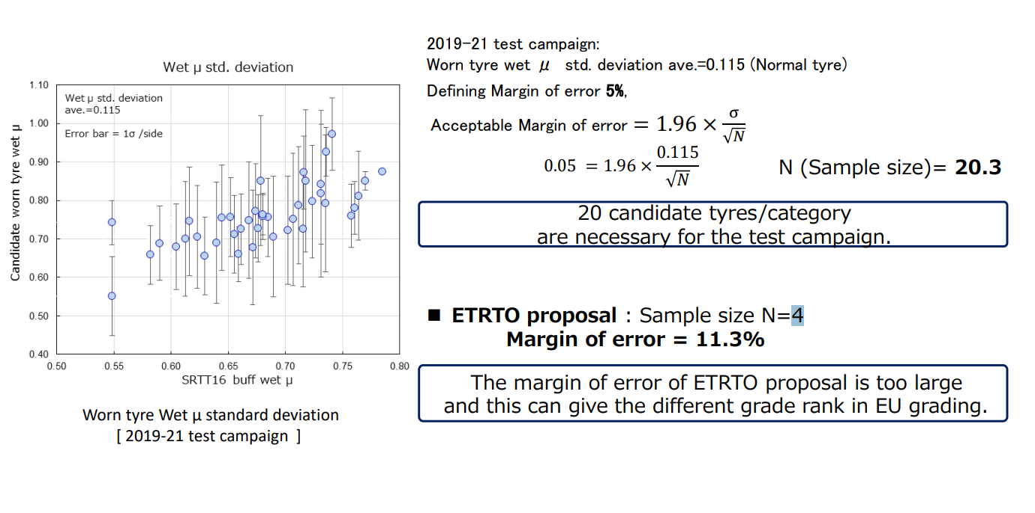
ETRTO new proposal N=12 → Margin of error: 6,5%

Slide 13
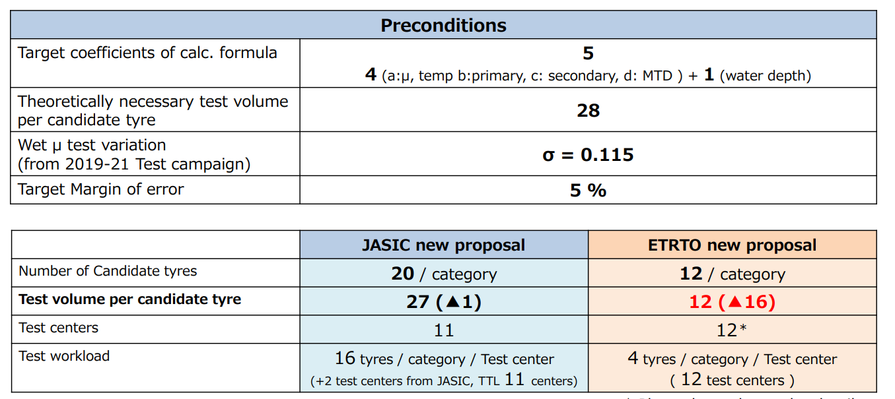
Comparison ETRTO – JASIC testplan proposal
JASIC summary
JASIC workplan is 3,75 broader than ETRTO workplan proposal
ETRTO alternate proposal is not responding to the (JASIC) workplan requirements

Slide 14
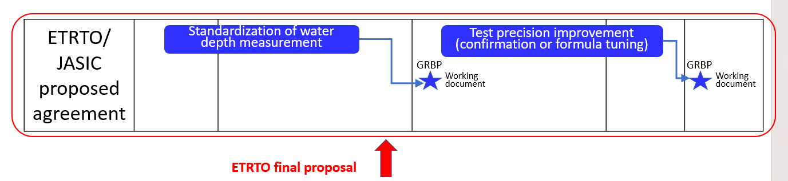
ETRTO further reflection
ETRTO would like to remind the IWG WGWT agreement as written in WT-47-5:
‘IWG WGWT agreed with the workplan proposal made by ETRTO in WT-47-2, with the exception to consider the re-postprocessing of 2021 test campaign data.’
JASIC statement in WT-46-2 slide 4
Source: WT-47-2 slide 5

Slide 15
ETRTO further reflection
ETRTO opinion is that the IWG WGWT and WTPP agreements taken in WT-47-2 and WT-57-2 are indicating clearly the objectives of the 2024-2025 workplan.
In ETRTO’s opinion, ETRTO is strongly convinced that the proposal is responding to the IWG WGWT objectives:
  To confirm the test method improvements
  To verify the improvement of the test precision.
  To reflect the IWG WGWT agreements and timeline.
Based on JASIC request, to consider the margin of error below 5%, ETRTO calculated that with the alternative workplan proposal the margin of error is at 6,5% (much lower than the 11,3% mentioned by JASIC).
ETRTO would also remind the need to consider the limited testing capacity resources (clearly indicated in WT-47-2). A possible revision of the correction formula would require a much broader test campaign considering also the vehicle method and M+S tyres.

Slide 16
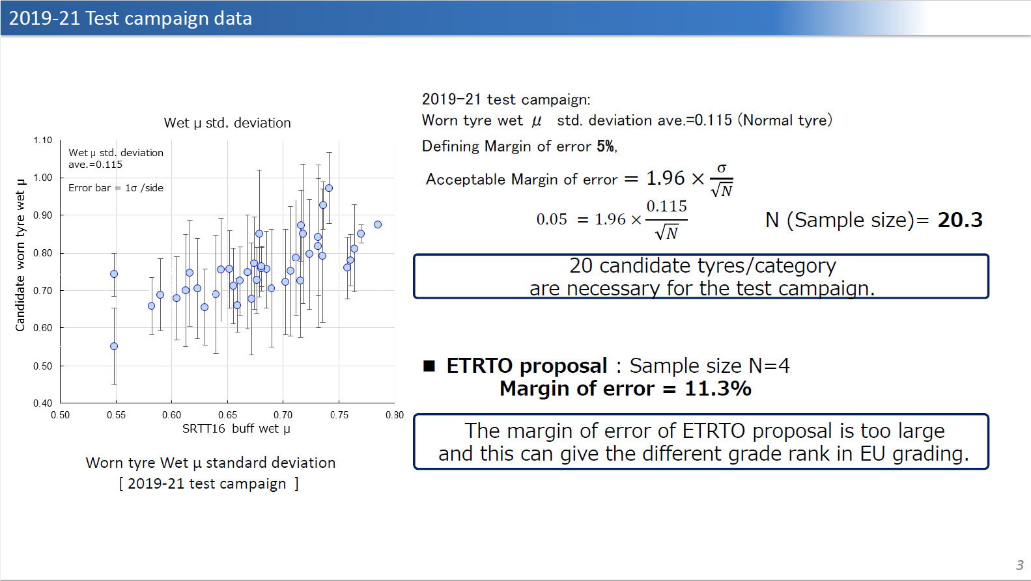

Input on Standard Error for ETRTO proposal
Following up on JASIC analysis shared during last meeting May-16th:
Latest ETRTO test plan proposal is sample size N=12 (tires per category):
Margin error = 6.5%
$$1.96×\frac{0.115}{\sqrt{12}}=0.065$$

Slide 17
ETRTO final proposal
For the Workplan 2024-2025 to consider ETRTO alternate proposal (to be seen as a compromise approach responding to JASIC request to increase the number of SKU’s
Target: to quantify the reduced dispersion of the test with the improvements implemented in step #1 (reduced friction range and recommendations for water depth) and the needed additional improvements
In a later stage, similarly as for wet grip in new state, to perform a dedicated RRT to assess whether the correction formula needs to be revised.

Slide 18
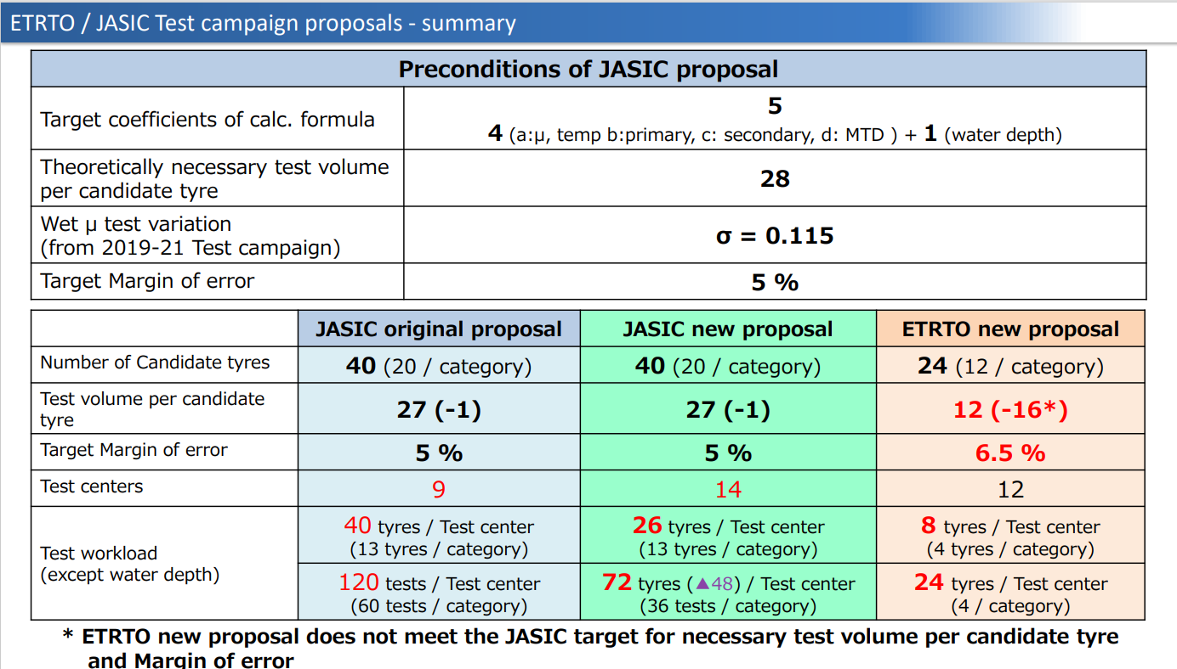

Slide 19
Thank you

