Slide 1
10th A-LCA IWG SG2 MTG
2024.May.30
Isao Tabushi / JASIC (Japan)

Slide 2
Overall schedule plan
 | 2023 |  |  |  |  |  | 2024 |  |  |  |  |  | 2025
 | Jun | Aug | Sep | Oct | Nov | Dec | Jan | Feb | Mar | 2Q | 3Q | 4Q | -
IWG MTG
Objective ,usage method, applicable product setting
Automotive material list/classification setting
System boundary setting - Material flow/hotspot - manufacturing SG3 - waste/recycling SG5
a level concept setting
Cutoff/Data requirement/
Setting of each material carbon intensity
Data collecting and setting
Info.exchange for verification
Material classification concept for Batteries
Secondary Data Sets discussion

Slide 3
Summary of 9th meeting
1. Battery material boundary
  GBA member did not participate this meeting.
  SG3 prefer Opiton3 boundary and would like to separate primary data discussion. (Information from OICA)
  Tabushi will contact SG3 to discuss this topic. And as SG2 prefer option2.
2. Secondary dataset
  Tabushi will propose the dataset list to next IWG in Seoul.
  Tabushi would like to confirm the matching of material classification on each dataset.
  Tabushi would like to have some volunteer to confirm each dataset.
  OICA proposed to add EF compliant dataset to the list
  Benedetta concerns that dataset could be updated regularly, and it could be regular task.
  Material classification matching with dataset will be considered two option.
    Matching by user
    SG2 arrange a direction ( making the flag which database has proper material dataset )

Slide 4
Agenda
Feedback from IWG in Korea
Dataset
  Discussion - dataset criteria
Agenda of SG2-3 meeting
  Boundary
  Allocation
  Chain of custody
Preparation for drafting (Discussion will be start from next time)

Slide 5
1. Feedback from IWG in Korea

Slide 6
Feedback from IWG in Korea
SG2 was mainly proposing about dataset in last IWG meeting in Korea.
Also, SG2 asked to every SGs to discuss about dataset in each SG’s meeting.
Finally, IWG make below conclusion for this agenda.
<Main conclusion>
Make a candidate list from existing dataset for A-LCA
Make a criteria to select the suitable dataset to the list
<Other comments from participants>
To list the dataset is not enough. We should have a rule to use dataset for A-LCA.
Each dataset has different boundary, and it should not be mixed.
Please consider also reginal data
If dataset is not free, this is unfair.
We don’t need high quality, but we need to follow to close the gaps every year.

Slide 7
2.Dataset

Slide 8
Remind of IWG presentation from SG2

Slide 9
Executive summary
GHG emissions
[kg-CO2e]
Activity Data
[kg]
Intensity Data
[kg-CO2e/kg]
※For material acquisition
Both Activity Data & Intensity Data can be Primary Data or Secondary Data.
It is nearly impossible to get the all data by Primary Data.
Therefore, Secondary Data discussion is needed.
SG2 has discussed Material Classifications, these materials need to set Secondary Data for Intensity Data.
To harmonize Secondary Data as one specific Data Set, has difficulty of consensus.
SG2 propose to nominate the list of several Data Sets as preference.
Primary Data : product specific data
Secondary Data : industrial average data

Slide 10
Secondary Data Sets discussion

Slide 11
Target of Secondary Data Sets discussion
Harmonized Level | Description | Difficulty of consensus | Fairness for all user | Target
Level 4 | Develop New Deliciated DB for A-LCA | High | High
Level 3 | Select one common DB from existing DB for A-LCA
Level 2 | Nominate several common DB from existing DB for A-LCA |  |  | ← Proposal
Level 1 | No decision making of DB selection for A-LCA | Low | Low
Need to be discussed Harmonized Level of Secondary Data Sets

Slide 12
Data set proposal list (summary of 8th Meeting)
Data set name | Recommender
GREET | JASIC, OICA, VECC
IDEA | JASIC, OICA
LCIDB | OICA
CALCD | OICA
Ecoinvent | OICA, VECC
GaBi Databases | OICA, VECC
EF compliant dataset | OICA
Each industry association dataset | JASIC, European Aluminum

Slide 13
Adoption of UUID to Material Classifications
Material | No | Upstream | Process name | ID | No | Downstream | Process name | ID
Steel | 1 | Blast furnace | Crude steel, convert furnace method | 221115201pJPN | 1 | Cast iron | Pig iron castings for machinery | 225111000pJPN
 | 2 | Methane DRI | Pig steel_Methane_DRI_1 | AIST_JAMA_001 | 2 | Cast steel | Ordinary steel castings (cast steel) (including cast steel pipes) | 225311000pJPN
 |  |  | Crude steel_Methane DRI_2 | AIST_JAMA_001A | 3 | Hot-rolled steel sheet | Ordinary steel medium and thin plates (less than 6 mm thick, including low-mo plates and electric steel plates) , converter method | 222118201pJPN
 | ３ | Hydrogen DRI | Hydrogen,SMR (Gray) | AIST_JAMA_021 | 4 | Cold-rolled steel sheet | Cold-rolled ordinary steel sheet (including cold-rolled low-mo steel sheet and recycled finished steel sheet) , converter method | 222212201pJPN
 |  |  | Hydrogen,SMR +CCS (Green) | AIST_JAMA_022 | 5 | Electromagnetic steel sheet | Cold-rolled electric steel strip, converter method | 222213201pJPN
 |  |  | Hydrogen,Renew Electrolysis (Blue) | AIST_JAMA_026 | 6 | Hot-rolled hot-dip galvanized steel sheet | Hot rolled hot dip galvanized steel sheet, converter method | AIST_JAMA_000A
 | 4 | Electric furnace | Crude steel, electric furnace method | 221115202pJPN | 7 | Hot-rolled electrogalvanized steel sheet | Hot rolled electrogalvanized steel sheet, converter method | AIST_JAMA_000B
 |  |  |  |  | 8 | Cold-rolled hot-dip galvanized steel sheet | Hot dip galvanized steel sheet, converter process | 224111211pJPN
 |  |  |  |  | 9 | Cold-rolled electrogalvanized steel sheet | Electrogalvanized steel sheet, converter process | 224111221pJPN
 |  |  |  |  | 10 | Carbon steel bar/wire rod | Ordinary steel wire rod and bar in coil, converter process | 222116201pJPN
SG2 has discussed adoption of UUID to each materials. But gave up…
⇒ Finally, SG2 decide just to nominate the Data sets List.

Slide 14
Discussion – dataset criteria
In IWG, there were many comment to make a criteria for the dataset.
Now we assume below points could be discussion point as criteria.
<Proposal of dataset criteria>
  Declaration of defined criteria
  Dataset updated date
  Dataset suitability for A-LCA (Suitable for our material classification list)
  Usage history (How many user was using the dataset)
  Data source (Original creation dataset (e.g., average value of industry) or Citations from other literature)
  External reviewer

Slide 15
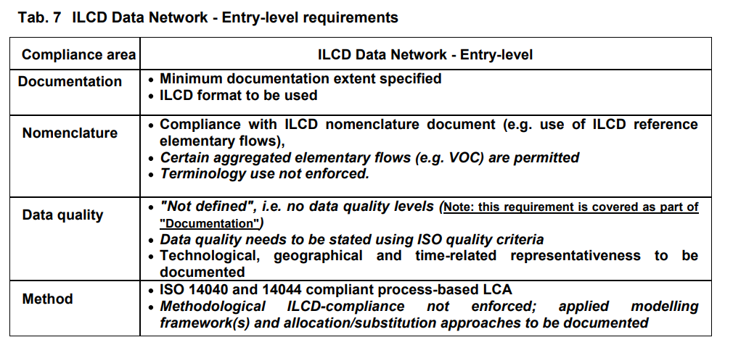
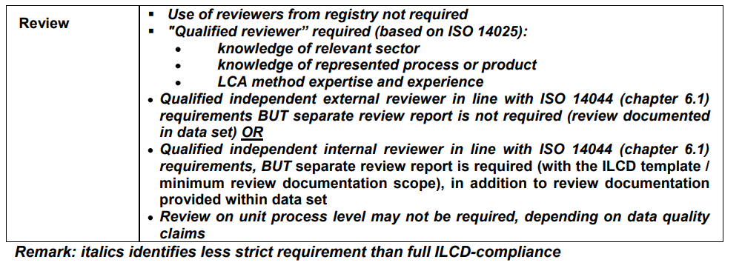
Reference
ILCD entry level requirement

Slide 16
3. Agenda of SG2-3 meeting
1. boundary

Slide 17
Material List by VDA classification
VDA material
5.1 | thermoplastic resin
5.1.a | Thermoplastic resin (containing filler)
5.1.b | Thermoplastic resin (without filler)
5.2 | thermoplastic elastomer
5.3 | Elastomer/elastomer composites
5.4 | thermosetting resin
5.4.1 | polyurethane
5.4.2 | unsaturated polyester
5.4.3 | Other thermosetting resins
5.5 | Polymer composites (e.g. laminated trim parts)
5.5.1 | Resins in polymer composites.
5.5.2 | Fibres in polymer composites (textiles)
6.1 | painting material
6.2 | Adhesives, sealants
6.3 | underseal
7.1 | Organic natural materials (e.g. leather)
7.2 | Ceramics/glass
7.3 | Other composite materials (e.g. friction linings)
8.1 | Electronic component materials (e.g. PCBs, displays)
8.2 | Electrical component materials
9.1 | fuel
9.2 | lubricant
9.3 | brake fluid
9.4 | Coolant/other glycols
9.5 | refrigerant
9.6 | Washer fluid, battery fluid
9.7 | preservative
9.8 | Other fuels and replenishers
 | Tyre
 | lead-acid battery
 | Drive battery cell
VDA Classification | VDA Classification Name
1.1 | Steel/cast steel/sintered alloys
1.1.1 | Unalloyed/low alloy steel
1.1.2 | high-alloy steel
1.2 | cast iron
1.2.1 | Gneissic graphite cast iron/ malleable cast iron
1.2.2 | Spheroidal graphite cast iron/Vermular cast iron
1.2.3 | high-alloy cast iron
2.1 | Aluminium / aluminium alloys
2.1.1 | Cast aluminium alloys
2.1.2 | Forged aluminium alloy
2.2 | Magnesium, magnesium alloys
2.2.1 | Cast magnesium alloy
2.2.2 | Forged magnesium alloy
2.3 | Titanium, titanium alloys
3.1 | Copper (e.g. copper in harnesses)
3.2 | copper alloy
3.3 | zinc alloy
3.4 | nickel alloy
3.5 | lead (the metal)
4.1 | Platinum/rhodium
4.2 | Other special metals
Not enough to show low CO2 material effect by VDA classification

Slide 18
Parts → material → system boundary
Example (steel)
Material Classification | Manufacturing Process |  |  | Examples of components used in automobiles
 | upper processes | mid- process | lower processes | Body & Chassis | Batteries and Motors | Engine | Transmission | Standard Components
Steel | Blast Furnace / Electric Furnace | - | Cast iron | Brake caliper, brake disc, knuckle |  | Bearing caps, crank pulleys, damper pulleys, Drive Plate, Camshaft, Turbo Housing
 |  |  | Cast steel
 |  |  | Hot-rolled steel sheet | Upper arm, lower arm, steel wheel, pedal, seat frame
 |  |  | Cold-rolled steel sheet | Side panel, Roof panel, Bumper beam, Roof frame, Door sash, Inside panel, Airbag module, Seat frame, Radiator |  |  | CVT belt
 |  |  | Electromagnetic steel sheet
 |  |  | Hot-rolled hot-dip galvanized steel sheet
 |  |  | Hot-rolled electro galvanized steel sheet
 |  |  | Cold-rolled hot-dip galvanized steel sheet | Side frames, floor panels, door panels, fender panels, hood panels, tailgate panels, trunk lid panels, side sills, rear frames, steering hanger beams, inside panels, dash panels | IPU Bracket
 |  |  | Cold-rolled electro galvanized steel sheet | Brake tube, wiper arm
 |  |  | Carbon steel bar/wire rod | Tire cords, door beams, steering hanger beams, seat frames |  | piston ring | DIFF Case
 |  |  | Special steel bar | Suspension Spring |  | Piston pin, connecting rod, crankshaft, valve | CVT pulleys, transmission gears, bearings, drive shafts, e-Axle | Gears, Bearings
 |  |  | Special steel wire rod/ spring steel | Sway bar, Torsion bar |  |  |  | Bolts, nuts, springs
 |  |  | Stainless steel sheet/bar | Fuel Pipe, Exhaust Manifold, Exhaust Pipe, Converter, Muffler |  | Fuel pipe, fuel rail, EGR pipe, EGR cooler |  | gasket
 |  |  | Sinterd steel |  | Motor Rotor | Pulley, sprocket, connecting rod, bearing cap, oil pump rotor, valve guide | Synchro Hubs, Prenteral Gear Carriers | magnet

Slide 19
Material List (1)
Upstream process
Material classification | Process Name | Description
Steel | Blast furnace | Crude steel, convert furnace method
 | Methane DRI | Crude steel, Methane DRI
 | Hydrogen DRI | Hydrogen,SMR
 |  | Hydrogen,SMR +CCS
 |  | Hydrogen,Renew Electrolysis
 | Electric furnace | Crude steel, electric furnace method
Aluminum alloy | Primary aluminum | Primary aluminum ingots by fossil energy
 | Renewable Energy | Primary Aluminum Ingots by renewable energy
 | Inert anode | Alumina, Inert electrode, liquid aluminum, Cast Aluminum
 | Secondary aluminum | Recycled aluminum ingots, aluminum alloys
Copper alloy | Pyrometallurgy | Crude copper, Electrolytic copper
 | Hydrometallurgy | Crude copper by Heap leaching, Electrolytic copper
Resin | Fossil resources | General purpose plastic, General purpose engineering plastic, Thermocurable resin

Slide 20
Material List (2)
Downstream process
Material classification | Material Name
Steel | Cast iron
 | Cast steel
 | Hot-rolled steel sheet
 | Cold-rolled steel sheet
 | Electromagnetic steel sheet
 | Hot-rolled hot-dip galvanized steel sheet
 | Hot-rolled electrogalvanized steel sheet
 | Cold-rolled hot-dip galvanized steel sheet
 | Cold-rolled electrogalvanized steel sheet
 | Carbon steel bar/wire rod
 | Special steel Bars
 | Special steel wire rod/spring steel
 | Stainless steel sheet/bar
 | Sinteried steel
Aluminum alloy | Cast aluminum alloys
 | Die-cast aluminum alloys
 | Wrought aluminum(Plate)
 | Wrought aluminum(Extruded)
Copper alloy | Tough pitch copper strip
 | Tough pitch copper wire
 | Oxygen free copper strip
 | Oxygen free copper wire
Material classification | Material Name
Nonferrous metals | Magnesium
 | Zinc alloy
 | Lead
 | Platinum / Rhodium
 | Other metals
Resin | PP (Polypropylene)
 | PE (Polyethylene)
 | PVC (Polyvinyl chloride)
 | ABS (Acrylonitrile butadiene styrene)
 | PA (Nylon)
 | PC (Polycarbonate)
 | PET (Polyethylene terephthalate)
 | PBT (Polybutylene terephthalate)
 | PUR (Polyurethane)
 | POM (Polyacetal)
 | ASA (Acrylonitrile styrene acrylate)
 | PMMA (Acrylic resin)
 | EP (Epoxy)
 | PPS (Polyphenylene sulfide)
 | TPO (Thermoplastic Olefinic Elastomer)
 | TPV (Themoplastic Vulcanizates)

Slide 21
Battery material classification
Material category | No | Upstream | No | Downstream
Cathode active material | 1 | Primary resource | 1 | LMO
 | 2 | Recycled material | 2 | NMC111
 |  |  | 3 | LFP:Hydrothermal
 |  |  | 4 | LFP:Solid State
 |  |  | 5 | NMC622
 |  |  | 6 | NMC811
 |  |  | 7 | NCA
 |  |  | 8 | NMC532
 |  |  | 9 | NMC95
Anode active material | 1 | Primary resource | 1 | Graphite / Carbon
Binder | 1 | Primary resource | １ | Binder(PVDF)
Electrolyte salt | 1 | Primary resource | １ | LiPF6
Electrolyte solvent | 1 | Primary resource | 1 | Ethylene Carbonate
 |  |  | 2 | Dimethyl Carbonate
 |  |  | 3 | Mix
Separator | 1 | Primary resource | 1 | Separator(PP,PE)
NMP | 1 | Primary resource | 1 | NMP

Slide 22
Material List (3)
Downstream process
Material classification | Material Name
Other organic materials | SBR (Styrene Butadiene Rubber)
 | EPDM (Ethylene Propylene Diene Monomer Rubber)
 | Other thermoplastic resins
 | Other thermosetting resins
 | Natural rubber
 | Synthetic rubber
 | CFRP (Carbon Fiber Reinforced Plastics)
 | Rust proofing oil
 | Wood
 | Adhesives
 | Other organic materials
Others | Glass
 | Other inorganic materials
 | Paint
 | Electronic components(including Silicon)
 | Electronic components
 | Engine oil
 | Brake fluid
 | LLC (Long Life Coolant)
 | Air conditioner refrigerant (HFO-1234yf)

Slide 23
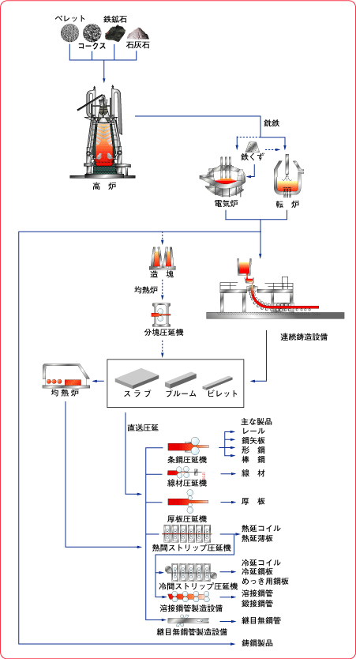


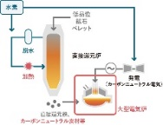
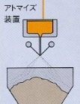


Parts → material → system boundary
Example (steel): upstream process
Upstream process
iron ore
process
coke
1. Blast furnace
pig iron
Converter furnace
input
output
limestone
iron ore
2. Direct reduction furnace
Continuous
casting
crude steel
NG-DRI
Natural gas
iron ore
⇒Outsourcing parts
manufacturing process
SMR
3. Direct reduction furnace
H-DRI
SMR+CCS
Hydrogen
Electrolysis
Atomization
/sintering
14. Sintered steel
scrap
4. Electric furnace
Low carbon technologies

Slide 24
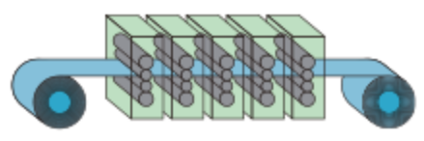

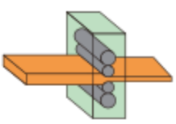
Parts → material → system boundary
Example (steel): downstream process
Downstream process
3. hot-rolled steel sheet
Automobile OEM
in-house factory process
Parts manufacturing process
10. Carbon steel bar/wire rod
process
1. Cast Iron
11. Special steel bar
input
Melting
output
2. Cast Steel
13. Stainless steel sheet/bar
Heat treatment
12. Special steel wire rod/ spring steel
4. Cold-rolled steel sheet
Cold rolling
Annealing
5. Electromagnetic steel sheet
crude steel
Heating
Hot rolling
6. Hot-rolled hot-dip galvanized steel sheet
Hot dip galvanizing
8. Cold-rolled hot-dip galvanized steel sheet
7. Hot-rolled electro galvanized steel sheet
Electro galvanizing
9. Cold-rolled electro galvanized steel sheet

Slide 25

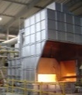


Aluminum upstream
Upstream process
Additive alloys
bauxite
process
Calcined lime
alumina
Electrolysis
input
NaOH
Cathode carbon
output
Aluminum fluoride
Petrol coke
Ingot casting
anode
Primary
aluminum ingot
Pitch
Inert anode
Additive alloys
electricity
Low carbon technologies
renewable energy
Scrap
Ingot casting
Secondary
aluminum ingot

Slide 26



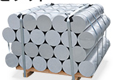
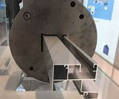
Aluminum downstream
Parts manufacturing process
process
input
Additive alloys
output
Casting
Heat treatment
1. Aluminum Casting
Primary
aluminum ingot
melting
Die-Casting
2. Aluminum Die casting
Secondary
aluminum ingot
melting
Aluminum slabs
rolling
3. Wrought Aluminum(Plate)
Liquid aluminum
Aluminum billet
extrusion
Heat treatment
4. Wrought Aluminum(Extruded)

Slide 27
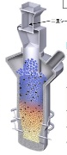
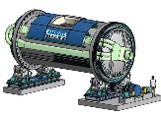

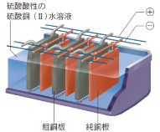

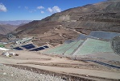
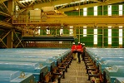
Copper upstream
Upstream process
1. Pyrometallurgy
process
input
copper ore
output
silica
Flash furnace smelting
crude copper
Fire refining
anode copper
Electrolytic refining
limestone
scrap
electricity
electrolytic copper
Low carbon technologies
renewable energy
2. Hydrometallurgy
copper ore
Leaching
Electrowinning

Slide 28
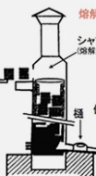
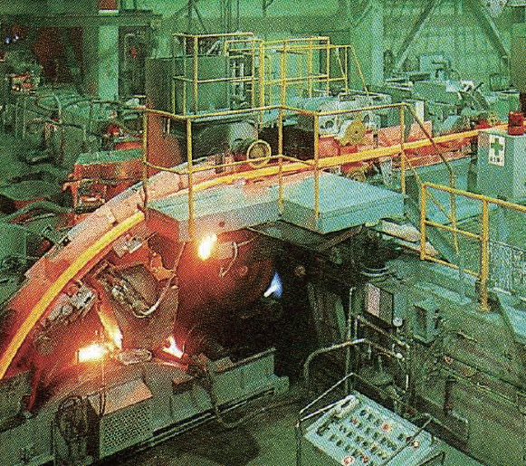
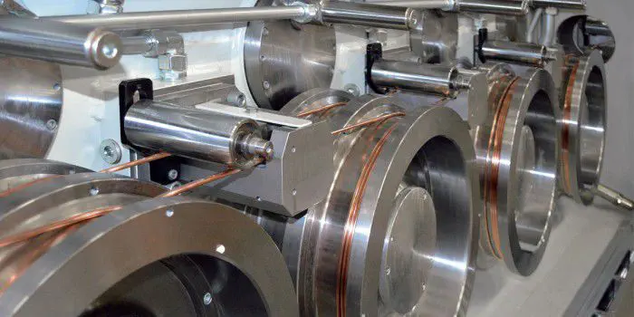
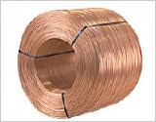
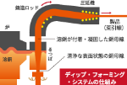

Copper downstream
Downstream process
process
input
output
electrolytic copper
Melting
Casting
Rolling
TPC
wire rod
Drawing
Annealing
Covering
Baking
TPC
bare wire
OFC
bare wire
scrap
OFC
wire rod
TPC
coated wire
Oxygen free
Casting
OFC
coated wire
TPC strip/bar
OFC strip/bar

Slide 29
Polymers upstream
Upstream process
process
PP
crude oil
input
PE
output
PVC
coal
distillation
ABS
natural gas
PA
naphtha
cracking
monomer
polymerization
PC
PET
recycled oil
PBT
POM
bio-based
Chemical recycled
ASA
PMMA
synthesis
polyol
polymerization
Resource circulation technology
PUR
polyisocyanate

Slide 30
Polymers downstream
Downstream process
process
PP
input
PP + filler
general purpose plastic
PE
output
PE + filler
PVC
PVC + filler
ABS
ABS + filler
PA
PA + filler
PC
compound
PC + filler
general purpose engineering plastic
PET
PET + filler
PBT
filler
PBT + filler
POM
POM + filler
ASA
Mechanical recycled
ASA + filler
PMMA
PMMA + filler
PUR
Resource circulation technology
PUR + filler
thermocurable resin

Slide 31
3. Agenda of SG2-3 meeting
2. Allocation

Slide 32
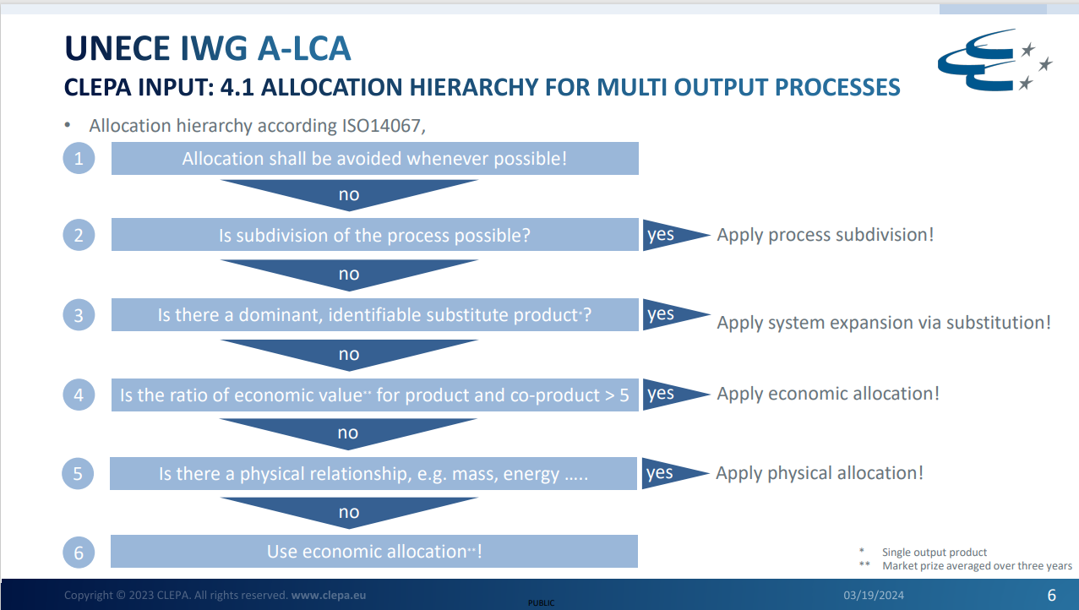
2.Allocaiton
There was a proposal from CLEPA on allocation as below
Need to confirm if SG2 agree this idea or not.
This point differ from ISO14067

Slide 33
3. Agenda of SG2-3 meeting
3. Chain of custody

Slide 34
3.Chain of custody
ISO 22095:2020 Chain of custody – General terminology and models
3.1.1 chain of custody
Process by which inputs and outputs and associated information are transferred, monitored and controlled as they move through each step in the relevant supply chain.
identity preserved model
2) segregated model
3) controlled blending model
4) mass balance model
5) book and claim model
High
Without mixing
Physical presence
Low
With mixing
No
Quote from : LCAF mass balance webinar presentation by Atsushi Inaba (25th Mar 2024)

Slide 35
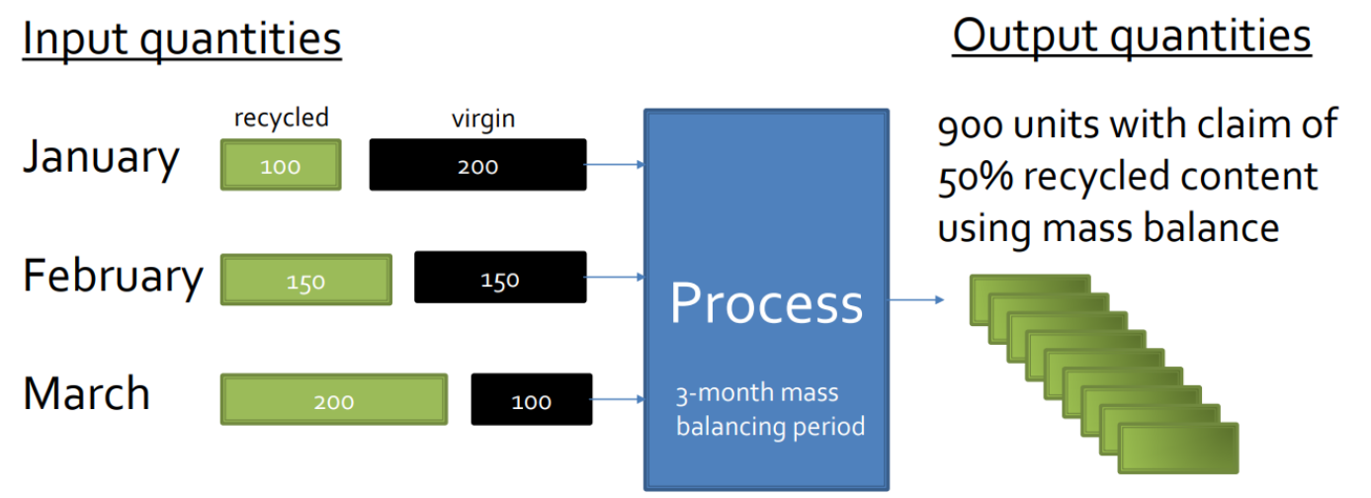

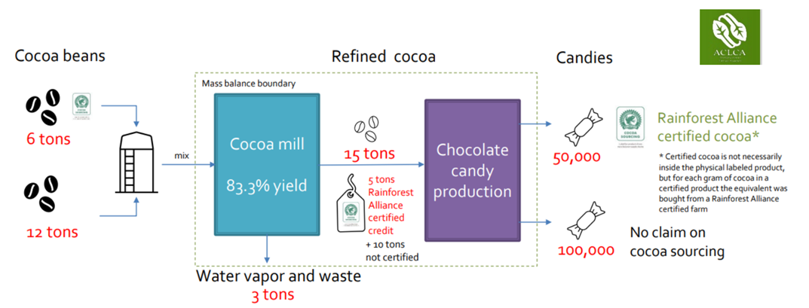
Mass balance model
Rolling average percentage
Credit method

Slide 36
Pros / Cons on chain of custody
Pros | Cons
Necessary to establish the circular economy Chemically same product Less additional facilities (investment) | Risk of Green wash → Green wash is unavoidable No actual benefit for society No information disclosure for residual products *If don’t count residual products, then double count could be happened.
Any methodology to avoid the green wash should be developed to avoid Cons

