Slide 1
10th A-LCA IWG SG2 MTG
Meeting minutes
2024.May.30
Isao Tabushi / JASIC (Japan)

Slide 2
Participants
Lead | ● | Isao | TABUSHI | CP | JP
Main Participants | ● | Koichiro | AIKAWA | NGO | OICA
 | ● | Johanna | BERLIN | NGO | OICA
 | ● | Toru | FURUSAWA | NGO | OICA
 | ● | Emmanuelle | KOBIALKA | NGO | OICA
 | ● | Torsten | KOSMEHL | NGO | OICA
 | ● | Duc-Nam | LUU | NGO | CLEPA
 | ● | Benedetta | Nucci | NGO | European Aluminium
 | ● | Mac | Ramsdell | NGO | CLEPA
 | ● | Sophie | RICHET | NGO | OICA
 | ● | Tetsuya | SUZUKI | CP | JP
 | ● | Alex | vanGELDEREN | NGO | BLIC
 | ● | Seunggu | Kang | CP | KR
 | ● | Zhangtong | Zhu | NGO | CATARC
 | ● | Zhanghong | Zie | NGO | CATARC
 | ● | Toshiyuki | Maruno | NGO | OICA
Present
Absent

Slide 3
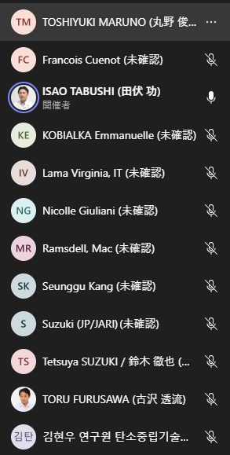
Participants & Observer list

Slide 4
Agenda
Feedback from IWG in Korea
Dataset
  Discussion - dataset criteria
Agenda of SG2-3 meeting
  Boundary
  Allocation
  Chain of custody
Preparation for drafting (Discussion will be start from next time)

Slide 5
Meeting minutes (Summary of 10th meeting)
2. Dataset criteria
The selection criteria for the datasets proposed by Tabushi include items such as clarification of defined criteria, dataset update date, dataset suitability, usage history, data sources, and external reviews.
Kobialka proposed adding items such as time, geographic technology representativeness of the dataset.
Lama commented that it is important to set quality standards for individual data, not datasets.
Tabushi argued that needed to first discuss the criteria for the entire data set.
Tabushi asked for feedback before the next meeting.
3-1. Boundary
Tabushi shared a list of newly added materials and asked for feedback before the next meeting.
The list includes those selected from the VGA material list, those discussed at the system boundaries of parts and materials, those discussed in the battery material classification, and those that are deemed necessary for the B Group LCA.
Tabushi asked that any comments or objections to the list be communicated by the next meeting.
During the meeting, no questions or comments were raised about the list.

Slide 6
Meeting minutes (Summary of 10th meeting)
3-2. Allocaiton
The allocation method proposed by SG3 is based on ISO 14067 and is applied in the following order: physical relationship, economic value, physical proportion, and economic proportion.
However, if there is a difference of more than 5 times in the economic value of the co-product, there is a condition that economic allocation is prioritized. 2
Maruno raised some concerns about this method.
  Some materials that used in a car could have a difference of more than 5 times in the economic value of the co-product.
  The upper process of some materials has co-products. (like as process of blast furnace)
  Datasets that have already been measured may use different hierarchies of allocation.
Maruno asked for time to consider above issue to respond to SG3.
3-3. Chain of custody
Tabushi introduced the concept and types of chain of custody and suggested that ISO standards should be followed. 1
Maruno expressed concern about mixed models such as mass balance and book and claim, saying that they are necessary for the circular economy, but there are problems such as greenwashing and social benefits.
Maruno suggested that standards and assumptions for the use of mass balance and book and claim should be considered, and touched on the status of the development of ISO standards. 3

