Slide 1
Report to 80th Session of GRBP
(September 2024)
Submitted by the Chair of SIG AVRS
Informal Document GRBP-80-xx
80th GRBP, 17-20, 2024,
agenda item xx
Task Force Automated Vehicles Regulation Screening
(TF AVRS)

Slide 2


TF Automated Vehicles Regulation Screening
6
22
Number of Meetings
Participants
(Contracting Parties & NGOs)
Web-meetings Task Force
21st of March 2024 (virtual)
17th of April 2024 (virtual)
15th of May 2024 (virtual)
19th of June 2024 (virtual)
17th of July 2024 (virtual)
3rd of September 2024 (virtual)
Small Drafting Group
6 meetings
Guidance meetings with GRVA FADS and GRVA AVC
CPs:
Australia, China, EC, Germany, India, Japan, Netherlands, Switzerland, United Kingdom.
NGO‘s:
OICA, EUWA, IMMA, SMMT, ETRTO

Slide 3
TF Automated Vehicles Regulation Screening
Targets
Update of GRBP regulations to facilitate the Type Approval of AVs
Considering:
TF-FADS suggests proposals for amendments to be submitted in 2024
TF-FADS (GRVA) provides further guidance
Roles
Chair: Netherlands
Secretariat: OICA
TF AVRS wikipage
https://wiki.unece.org/pages/viewpage.action?pageId=190087308
Documentation:
https://unece.org/sites/default/files/2022-07/ECE-TRANS-WP29-1166e_0.pdf
https://unece.org/sites/default/files/2022-05/GRVA-13-18e.pdf
Report GRVA FADS from WP29 June 2023: https://unece.org/sites/default/files/2023-06/ECE-TRANS-WP.29-2023-86e.pdf
Report WP29 190th meeting, June 2023: https://unece.org/sites/default/files/2023-07/ECE_TRANS_WP.29_1173e_0.pdf items 25 to 32.
AVC-06-11rev1 update of AVC-05-03rev3 Consolidated R.E.3

Slide 4
Update proposal for Guideline document
The objectives of the task force are to:
Update GRBP regulations to facilitate Type Approval of AVs
Align the work of TF-AVRS with the GRVA TF-FADS and other GRs
Consider the activities and results of GRVA IWGs VMAD and FRAV
Propose amendments to the R28, R51, R138 and R141, R165 to facilitate the approval of AVs
Present a timeline for the amendments of other relevant regulations under the responsibility of GRBP
Documentation:
GRBP-79-03 - (SIG AVRS) Guidelines of the Task Force on Automated Vehicle Regulation Screening

Slide 5
Priority Regulations
4 types of solutions
R28 – Horn
  Activation by the ADS is required
R51 – Noise
  Test mode to be required in ADS, adaption of test road (lining)
R138 - QRTV
  Regulations only needs minor amendments
R141 – TPMS (not in priority list yet)
  ADS must receive the TPMS input

Slide 6
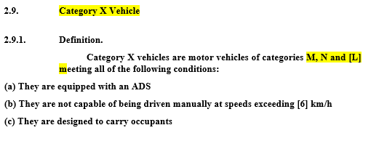
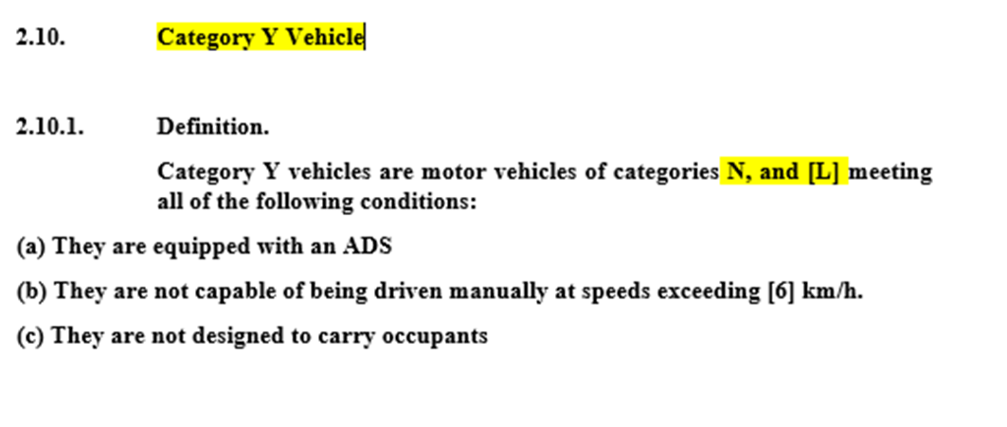
Automated Vehicle Categories (TF AVC)
Busses (occupants)
Trucks (goods only)
Dual Mode is not defined;
therefore, it needs to be described when it is relevant

Slide 7
About definitions
Add from TF-AVC (amendment RE3)
1.16* | “Automated Driving System(ADS)” | means the vehicle hardware and software that are collectively capable of performing the entire Dynamic Driving Task (DDT) on a sustained basis.
1.17* | “Dynamic Driving Task (DDT)” | means the real-time operational and tactical functions required to operate the vehicle.
2.2.5.4 | "Mass in running order" | …. driver (75 kg), if there is a driver seat in the vehicle and, for buses and coaches [and Category X vehicles], the mass of the crew member (75 kg) if there is a crew seat in the vehicle.
 | “Bi-directional vehicle” | means a vehicle that can operate in two opposite forward directions.
 | Footnote*: This definition is based on SAE J3016 and ISO/PAS 22736 (Taxonomy and Definitions for Terms Related to Driving Automation Systems for On-Road Motor Vehicles). These standards define levels of driving automation based on the functionality of the driving automation system feature as determined by an allocation of roles in DDT and DDT fallback performance between that feature and the (human) user (if any). The term “Automated Driving System” is used specifically to describe a Level 3, 4, or 5 driving automation system.
Discussion (R51)
“Accelerator” | means an acceleration pedal for manually driven vehicles and acceleration command for vehicles with no accelerator pedal.

Slide 8
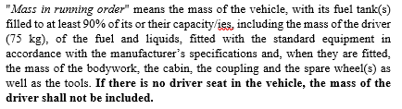
On “Mass in running order”
R138 legacy vs. RE.3 consistency
Crew seat irrelevant
Stay close to original R138
General approach
In case of a driverless AVs the m_{d}(mass of the driver) = 0 kg for the calculations

Slide 9
“Bi-directional”
Not considered in RE3 by AVC
  Bi-directional was considered out of scope
GRBP Summary on bi-directional vehicles
Forward and reverse driving
  Conclusion:
  Reverse requirements only when applicable.
Notes:
Opposing to the AVC position:
See bi-direction summary of the TF AVRS of GRBP
Reverse driving differs on the aspect of sight in a reduced field of vision for a manual driver. An automated vehicle will likely be equipped with sensors that guarantee a complete field of vision both in the forward and reverse direction. This makes bi-directional an AV-related topic. It should be considered in a later stage in

Slide 10
R28 nature of amendments
Operated by driver or ADS
Definitions in Part II
  ADS, DDT, Bi-directional (chpt 11)
Installation specifications
  14.1.3 In the case of bi-directional designed vehicles, the sound pressure shall be measured separately for each front plane of the vehicle.
A dedicated Annex for vehicles equipped with ADS is not necessary for this regulation

Slide 11
R138
Definitions
  Mass in Running Order, ADS, DDT, Bi-directional
Driver selectable sound → different available sounds
Annex 3 Methods..
  3.3.1 General
    For bi-directional vehicles → Reverse sound only when applicable
Annex 5 Vehicles equipped with ADS
  Option to test dual mode in manual
  Preparation by manufacturer to fulfil the conditions for test method
  Bi-directional

Slide 12
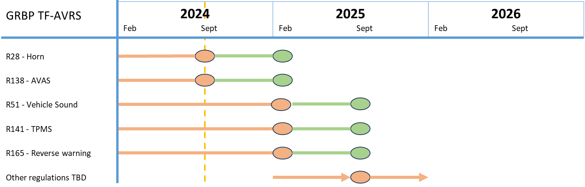
Planning
R51 - Vehicle Sound
Informal document
Working document

Slide 13
UN Regulations | Title | Topic | category | to be checked | changes required
UN R 9 | Noise of three-wheeled vehicles | Noise | L2, L4, L5 | YES | YES
UN R 28 | Audible warning devices | Noise | M, N, L3, L4, L5 | YES | YES
UN R 41 | Noise emissions of motorcycles | Noise | L3 | YES | ??**
UN R 51 | Noise of M and N categories of vehicles | Noise | M, N | YES | YES
UN R 59 | Replacement silencing systems | Noise | M1, N1 | YES | copy UN R 51
UN R 63 | Noise emissions of mopeds | Noise | L1 | YES | ??**
UN R64 | Temporary use spare unit, run flat tyres | Tyres | M, N | YES | ?**
UN R 92 | Replacement exhaust silencing systems (RESS) for motorcycles | Noise | L | YES | copy UN R 41**
UN R 124 | Replacement wheels for passenger cars | Tyres | M | YES | YES**
UN R 138 | Quiet Road Transport Vehicles (QRTV) | Noise | M, N | YES | YES
UN R 141 | Tyre Pressure Monitoring Systems (TPMS) | Tyres | M1, N1 | YES | YES
UN R 142 | Tyres installation | Tyres | M1 | YES | ?
UN R 165 | Audible reverse warning devices and audible reverse warning signals | Noise | M2, N2, M3, N3 | YES | ?

