Slide 1
TASK FORCE ON AUTOMATED VEHICLE CATEGORISATION (AVC)
Eighth Meeting:
16th September 2024
Meeting plan

Slide 2
Meeting objective
Reach consensus on Category X and Y definitions, OR propose options to take to GRVA and GRSG

Slide 3
R.E.3 concept for categorisation
The creation of:
  Category X – (M, N, [L])
  Category Y – (N, [L])
…meeting all of the following conditions:
(a) They are equipped with an ADS​
(b) They are not capable of being driven manually at speeds exceeding [6] km/h
(c) They are designed to carry occupants*
* For Category Y vehicles, this reads: ‘They are not designed to carry occupants’
Designed primarily for
the carriage of
occupants
Designed primarily for
the carriage of
Goods (with occupants)
Designed primarily for
the carriage of
Goods (without occupants)
M₁X
N₁X
N₁Y
M₂X
N₂X
N₂Y
M₃X
N₃X
N₃Y
Concept for categorisation based on R.E.3 designations
Copyright 16/09/24, Chairs of TF-AVC, all rights reserved. For reproduction permission and all other issues, please contact geena.rait@dft.gov.uk and thies.weinand@kba.de

Slide 4
S.R.1 concept for categorisation
Category X vehicles ​
Category X vehicles are vehicles of category 1 or 2 [or 3] which:​
are equipped with an ADS and ​
are not capable of being driven manually at speeds exceeding [6] km/h and ​
they are designed to carry occupants
Category Y vehicles ​
Category Y vehicles are vehicles of category 2 [or 3] which:​
are equipped with an ADS and ​
are not capable of being driven manually at speeds exceeding [6] km/h and ​
they are not designed to carry occupants
The category titles, applicability and definitions are still to be agreed and will match with the agreed proposal for R.E.3.
Copyright 16/09/24, Chairs of TF-AVC, all rights reserved. For reproduction permission and all other issues, please contact geena.rait@dft.gov.uk and thies.weinand@kba.de

Slide 5
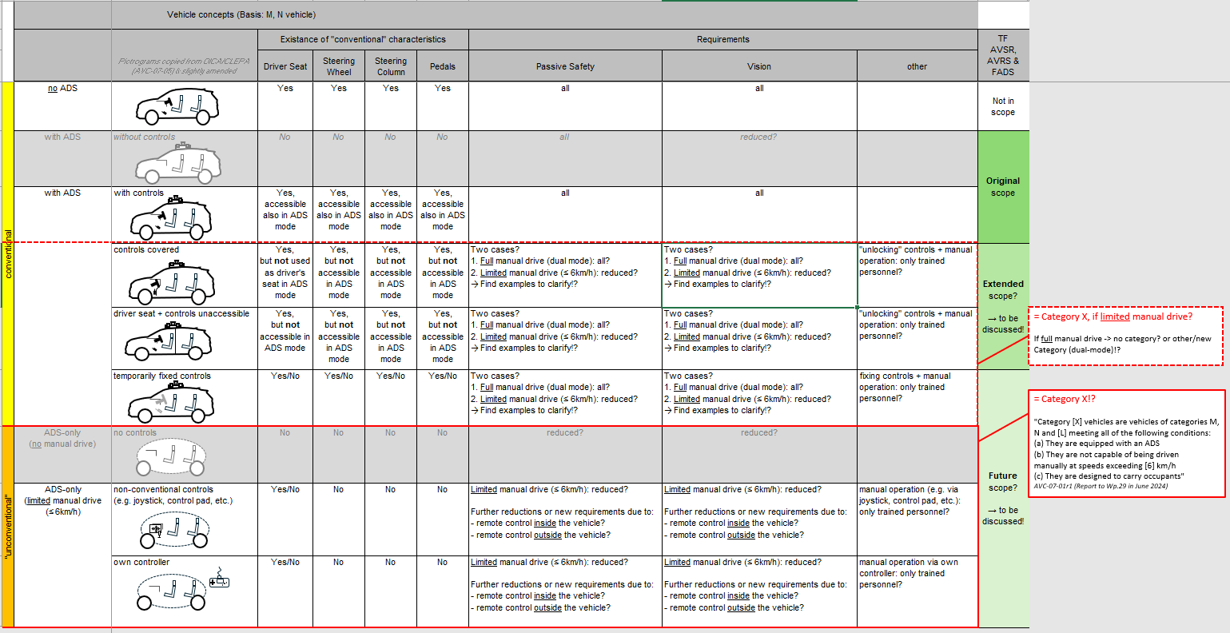




Document AVC-08-01 from Germany

Slide 6
Proposals for next steps
Option 1
OR
Option 2
Today: Consensus on Cat X and Y definition
Informal document to GRVA and GRSG outlining very basic amendments to R.E.3 and S.R.1. [] used where consensus not reached, e.g.: Category L, passengers vs. occupants etc.
Continue discussions in Hamburg (Oct) and China (Nov) and December meeting so that formal documents can be submitted for: 129th session of GRSG (April 2025), 22nd session of GRVA (May 2025) and 196th session of WP.29 (June 2025)
Today: No consensus on Cat X and Y definition
Push timeline for submitting informal and formal documents back by one session… informal documents -> mid-2025, formal documents-> late 2025.
Present options for way forward/guidance to GRVA next week and GRSG in October.
Notes:
The Contracting Party, which proposes the amendments of the S.R. 1, shall also submit the amendment proposals relating to the definitions of all gtrs currently in force.

Slide 7
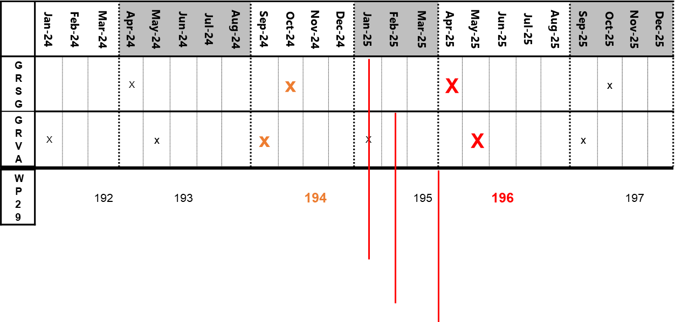

Current Timeline
(below is a tentative timeline; the schedule of meetings, and adoption of working documents, is the prerogative of WP.29 and its subsidiary Working Parties
– Text and table modified from informal document WP.29-192-17 with permission
Formal document to GRSG (129th session)
Formal document to GRVA (22nd session)
Formal document to WP.29 (196th session)

Slide 8
Confirmed Meeting Schedule / Deliverables: July - Dec 2024
7th Meeting
17 July
(Online only)
8th Meeting
16th September
(Online)
9th Meeting
1st & 2nd October
(Hybrid Hamburg)
10th Meeting
7th & 8th November
(Hybrid Shanghai)
11th Meeting
2nd December
(online)
Jul 24
Sep 24
Oct 24
Nov 24
Dec 24
Status report and informal document
GRVA
23th – 27th September
Status report and informal document
GRSG
7th – 11th October
Status report and informal document
WP.29
December

Slide 9
Provisional Meeting Schedule / Deliverables: Jan - June 2025
12th Meeting
20th January
(online)
13th Meeting
17th & 18th February
(hybrid | OICA?)
15th Meeting
24th March
(online)
16th Meeting
? April
(online)
15th Meeting
? May
(online)
Jan 25
Feb 25
Mar 25
Apr 25
May 25
GRVA
WP.29
GRSG
GRVA

Slide 10
Further topics
Agreement of whether to categorise vehicles that are capable of being driven manually (under nominal conditions)
Consideration of more novel vehicle designs:
  What are the most viable use cases to take forward?
  What are their priority?
  e.g: shuttles with standees? Low-speed vehicles? Bi-directional vehicles? Etc.

