Slide 1
Info Slides for 9th session of TF AVC
01-02 October 2024
Hamburg, Germany
Start time: 10:30 am (CET) on 01st October
Finish time: 12:30 pm (CET) on 02nd October

Slide 2
Visa Application
Please check before youre visit whether you need a visa in Germany
  Information webpage
  Application process

Slide 3
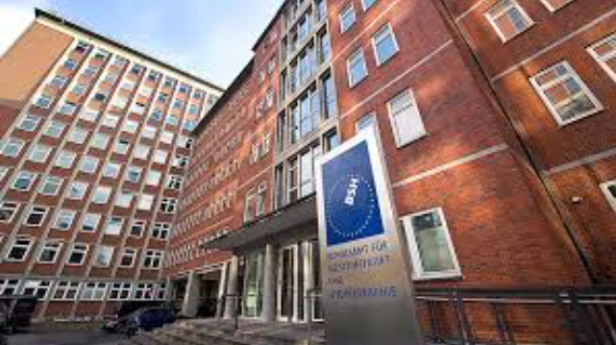
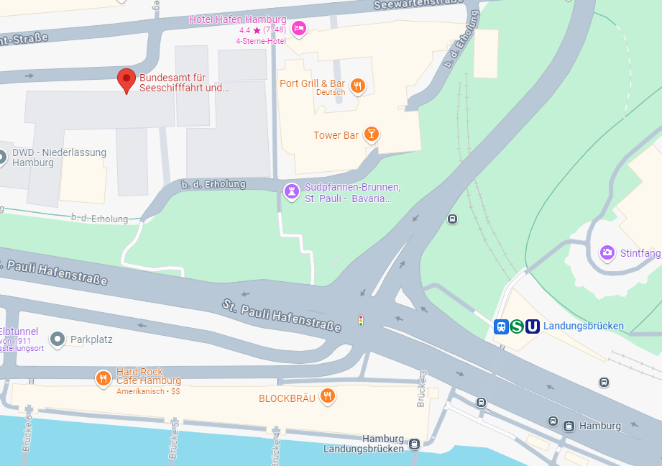
Meeting location
Bundesamt für Seeschifffahrt und Hydrographie (Federal Maritime and Hydrographic Agency)
Bernhard Nocht Straße 78
20359 Hamburg
Germany
Meeting Room 602
Train Station: Landungsbrücken
Please bring your passport for access control

Slide 4
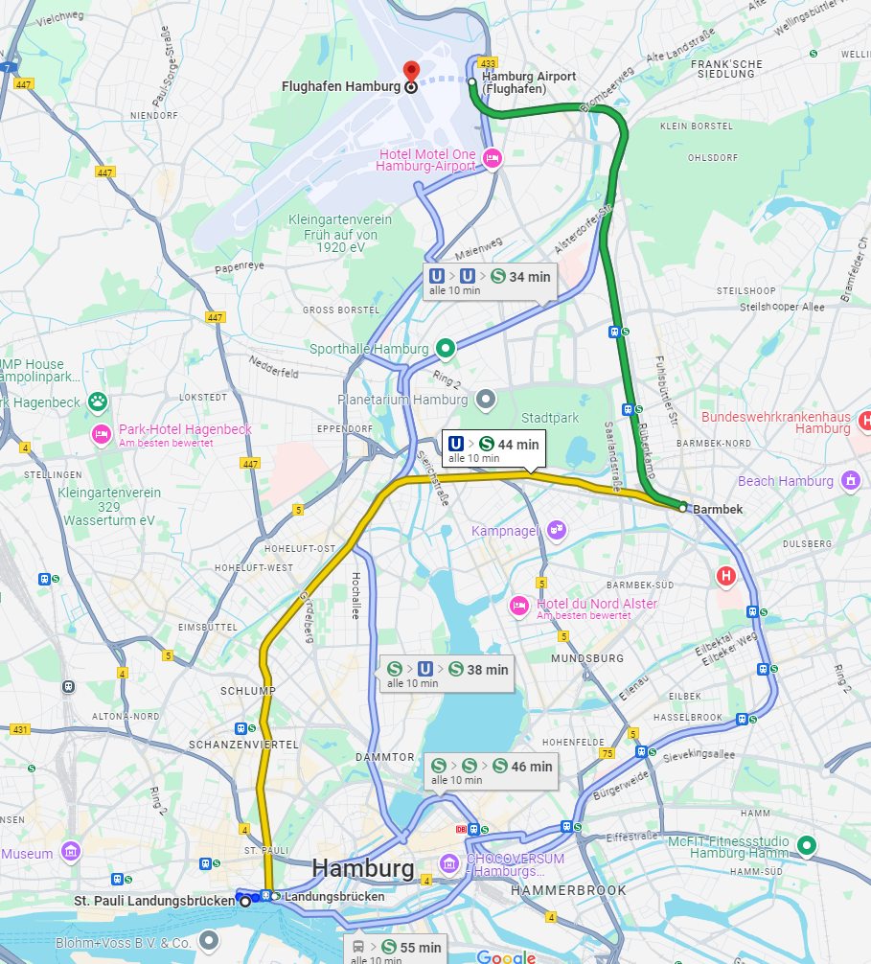
Transport from AIRport
Arrival by Plain at Hamburg Airport - Fuhlsbüttel: Take a train either S or U to the next train station close to your hotel or take a Taxi. Approxitmitly 45 minutes ride to the area of the meeting location.

Slide 5
Hotel recommendation
Hotel Hafen Hamburg
Radisson Blu Hamburg
Motel One Am Michel
Empire Riverside Hotel

Slide 6
Confirmation and contact
Please confirm your attendance by the 20th September to thies.weinand@kba.de
Thank you

