Slide 1


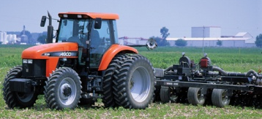
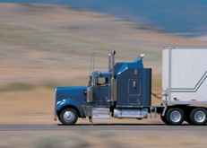
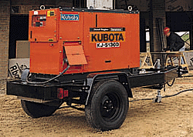


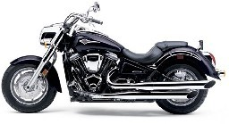
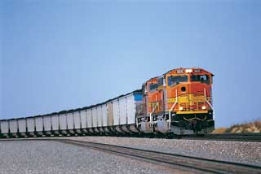


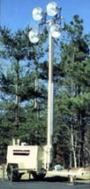
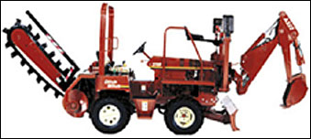

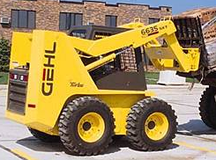
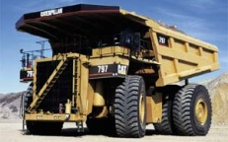

USEPA Office of Transportation and Air Quality
Compliance Overview
November 2014

Slide 2
Importance of Compliance
Clean Air Benefits
  1990 Clean Air Act Amendments:
    From 1990-2020, 4.2 million lives saved, benefit outweighs costs ~30:1
  In 2030 alone,
    Eliminate more than 38,000 premature deaths
    Realize more than $380 billion in health and welfare benefits
  The light-duty vehicle greenhouse gas program (LDV GHG) is projected to result in:
    $1.7 trillion dollars of fuel savings over the lifetime of vehicles produced between 2012 and 2025
    12 billion fewer barrels of oil consumed
Level Playing Field
  Vehicle, engine, and fuels industries are highly competitive, especially in today’s global environment
    Regulated industries expect and rely on EPA to protect their investment in emissions compliance

Slide 3
OTAQ Implementation Challenges:
Scope, Volume, and Complexity
Highway Vehicles and Engines
  Cars, trucks, vans, SUVs, motorcycles
  Heavy duty trucks, buses
Nonroad Engines, Vehicles, and Equipment
  Large diesel (construction equipment)
  Large gas (forklifts, compressors, air ground service equipment)
  Handheld utility engines (chainsaws, leaf-blowers, trimmers)
  Non handheld utility engines (lawnmowers, garden tractors)
  Marine (outboard/inboard motors, jet skis)
  Recreational vehicles (snowmobiles, ATVs, off-road motorcycles)
  Locomotives
  Ocean Going Vessels (OGVs)
Fuels Regulations Apply To:
  Gasoline and diesel refiners and importers
  Renewable fuel producers and importers
  Fuel additive producers and importers
  Retail stations and terminal operators (oxygenate blenders)

Slide 5


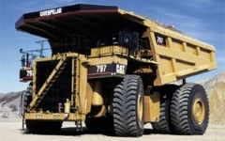
OTAQ Implementation Challenges:
Scope, Volume, and Complexity
Model Year 1995 Certificates
Post 2014 (~5,000 per year)
Total = 810
LDV – 464
ICI – 11
Alt Fuel - 205
HMC – 380
OFMC - 58
HDDE - 57
Snowmobile - 26
NRCI – 506
Large SI - 88
Locomotive - 58
Small SI – 984
Evap Components - 811
Marine SI - 87
HDGE - 10
ATVs - 199
Marine CI - 200
Text at
5

Slide 6
OTAQ Implementation Challenges:
Scope, Volume, and Complexity
Sheer Numbers are Big:
Vehicles and Engines
  >5,000 certificates, >1,150 fuel economy labels
  About 900 manufacturers
  About 2,000 Verify (e-system) business rules in place to process 2,200 specific types of manufacturer certification data
Fuels
  75 new fuel and 500 new fuel additive registrations, + 400 registration updates
  120 new company registrations , 130 new facility registrations + 800 updates
  100,000 reports per year, excluding Renewable Fuels Standards (RFS)
  More than 23,000 RFS transactions per day (6 million per year)
Public Information and Compliance Assistance
  Nearly 1,000 public inquiries through compliance email boxes alone
  At least 6,000 unique tickets logged with Fuels Helpline

Slide 7
OTAQ Implementation Challenges:
Scope, Volume, and Complexity
Fourth tier of emission regulations – necessarily complex after earlier tiers picked the low hanging fruit
  Required technical and policy innovation - EPA has designed flexible approaches that enable industry to comply
  As a result industry and EPA implementation inherently more complex
    Extraordinarily diverse regulated community
      Regulations must be flexible enough to work for huge conglomerates and small business start-ups
New demands are adding to an already broad portfolio
  GHG, RFS authorities introduce new and different compliance challenges
  New vehicle and fuel technologies demand specialized expertise
  Increased flexibility for industry increases implementation complexity for EPA
  Industries and manufacturers new to EPA regulation require staff-intensive compliance support
Globalization and foreign manufacturers present some special challenges
      Explosive growth especially from China

Slide 8
Sector (Center) Profiles
Light Duty Vehicles
Heavy-Duty and Nonroad Diesel
Gasoline Engines & Equipment
Fuels
Data and Information

Slide 9
Light Duty Vehicles Sector
Automobiles and light trucks
  Currently 70 manufacturers
    30+ small volume (10 – 15,000 units)
    Manufacturers in N. America, Europe, and Asia
  14.5 million vehicles in 2012, revenues of $453 billion
EPA oversight and testing
  Certificates & fuel economy labels issued
    2012 MY Certificates – 688
    2012 MY FE Labels – 1,159
  Complex emission standards
    Exhaust - Tier 2, SFTP (US06 & SC03), Cold CO & NMHC, GHG, LEV3
    Evaporative - 2-Day Diurnal, 3-Day Diurnal, Running Loss, ORVR
    Other - OBD, Durability, IUVP, Banking and Trading, Off-Cycle GHG
  Fuel Economy
    Label, CAFE, Gas Guzzler Tax
  EPA confirmatory tests about 15% of all official vehicle tests
    Requires emissions testing per specific regulations

Slide 10
Light-Duty Vehicle Compliance Program
EPA Action
Durability Review and Approval Process
Manufacturer Action
EPA Follow-Up (Defect and Recall Reports, Mfr. In-Use Testing, EPA Testing)
EPA Test Data Review/Analysis
CARB Coordination (Warranty Reporting)
OECA Coordination (Enforcement)
EPA Issues Certificate of Conformity
EPA Review of Manufacturer Application
EPA Confirmatory Testing (Random and Targeted)
EPA In-Use Surveillance Testing
EPA Certification Preview and Pre-model Year Reports
0 Miles
10,000 Miles
20,000 Miles
50,000 Miles
90,000 Miles
120,000 Miles
(End of Useful Life)
Vehicle Design and Build
Low-mileage In-Use Verification Testing Performed by Manufacturer
High-Mileage In-Use Verification Testing Performed by Manufacturer
Vehicle May Enter Commerce
End of Useful Life (per CAA)
Manufacturer Emissions Vehicle Prototype and Durability Testing
Warranty Tracking and Emission Warranty Reports (EWIRs) to CARB
Emission Defect Information and Voluntary Emission Recall Reports (EDIRs/VERRs) to EPA
(introduction into commerce – useful life miles)

Slide 11
Heavy Duty Diesel Sector
Highway and Nonroad Compression Ignition Vehicles and Engines
Industry characteristics and economics
  Heavy-duty on-highway engines, trucks and buses; nonroad and marine engines; and locomotives
  Sector contributed $101 billion to US economy in 2009, or almost1% of GDP
  175 engine and truck manufacturers; 750+ nonroad equipment manufacturers
    Large global companies employing thousands such as Caterpillar and Volvo to small, relatively inexperienced companies such as Therm Dynamics with fewer than 20 employees
    Production volumes and locations vary significantly by industry subsector
      Truck engine production: ~ 630,000 units per year, 95% domestic
      Nonroad engine production: ~ 1M units per year, more than 65% foreign
  Railroads and ocean-going shipping companies are regulated parties
EPA oversight
  ~ 950 certificates per year
  Regulate traditional criteria pollutants (PM, CO, HC, and NO_{X}) and now GHGs (CO₂, CH₄, and N₂O) for highway engines and trucks
  Current standards:
    Nonroad Tier 4 most recent and stringent requirements
      But regulatory flexibilities still allow production of some engines meeting earlier standards
    Highway 2010 engine standards
    Marine and locomotive Tier 3

Slide 12
Heavy-Duty Diesel Compliance Program
EPA Issues Certificate of Conformity
EPA Follow-up (Defect and Recall Reports, Mfr. In-Use Testing, EPA Testing)
EPA Test Data Review/Analysis
CARB Coordination (Warranty Reporting)
OECA Coordination (Enforcement)
PLT,TPEM, ABT, and Production Report Review
EPA Confirmatory Testing
EPA Selective Enforcement Audit
EPA In-Use Surveillance Testing
EPA Review of Manufacturer Application
0 Miles / Hours
End of Useful Life
(Varies by subsector)
25%
50%
75%
Engine Design and Build
On-highway / Locomotive In-use Testing
Manufacturer Prototype and Durability Testing
Engine Production Line Testing
Engine May Enter Commerce
Warranty Tracking and Emission Warranty Reports to CARB
Emission Defect Information and Voluntary Emission Recall Reports to EPA
(introduction into commerce – useful life miles)
EPA Action
Manufacturer Action
On-highway: up to 10 years / 435,000 miles
Nonroad: up to 10 years / 8,000 hours
Marine: up to 10 years / 20,000 hours
Locomotive: up to 10 years / 32,000 MW-hours
Full Useful Life:

Slide 13
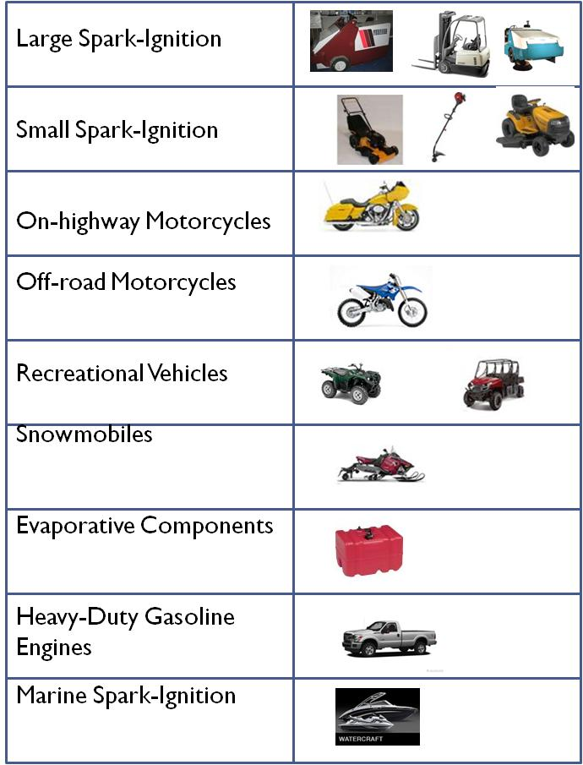
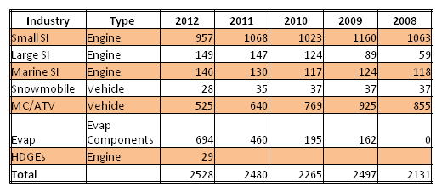
Gasoline Engine Sector
27
Small SI, Large SI, Heavy-Duty Gasoline, On-Highway Motorcycles, Off-Road Motorcycles, Recreational Vehicles, Snowmobiles, Marine SI, Evaporative Components (Portable Fuel Containers, Fuel Lines, and Fuel Tanks)
Sector includes companies like Briggs and Stratton, Indmar, Honda, Toyota, Generac, Mitsubishi, Polaris, John Deere, Jonway, Lifan, Linyi Sanhe Yongjia Power, General Electric, Suzuki, and ChongQing AM Pride.
112
83
24
51
Certificates By Calendar Year
4
349
12
Number of manufacturers in each sector.
23
13

Slide 14
Gasoline Engines, Motorcycles, and Recreational Vehicles Compliance Program
EPA SEAs conducted at Manufacturers’ designated facility or by letter audit.
Manufacturer Follow-Up (EPA Testing)
EPA Test Data Review/Analysis
CARB Coordination (Warranty Reporting), PLT Review)
OECA Coordination (Enforcement)
TPEM, ABT, and Production Report Review
OBD for HDGEs Certification / Pre-Cert Meetings
EPA In-Use Surveillance Testing,
Manufacturer In-Use Testing for some Sectors, and In-Use Product Surveys
Confirmatory Testing
OBD for HDGEs Issues Review
0 Miles / Hours
25%
50%
75%
Varies by sector
(End of Useful Life)
Engine / Vehicle introduction into commerce
Motorcycle Confirmatory Testing
PLT testing of engines
(Current MY production)
MSI Marine In-use Tests selected by EPA
EPA Action
OBD I/M Issue Identification and Resolution
Manufacturer Action
Warranty Tracking and Emission Warranty Reports (EWIRs) to CARB
Emission Defect Information and Voluntary Emission Recall Reports (EDIRs/VERRs) to EPA
(introduction into commerce – useful life miles)
LSI UL: 7 years / 5,000 hours
PWC: 5 years / 350 hours
OB: 10 years / 350 hours
SD/I: 10 years / 480 hours
NHH: 125 / 250 / 500/ 1000 hours
HH: 50 / 125 / 300 hours
HMC:
OHMC / Rec Veh:
HDGE:
Full Useful Life:

Slide 15
Data Analysis and Information
The Verify system is the cornerstone of compliance for vehicles and engines
Comprehensive information management system that facilitates EPA certification and compliance oversight
Allows streamlined collection, validation, and analysis of the data submitted for certification
    For light duty there are 16 data sets submitted to support certification, fuel economy labels and CAFE comprised of over 875 distinct data elements being analyzed by over 1100 business rules
    Automates certificate approval and test scheduling workflows
Captures and stores information that feeds into multiple data reporting needs
Notes:
Common portal for information collection, validation, viewing, and reporting
Collects certification data, provides electronic certificate processing and tracking
Automates certificate approval and test scheduling workflows
Enhances data accessibility for regulatory implementation and data analysis
Light-Duty
Business Rules - 885
Data Elements - 1146
Data Sets -16
NRCI
Business Rules - 353
Data Elements - 248
Data Sets - 7
NRSI
Business Rules - 513
Data Elements - 362
Data Sets - 4

Slide 16
For Further Information …
EPA website includes regulatory documents, implementation guidance documents, and implementation data
  www.epa.gov/otaq - home page
    www.epa.gov/otaq/actions.htm - consumer information
    www.epa.gov/otaq/cert.htm#Fact – compliance publications and annual reports
    www.epa.gov/otaq/crttst.htm - certification data for light-duty vehicles

