Slide 1
Comment from Japan for Normalization item “Deviation from target speed”
WLTP-09-24e

Slide 2
Comment for “Deviation from target speed”
“Deviation from target speed” needs more studies* and questionable to be completed during Phase1b.
*HEV study not finished, excessive driving behavior (see next slide), treatment for W.O.T. and gear shifting event.
<counter-proposal>
Phase1b : apply "Driving Indexes"
Phase2 : keep study on undeveloped items

Slide 3
Justification and next step
Unless setting a limit of driving behavior, Normalization could result in inappropriate correction in case of too smooth or too aggressive driving.
  A small veline error could cause a big CO2 correction error with excess driving case.
  A veline can be different if driving energy/behavior is different significantly.
Need to set the limit of allowable driving behavior based on SAE J2951 driving index first.
Proposed next steps,
  Japan proposes driving index criteria for test validity based on CP’s data, can be updated by available round robin results before Phase1b finalized.
  Collaborate “normalization procedure”.

Slide 4
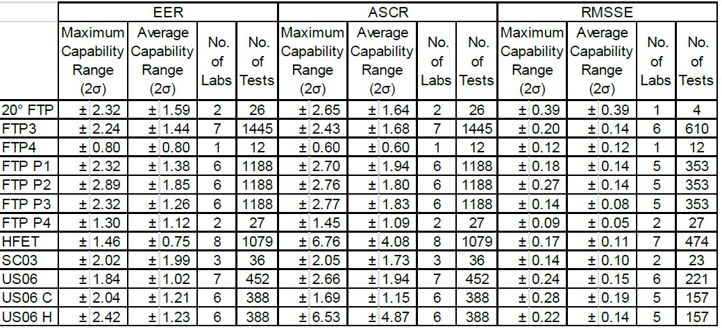
[reference] SAE J2951 driving index
SAE J2951 driving indexes can capture various driving style difference (not only energy). The followings are possible indexes to be applied in WLTP
Energy Economy Rating (EER)
  The EER is defined as the percentage difference between the distance per unit cycle energy for the driven and target traces.
Absolute Speed Change Rating (ASCR)
  The ASCR is defined as the percentage difference between the ASC (the integral of the absolute magnitude of acceleration) for the driven and target traces. It provides an indicator of the "smoothness" of the driven trace relative to the scheduled trace.
Root Mean Squared Speed Error (RMSSE)
  The RMSSE metric provides the driver’s performance in meeting the schedule speed trace throughout the test cycle in terms of the Root Mean Squared (RMS) Speed Error.
SAE defined “driver capability range” which is expected range of each index with normal driver.

