Slide 1
GTR Corrections, Open Points, Expert Proposals and Confirmations in GTR 15
WLTP-09-26e

Slide 2
Comments:
1. These PowerPoint slides summarise all GTR corrections, open points, expert proposals and confirmations in the GTR.
2. The slides incorporate comments from experts received since 10.07.2014 including those related to the 31.08.2014 and 31.10.2014 deadlines, and new items since publication of the GTR on September 14, 2014.

Slide 3
Some examples of items to be processed by the drafting sub-group

Slide 4
II. Text of the global technical regulation, §5.6.1.
Approval of additional text
GTR Text:
EXPERT PROPOSAL: 01.11.2014: From C. Lueginger and A. Feucht.

Slide 5
Definitions (mass)
Deletion of text to align with existing legislation
3.2.5. "Mass in running order" means the mass of the vehicle, with its fuel tank(s) filled to at least 90 per cent of its or their capacity/capacities, including the mass of the driver and liquids, fitted with the standard equipment in accordance with the manufacturer’s specifications and, when they are fitted, the mass of the bodywork, the cabin, the coupling and the spare wheel(s) as well as the tools when they are fitted
Proposal from W. Coleman: "Mass in running order" means the mass of the vehicle, with its fuel tank(s) filled to at least 90 per cent of its or their capacity/capacities, including the mass of the driver and liquids, fitted with the standard equipment in accordance with the manufacturer’s specifications and, when they are fitted, the mass of the bodywork, the cabin, the coupling and the spare wheel(s) as well as the tools when they are fitted.
Reason: align with 692/2008

Slide 6
Definitions (mass)
Approval of deletion of technically relevant text (first example)
3.2.7. "Maximum vehicle load" means in this GTR the difference between the technically permissible maximum laden mass and the sum of the mass in running order, 25 kg and the mass of the optional equipment of vehicle H.
TASK: Approval of proposed deletion in red.
Reason: To align with EU legislation the mass of optional equipment needs to be defined. Once this is done the reference to vehicle H becomes redundant and potentially confusing

Slide 7
Definitions
Approval of deletion of technical text (second example)
Current GTR Text:
3.3.1. "All-electric range" (AER) means in the case of an off-vehicle charging hybrid electric vehicle (OVC-HEV) the total distance travelled from the beginning of the charge-depleting test over a number of complete WLTCs to the point in time during the test when the combustion engine starts to consume fuel.
Proposal from W. Coleman:
3.3.1. "All-electric range" (AER) means in the case of an off-vehicle charging hybrid electric vehicle (OVC-HEV) the total distance travelled from the beginning of the charge-depleting test over a number of complete WLTCs to the point in time during the test when the combustion engine starts to consume fuel.

Slide 8
Definitions (mass)
Approval of new text
PROPOSAL:
3.2.a. "Mass of the optional equipment" means the mass of the equipment which may be fitted to the vehicle in addition to the standard equipment, in accordance with the manufacturer’s specifications.
TASK: Approval of proposed text. Proposal from W. Coleman.
Reason: Although this definition is only valid in the context of application for and granting of an approval, it is essential to operate the combined approach.

Slide 9
Definitions (see also next slide)
Text yet to be processed (written, approved) by the appropriate experts
GTR Text:
3.8.1. "Periodically regenerating system" means an exhaust emissions control device (e.g. catalytic converter, particulate trap) that requires a periodical regeneration process in less than 4,000 km of normal vehicle operation. During cycles where regeneration occurs, emission standards can be exceeded. If a regeneration of an anti-pollution device occurs at least once during vehicle preparation cycle, it will be considered as a continuously regenerating system which does not require a special test procedure.
Proposal: deletion of the last 2 sentences “During cycles where regeneration occurs, emission standards can be exceeded. If a regeneration of an anti-pollution device occurs at least once during vehicle preparation cycle, it will be considered as a continuously regenerating system which does not require a special test procedure.” and integrate this in the technical annex without the reference to “continuously regenerating system which is not defined in light duty legislation.

Slide 10
Annex 4, Road load and dynamometer setting
Open technical point to be processed by experts
GTR Text: 3.1.(j)
EXPERT PROPOSAL: 01.11.2014: From C. Lueginger, A. Feucht and Daimler. Value in square brackets.

Slide 11
Reference to Annex 6, Test procedure, §1.2.6.5. Use of the Transmission: proposal from drafting coordinator
Moving text to simplify and/or clarify the GTR
GTR Text:
Move §1.2.6.5. to Annex 2??
Drafting coordinator proposal: 20.11.2014. Move paragraphs §1.2.6.5. up to and including §1.2.6.5.3.2. on the use of a manual and automatic transmission from Annex 6 to Annex 2.

Slide 12
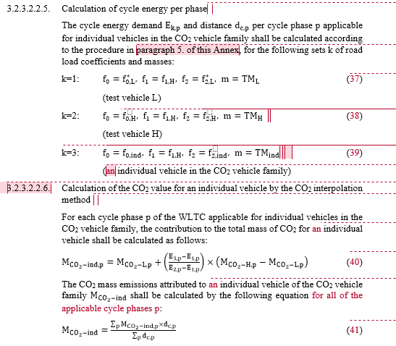
Annex 7, Calculations, §3.2.3.2.2.5. & 3.2.3.2.2.6.
Making the GTR more logical
OPEN POINT: 13.01.2015: Could these calculations not be entered here? It would make for a connection between this paragraph and the next more logical.

Slide 13
Annex 3, Fuels
Open technical question
TASK: Are ICE vehicles powered by hydrogen fuel to be taken into consideration in the GTR?

Slide 14
Annex 8, Pure and HEVs, §1.6.
Open technical point
GTR Text:
1.6. OVC-HEVs. NOVC-HEVs and PEVs with manual transmissions shall be driven according to the manufacturer’s instructions, as incorporated in the manufacturer's handbook of production vehicles and indicated by a technical gear shift instrument.
OPEN POINT. 02.09.2014: Question from I. Riemersma: GSIs (= technical gear shift instrument) are not included in the GTR but rather the shift points described in Annex 2 are to be used. This point to be discussed in the appropriate meeting.

Slide 15
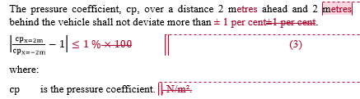
Annex 4, Road load and dynamometer setting, paragraph 3.2.8.
Reworking equations to make more logical/simpler
GTR Text:
EXPERT PROPOSAL: 30.10.2014. Equation changed to read that the absolute value of the quotient minus one shall be less than or equal to 1 per cent. Input from C. Lueginger and A. Feucht.

Slide 16
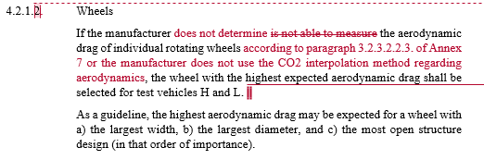
Annex 4, Road load and dynamometer setting
Possible deletion of a complete paragraph
GTR Text:
EXPERT PROPOSAL: 03.11.2014: proposed by Road Load task force (C. Lueginger, A. Feucht). The task force is not convinced that the paragraph is necessary.

Slide 17
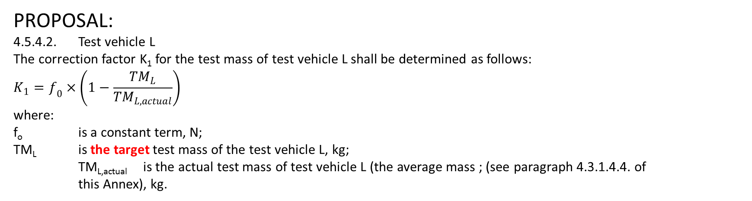
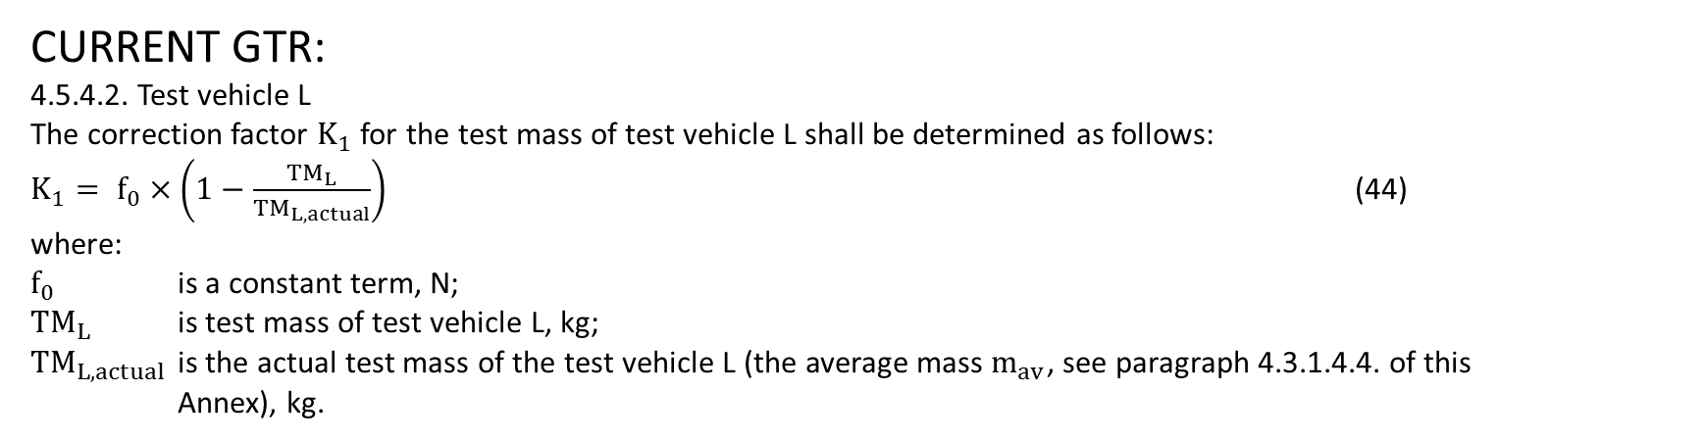
Annex 4, Road load and dynamometer setting (mass)
Consistency in usage of certain terms
CURRENT GTR:
4.5.4.2. Test vehicle L
The correction factor $K_{1}$ for the test mass of test vehicle L shall be determined as follows:
$K_{1}= f_{0}×\left(1−\frac{{TM}_{L}}{{TM}_{L, actual}}\right)$ (44)
where:
$f_{0}$ is a constant term, N;
${TM}_{L}$ is test mass of test vehicle L, kg;
${TM}_{L, actual}$ is the actual test mass of the test vehicle L (the average mass $m_{av}$, see paragraph 4.3.1.4.4. of this Annex), kg.
PROPOSAL:
4.5.4.2. Test vehicle L
The correction factor K₁ for the test mass of test vehicle L shall be determined as follows:
$$K_{1}=f_{0}×\left(1−\frac{{TM}_{L}}{{TM}_{L,actual}}\right)$$
where:
f_{o} is a constant term, N;
TM_{L} is the target test mass of the test vehicle L, kg;
TM_{L,actual} is the actual test mass of test vehicle L (the average mass ; (see paragraph 4.3.1.4.4. of this Annex), kg.
TASK: Approval of proposed text in red.
STATUS AS OF 22.09.2014: Entered in the GTR requesting comments < 31.10.2014.

Slide 18
Annex 6, Appendix 2, Test procedure for electric power supply system monitoring (page 1 of 2)
Consistency in the use of units
EXPERT PROPOSAL: 29.07.2014: Dr. Ligterink (TNO) and his colleague, Gerrit Kadijk, highlights inconsistencies within the GTR concerning units used in Annex 6, Appendix 2 (Test procedure for electric power supply system monitoring). The problem is whether (a) kW.h, joules or megajoules should be used in equations, and, (b), whether kW.h, joules or megajoiules should be used in the Willans factors, and (c) whether the equations are all correct. This applies also to Annex 7 (Calculations) and to Annex 8 (Evs).
STATUS AS OF 22.09.2014: Entered in the GTR requesting comments < 31.10.2014.

Slide 19
Various annexes (page 2 of 2)
Consistency in the use of MJ or other units
GTR Text:
Should energy content of fuel be in joules, megajoules, Wh or kWh?
May the CO₂ correction factor (g/km)/(Wh/km) be written as (g/Wh) (see Table A8/2 in Annex 8)? See also §3.1.1. in Annex 8, Appendix 2.
May the fuel consumption correction factor (l/100 km/(Wh/km) be written as l/100/Wh (see Table A8/2 in Annex 8)? See also §2.1.1. in Annex 8, Appendix 2.

Slide 20
Annex 8, Pure and HEVs, §2.3.3.
Language item with possible repercussions
GTR Text:
EXPERT PROPOSAL: 30.10.2014. Japan proposes replacing "shall" with "may"..

Slide 21
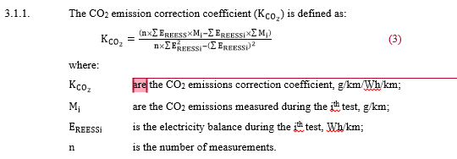
Annex 8, Appendix 2, Pure and HEVs, §3.1.1., REESS charge balance correction
Language item with possible repercussions
GTR Text:
OPEN POINT: 30.10.2014: ACEA believes that this should be "is". Japan believes it should remain as "are" as separate emissions and fuel consumption correction factors shall be calculated for each phase of the WLTC and corrected to zero over each WLTC

Slide 22
Additional slides as of 14.12.2014

Slide 23
Annex 7, Calculations, §3.2.3.2.2.4.
Eliminating repetitions, in this case, of headings
GTR CORRECTION: 13.01.2015: This is essentially the same title as 3.2.3.2.2. (see below). Can both nevertheless remain?

Slide 24
General comment
Proposal for new terminology
EXPERT PROPOSAL FROM A. FEUCHT
Regarding the renaming of “CO2-family” it is proposed to refer to an “energy interpolation family” or, in case of EVs where there is another parameter to interpolate, just “interpolation family”.

Slide 25
End

