Slide 1
Consideration of PLS testing condition from view point of UN Reg.112 requirement.
Material used during the discussion of the revision on PLS requirement
to be suggest for Zoetermeer meeting by working group member, to revise
testing condition of PLS measurement.
Eiji OBA
JASIC

Slide 2
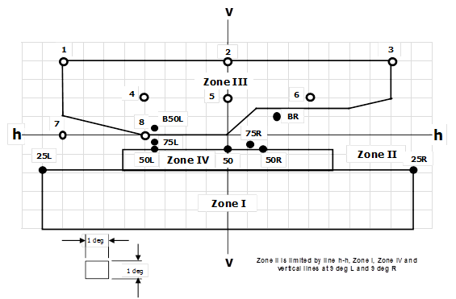
Requirement under Reg.112
Center illumination
Illumination to see Traffic Signs at 50 [m]ahead
Illumination to see Traffic Signs at 100 [m] ahead
Requirement to avoid glare and keep minimum illumination to observe the Traffic Signs.
  The illumination shall not exceed 625[cd], in any of the orientation measuring point within Zone III.
  The sum of illumination measured at points 4, 5 and 6 shall be more than 375(cd). This requirement is to secure that enough illumination to observe the traffic sign standing over the road surface.

Slide 3
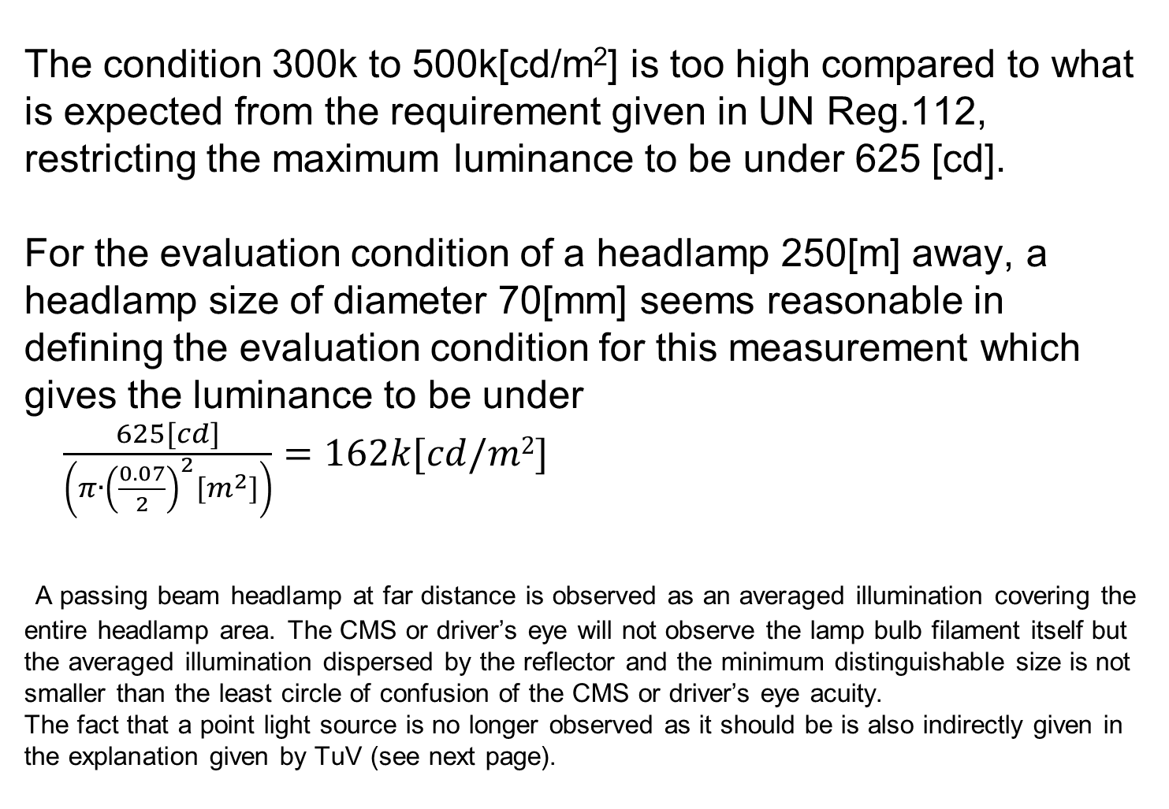
  The condition 300k to 500k[cd/m²] is too high compared to what is expected from the requirement given in UN Reg.112, restricting the maximum luminance to be under 625 [cd].
  For the evaluation condition of a headlamp 250[m] away, a headlamp size of diameter 70[mm] seems reasonable in defining the evaluation condition for this measurement which gives the luminance to be under
  $\frac{625[cd]}{\left(π∙{\left(\frac{0.07}{2}\right)}^{2}[m^{2}]\right)}=162k[cd/m2]$
  A passing beam headlamp at far distance is observed as an averaged illumination covering the entire headlamp area. The CMS or driver’s eye will not observe the lamp bulb filament itself but the averaged illumination dispersed by the reflector and the minimum distinguishable size is not smaller than the least circle of confusion of the CMS or driver’s eye acuity.
  The fact that a point light source is no longer observed as it should be is also indirectly given in the explanation given by TuV (see next page).

Slide 4
Partially taken from IGCMS-II-03-04 Testing and assessment of point light sources_21.05.2014.doc
Light is detected as an averaged signal within minimum resolvable pixel size. And the TuV table shows that a lamp of 200[mm] or smaller in diameter is no longer distinguishable.

Slide 5
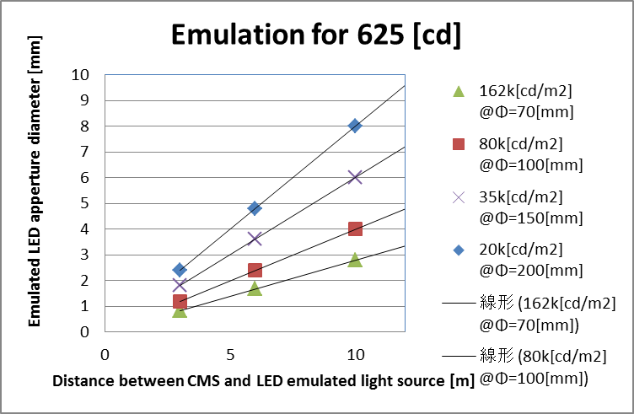
Aperture and luminance of LED to emulate a headlamp light at 250 [m] at closer
distance than the actual 250 [m] target.
If PLS evaluation is defined to be measured at 6[m], considering a 70[mm] diameter lamp,
the aperture of LED shall be defined to be 1.68 [mm] in diameter, luminance set to 162k[cd/m²] and separation between lamp set to 31 [mm]

Slide 6
Test condition
We shall select a candidate condition of the Type Approval test.
To be defined:
1. headlamp size = 70[mm]
the maximum luminance is consequently derived as 162k[cd/m²]
And if not measuring at 250 [m] ahead.
2. Emulation test distance = 6 [m]
gives a LED with diameter 1.68[mm]
with separation of 31[mm] from each LED source,
assuming headlamp of 70 [mm] diameter.

Slide 7
EOF

