Slide 1
Modular Vehicle combinations
MVC in Paris 27and 28. Januar 2014
MVC-03-04
Recommended armament of modular road trains in use.

Slide 2
General provisjons in Norway today
General provisions on module trucks
Road train up to 25,25 meters and maks weight: Max 60 tons.
Own roadmap with limited opportunities. just related to road network between major cities and some border crossings. Located warehouse, factories many kilometers (15) from the main road, the person performing the transport search dispensing from Norwegian Public roads administration to be allowed to drive to Arrivals position.
The minimum wheelbase by total weight of 60 tons and at list 19 m from first to last axle in the road train. Maximum length 25,25cm.
Joint: Road trains shall not have more than two trailers pulling up to two followers are allowed .
Brakes: All vehicles that are part of a modular vehicle combination shall have ABS brakes
Signage: Road trains longer a 19,50 meters shall have a sign on the back of the trailer where the length is specified .
Tracking Requirements: A modular vehicle combination shall, from the location of the line will run 360 ° between two concentric circles with a radius of 12.50 meters and 2.00 meters.
Dangerous goods: Can not transported by module roads train on 25.25. Norwegian authorities are now working on new guidelines for modular vehicle combinations

Slide 3
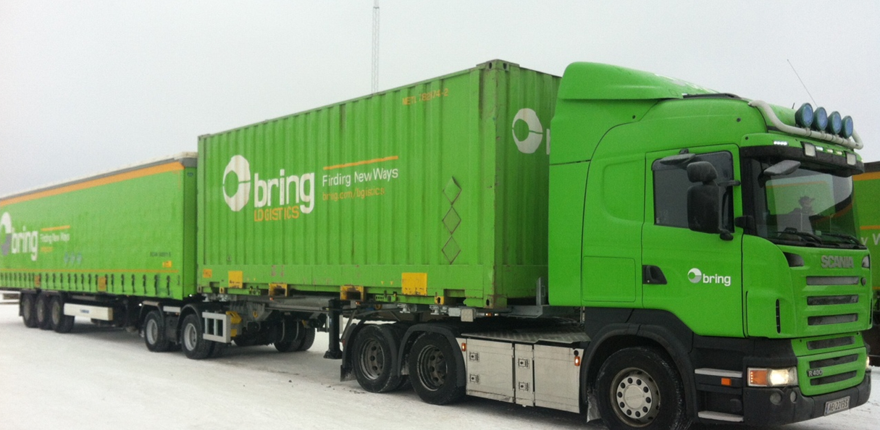
The most common used combinations in Norway today.

Slide 4
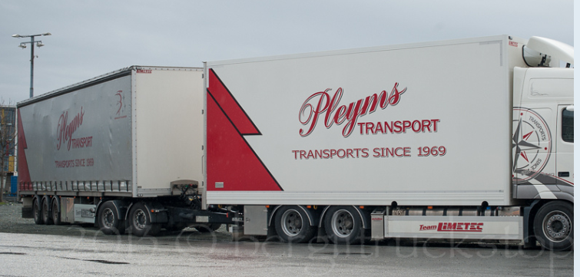

Slide 5
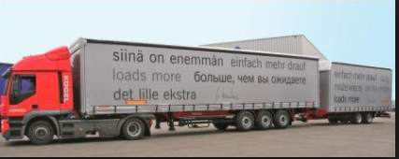
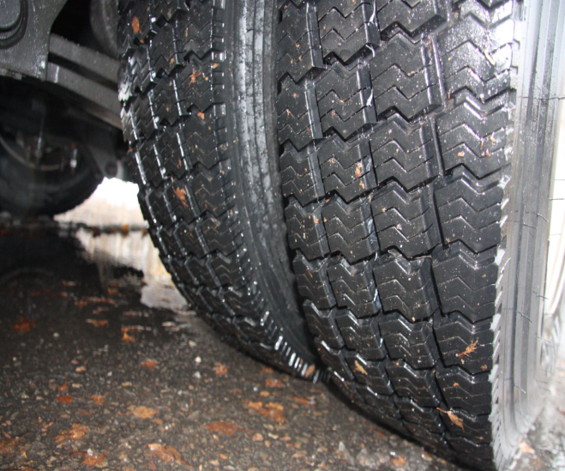
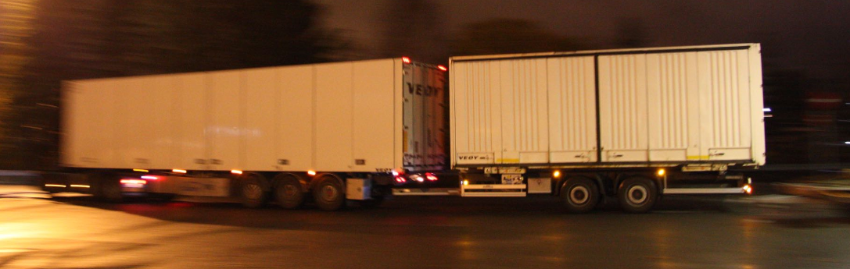
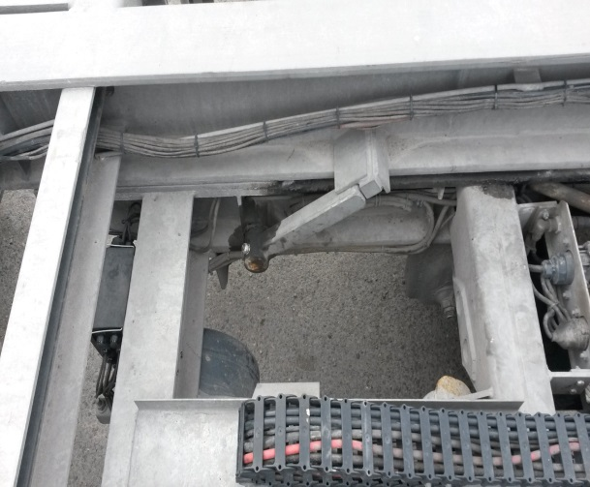
Combination unsuitable in Norway due to topographic conditions and slippery roads or registered accidents involving vehicles combination has been too unstable with misplaced goods on vehicles.

Slide 6
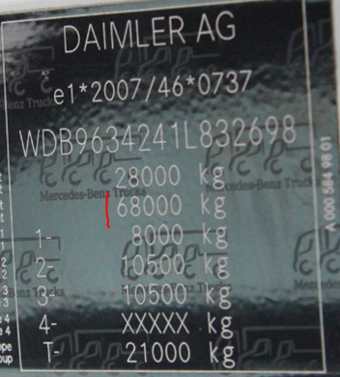
Modular Vehicle combinations ( MVC)
Comments on Agenda to 3.Meeting of GRRF / IG.
Truck for use in Modular vehicle combinations, must document through claim area 18A in Directive 2007/46/EF attachments IV. chassis number and fabrication plate EU 19/2011. latest change regulation EU 249/2012.That vehicle satisfies weights and dimension requirements as a road train combination will involve. The red line indicates that the vehicle is approved for a train weight of 68000 kg.
Eks.

Slide 7
5. Definition of a dolly to be used in a modular vehicle combinations.
Directive 2007/46/EF describes and are defines through directive 678/2011. Annex 1. GENERAL DEFINITIONS, CRITERIA FOR VEHICLE CATEGORISATION, VEHICLE TYPES AND TYPES OF BODYWORK
Criteria for vehicle categorisation :1.3.4 Category O 4 Vehicles of category O having a maximum mass exceeding 10 tonnes.
Part C Definitions of types of bodywork , 4. Vehicles of category O
4.3. DC Centre-axle trailer a trailer where the axle(s) is (are) positioned close to the center of gravity of the vehicle (when uniformly loaded) so that only a small static vertical load, not exceeding 10 % of that corresponding to the maximum mass of the trailer or a load of 1 000 daN (whichever is the lesser) is transmitted to the towing vehicle.
In addition to this today Centre- axle trailer through Regulation EC 661/2012 fitted with EBS with RSS system includes.
As an important contribution to traffic safety, we will mention standard equipment that will be needed and in such combinations.

Slide 8
Axle Combination on center axle trailer must have at least a spring center between the frame side members of 1300 mm to the charge stability.
Only allowed with fixed axle , minimum bogi mounting in a center axle trailer. Fifth wheel couplings mounted on a ball bearing turntables with max angel of 20°.This provides the necessary security to all weather conditions.
Based on Regulation EC 661/2209.Must reach all vehicle combinations equipped with EBS. ECE 13. Because of legal regulation ECE 13, ranks can signal until 18 meters. With can router directly engaged signal may be extended until 80 m if the combination fitted with EBS was so long. Thus we are assured that instrument inside the cab alert so that the driver will be notified of a trailer have lost EBS regulation.

