Slide 1
Type 0 | 50% | 50% | 50% | 50% | 45%
 |  |  |  | Same as tractor + semi-trailer. To be compared with performance of a full-trailer (50%) → do we have a proven calculation?
Compatibility | Annex 10 Diagram 2 Towing vehicles and trailers | Annex 10 Diagram 2 Towing vehicles and trailers | Annex 10 Diagram 2 Towing vehicles and trailers X 0.95 | Annex 10 Diagram 2 Towing vehicles and trailers X 0.95 | Annex 10 Diagram 4A Semi-trailers
Are these 5% relevant for a dolly?

Slide 2
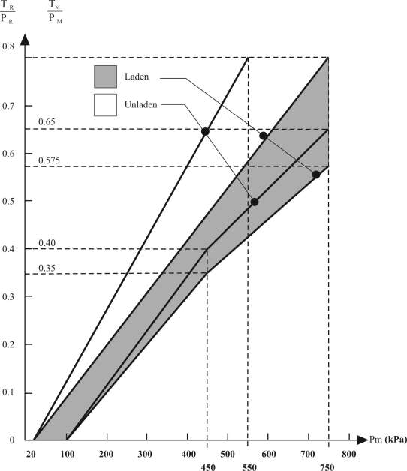
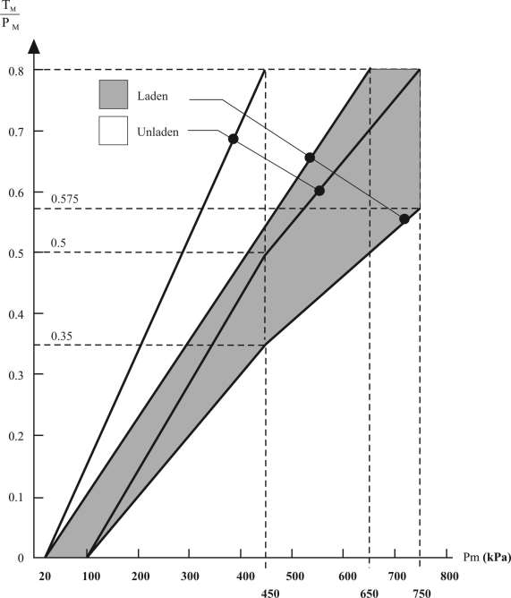
Annex 10
Diagram 2
Towing vehicles and trailers
Diagram 3
Tractors for semi-trailers
Both Dollies and tractors must be compatible with a semi-trailer

Slide 3
Tractor bands
(laden)
CAT bands
(Laden)
(0.95 factor
not shown)

Slide 4
Annex 10
5.2. For centre-axle trailers fitted with compressed-air braking systems:
5.2.1. The permissible relationship between the braking rate TR/PR and the pressure pm shall lie within two areas derived from diagram 2 of this annex, by multiplying the vertical scale by 0.95. This requirement shall be met at all pressures between 20 and 750 kPa, in both the laden and unladen states of load.

