Slide 1
Summary of GTR-relevant text from the April 2015 IWG #10 and Drafting Subgroup meetings, Stockholm, plus new slides since then
WLTP-SG-Drafting-03-03e-Working slides

Slide 2


The following collection of slides summarise the results of the April 2015 IWG#10 and Drafting Subgroup meetings held in Stockholm.
The slides are arranged in the following order:
Text of the Regulation
Definitions
Annexes 1 through to 8
Miscellaneous
Each slide is marked with one of two symbols:
  A check mark identifies those slides whose content has been approved/adopted.
  A construction site symbol identifies those slides whose content is still under review or under development.

Slide 3
I. Statement of technical rationale and justification: Introduction, paragraph 5

Slide 4



Introduction, paragraph 5
OPEN POINT: 5. March 2015 drafting meeting. Japan proposes deleting the whole sentence or delete "fuel cells".
April IWG/drafting meeting (Stockholm): The Commission should review the introduction part of the GTR. Mail sent to K. Steininger on 22.04.2015.

Slide 5
II. Text of the global technical regulation

Slide 6
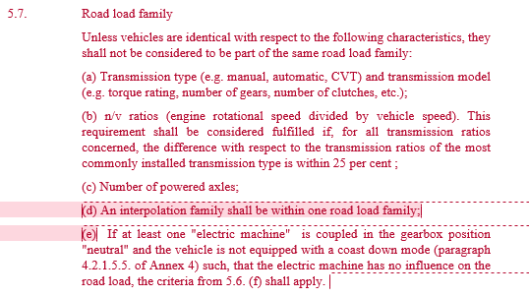
OPEN POINT: 5.7. Introduction of a reserved section for "Road load family".
April IWG/drafting meeting (Stockholm): (d) has been eliminated; (e) must go to EV for approval.

Slide 7
Definitions

Slide 8
DC: All definitions will be renumbered once they are all adopted. X-references in the GTR will be checked.

Slide 9
Definitions (mass)
CONFIRMATION: adopted at WLTP IWG #8, Pune; however still in progress. April IWG/drafting meeting (Stockholm): still open.
PROPOSAL:
3.2.8. "Mass of the optional equipment" means the mass of the equipment which may be fitted to the vehicle in addition to the standard equipment, in accordance with the manufacturer’s specifications.
TASK: Approval of proposed text. Proposal from W. Coleman.
Reason: Although this definition is only valid in the context of application for and granting of an approval, it is essential to operate the combined approach.

Slide 10
Definitions (mass)
CONFIRMATION: adopted at WLTP IWG #9, Geneva
11.03.2015: still in progress
April IWG/drafting meeting (Stockholm): still open.
PROPOSAL:
3.2.d. "Test mass of the vehicle" means the sum of the actual mass of the vehicle, 25 kg and mass representative of the vehicle load.
TASK: Approval of proposed text. Proposal from W. Coleman.
Reason:
No definition of this term was included in the gtr in phase 1a.
This term is generic but describes a vehicle specific condition which will be used throughout the combined approach and in future to describe test conditions for individual vehicles post approval.

Slide 11
Definitions (mass)
CONFIRMATION: adopted at WLTP IWG #9, Geneva
11.03.2015: still in progress. April IWG/drafting meeting (Stockholm): still open.
Proposals from W. Coleman (the second from early 2015).
:
3.2.e. "Mass representative of the vehicle load" means 15 per cent for category 1 vehicles or 28 per cent for category 2 vehicles from the maximum vehicle load.
3.2.e. "Mass representative of the vehicle load" means x per cent of the maximum vehicle load where x is 15 per cent for category 1 vehicles and 28 per cent for category 2 vehicles.
REASON: No definition of this term was included in the GTR in phase 1a. This term is generic covering both categories of vehicle included in the WLTP scope.

Slide 12
Definitions
April IWG/drafting meeting (Stockholm): still open. Wait for June GRPE decision.
Current GTR Text:
3.3.10. "Energy converter" means the part of the powertrain converting one form of energy into a different one.
Proposal from W. Coleman:
3.3.10. "Energy converter" means the part of the powertrain converting one where the form of energy input is into a different from the form of energy output one.
Reason: Discussions in WLTP 6 in Vienna and in VPSD suggested that a battery could be seen as converting chemical energy into electrical energy. VPSD therefore agreed on a „black box“ approach considering input and output to the system.

Slide 13
Definitions
12.03.2015: "ESS" means a system which stores energy and releases it in the same form as was input" [see VPSD]
April IWG/drafting meeting (Stockholm): still open.
Current GTR Text:
3.3.11. "Energy storage system" means the part of the powertrain on board a vehicle that can store chemical, electrical or mechanical energy and which can be refilled or recharged externally and/or internally.
Proposal from W. Coleman:
3.3.10. "Energy storage system" means the part of the powertrain on board a vehicle that can store chemical, electrical or mechanical energy and release it in the same form as it was input which can be refilled or recharged externally and/or internally.
Reason: This proposal is consistent with that of energy converter. The text differentiating refilling and refuelling and internal or external appears redundant.

Slide 14
Definitions
12.03.2015: “Hybrid electric vehicle” means a hybrid vehicle equipped with a powertrain containing at least one electric motor or electric motor-generator and at least one internal combustion engine as propulsion energy converter.
Do not insert, still in progress. April IWG/drafting meeting (Stockholm): still open.
GTR Text:
3.3.14. "Hybrid electric vehicle" means a vehicle using at least one fuel consuming machine and one electric machine for the purpose of vehicle propulsion.
Proposal from W. Coleman:
3.3.14. "Hybrid electric vehicle" means a hybrid vehicle where one of the energy converters is an electric machine.
Reason: This is consistent with other definitions and also with the concept of hierarchical definitions favoured by VPSD.

Slide 15
Definitions, §3.6.1.
"Particle number" (PN) means the total number of solid particles emitted from the vehicle exhaust quantified according to the sampling and measurement approaches as specified in this gtr;
Expert input requested regarding the text in the yellow box.
11.03.2015: see changes in Björn Ramacher/Bill's paper, incorporate in gtr, circulate to Caroline, Björn, Carli, Giorgio, Les Hill, Céline
April IWG/drafting meeting (Stockholm): Giorgio Martini contacted on 26.04.2015.
EXPERT PROPOSAL: From Barouch Giechaskiel (JRC). Definition agreed upon by the PMP group.

Slide 16
Definitions, §3.6.2.
3.6.2. "Particulate (matter) mass" (PM) means the mass of any material collected on the filter media from diluted vehicle exhaust quantified according to the sampling and measurement approaches as specified in this gtr;
Expert input requested regarding the text in the yellow box.
11.03.2015: see changes in Björn Ramacher/Bill's paper, incorporate in gtr, circulate to Caroline, Björn, Carli, Giorgio, Les Hill, Céline
April IWG/drafting meeting (Stockholm): Giorgio Martini contacted on 26.04.2015.
EXPERT PROPOSAL: From Barouch Giechaskiel (JRC). Definition agreed upon by the PMP group.

Slide 17
EXPERT PROPOSAL: Japan wishes to have a definition of a fuel cell vehicle.
April IWG/drafting meeting (Stockholm): wait for VPSD and incorporate accordingly.
3.X.X. "Fuel cell vehicle" means ……………………………….

Slide 18
Annex 4
Road load and dynamometer setting

Slide 19
Annex 4, Road load and dynamometer setting
Expert input required, R. Cuelenaere
12.03.2015: still in progress
April IWG/drafting meeting (Stockholm): leave in square brackets, still under discussion.
GTR Text: 3.1.(j)

Slide 20
Annex 4, Road load, §3.2.6. Moving belt
EXPERT PROPOSAL: From Japan.
Proposed text:
Annex 4
3.2.6. Moving belt
To simulate the fluid flow at the underbody of the test vehicle, the wind tunnel shall have a moving belt extending from the front to the rear of the
vehicle. The speed of the moving belt shall be within ± 3 km/h of the wind velocity. At the request of the manufacturer and with approval of the responsible authority, the wind tunnel without moving belt may be used only for the determination of ΔCd x A. In that case, the paragraph 3.2.9. shall not be applied. However the manufacturer shall give evidence that the ΔCd x A fulfills an accuracy of 0.015m2.
Current text:
Annex 4
3.2.6. Moving belt
To simulate the fluid flow at the underbody of the test vehicle, the wind tunnel shall have a moving belt extending from the front to the rear of the
vehicle. The speed of the moving belt shall be within ± 3 km/h of the wind velocity.
Justification:
Alternative method for determination of Δ(C_{D} x A_{f}) should be allowed as long as the accuracy is with 0.015m², which is in line with “alternative (C_{D} x A_{f}) determination”.

Slide 21
Annex 4, Road load, §3.2.8. Air pressure at the nozzle outlet
EXPERT PROPOSAL: From Japan.
Current text:
Annex 4, 3.2.8. Air pressure at the nozzle outlet
[...]
The absolute difference of the pressure coefficient, cp, over a distance 2 metres ahead and 2 metres behind the vehicle shall not deviate more than ± 1 per cent.
[...]
Proposed text:
Annex 4, 3.2.8. Air pressure at the nozzle outlet
[...]
The absolute difference of the pressure coefficient, cp, measured at nozzle outlet center height over a distance 2 metres ahead and 2 metres behind a balance center point the vehicle shall not deviate more than ± 1 per cent.
[...]
Justification:
Clarification of measurement point.

Slide 22

Annex 4, Road load, Wind tunnel method, §6.2.3.
Comment: Is the text “according to the following paragraphs” necessary?
OPEN POINT: April 2015 drafting meeting, Stockholm should this not refer directly to the references in 6.5.2.1.?

Slide 23
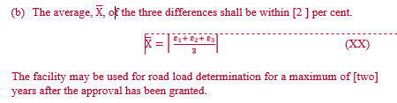
Annex 4, Road load, Wind tunnel method, §6.2.4.
OPEN POINTS: [2] per cent and [two] years are yet to be resolved.

Slide 24
Annex 4, Road load, §6.4.2.
EXPERT PROPOSAL: Proposal from Japan
Current text:
Annex 4
6.4.2. Wind tunnel measurement
[...]
The aerodynamic drag shall be measured at least for [60] seconds and at a minimum frequency of 5 Hz. The result shall be the average of the measured drag during the measurement.
[...]
Proposed text:
Annex 4
6.4.2. Wind tunnel measurement
[...]
The aerodynamic drag shall be measured at least for [60] seconds and at a minimum frequency of 5 Hz. Alternatively, the aero dynamic drag may be measured at a minimum frequency of 1 Hz and more than 300 samples. The result shall be the average of the measured drag during the measurement.
[...]
Justification:
The longer sample time ensures measurement accuracy even slower sampling rate, unless the frequency phase matches the sampling rate.

Slide 25
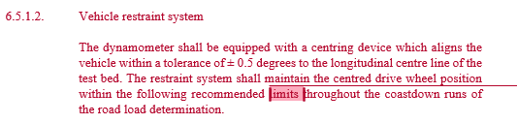
Annex 4, Road load, Wind tunnel method, §6.5.1.2.
OPEN POINT: April 2015 drafting meeting, Stockholm: are these really limits? How to encompass 6.5.1.2.1., 6.5.2.1.2.2. and 6.5.1.2.3.?
GTR CORRECTION: 01.05.2015. Proposal: The restraint system shall maintain the centred drive wheel position by fulfilling the requirements of paragraphs 6.5.1.2.1. to 6.5.1.2.3. inclusive throughout the coastdown runs of the road load determination.

Slide 26
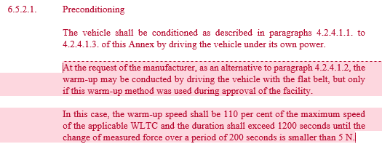
Annex 4, Road load, Wind tunnel method, §6.5.2.1.
GTR CORRECTION: OPEN POINT: April 2015 drafting meeting, Stockholm. Should these 2 paragraphs be merged to clarify what is meant by “in this case”? Or, does the paragraph starting with "In this case" clearly refer to the text in the paragraph above it?

Slide 27

Annex 4, Road load, Wind tunnel method, §6.5.2.2.5.
OPEN POINT: April 2015 drafting meeting, Stockholm.
Is the second sentence redundant? It basically says the same as the first.
Furthermore, are the 6 seconds agreed upon?

Slide 28
Annex 5
Test equipment and calibrations

Slide 29
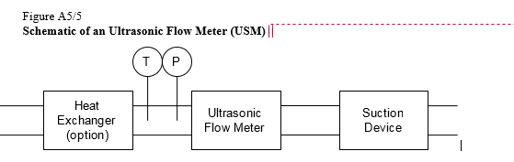
Annex 5, Test equipment, §3.3.6.4.2.
EXPERT PROPOSAL: The diagram appears OK on a screen, but prints out poorly on paper. Correction?
April: see that all diagrams are editable into Russian and French. Modified diagrams received from L. Hill.

Slide 30

Annex 5, Test equipment, USM, §3.3.6.4.3.(d)
OPEN POINT: 01.02.2015. Is “accuracy less than” meant or “an accuracy of at least”?

Slide 31

Annex 5, Test equipment, §4.1.4.11.
April drafting session: Expert proposals (T. Adam). The proposals were not discussed at the meeting; to be discussed in Geneva, June 2015.

Slide 32
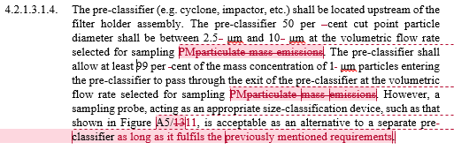
Annex 5, Test equipment, §4.2.1.3.1.4.
OPEN POINT: April 2015 drafting meeting, Stockholm. What does “previously mentioned requirements” refer to?
DC interpretation: it refers to the requirements of this paragraph. 4.2.1.3.1.1. also refers to the requirements in 4.2.1.3.1.4.

Slide 33
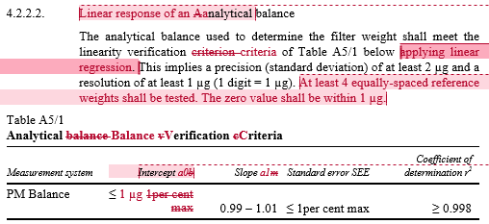
Annex 5, Test equipment, §4.2.2.2.
April drafting session: Expert proposals (T. Adam). The proposals were not discussed at the meeting; to be discussed in Geneva, June 2015.
DC asks: within ± 1 µg?

Slide 34
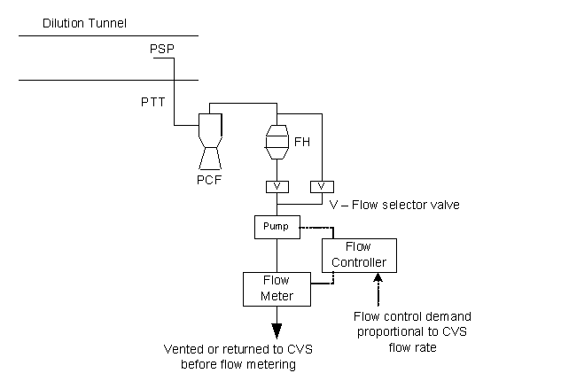
Annex 5, Test equipment, Figure A5/12
GTR CORRECTION: A figure of higher quality has been requested . April: see that all diagrams are editable into Russian and French. Modified diagrams received from L. Hill.

Slide 35

Annex 5, Test equipment, §7.2.1.8., Calculation of N2O concentration
EXPERT PROPOSAL: T. Adam. Proposal that 7.2.1.8. remain in Annex 5, although it was decided at the March 2015 drafting meeting to delete it from Annex 5.
DC: The entire paragraph 7. in Annex 5 is still being developed.

Slide 36
Annex 5, Test equipment, §7.3., Sampling for ethanol
OPEN POINT

Slide 37
Annex 5, Test equipment, §7.4., Sampling for formaldehyde and acetaldehyde
OPEN POINT

Slide 38
Annex 6
Type 1 test procedure and test conditions

Slide 39
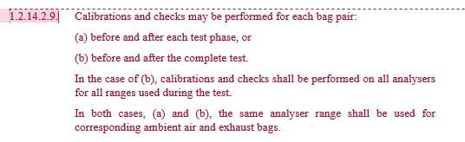
Annex 6, Test procedure (§1.2.14.2.),
Bag analysis (From K. Engeljehringer, AVL)
EXPERT PROPOSAL: not yet reviewed. See also 05.05.2015 mail exchange Bergmann/Ichikawa/Engeljehringer.

Slide 40
Annex 6, Appendix 2, Test procedure for electric power supply system monitoring (page 1 of 2)
April IWG/drafting meeting (Stockholm): Rob Cuelenaere to investigate.
EXPERT PROPOSAL: 29.07.2014: Dr. Ligterink (TNO) and his colleague, Gerrit Kadijk, highlights inconsistencies within the GTR concerning units used in Annex 6, Appendix 2 (Test procedure for electric power supply system monitoring). The problem is whether (a) kW.h, joules or megajoules should be used in equations, and, (b), whether kW.h, joules or megajoiules should be used in the Willans factors, and (c) whether the equations are all correct. This applies also to Annex 7 (Calculations) and to Annex 8 (Evs).
STATUS AS OF 22.09.2014: Entered in the GTR requesting comments < 31.10.2014.

Slide 41
Various annexes (page 2 of 2)
April IWG/drafting meeting (Stockholm): Rob Cuelenaere to investigate.
Consistency in the use of MJ or other units
GTR Text:
Should energy content of fuel be in joules, megajoules, Wh or kWh?
May the CO₂ correction factor (g/km)/(Wh/km) be written as (g/Wh) (see Table A8/2 in Annex 8)? See also §3.1.1. in Annex 8, Appendix 2.
May the fuel consumption correction factor (l/100 km/(Wh/km) be written as l/100/Wh (see Table A8/2 in Annex 8)? See also §2.1.1. in Annex 8, Appendix 2.

Slide 42
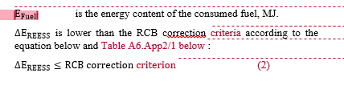
Annex 6, Test procedure, Appendix 2, §3.5 (c)
Expert approval required: Net heating value required to calculate Efuel.
April: net heating values not in the fuels tables.
Incorporate table from WLTP-08-06rev1

Slide 43
Annex 7
Calculations

Slide 44
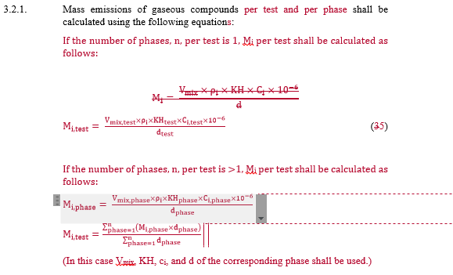
Annex 7, Calculations, §3.2.1.,
Mass emissions calculations
EXPERT PROPOSAL: April IWG/drafting meeting (Stockholm)

Slide 45

Annex 7, Calculations, §3.2.3.2.5.
Calculation of the fuel consumption, FC, value for an individual vehicle using the energy interpolation method
GTR CORRECTION: April 2015 drafting meeting, Stockholm. Why is FC_{ind} twice here?

Slide 46
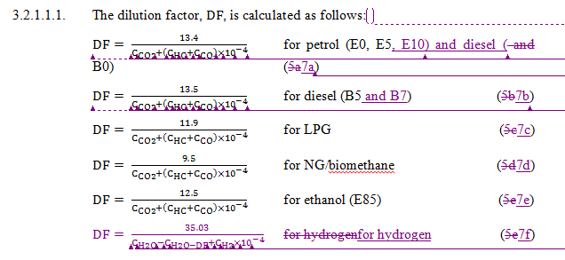
Annex 7, Calculations, §3.3.1.1.
If the manufacture uses the DF which covers several phases, the manufacture shall use averaged concentration of gaseous compound of each phases instead of individual phases for DF calculations.
The averaged concentration shall be calculated as dividing sum of each phase’s concentration multiplied by each phase’s Vmix, by sum of each phase’s Vmix.
GTR text proposal
April IWG/drafting meeting (Stockholm): Text rewritten and sent to Fujiwara-san for approval.
If the manufacturer uses a DF which covers several phases, it shall calculate a DF using the average concentration of gaseous compounds for the phases concerned.
The average concentration of a gaseous compound shall be calculated by dividing the sum of the product of the concentration of each phase times its V_{mix} by the sum of each phase's V_{mix}.

Slide 47
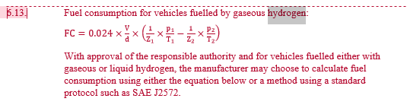
Expert input required. See comment from Japan.
April IWG/drafting meeting (Stockholm): Text below in GTR as EXPERT PROPOSAL.
Annex 7, Calculations, §6.13. Fuel consumption for vehicles fuelled by gaseous hydrogen

Slide 48

OPEN POINT. DC: will "equivalency" be determined according to Annex 9? Is a reference to "equivalency" necessary?
Annex 7, Calculations, §7.3.4.3. Alternative warm-up procedure

Slide 49
Annex 8
Pure and hybrid electric vehicles

Slide 50

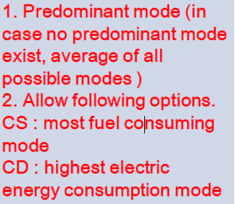
Annex 8, Pure and HEVs, OVC-HEV, CD test with no subsequent CS test, §3.2.4.2.2.1.
April IWG/drafting meeting (Stockholm): still in progress.
GTR Text:
EXPERT PROPOSAL from JAMA at IWG #8:
Text proposal from drafting coordinator:
The CD test shall be performed in the predominant mode. Should there be no predominant mode, the electric energy consumption shall be the average of that measured in the worst and best case. Optionally, the test may be performed in the highest energy consumption mode.

Slide 51

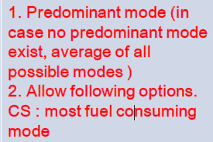
Annex 8, Pure and HEVs, OVC-HEV, CS test with no subsequent CD test , §3.2.5.2.2.
April IWG/drafting meeting (Stockholm): still in progress.
GTR Text:
EXPERT PROPOSAL from JAMA at IWG #8:
Text proposal from drafting coordinator:
The CS test shall be performed in the predominant mode. Should there be no predominant mode, the fuel consumption shall be the average of that measured in the worst and best case. Optionally, the test may be performed in the highest fuel consuming mode.

Slide 52
Annex 8, Pure and HEVs, NOVC-HEV,
3.3. NOVC-HEV, with and without driver-selectable operating modes
April IWG/drafting meeting (Stockholm): still in progress.
GTR Text:
EXPERT PROPOSAL from JAMA at IWG #8:
This text to be inserted in §3.3. Text proposal from drafting coordinator:
The CS test shall be performed in the predominant mode. Should there be no predominant mode, the fuel consumption shall be the average of that measured in the worst and best case. Optionally, the test may be performed in the highest fuel consuming mode.

Slide 53

Annex 8, Pure and HEVs, PEVs, §3.4.4.1.
April IWG/drafting meeting (Stockholm): still in progress.
GTR Text:
EXPERT PROPOSAL from JAMA at IWG #8:
Text proposal from drafting coordinator:
The CD test shall be performed in the predominant mode. Should there be no predominant mode, the electric energy consumption shall be the average of that measured in the worst and best case. Optionally, the test may be performed in the highest energy consumption mode.
03/06/2015
53

Slide 54
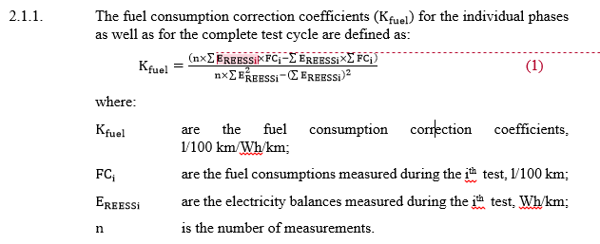
Annex 8, Pure and HEVs, Appendix 2, §2.1.1.
EXPERT PROPOSAL: Subject: is subscript "i" to be added to E_{REESS}?
April IWG/drafting meeting (Stockholm): see the reworked version of annex 8.
03/06/2015
54

Slide 55
Miscellaneous

Slide 56
EXPERT PROPOSAL: M. Bergmann mail from 17.04.2015.
Start of the engine: new wording needed for ICE and EV-vehicles
Dyno load setting: slides by M. Bergmann to be finalised during next Annex 4 task force meeting
8.1.2. Coastdown: The coastdown test on the chassis dynamometer shall be performed with the procedure given in paragraphs 8.1.3.2.1. (4.3.1.3.1.) and 8.1.3.2.2. (4.3.1.3.2.) of this Annex
Bag analysis: describe the process that it is allowed to calibrate only once-e-mail Engeljehringer and Markus' slides
1.2.2. As soon as practical prior to the first bag analysis, the analyser range to be used for each compound shall be set to zero with the appropriate zero gas.
Consistency in the use of the term masses, especially when test mass, inertia, etc. is used.

Slide 57
End

