Slide 1
Extreme transports
Measurements are showing that dynamic forces is decreasing with speed at higher speeds.
At lower speeds dynamic traction forces are governed by engine capacity installed. I.e. more or less independent of speed. If any dependence forces might be increasing at lower speed.
Proposal:
Await further measurements and simulations before setting any rules.
TA31
D
[V]
0,65D
Likely outcome of further investigations
25
v_{o}
Speed
80

Slide 2
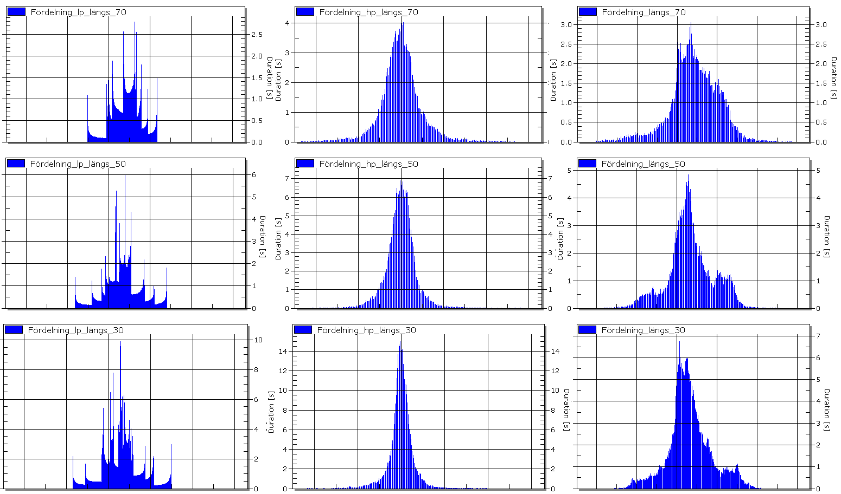
Extreme transports
Speed relation Longitudinal

Slide 3
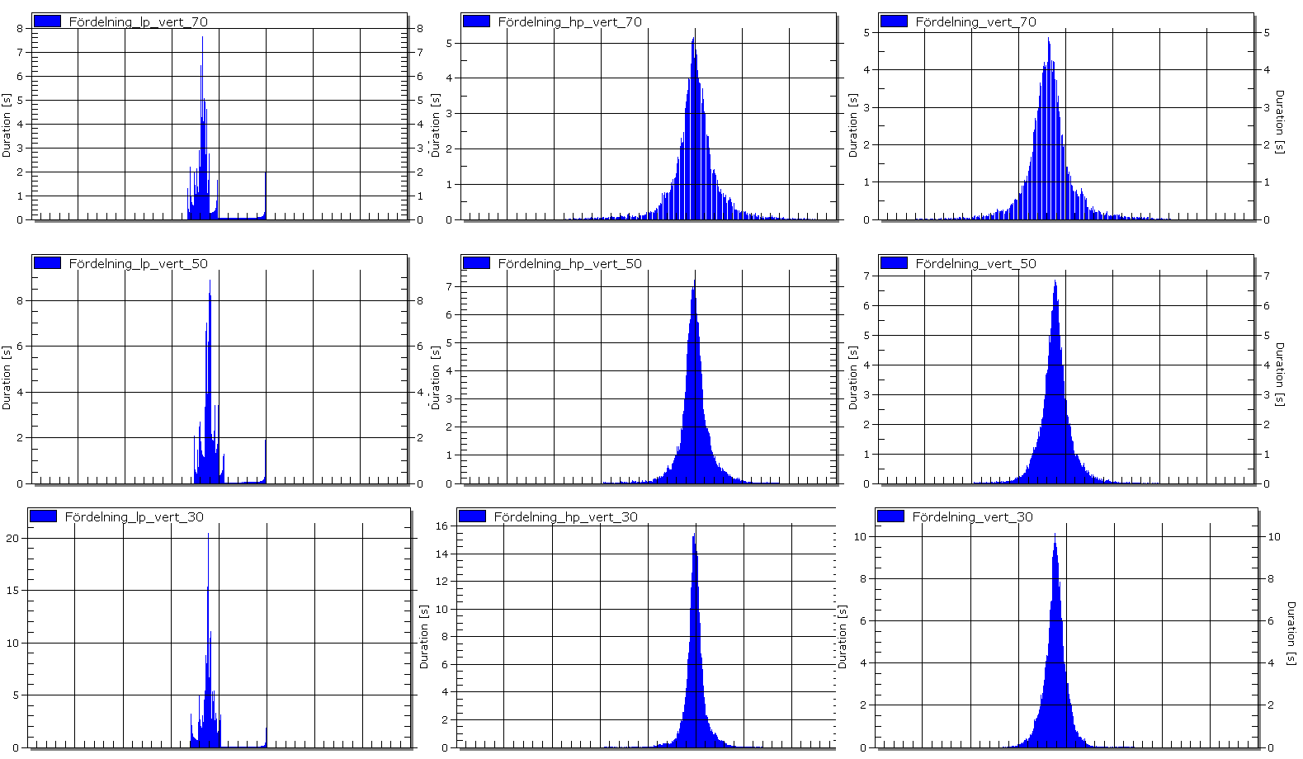
Extreme transports
Speed relation Vertical

Slide 4
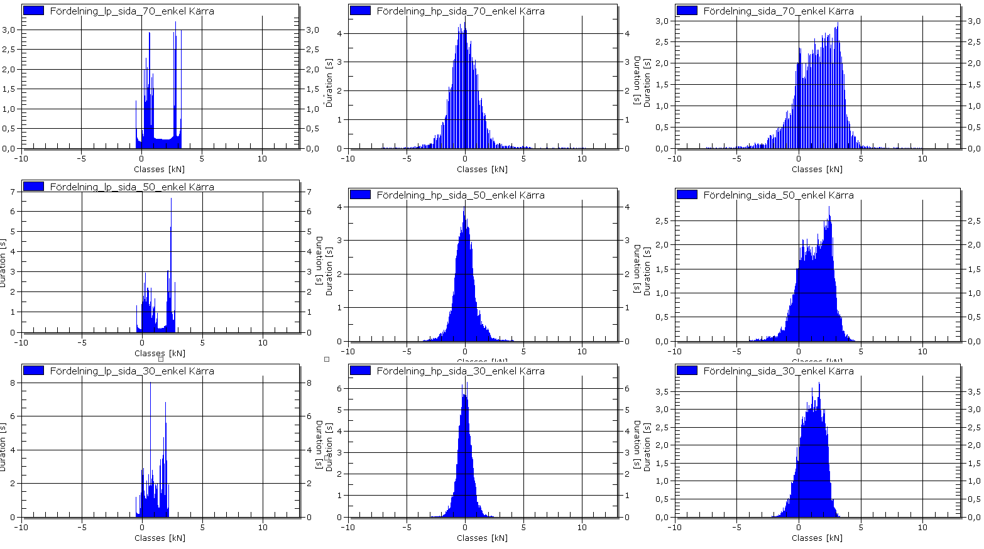
Extreme transports
Speed relation side

Slide 5
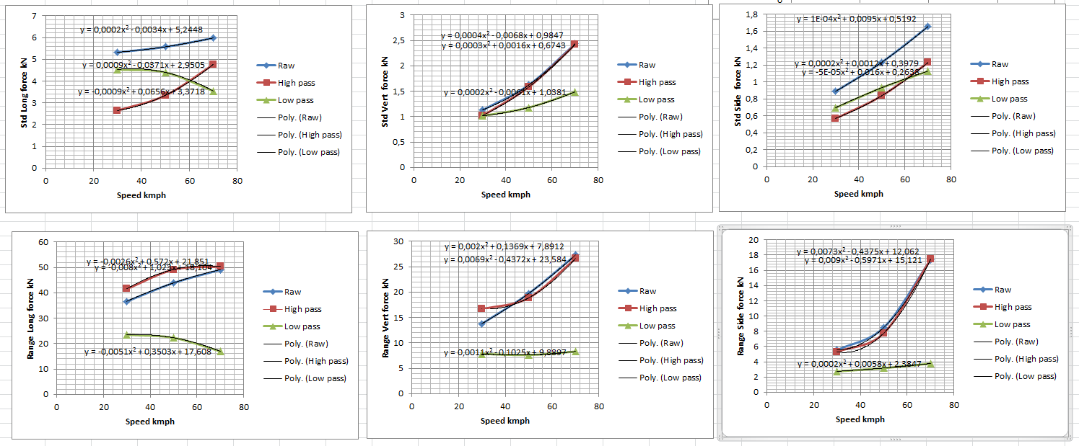
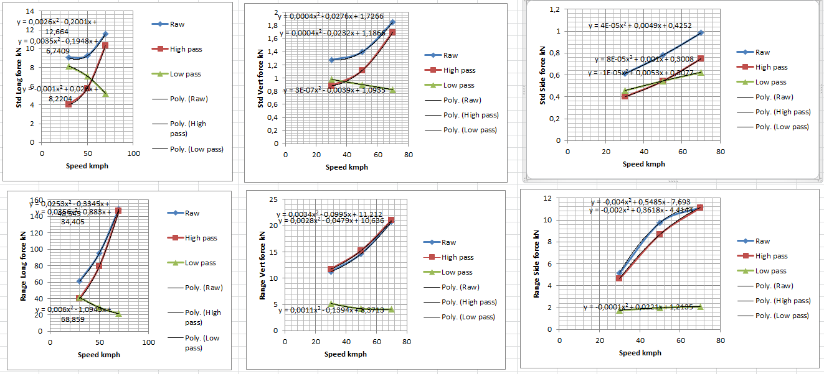
Extreme transports
Center axle trailer and Dolly in duo trailer
CAT
Dolly

Slide 6
Extreme transports
Center axle trailer

Slide 7
Extreme transports
Dolly in duo trailer

