Slide 1
WLTP
PEV Range test procedure : End of test criteria

Slide 2

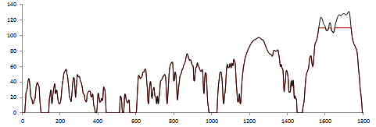
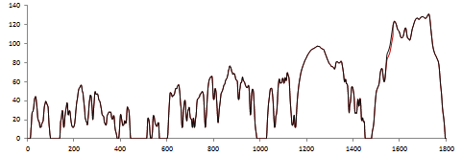
: Problem definition
1
Present GTR draft: ‘Break up criteria is reached when vehicle deviates from prescribed tolerance for 4 seconds or more’
In the present GTR-draft, the energy consumption is also calculated over the range test
There are two possible situation where the ‘4second - end of test criteria’ may lead to incoherent AER and electric energy consumption value
Probelm1: Low speed PEV (capped speed)
Problem 2: Low powered PEV
Some times the maximum speed of ‘utility vehicles’ are capped (ex: 110 km/h)
These kind of vehicle will certainly not able to follow the drive cycle above the maximum speed of the vehicle (V_{max} Vehicle <V_{max} WLTC)
Example: a vehicle with a maximum speed of 110 km/h will have a range 16.7 km (real range >200 km)
If the vehicle power is lower than the required power, then vehicle will not be able to follow the drive cycle (Even if it has a high capacity battery)
In this case the test has to be stopped before completing the first WLTC cycle even though the battery is capable of driving a very long range)
Example: A vehicle with a real range of 150 km can have result in a range of 17 km

Slide 3
Possible solutions
2
There are two possible solutions under discussion
Already
agreed
 |  | Solution 1 (based on WLTP -ICE proposal) | Solution 2 (based on SAE J1634)
Problem | Low speed vehicle | -’End of test criteria’ is not applicable to speed more than the ‘maximum speed’ of the vehicle | -Shall be operated at maximum available power (or full throttle) when the vehicle can not achieve the speed trace within the speed and time tolerance -First drive cycle will be used as reference cycle (best effort situation)
 | Low powered vehicle | -Downscaling method according to the ‘cycle modification method’ for ICE vehicle should be used -In this case peak power of PEV should be used for calculation
Comments | Advantage | -Coherent with the ICE vehicle in the present draft GTR | -One solution fits for all
 | Disadvantage | -PEV power defined according to R85 (peak or 30 minutes) does not consider the battery capacity of the vehicle. In reality the available [peak power] can be less than the declared power. Hence the cycle modification will be a worst case situation for OEM | -Needs a pre-test to conform that the first cycle is the maximum power condition (best effort speed situation) -Not coherent with the ICE vehicle in the draft GTR

Slide 4
Text proposal for solution 1 (based on GTR draft on ICE )
3
Add the following text to the 3.4.3.2. of the Annex 8 (cleaned draft) :
  If the vehicle is not able to follow the extra high phase of the first drive cycle due to low power of the vehicle then cycle modification method described in section 7 of annex 1 should be applied. In this case peak power should be used for calculation purpose. The ‘first drive cycle’ should be used as the reference ‘drive cycle’ for the end of test criteria
  For the ‘extra high phase’ , if the maximum speed of the vehicle is lower than the maximum speed of the drive cycle, the vehicle shall be driven with its maximum speed in those cycle periods where the cycle speed is higher than the maximum speed of the vehicle. For these type of vehicle the end of test criteria given in section 3.4.4.3.1.3 of Annex 8 does not apply above the maximum speed of the vehicle.” The ‘first drive cycle’ should be used as the reference ‘drive cycle’ for the end of test criteria
Already
agreed
To be conformed
Only the sentence in red is specific to the PEV. Rest of the text is same as that for ICE vehicle in the GTR draft

Slide 5
Annex

Slide 6
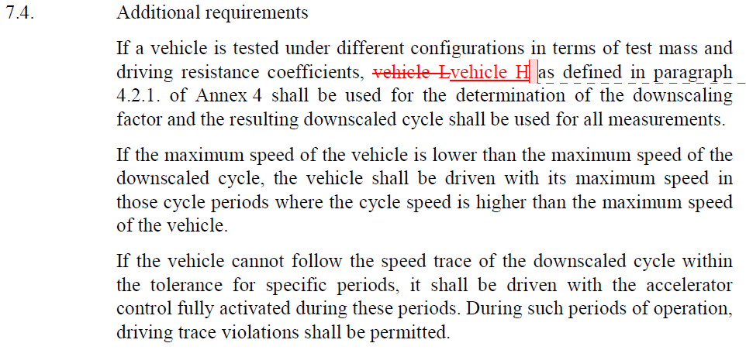
Vehicle not able to follow the drive cycle: What about ICE ?
Ref: WLTP-2014-005 GTR Version 14.09.2014

Slide 7
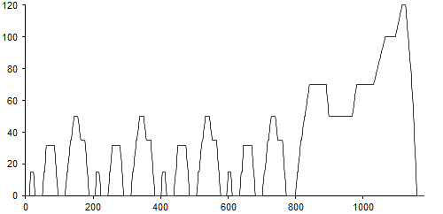
Electric Vehicle: NEDC end of test criteria
Required to follow the drive cycle trace
Violations is not ignored
Trace violations is acceptable if full power is used

Slide 8
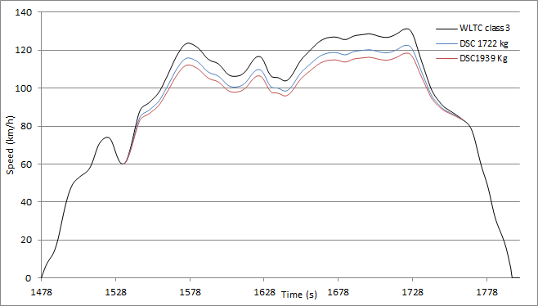
Downscaling application to PEV
Down scaling works well for Kangoo ZE
Need to justify the type of power used for calculation (net power or continuous power)
Kangoo data: P_{30 min}= P_{peak}= 44 kw

